Slide 1

By:
Arth Mehta (16012011022)
Nikita Lalwani (17012012004)

Slide 2

Contents
What is EyeOS?
Define Web desktop
History of EyeOS
The idea behind EyeOS
Architecture
How to use?
Areas of Application
Features
Advantages and Disadvantages
Conclusion

Slide 3
Introduction
eyeOs is a Commonly called a cloud desktop because of its unique user interface, eyeOs delivers a whole desktop from the cloud with file management, personal management information tools, collaborative tools and with the integration of the client’s applications.
It is an open source web desktop following the cloud computing concept, mainly written in PHP, XML and JavaScript. It acts as a platform for web applications written using the eyeOS Toolkit. It includes a Desktop environment with 67 applications and system utilities. It can be accessed from Windows, Linux or Macintosh computers or from mobile devices that support the technologies.

Slide 4
What is Web-desktop?
A web-based desktop or webtop integrates web applications, web services, client-server applications, application servers and applications on the local client into a desktop environment using the desktop metaphor.
It is a desktop embedded in a web browser or any similar client application.

Slide 5
History
Establishment: In 2005, a group of young people worked together and put all their efforts in a new project, a new open source web desktop, EyeOS.
August 1, 2005: The first publicly available EyeOS version was released as EyeOS 0.6.0. At the time, it greatly participated in creating the definition of a web operating system and acted as a concept.
June 4, 2007: After two years of development, the EyeOS Team published EyeOS 1.0. Compared with previous versions, EyeOS 1.0 introduced a complete reorganization of the code and some new web technologies, like eyeSoft, a portage-based web software installation system.
July 2, 2007: With the release of the 1.1 version, EyeOS changed its license and migrated from GNU GPL Version 2 to Version 3.
October 29, 2007: 1.2 version was launched with full integration compatibility with Microsoft Word files.

Slide 6
January 15, 2008: EyeOS 1.5 Gala was liberated. The first version that supported both Microsoft
Office and OpenOffice.org file formats for documents, presentations and spreadsheets. It also
had the ability to import and export documents in both formats using server side scripting.
April 25, 2008: EyeOS 1.6 included many improvements such as synchronization with local
computers, drag and drop, a mobile version and more.
January 7, 2009: EyeOS 1.8 Lars featured a completely rewritten file manager and a new sound
API to develop media rich applications.
April 1, 2009: 1.8.5 version incorporated a new default theme and some rewritten apps like the
Word Processor and the Address Book.
March 3, 2010: EyeOS 2.0 release took place on. This was a total re-structure of the OS operating system.

Slide 7

April 1, 2014: Telefónica announced the acquisition of eyeOS, but this acquisition reinforces Its future mobile cloud services plans and the development of free software solutions.

Slide 8
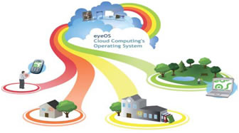
The idea behind EyeOs
The idea behind EyeOs is that the whole system lives in the web browser. The client must have only a web browser to work with EyeOs and all its applications, including Office and PIM ones. This applies to for both modern and obsolete PC's An Open Source Platform designed to hold a wide variety of Web Applications. EyeOs was thought of as a new definition of an Operating System, where everything inside it can be accessed from everywhere inside a Network. All you need to do is login into your EyeOs server with a normal Internet Browser, and you have access to your personal desktop, with your applications, documents, music, movies just like you left it. EyeOs lets you upload your files and work with them no matter where you are.

Slide 9
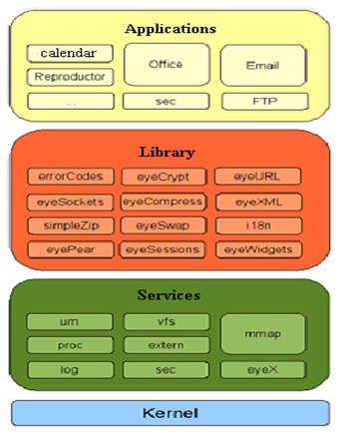
Architecture

Slide 10
EyeOS kernel uses a structure divided into 4 layers:
Kernel: unified system services.
Services: lower-level functions.
library services: higher-level functions
Applications: can call functions from any? Layer
Service - MMAP
Vital component in the communications of the application.
route messages to the client application.
Automated service.
Service - VFS
It is the EyeOS file system.
implement security systems.
Concatenate 32 random characters.
virtual and real functions.
Provides application development.

Slide 11
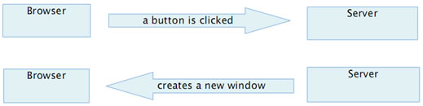
Service – VFS (implementation)Internally creates two files for each file (virtual functions):
file content.
File information
Service – Eyex
Get the XML messages and respond in the same format to the browser
Fig : working of eyeX in kernel
Service – Proc Process Management:
Launch.
Finish.
List.
etc.

Slide 12
Process defines important variables for the application: myPid
myPid: identifies every process.
checksum: identifies the process in the client-server communication.
Client-server communication -
EyeOS use a two-tier architecture in which one machine acts as both application and
presentation server. The client is the second tier. The application server hosts virtual machines
that run programs and push them to a presentation server, which manages the client connection.The thin client runs the application and passes user input back to the application server.
Client-side
EyeOS makes use of several technologies on the client (browser) side:
XHTML and CSS are used to display the user interface. The content, however, is created and changed dynamically by the local JavaScript engine, which uses the DOM for this task.
The local engine handles communication with the server asynchronously, using AJAX. Client and server communicate via XML requests/responses. The client always initiates communication. Each server response specifies a series of tasks to the client engine (e.g. creating a widget, changing a value of a component, executing JavaScript code embedded in the message, etc.).
Not all interactions require communication with the server. JavaScript is used to provide client-side-only interactions

Slide 13
Server-side-
Though it is not the focus of the project, we briefly comment on the server side of the
architecture. EyeOS is written in PHP on the server side, and provides multiple high level
abstractions. The goal of these is to make it easy to write new applications, and avoid dealing
with low-level primitives. In this sense, EyeOS is also a web application development framework.

Slide 14
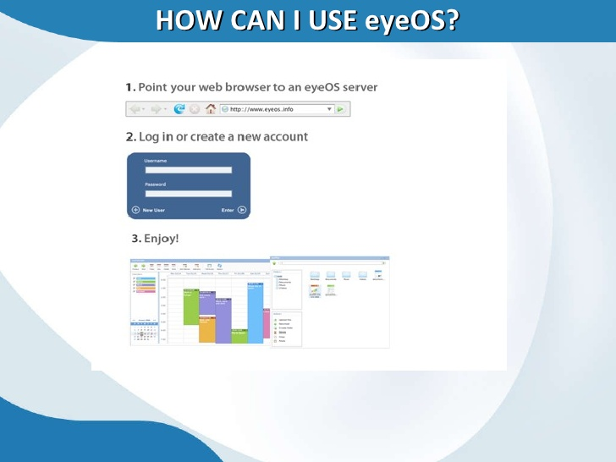
How to use?

Slide 15
Areas of Application-
Provides system for the users where they work with eyeOS and all its applications, including
Office and PIM ones.
A toolkit to create new applications easily.

Slide 16
School and Universities with a full web platform.
With a private server, eyeOS can provide,
City counsils
Public library networks
Free internet points & other public environments.
Useful for those who travel frequently, for schools that want a centralized storage.
Social organizations and Companies: Contacts, personal files and communications to which
members can access businesses and organizations large and small.
Intranets and business in general.
Service to replace the need for a hard disk.

Slide 17
Features-
Easy installation
Free and open source cloud OS software
Has Personal Information Manager (PIM)
Being able to work from everywhere, regardless of whether or not you are using a full-featured, modern computer, a mobile gadget, or a completely obsolete PC.
Sharing resources easily between different work centres at company, or working from different places and countries on the same projects.
Always enjoying the same applications with the same open formats, and forgetting the usual compatibility problems between office suites and traditional operating systems.
Being able to continue working if you have to leave your local computer or if it just crashes, without losing data or time: Just log in to your EyeOS from another place and continue working.
Boot in few seconds.
Application developers create an application only once for a Web OS, rather than many times for each of the traditional operating systems.
Web OS users don’t have to back up or archive work because the provider’s remote server handles these functions.
With a Web OS, users can store, find, and otherwise manage files and services, such as calendars and email, from a Web desktop.

Slide 18
Dynamic content and design: Interface can be customized according your needs, windows are
floating so that they can be repositioned
Extensive list applications: Office applications, multimedia applications, network applications and chat applications etc. are available.
Remote storage facility: Through the file browser you can store files over the internet and edit
them as you want.
Browser and Platform independent: All browsers and all operating systems are supported.
Rich text editing facility

Slide 19
Advantages-
Portability,
Decentralization,
Browser with java support is more enough
Platform independent
World Wide Availability.
Remote storage facilities
Disadvantages-
Safety,
Need for fast connection performance,
Isolation of the host system.

Slide 20
Conclusion-
Can use every where remotely.
Is designed for developers without experience to develop web applications.
Communication with the user through events.
Creation of the interface using widgets.

