Slide 1

Resulting value if mapped key has a value
Value mapping is optional
Mapped Key
Resulting value if mapped key is empty
Expression Begin
Ternary operator
Ternary else operator
Expression End
String Pipe Functions

Slide 2
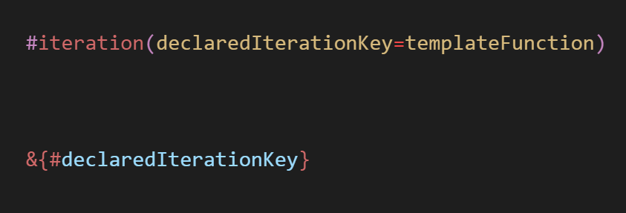
Declared Iteration:
Declared Iteration Begin
Iteration Key
Template Function to run
Declared Iteration End
Iterated Expression:
Iterated Expression Begin
Declared Iteration Key
Iterated Expression End

