Slide 1
PORES Coronavirus Hackathon Presentation for GAFL 531
-Siddhi Velankar, Arth Talati, Hemanth Kothapalli

Slide 2
Dataset
We wanted to explore the condition of different countries that are affected by this pandemic.
Hence, we chose the John Hopkins Dataset which has date wise information regarding cases in countries throughout the world in the following categories: confirmed cases, recovered cases, total deaths.

Slide 3
Overview of shiny app
WELCOME: This is the introduction page that gives the user a general idea of how to navigate through the application.
FORECASTING: This page lets the user choose the country and the status, and then outputs the plot showing date-wise increase in cases in accordance with the chosen input. It also forecasts the cases in the selected category in the upcoming days.
MAP: This page opens a world map showing total Coronavirus cases throughout the world.

Slide 4
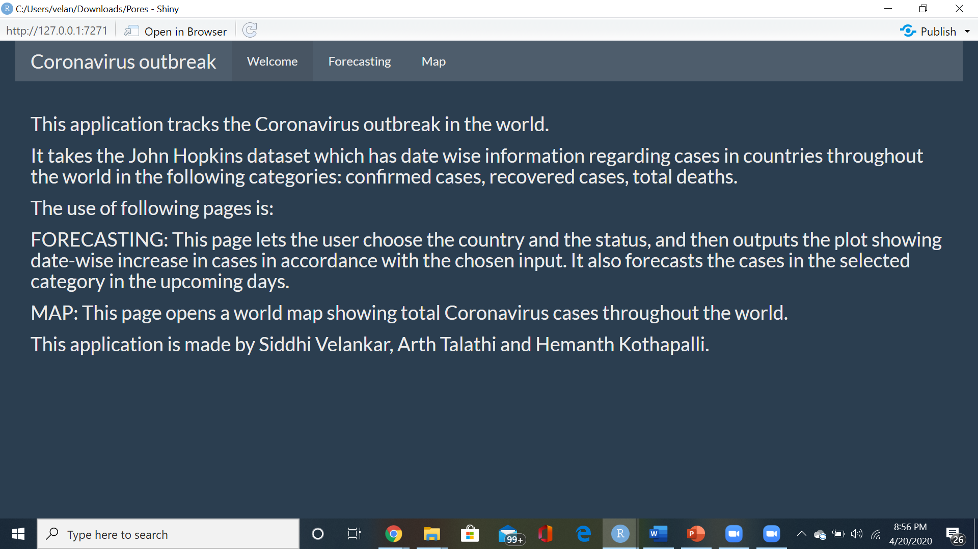
WELCOME

Slide 5
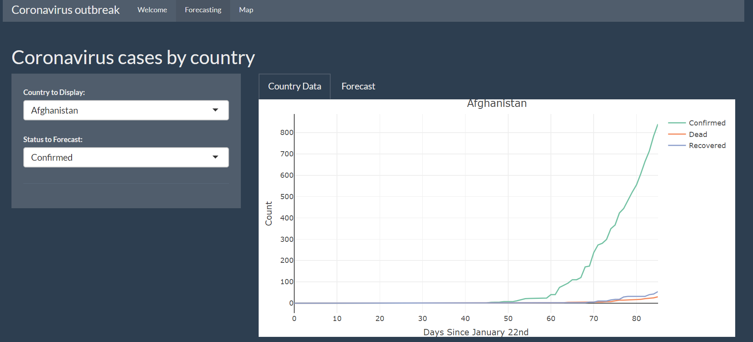
FORECASTING
Country data plot for Afghanistan:

Slide 6
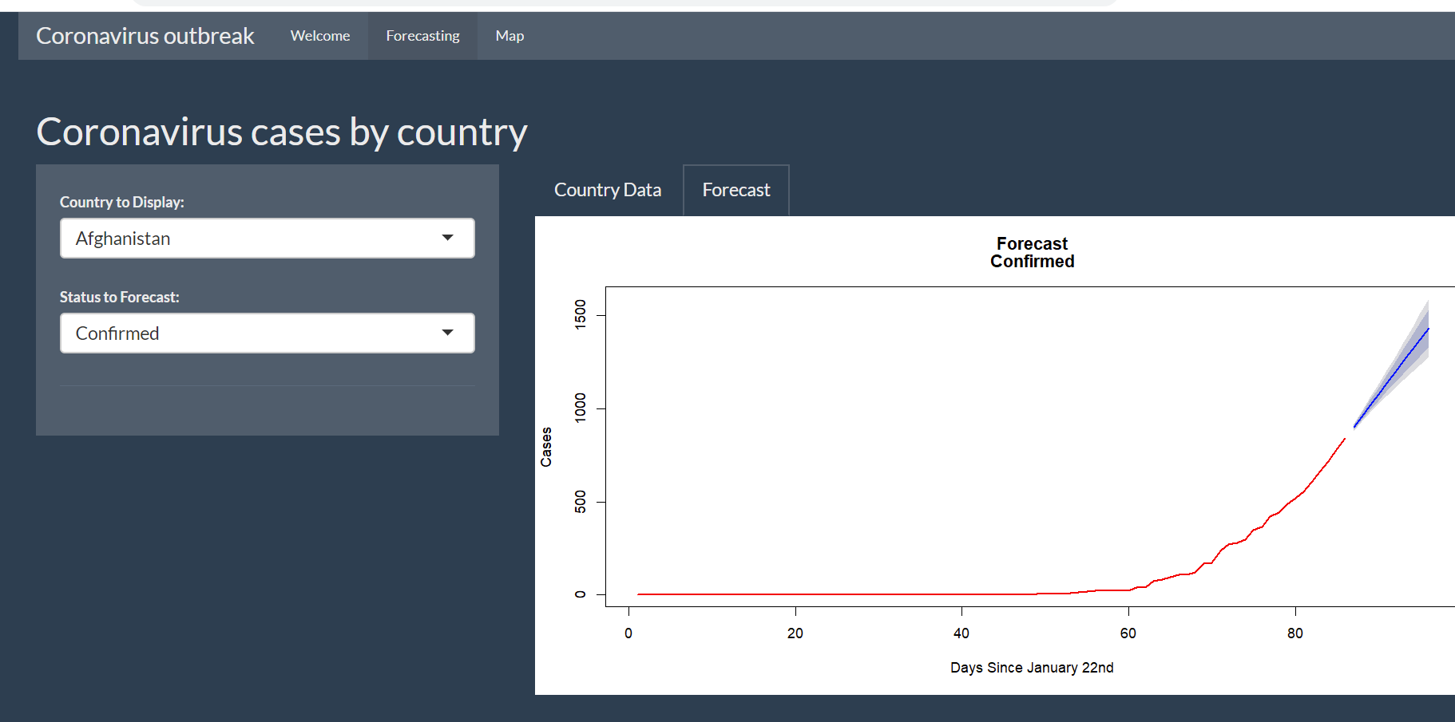
FORECASTING
Forecast plot for Afghanistan (confirmed cases):

Slide 7

FORECASTING
Country data plot for India:

Slide 8

FORECASTING
Forecast plot for India (recovered cases):

Slide 9

FORECASTING
Country data plot for US:

Slide 10
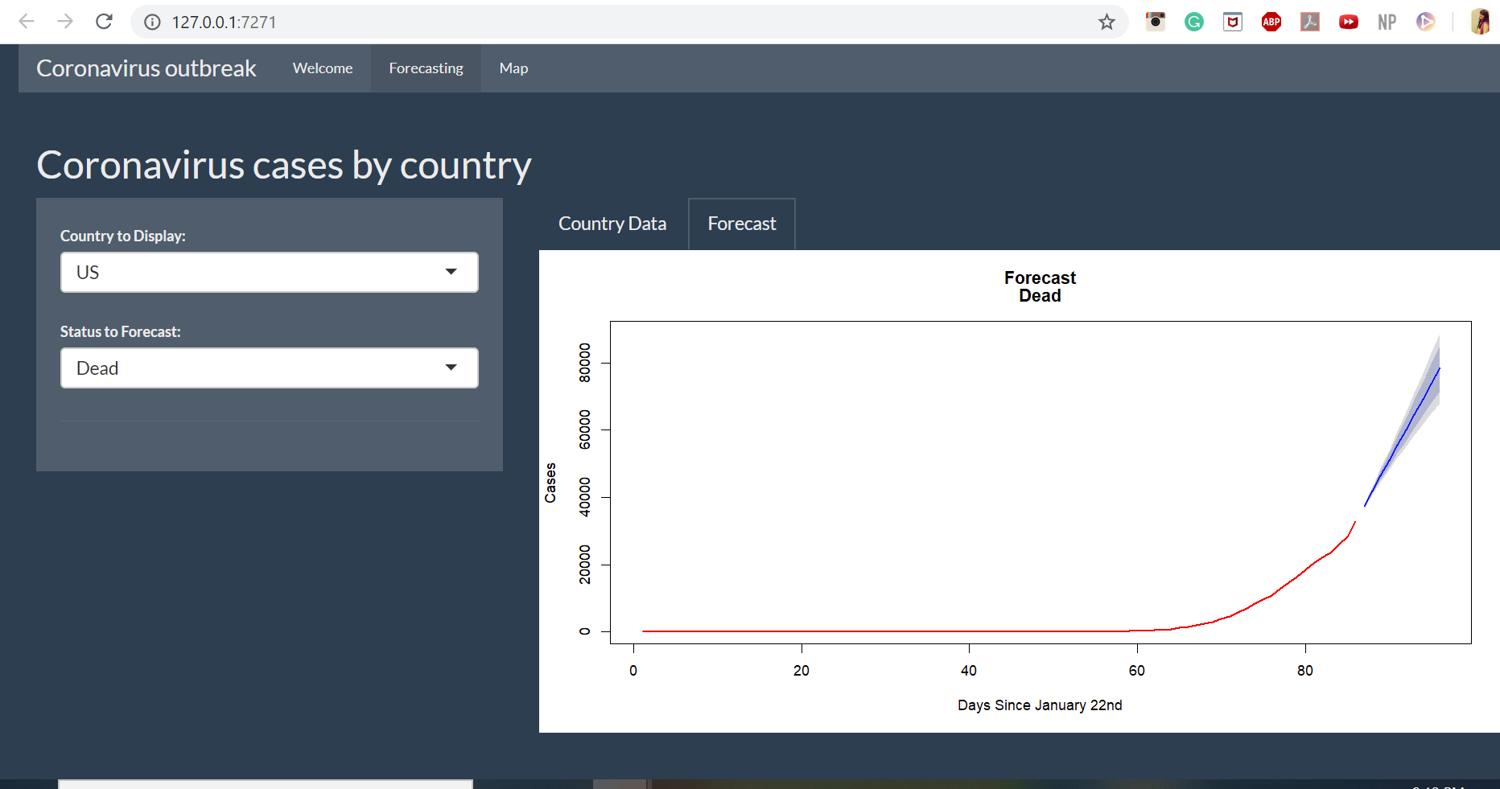
FORECASTING
Forecast plot for US (deaths):

Slide 11
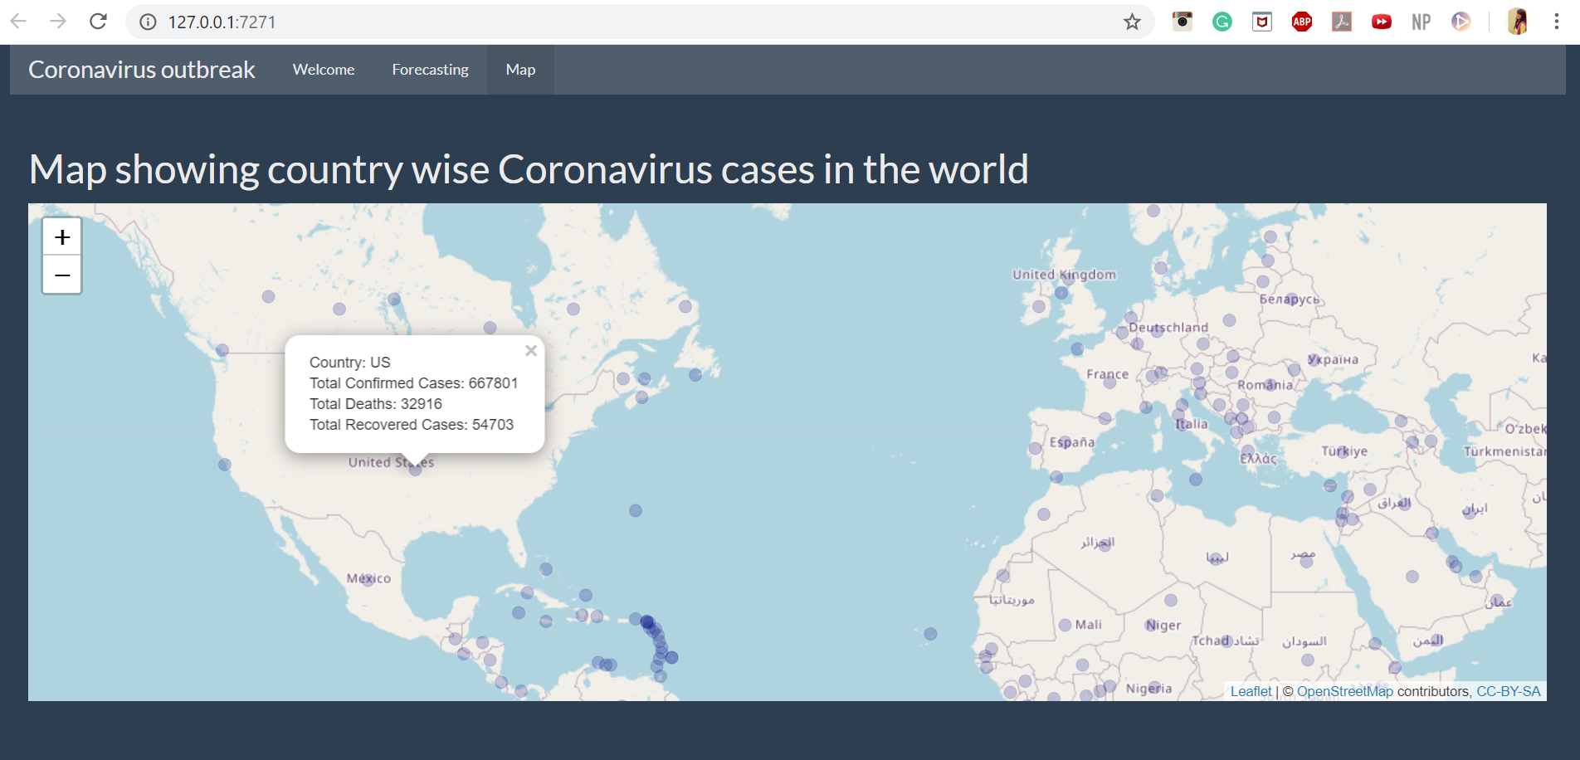
MAP

Slide 12
Thank you!

