Slide 2
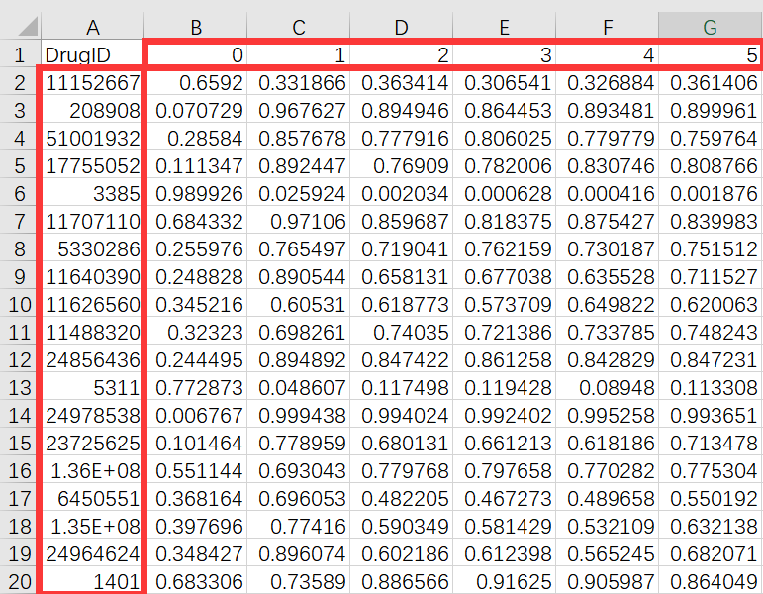
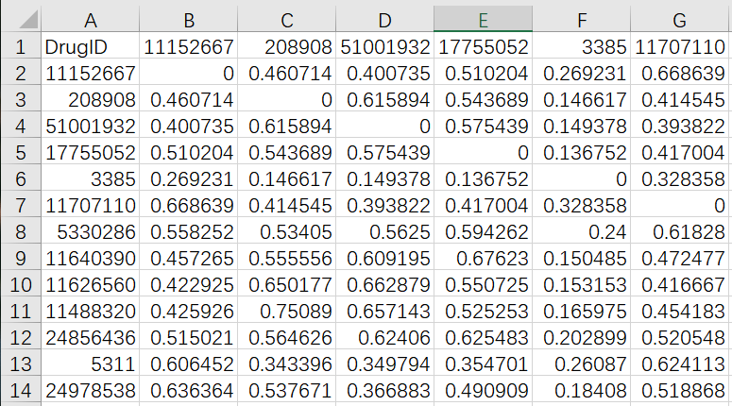
数据
Drug：
Feature | Value
drug_fetures:
[
[0.6592,0.3318,...,0.3614],
[0.0707,0.3318,...,0.3614],
...
[0.5242,0.2515,...,0.5455]
]
edge_index:
[
[0,1],[2,1],[5,2]
]
权重 ？
边的类型 ？

Slide 3
模型
Model(): __init__:
GNN()
MLP()
Classfier()
forward(self, features, edge_index, drug1, drug2, cell):
_features = GNN(features,edge_index)
hidden1,hidden2 = _features[drug1],_fetures[drug2]
cell_hidden = MLP(cell)
hidden = concat(hidden1,hidden2,cell_hidden)
output = Classfier()
自监督学习？

Slide 4
Dataset(): __init__:
examples=read_file(label.csv)
edges=read_file(edge.csv)
features=read_file(features.csv)
__getitem__(self, index):
# return:
# examples[index]: (drug1,drug2,cell,label) return examples[index], edges, features
drug1: 0
drug2: 1
...
drug100: 99
target1: 100
target2: 101
...
target100: 199

