Slide 1
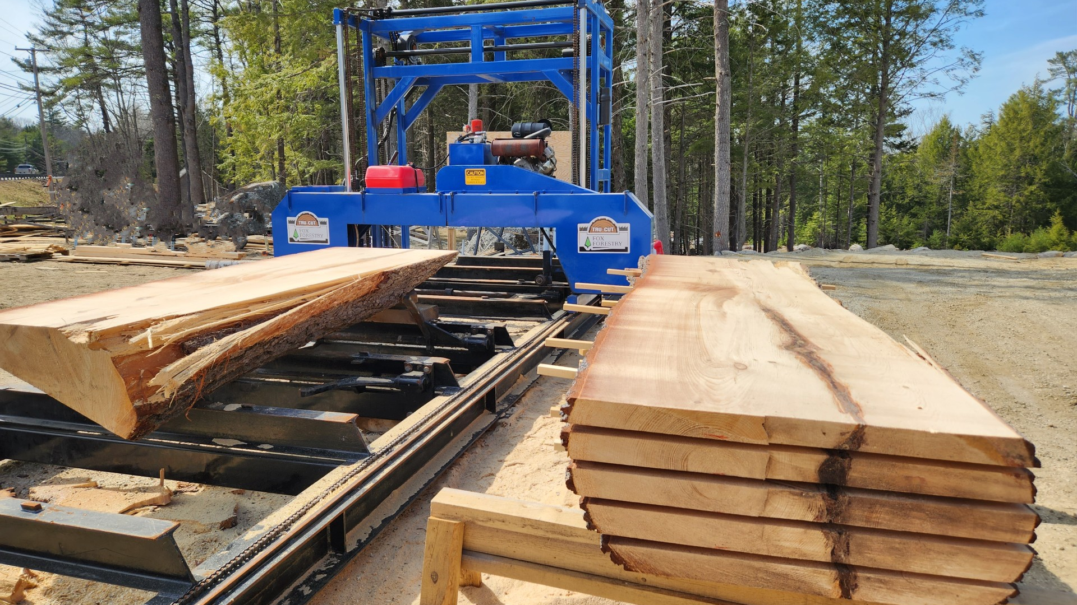
SawMill++
By Arthur LEMOINE

Slide 2
Notes:
History of sawmills

