Slide 1
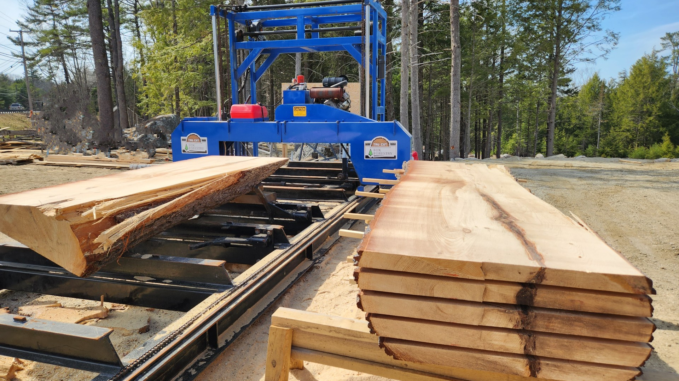
SawMill++
By Arthur LEMOINE

Slide 2
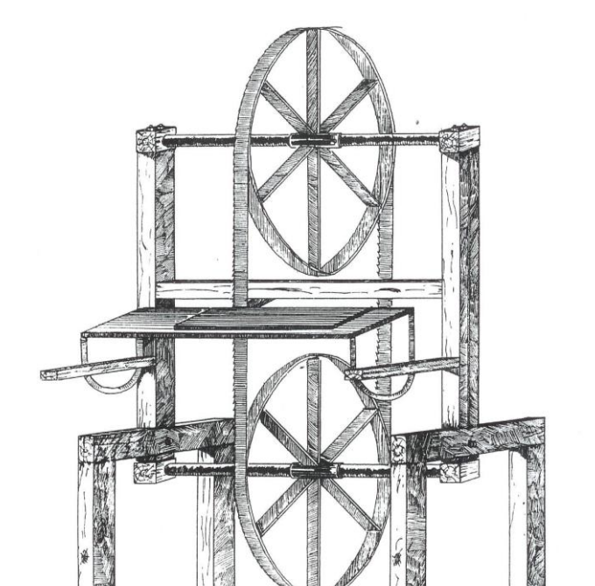
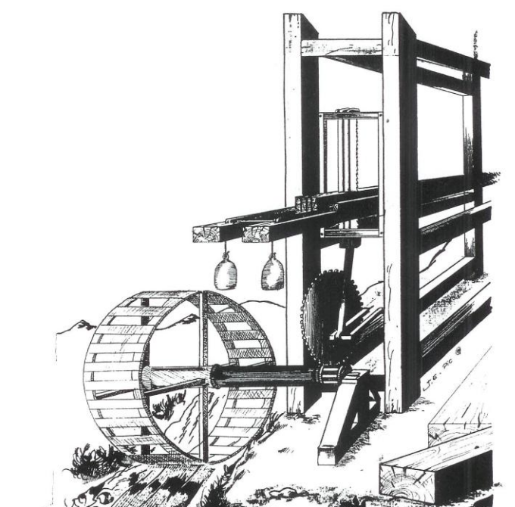
History

Slide 3

Sawmills in France
Average Annual Production
800 m3 -> 4716 m3

Slide 4
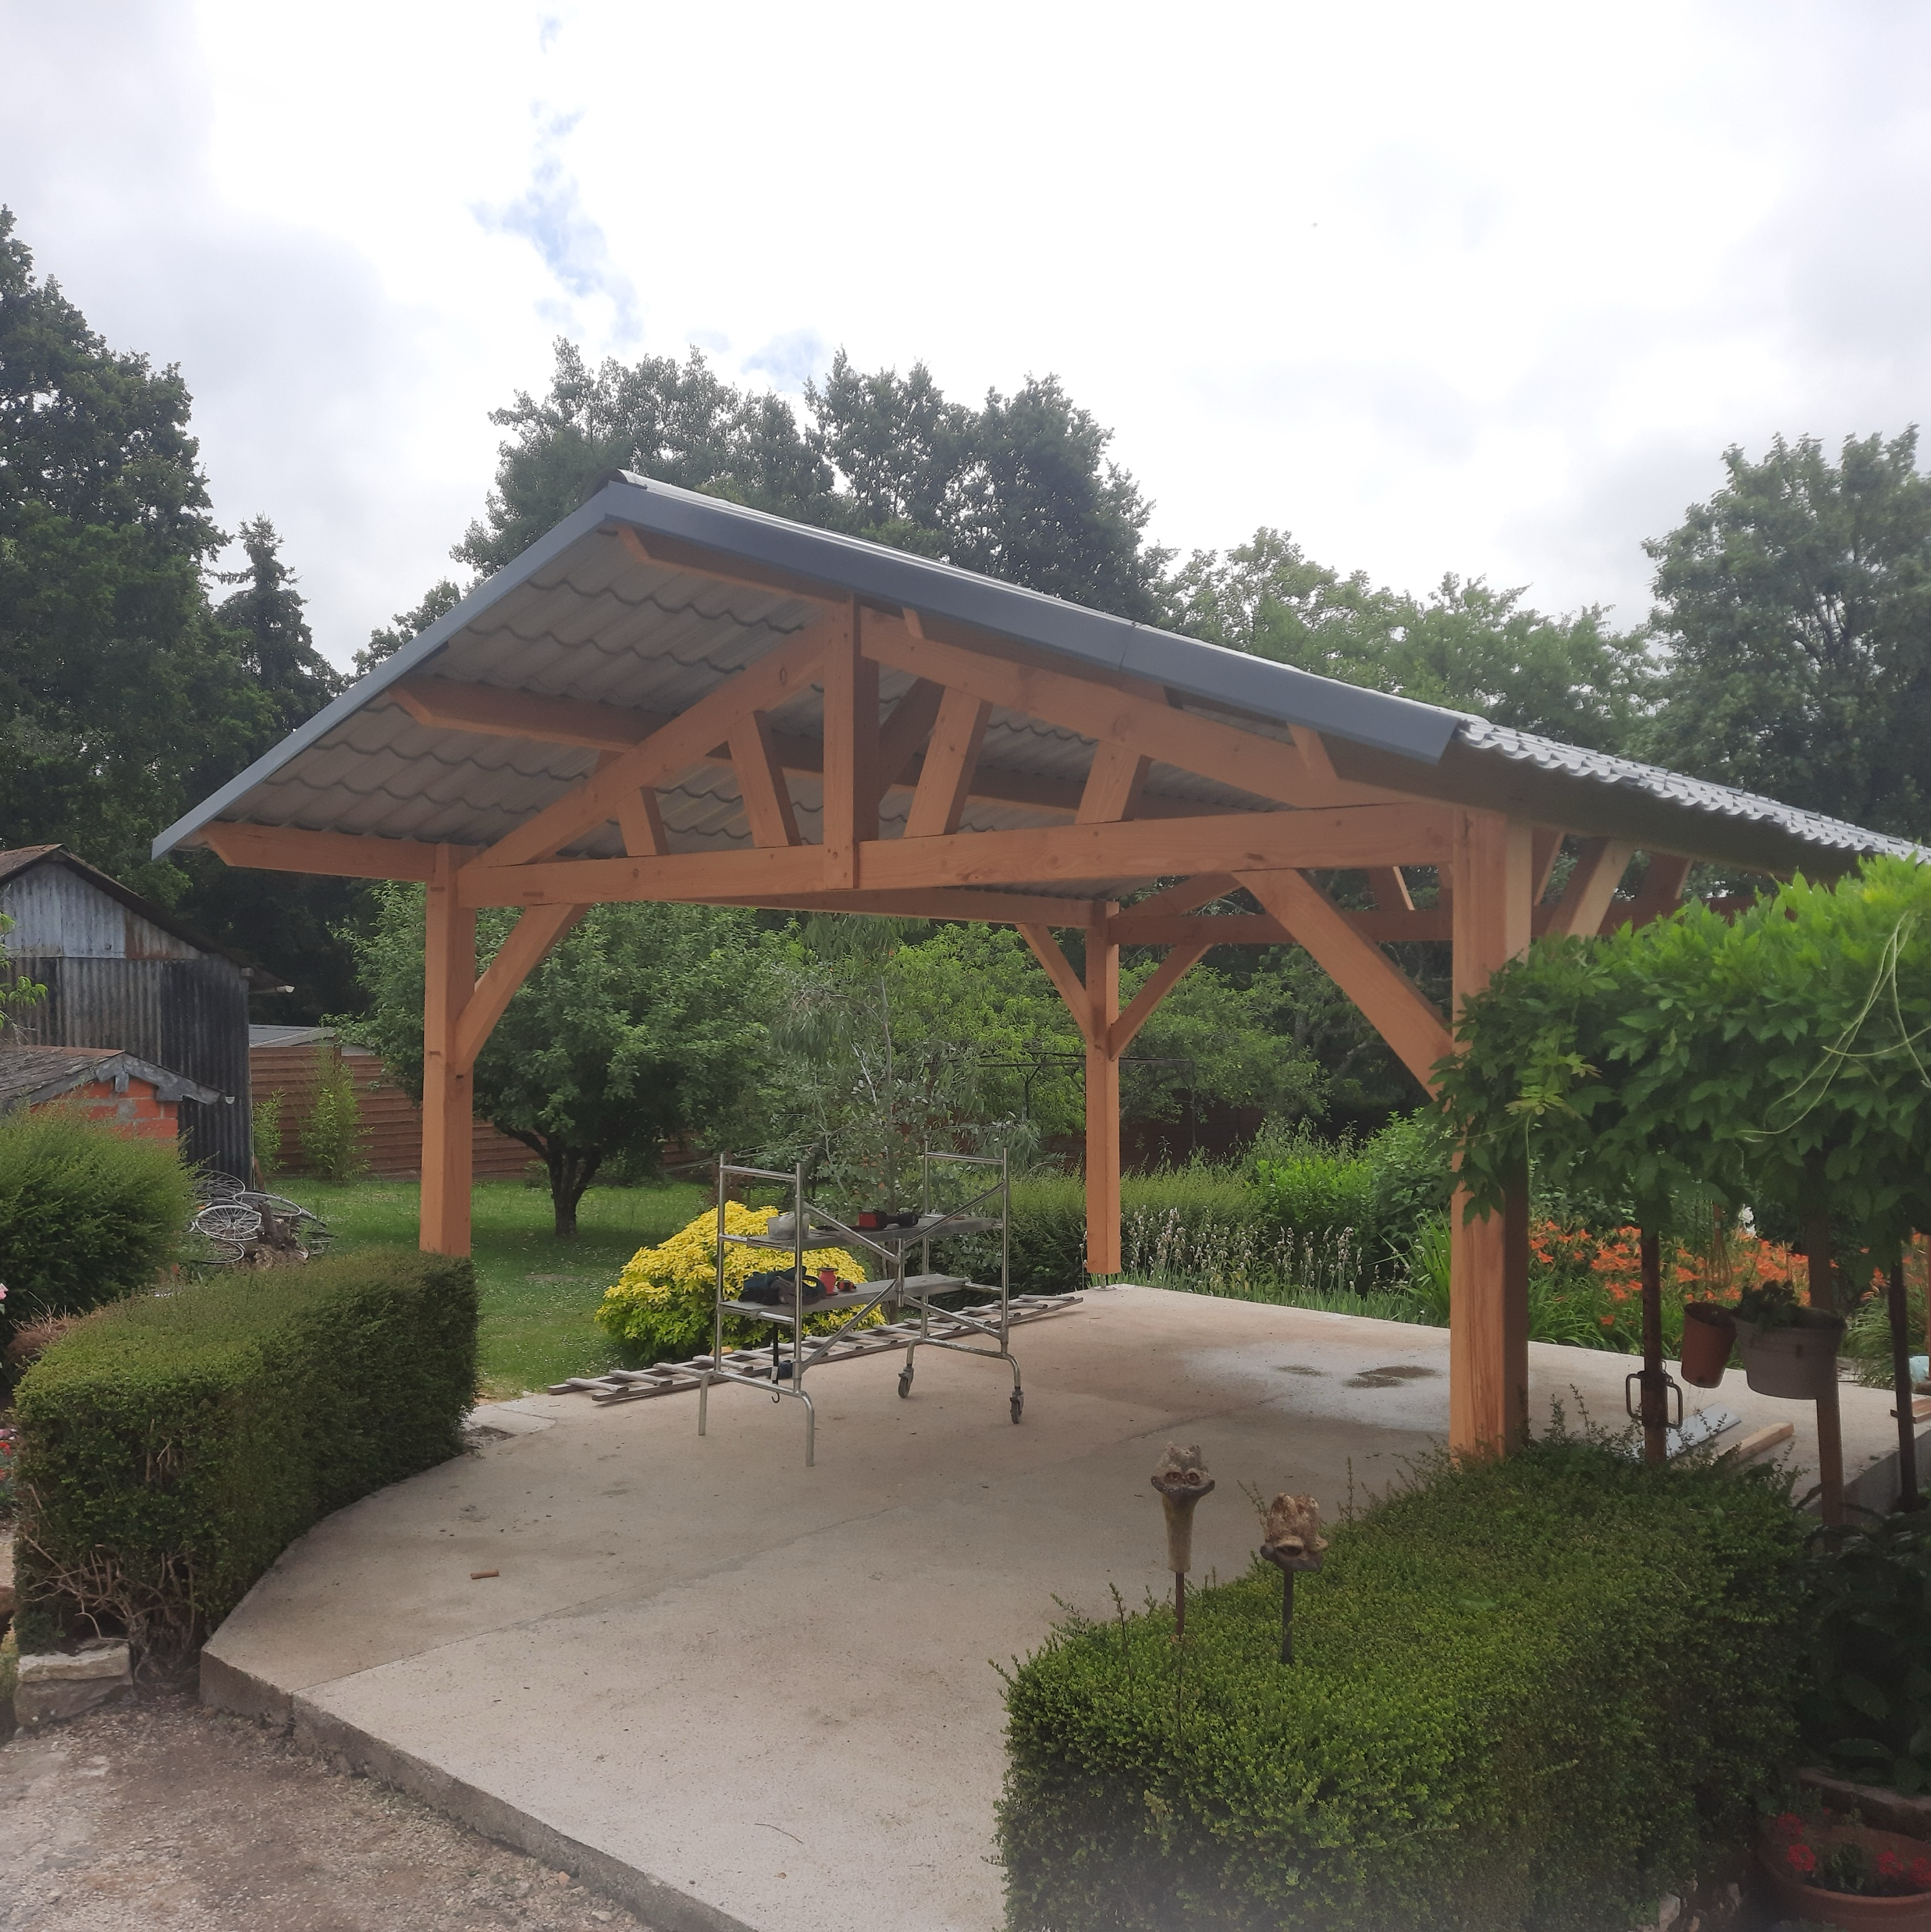
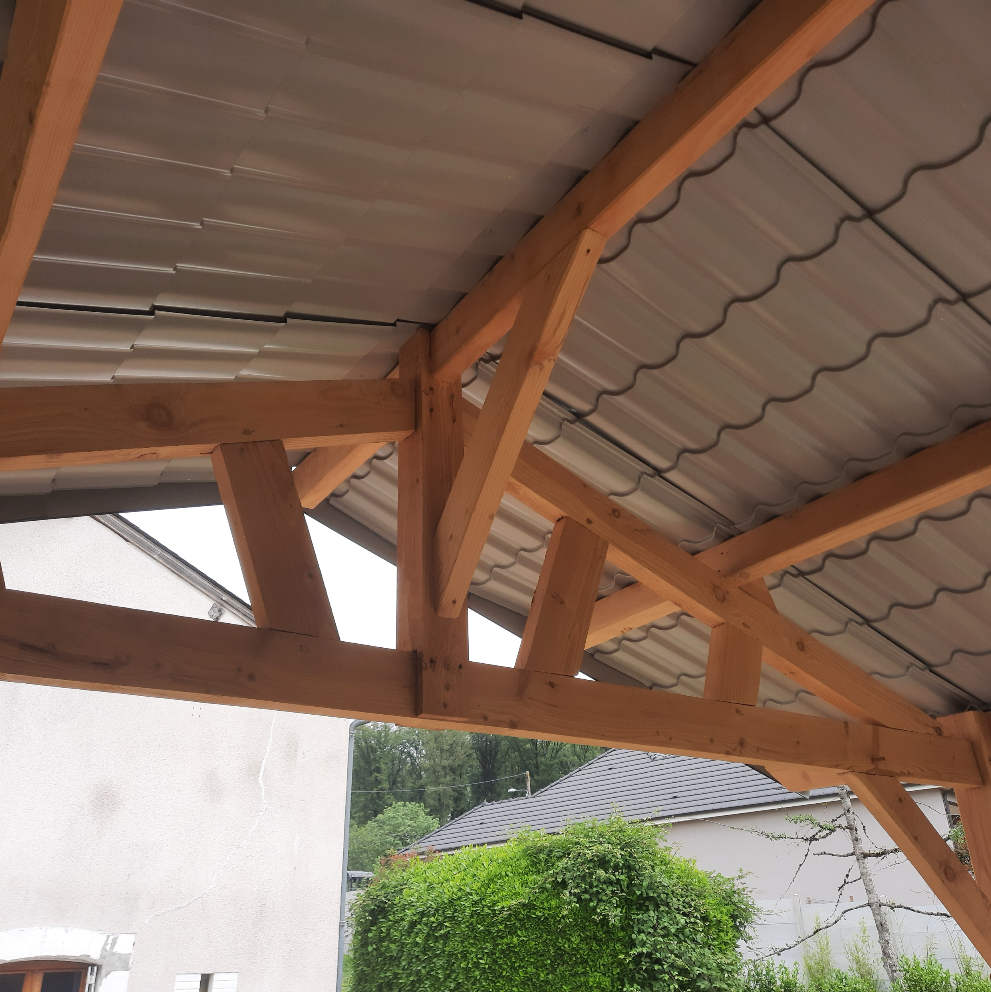
My personal experience
Two Years in the wood industry

Slide 5
losses during the sawing process
~64%
~16%
~25%
~23%
Sawdust
Bark & Sapwood
Heart Quality
&
Cut losses

Slide 6
Implications
Ecology
Economy
Notes:
Ecology
Economy
Applied to many fields
Construction
Carpentry
Furnitures

Slide 7




The software
Notes:
Paper
Implementation
feedback

Slide 8
Objectives
Increase Efficiency
Minimise Losses

Slide 9
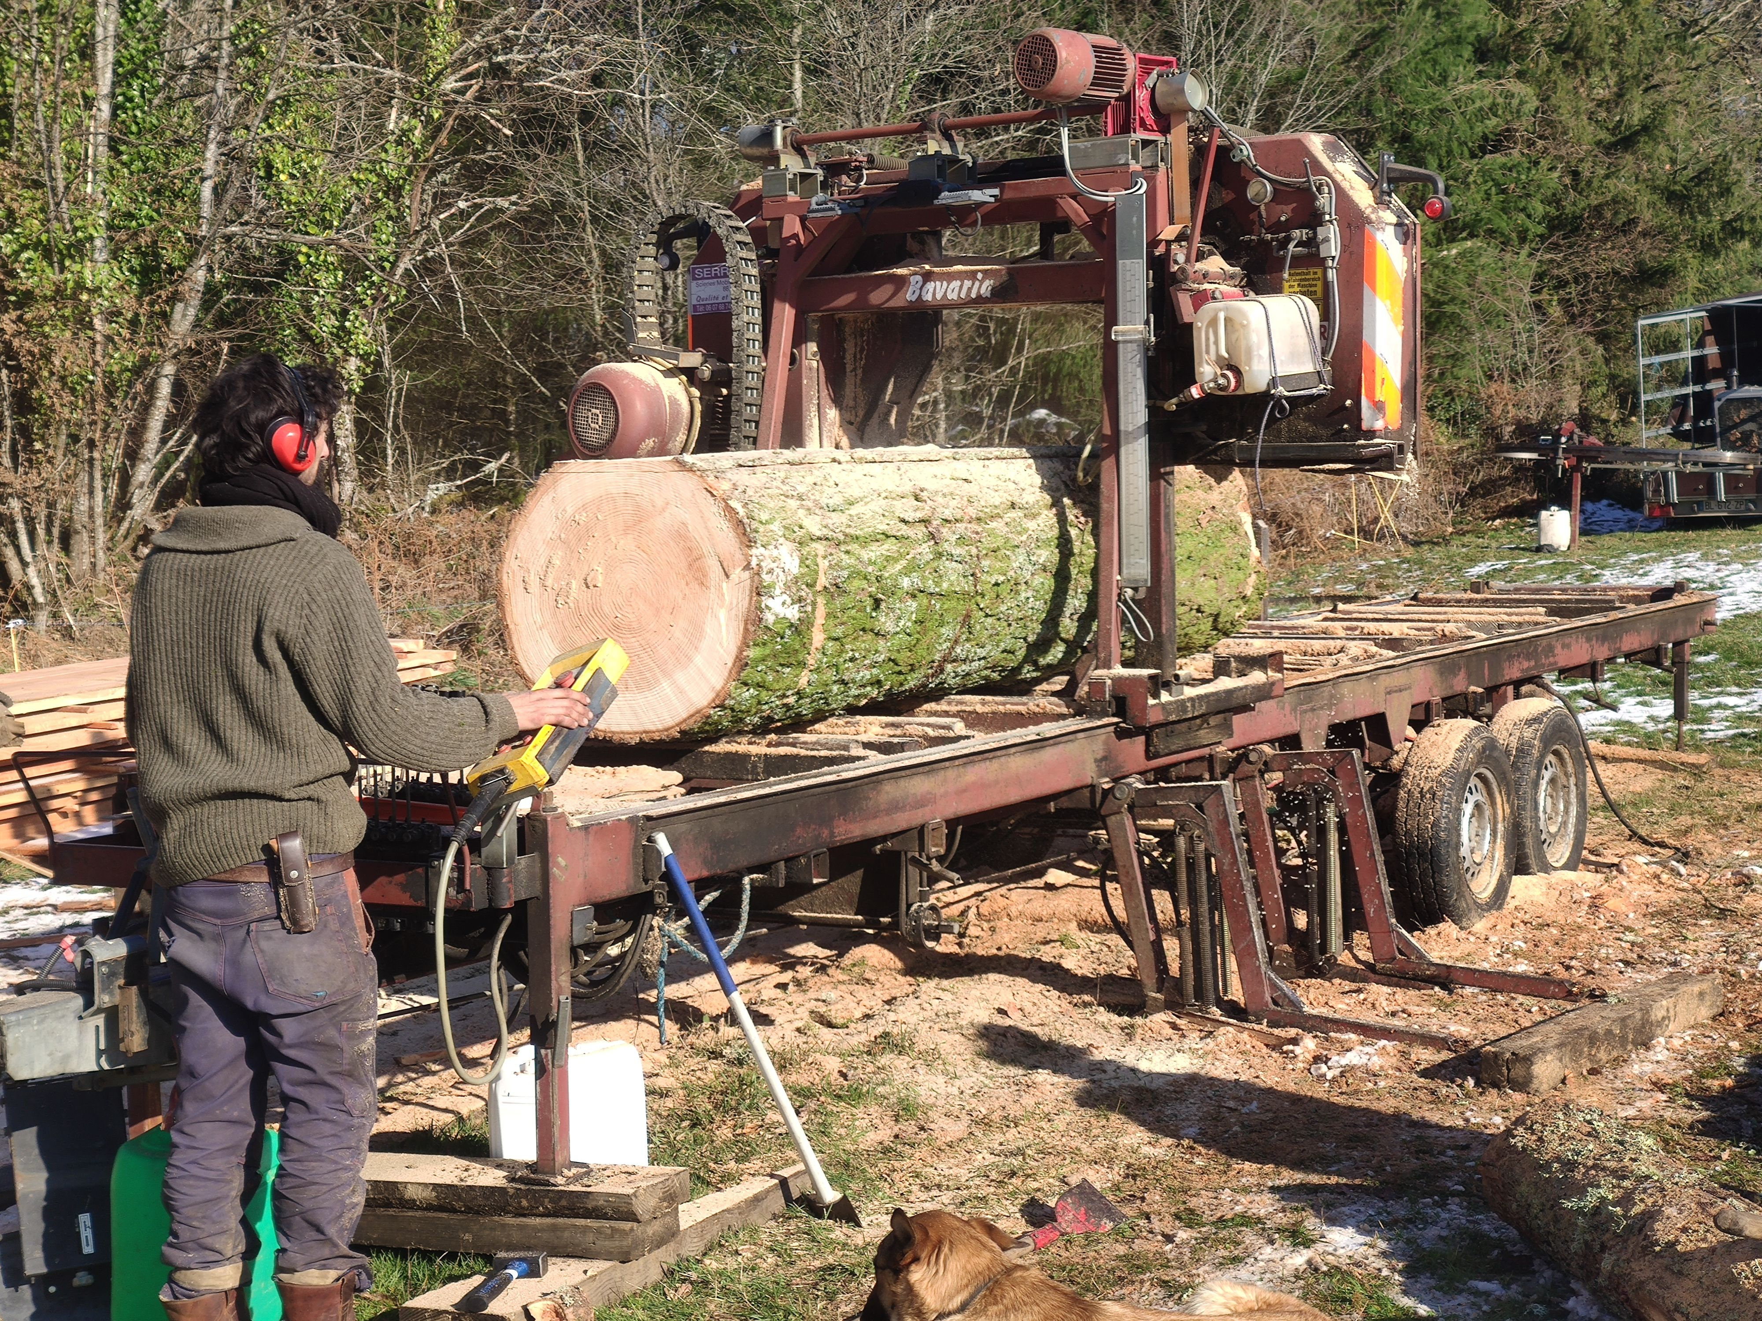
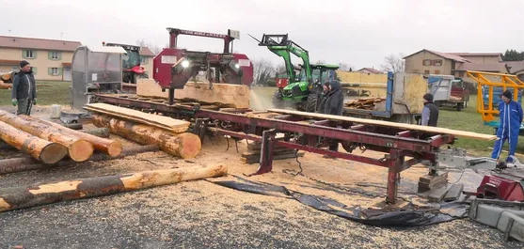
Target

Slide 10
Algorithm

Slide 11


Technologies

Slide 12
Demonstration

Slide 13
Feedback
Bugs
New Features
& Improvements

Slide 14
Future improvements
Bug correction
Needed features
Quality of life
Algorithm refining
V2.0

Slide 15
Retrospective
Tasks & objectives
Work management
Time management
Progress monitoring

Slide 16
Project driving
&
delivering
Wood-working
&
New experience
Marketing

Slide 17
Thanks

