Slide 1
LinkerD
Arthur Mulkandov 2016.12.26

Slide 2
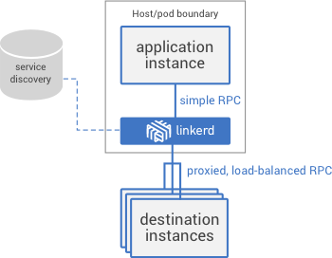
What is LinkerD
Linkerd is scalable service mesh for cloud-native applications
Linkerd is a standalone, open source RPC routing proxy.
Linkerd built on Netty and Finagle (Scala/JVM).

Slide 3
LinkerD MAIN Features
Load balancing: linkerd provides multiple load-balancing algorithms that use real-time performance metrics to distribute load and reduce tail latencies across your application.Linkerd is a standalone, open source RPC routing proxy.
Circuit breaking: linkerd includes automatic circuit breaking that will stop sending traffic to instances that are deemed to be unhealthy, giving them a chance to recover and avoiding cascading failures.
Service discovery: linkerd integrates with various service discovery backends, helping you to reduce the complexity of your code by removing ad-hoc service discovery implementations.
Dynamic request routing: linkerd enables dynamic request routing and rerouting, allowing you to set up staging services, canaries, blue-green deploys, cross-DC failover, and dark traffic with a minimal amount of configuration.
HTTP proxy integration: linkerd can act as an HTTP proxy, which is widely supported by almost all modern HTTP clients, making it easy to integrate into existing applications.
gRPC: linkerd supports both HTTP/2 and TLS, allowing it to route gRPC requests, enabling advanced RPC mechanisms such as bidirectional streaming, flow control, and structured data payloads.

Slide 4
LINKERD: Pros and CONs
PROS
linkerd supports HTTP/1.1, Thrift, ThriftMux, HTTP/2 and gRPC .
linkerd allows visibility and control over communication mechanics without changing the application itself.
linkerd publishes machine-readable versions of its metrics in multiple formats which may be polled by external metrics-collection utilities and sent to backends such as statsd and Prometheus.
Linkerd can run locally, with Docker , in Kubernetes and in DCOS
CONS
linkerd’s memory and CPU requirements are significantly higher than other similar systems
Linkerd+Finagle are written in Scala, so running one of these on every app server means running a jvm on every server.
Linkerd is young product with a small number of customers

Slide 5

Who use linkerd today

