Slide 1
Inventory Management System
Serverless REST API on AWS
Python | Flask | AWS Lambda | DynamoDB | CDK
Project Overview

Slide 2
Project Overview
A lightweight inventory management system for warehouse operations, tracking products, categories, and stock movements through a REST API.
Product Management
Stock Tracking
CRUD operations for products
with SKU, pricing, categories
Record movements: received,
shipped, adjusted, returned
Reorder Alerts
Reporting
Automatic low-stock alerts
with suggested reorder quantities
Stock summaries, movement
history, category reports

Slide 3
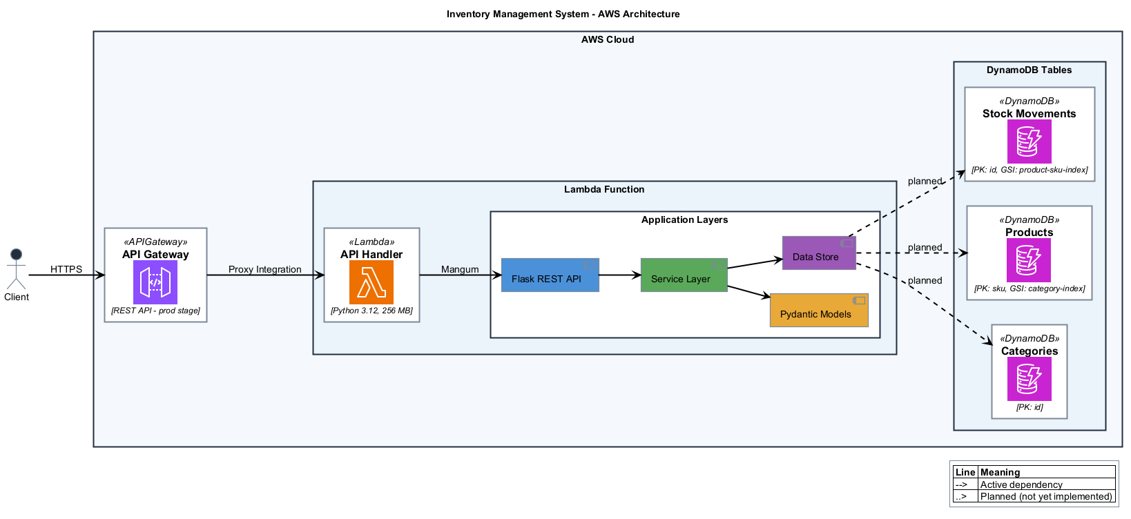
System Architecture

Slide 4
Technology Stack
Application
AWS Infrastructure
Python 3.12 Runtime
API Gateway REST API with throttling
Flask REST API framework
Lambda Serverless compute (256MB)
Pydantic Data validation & models
DynamoDB NoSQL tables (pay-per-request)
Mangum ASGI/WSGI to Lambda adapter
CDK Infrastructure as Code
Data Model
Categories
Products
Stock Movements
PK: id
PK: sku, GSI: category-index
PK: id, GSI: product-sku-index

Slide 5
REST API Endpoints
Categories
GET /categories | POST /categories | DELETE /categories/{id}
Products
GET /products | POST /products | DELETE /products/{sku}
Stock
GET /stock/{sku}/level | POST /stock/movements | GET /stock/movements
Alerts & Reports
GET /stock/alerts | GET /stock/summary
All endpoints return JSON | Input validation on all requests | Standard HTTP status codes

Slide 6
Application Layers
API Layer
src/app.py
Flask routes handling HTTP requests and responses
Service Layer
src/services.py
Business logic, validation, stock calculations, reorder alerts
Model Layer
src/models.py
Pydantic models: Category, Product, StockMovement, ReorderAlert
Data Store
src/store.py
In-memory storage (planned DynamoDB backend via CDK)

Slide 7
Deployment & Next Steps
Current State
Next Steps
Fully functional REST API
Connect DynamoDB backend
In-memory data store with sample data
Add authentication (Cognito)
CDK stack defined and ready to deploy
Implement date-range filtering
Comprehensive input validation
Add automated testing suite
CI/CD pipeline setup
Deploy with:
cd cdk && cdk deploy

