Slide 1


Slide 2
GITHUB
Sharing a Project on Github
Push
Fetch
Pull / Update the Project

Slide 3
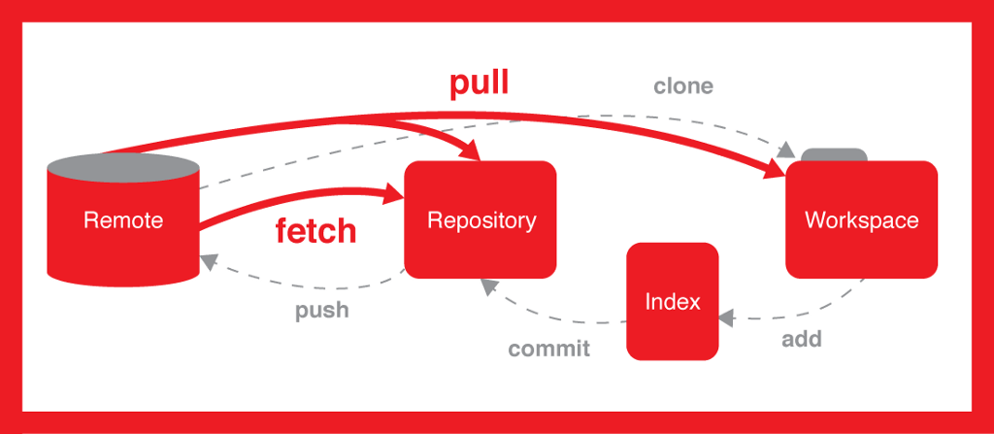
Notes:
The workspace, also known as the working directory, is the directory on your local computer where you have a copy of the files from your Git repository.
It's where you make changes to your project's files. These changes can include creating, modifying, or deleting files.
The index, also called the staging area, is an intermediate step between your workspace and the local repository.
When you make changes in your workspace, you can choose which changes you want to include in your next commit by adding them to the index.
This allows you to selectively include specific changes rather than committing all changes in your workspace.
The local repository is where all the committed changes and the complete project history are stored on your local machine.
When you commit changes, they are saved to the local repository. This creates a snapshot of your project at that point in time.
You can think of the local repository as your personal, self-contained copy of the project's history.

Slide 4
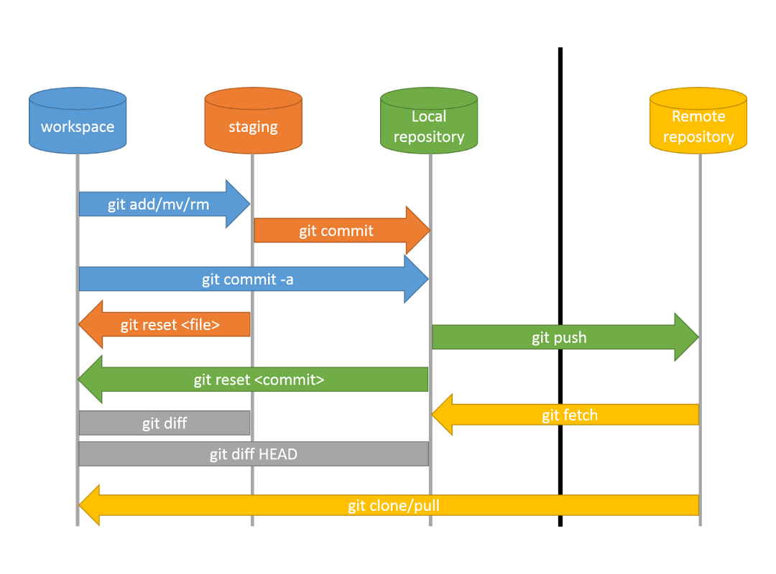
Notes:
git add: This command is used to stage changes in your working directory, preparing them to be committed. You can specify individual files or directories to stage, or use git add . to stage all changes.
git commit: After you've staged your changes, you use this command to create a new commit with a message that describes the changes you're making.
git push: Once you've committed your changes, you can use this command to push your local commits to a remote repository. This is important when collaborating with others or updating a central repository.

Slide 5
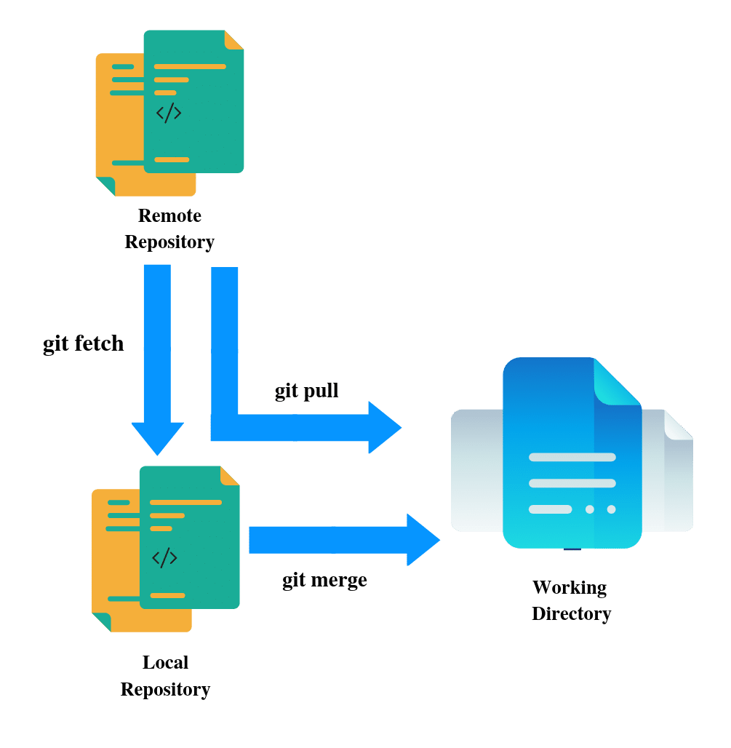
Notes:
Fetch: In Git, the git fetch command is used to retrieve updates from a remote repository, but it does not integrate those changes into your current working branch. It's often used to see what changes are available on the remote repository before merging them into your local branch.
Merge:The git merge command is used to combine the changes from one branch into another. For example, you might merge changes from a feature branch into the main branch. This integrates the changes and creates a new commit in the current branch to capture the merged content.
Pull: The git pull command is a combination of two actions: a git fetch followed by a git merge. It fetches changes from a remote repository and then merges them into your local branch. This command is commonly used to update your local branch with the changes from the remote repository.

Slide 6
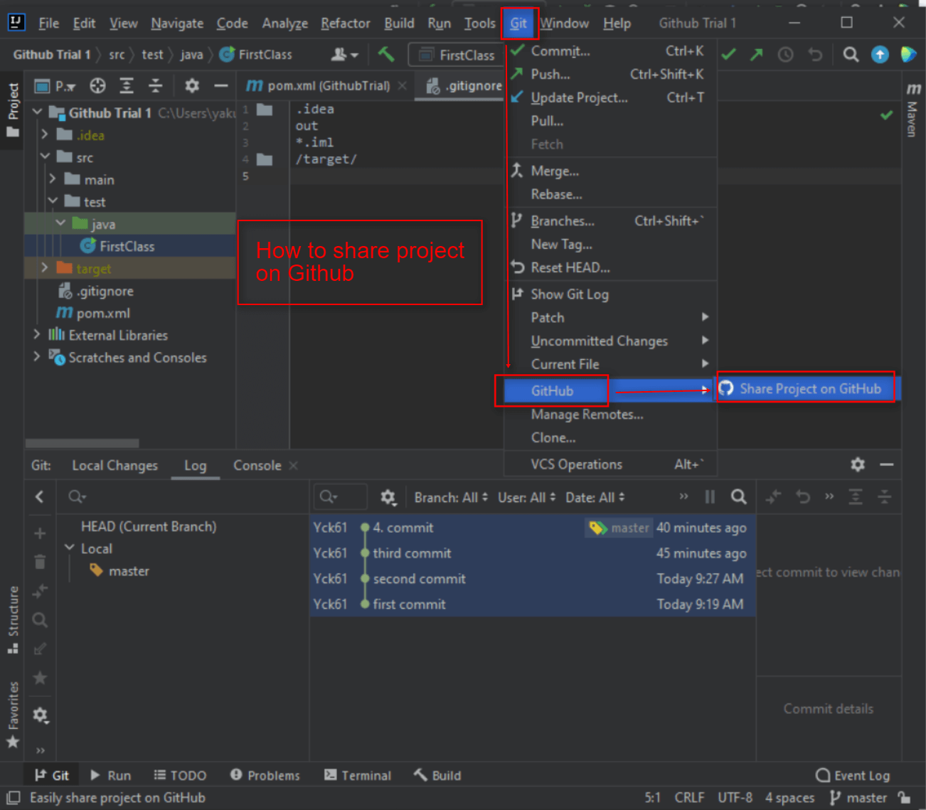
This procedure is a shortcut and applicable just first time when you create project

Slide 7
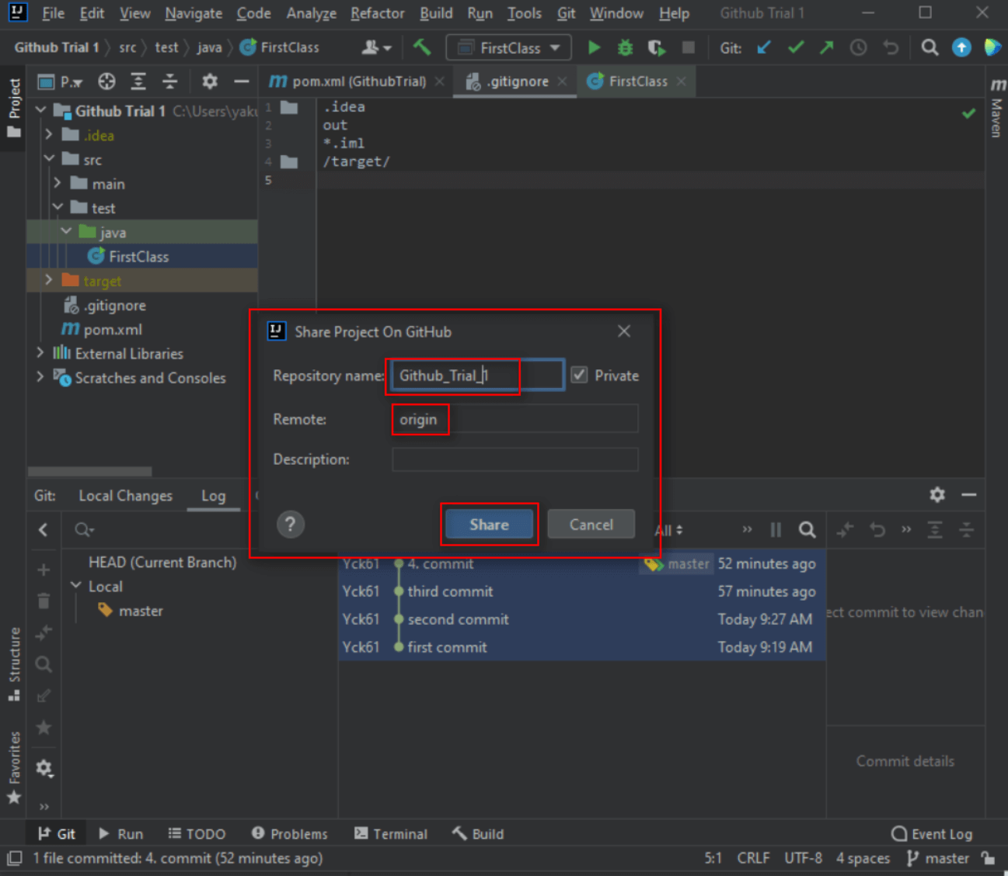

Slide 8
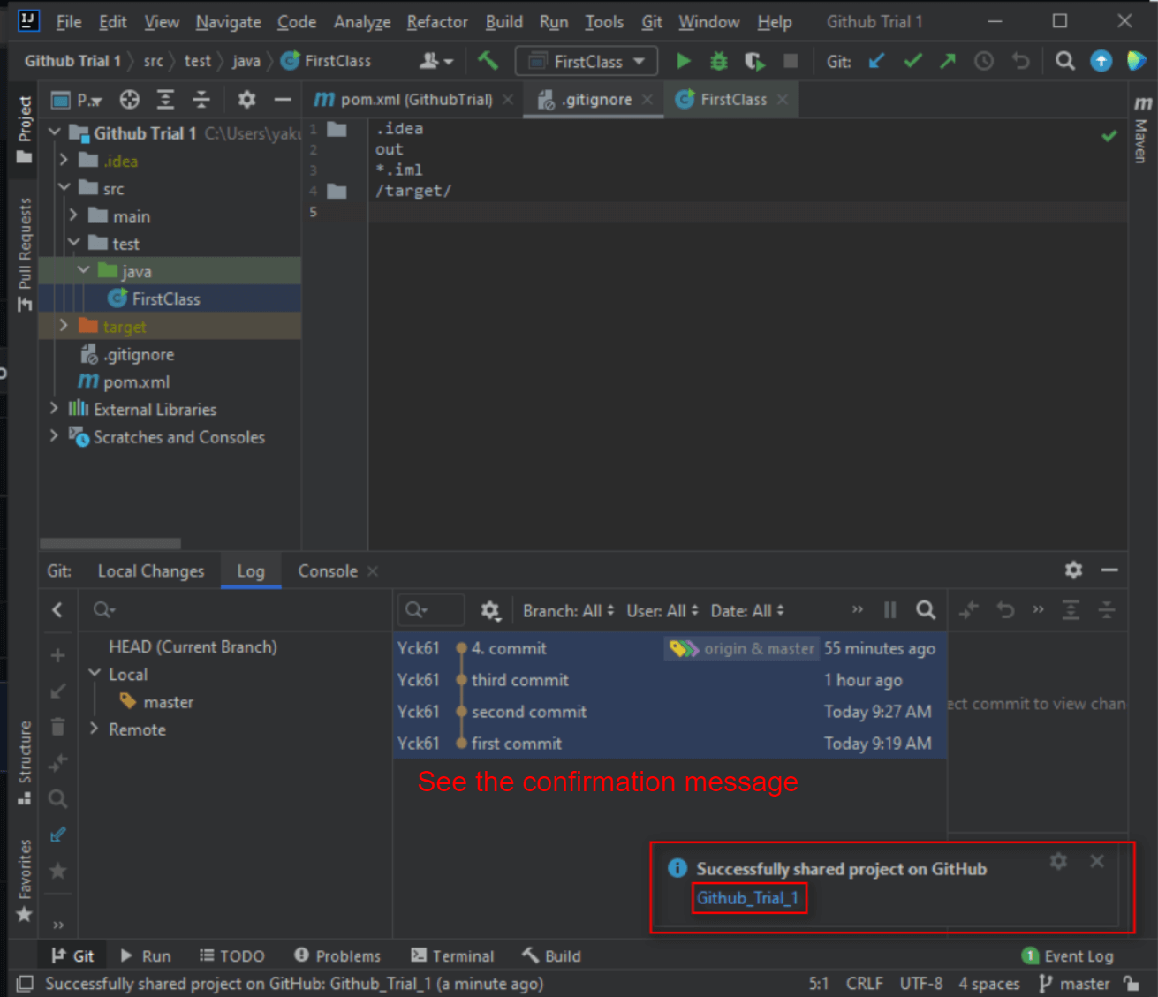

Slide 9
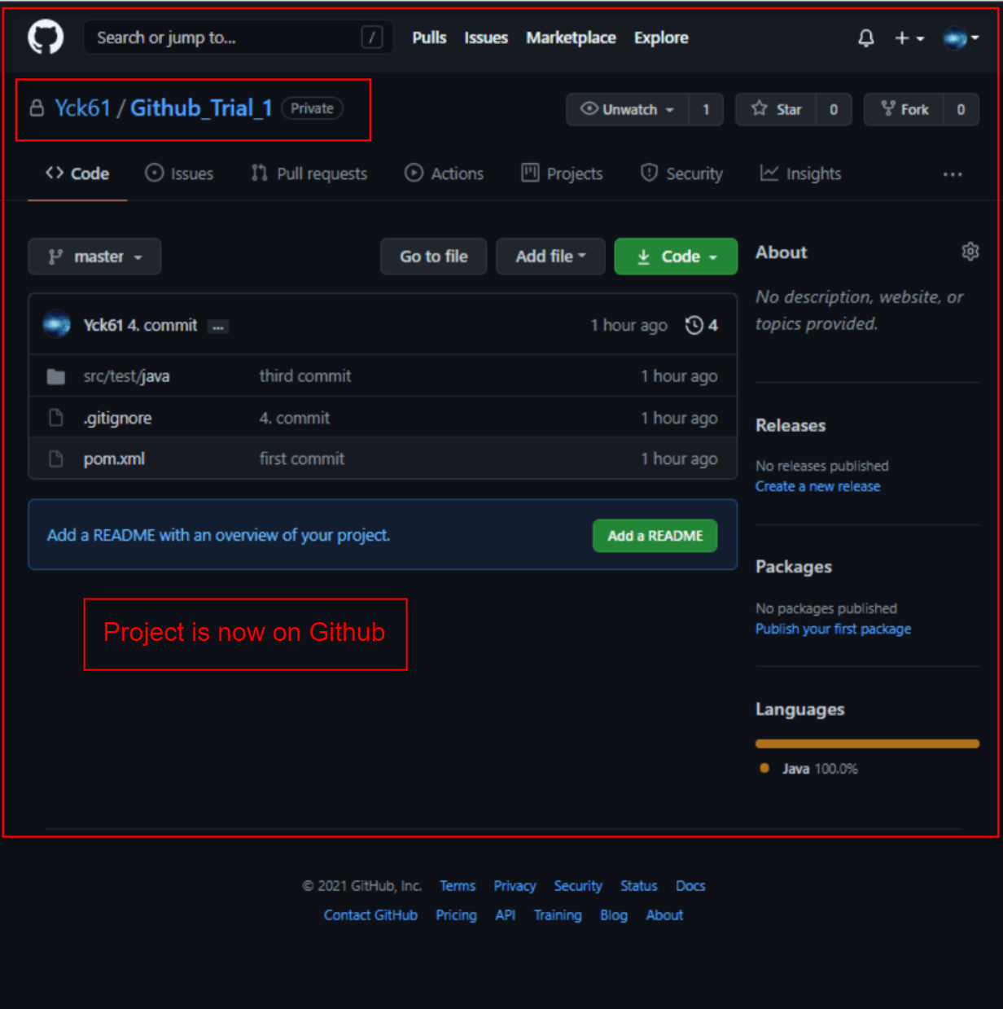

Slide 10
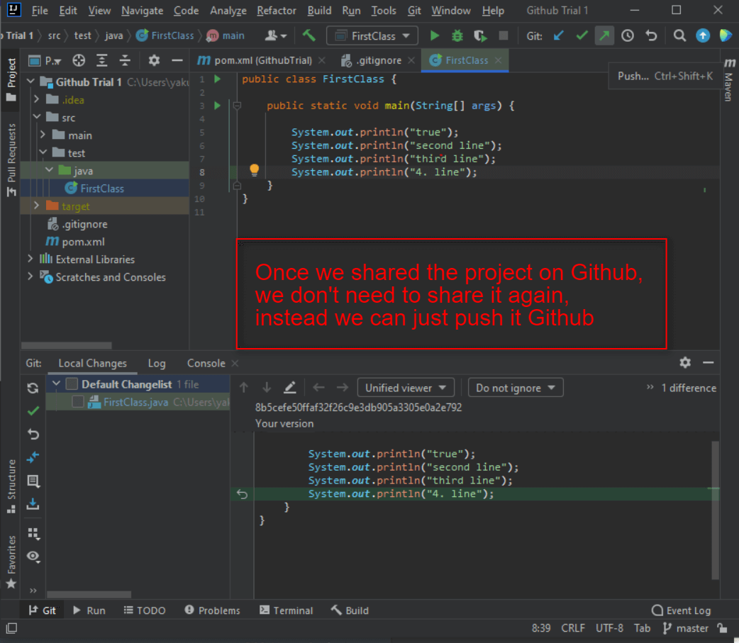

Slide 11
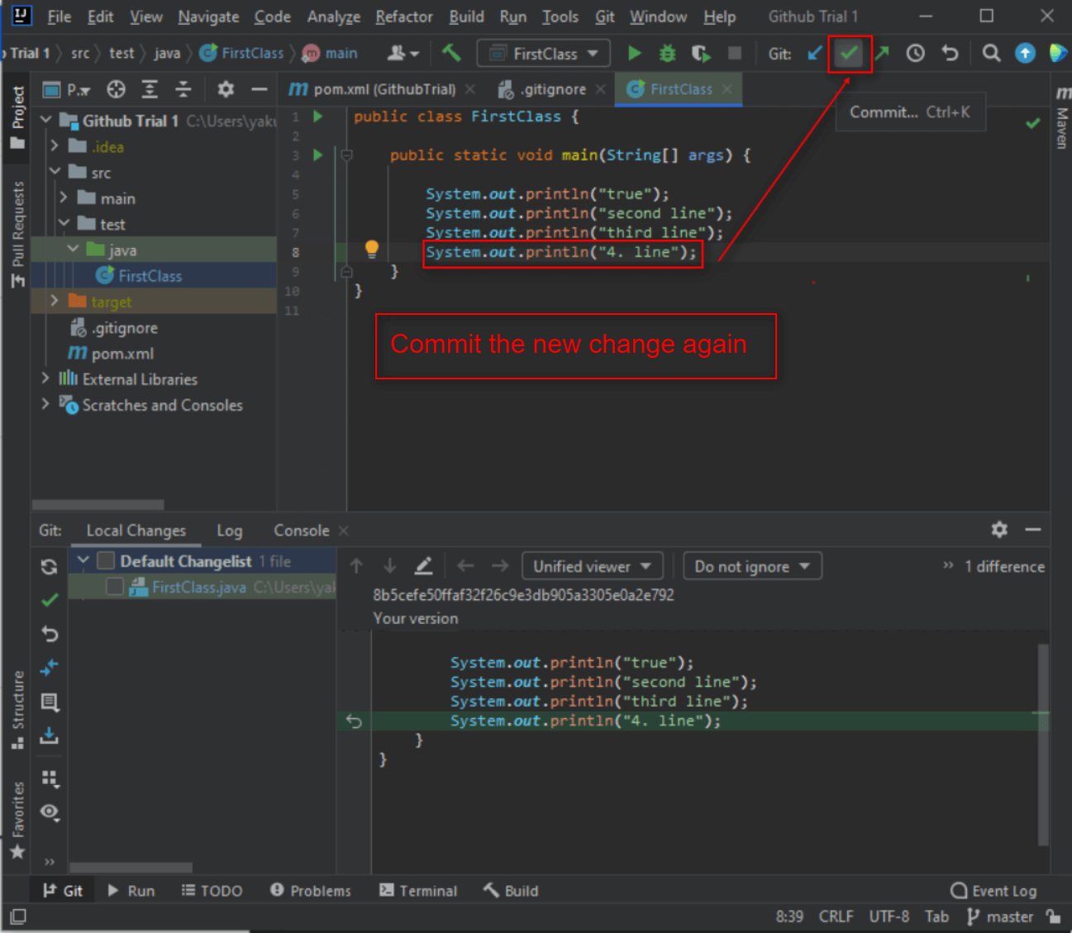

Slide 12
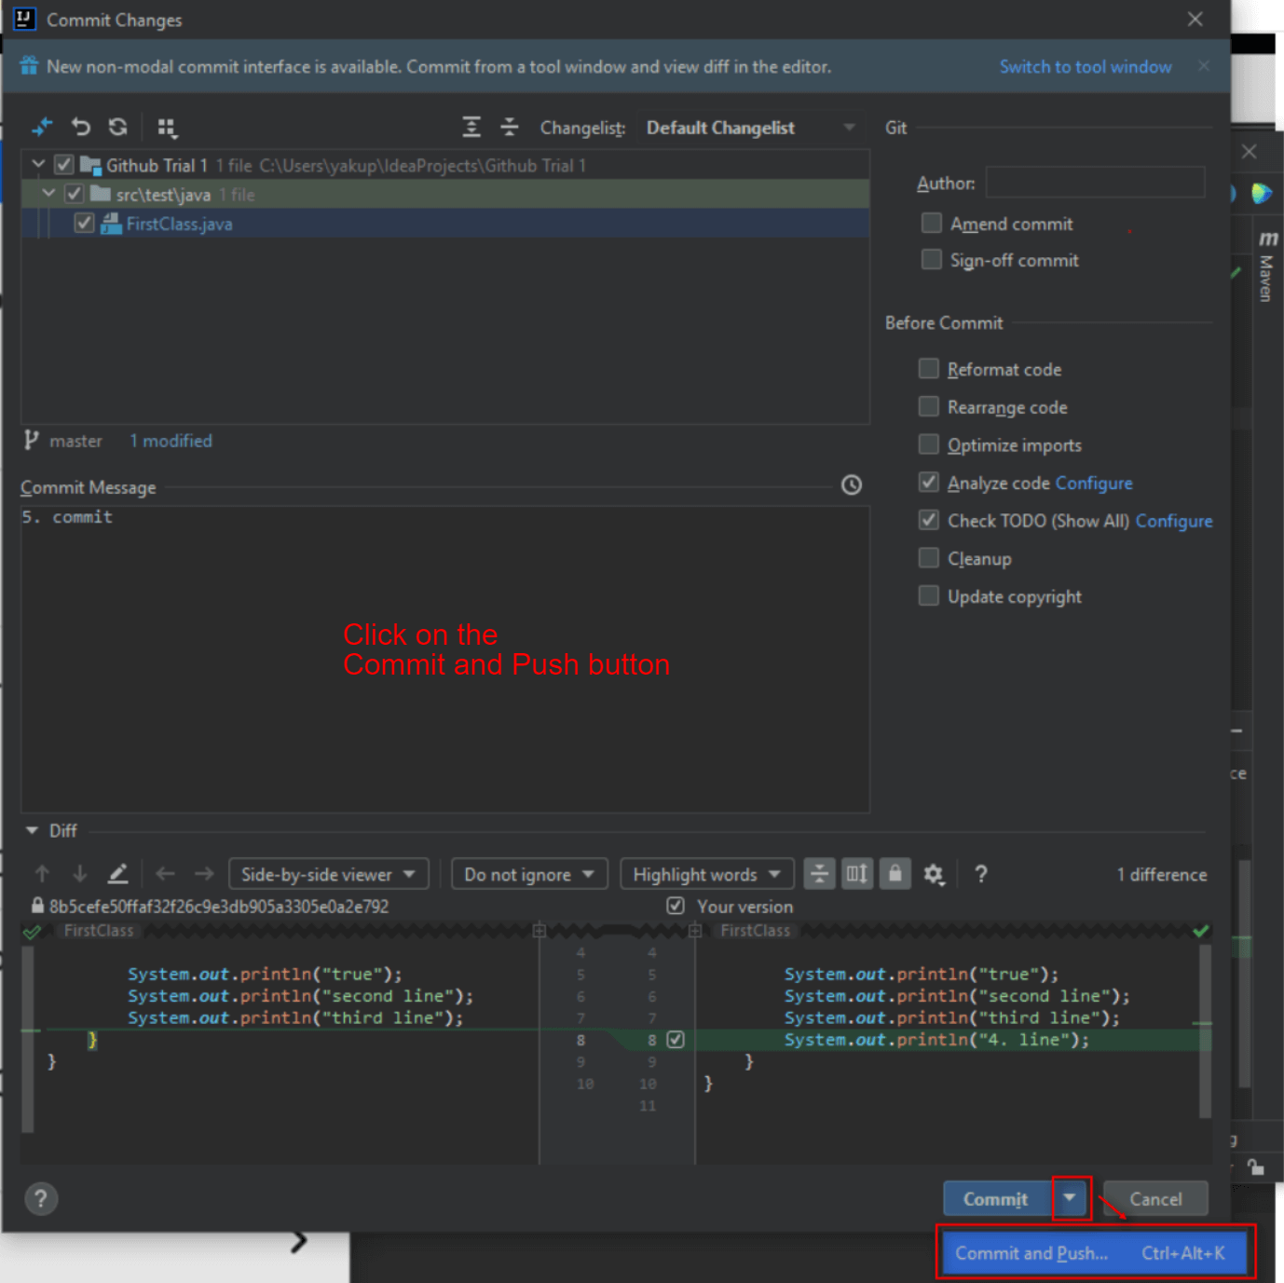

Slide 13
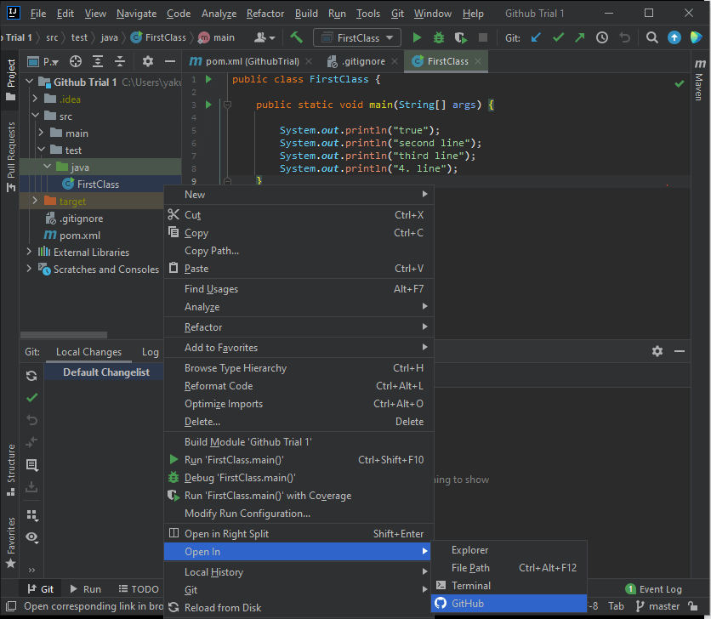

Slide 14
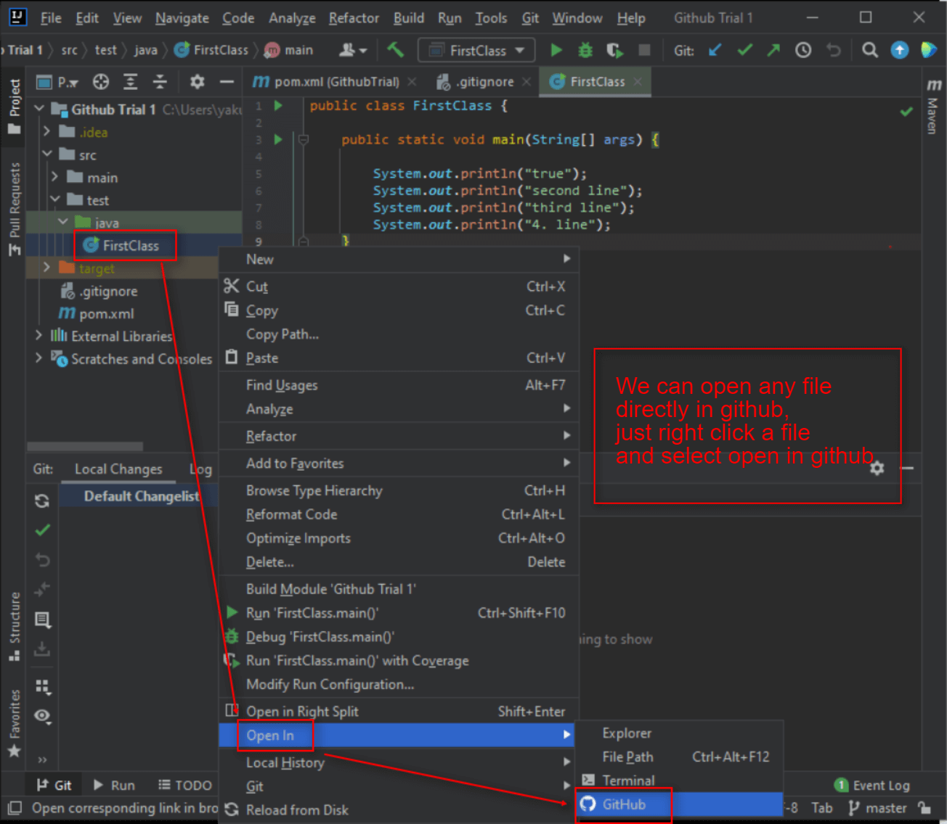

Slide 15
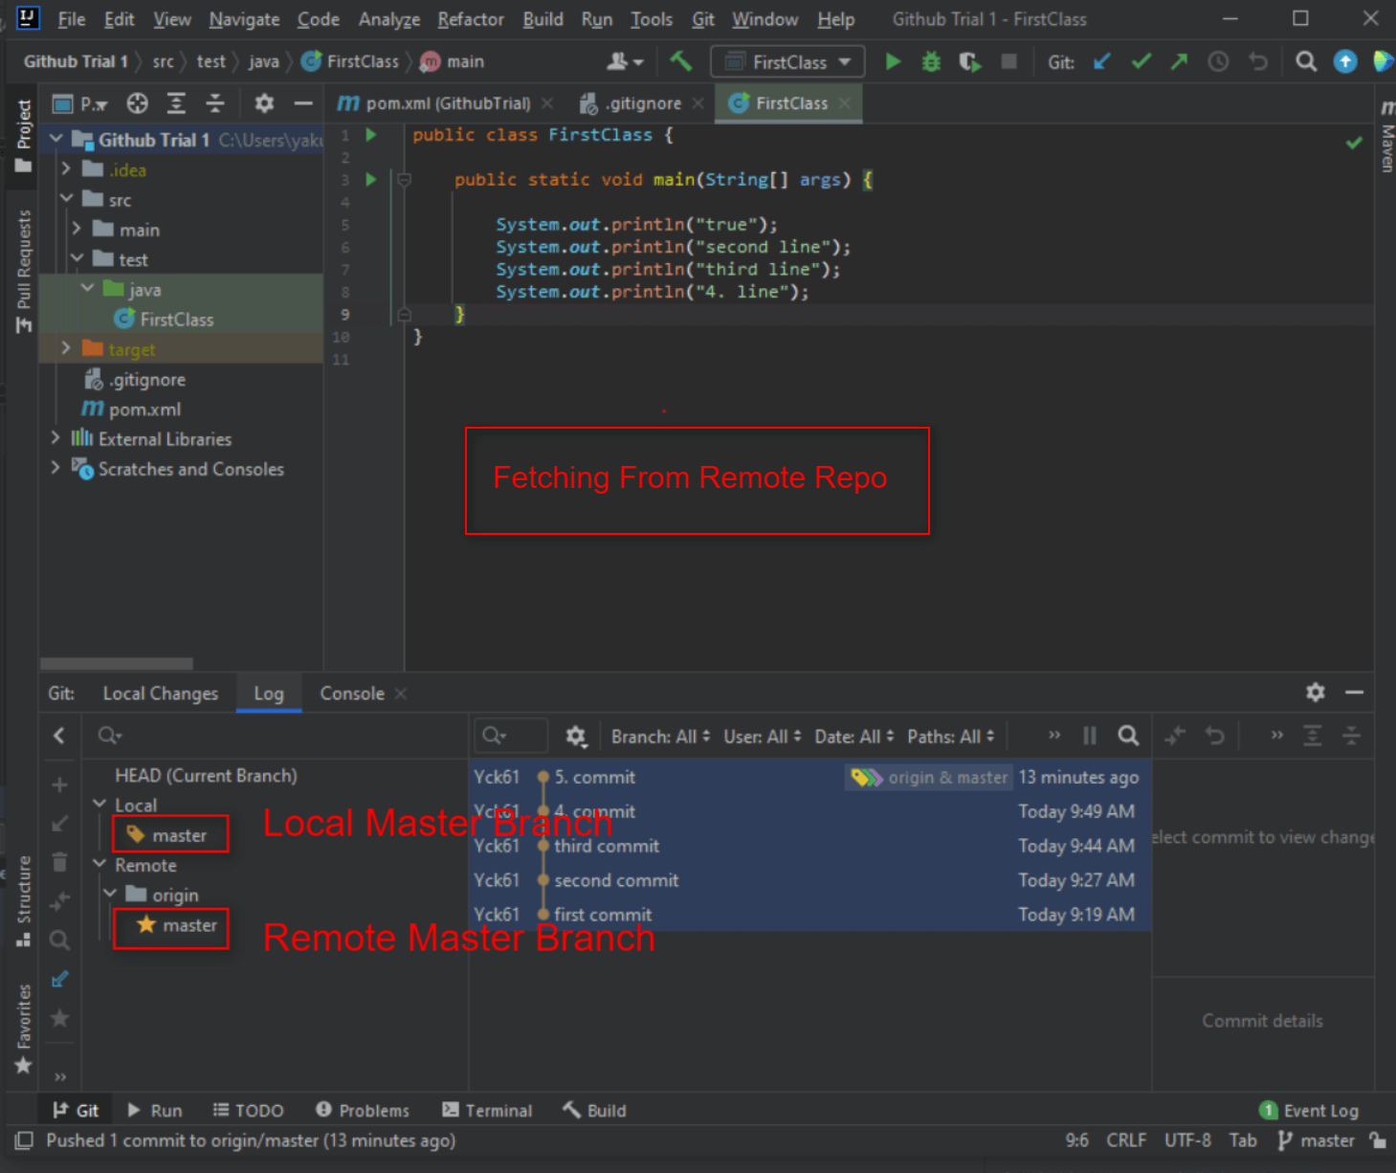

Slide 16
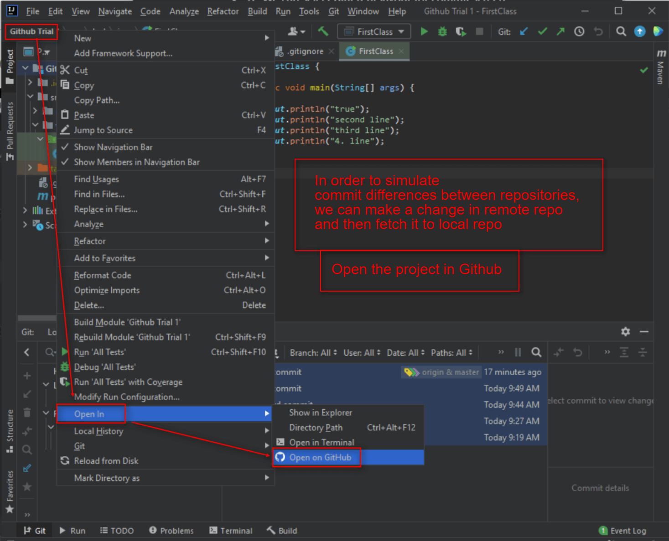

Slide 17
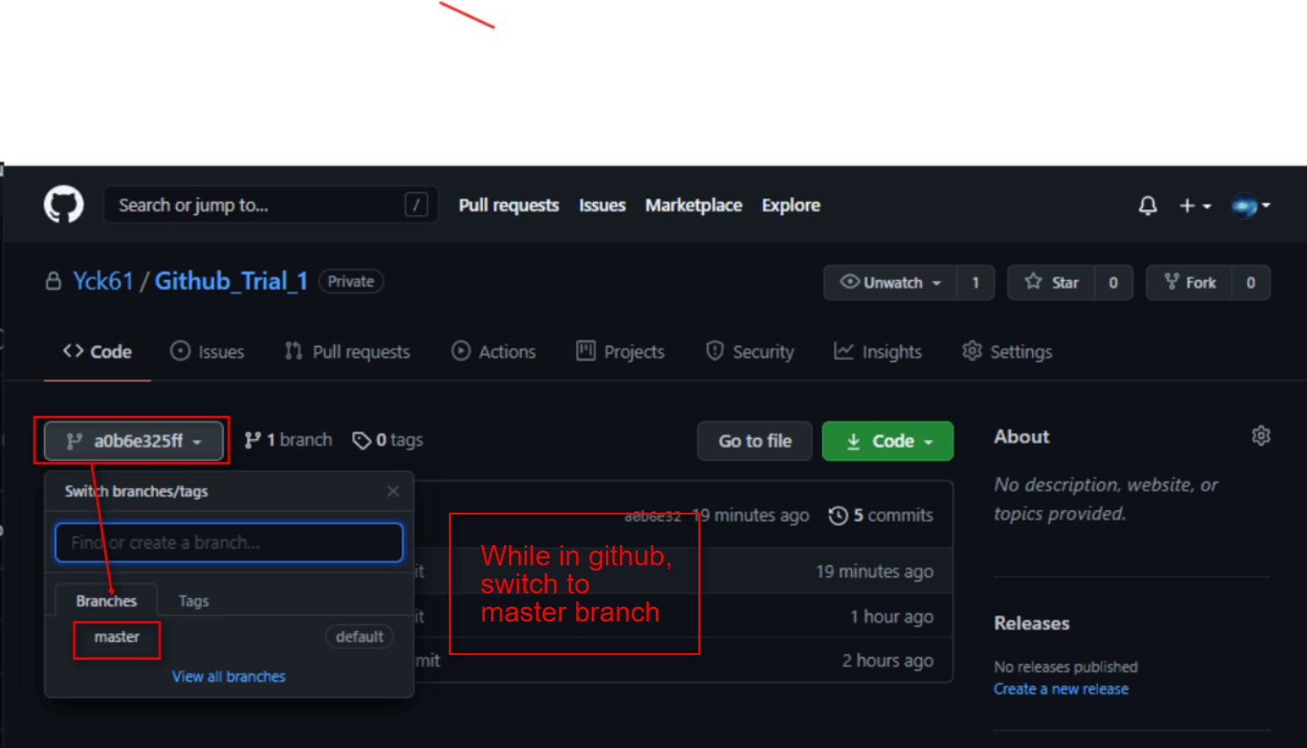

Slide 18
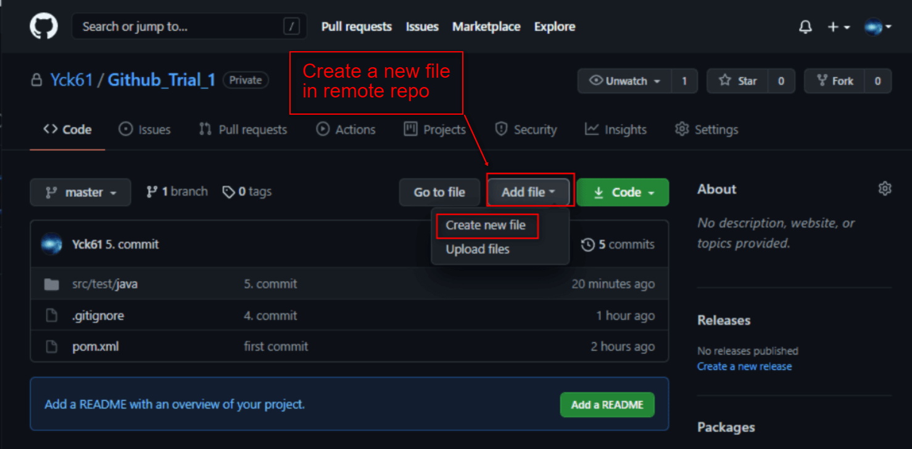

Slide 19
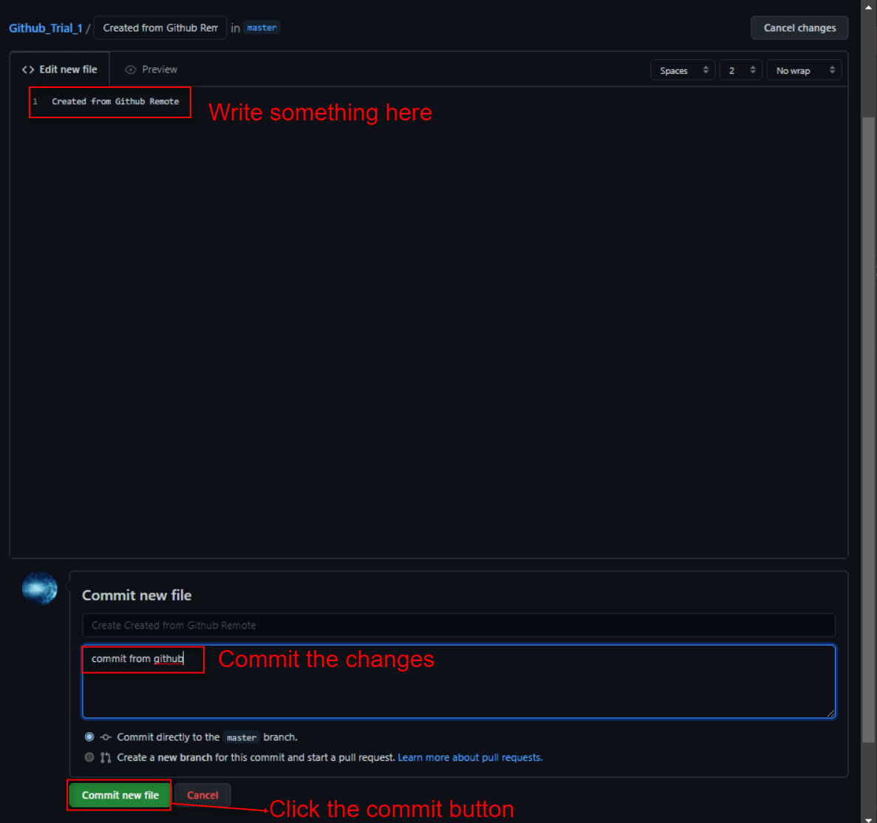

Slide 20
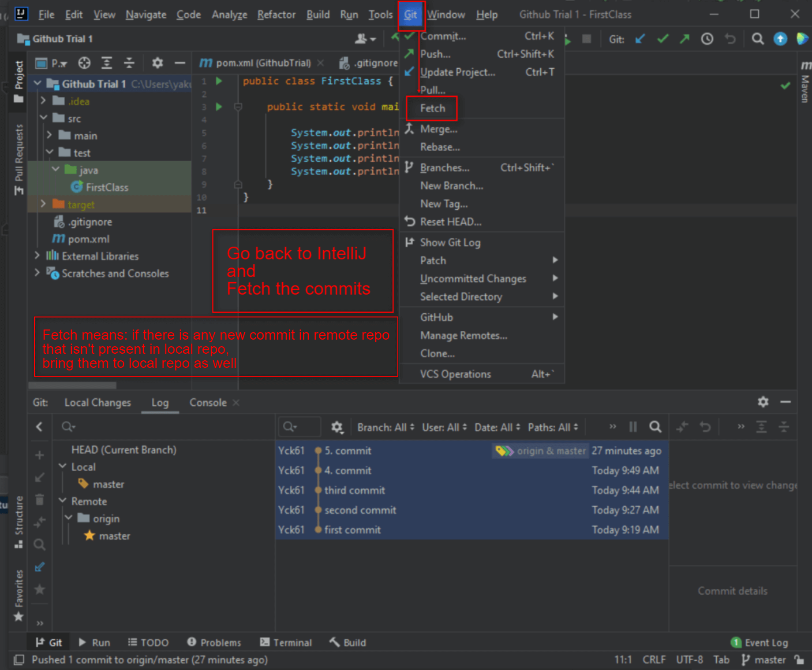

Slide 21
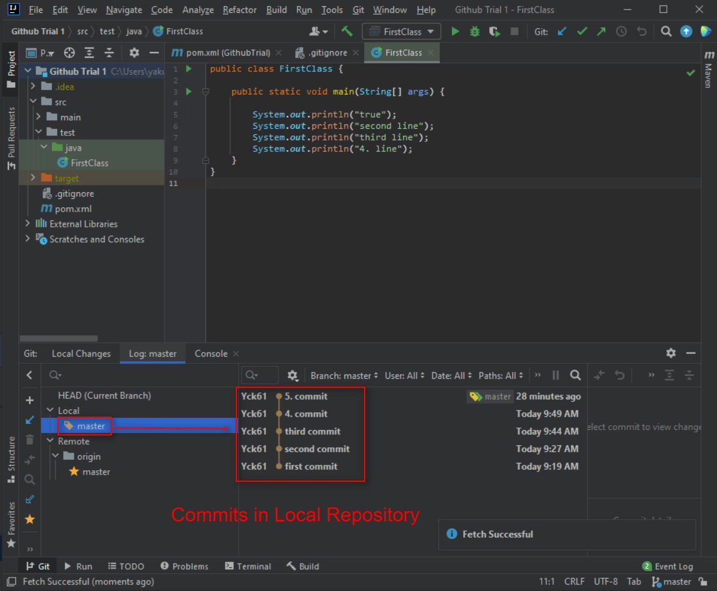

Slide 22
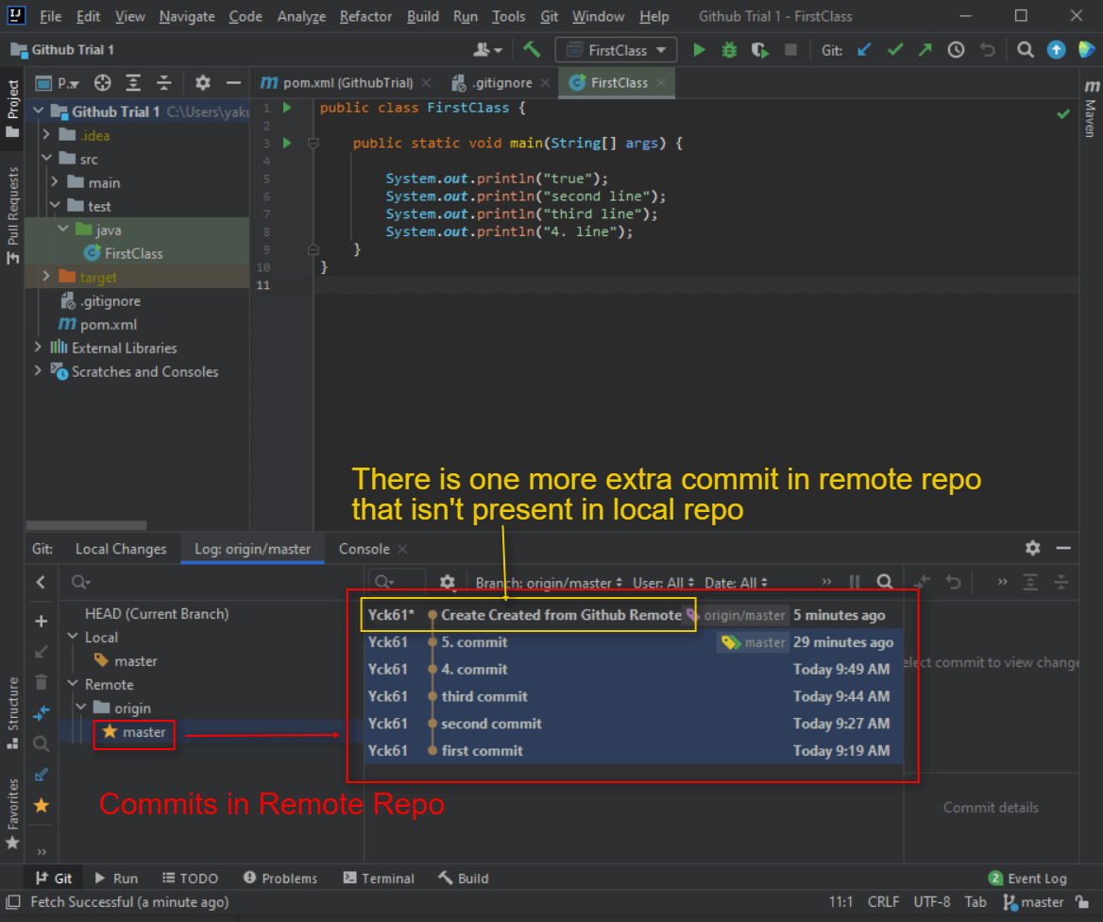

Slide 23
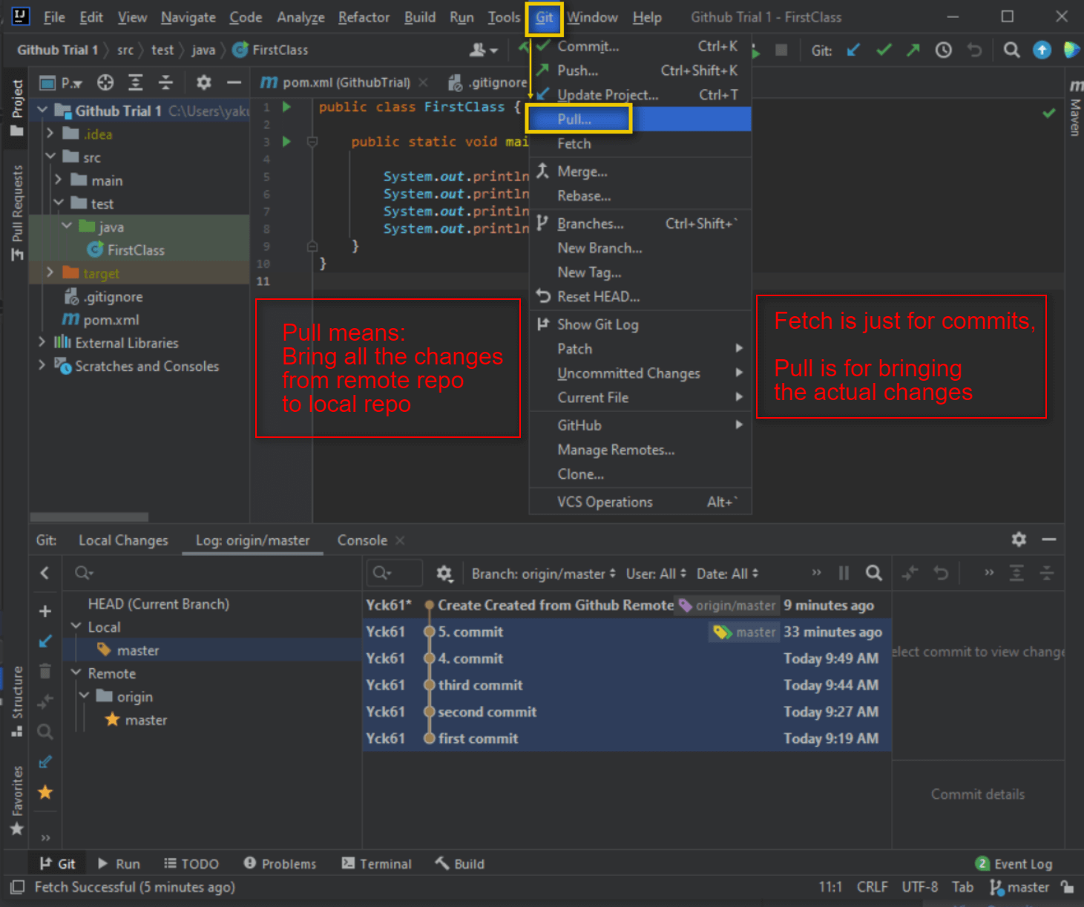

Slide 24
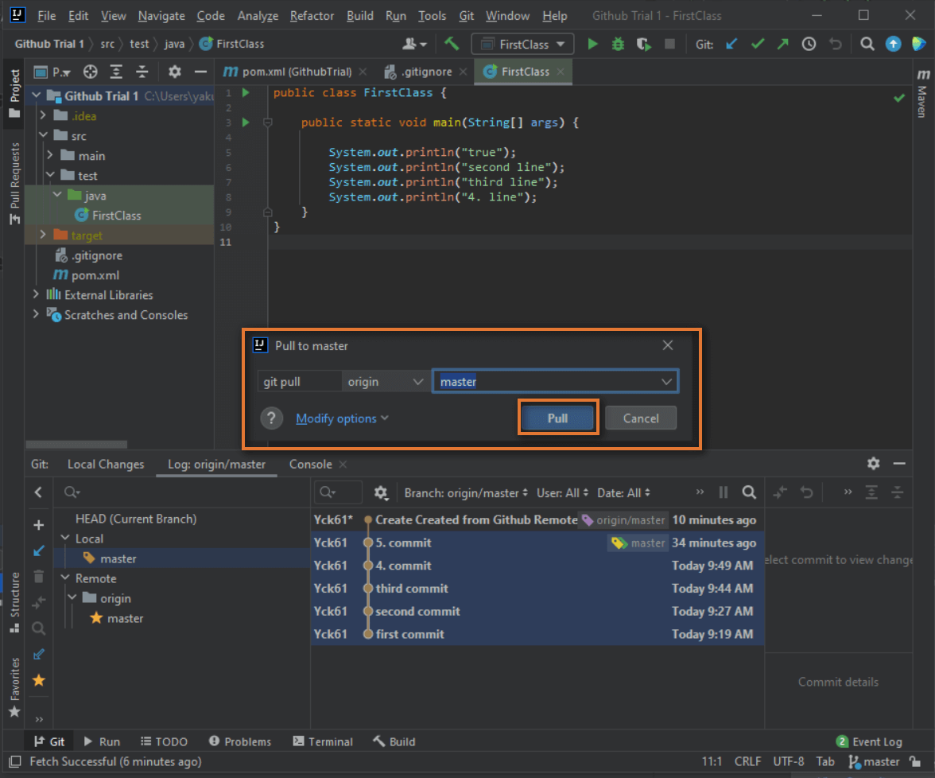

Slide 25
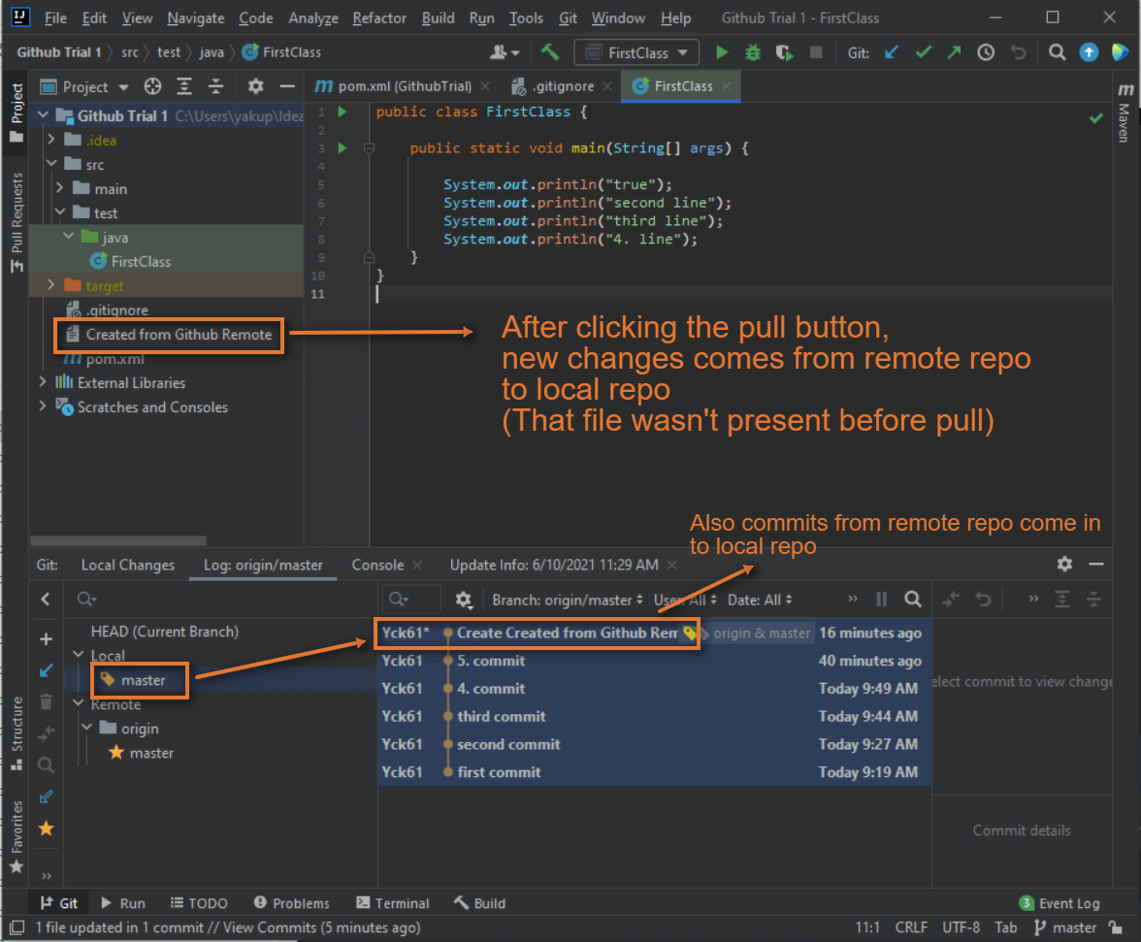

Slide 26
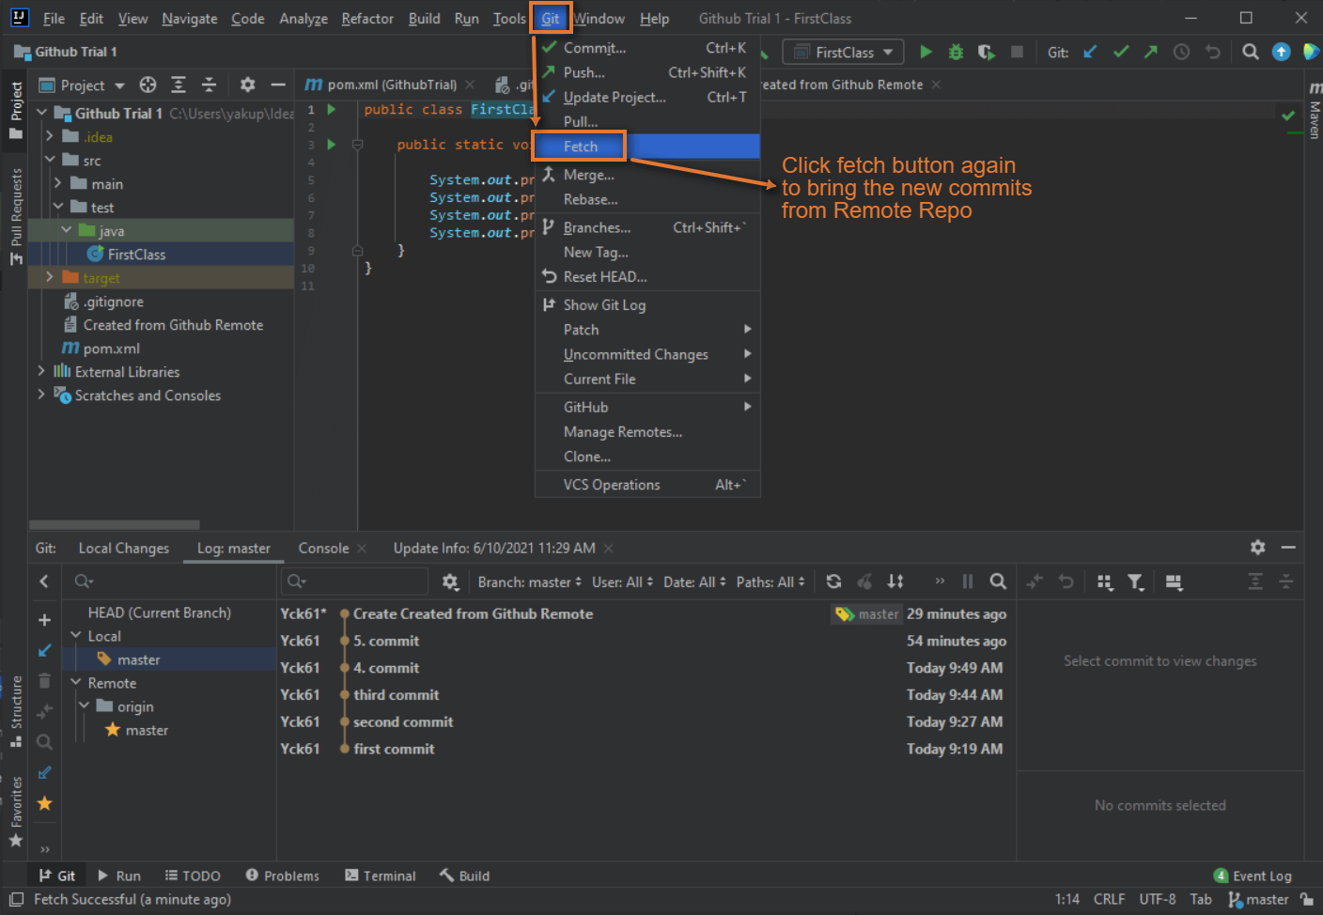

Slide 27
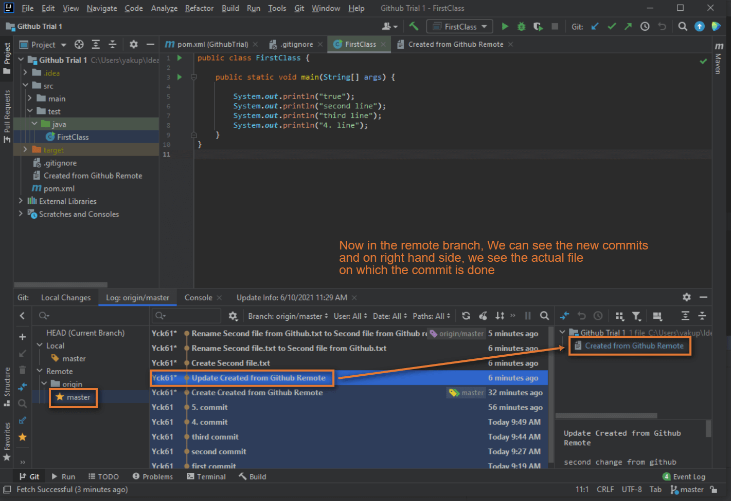

Slide 28
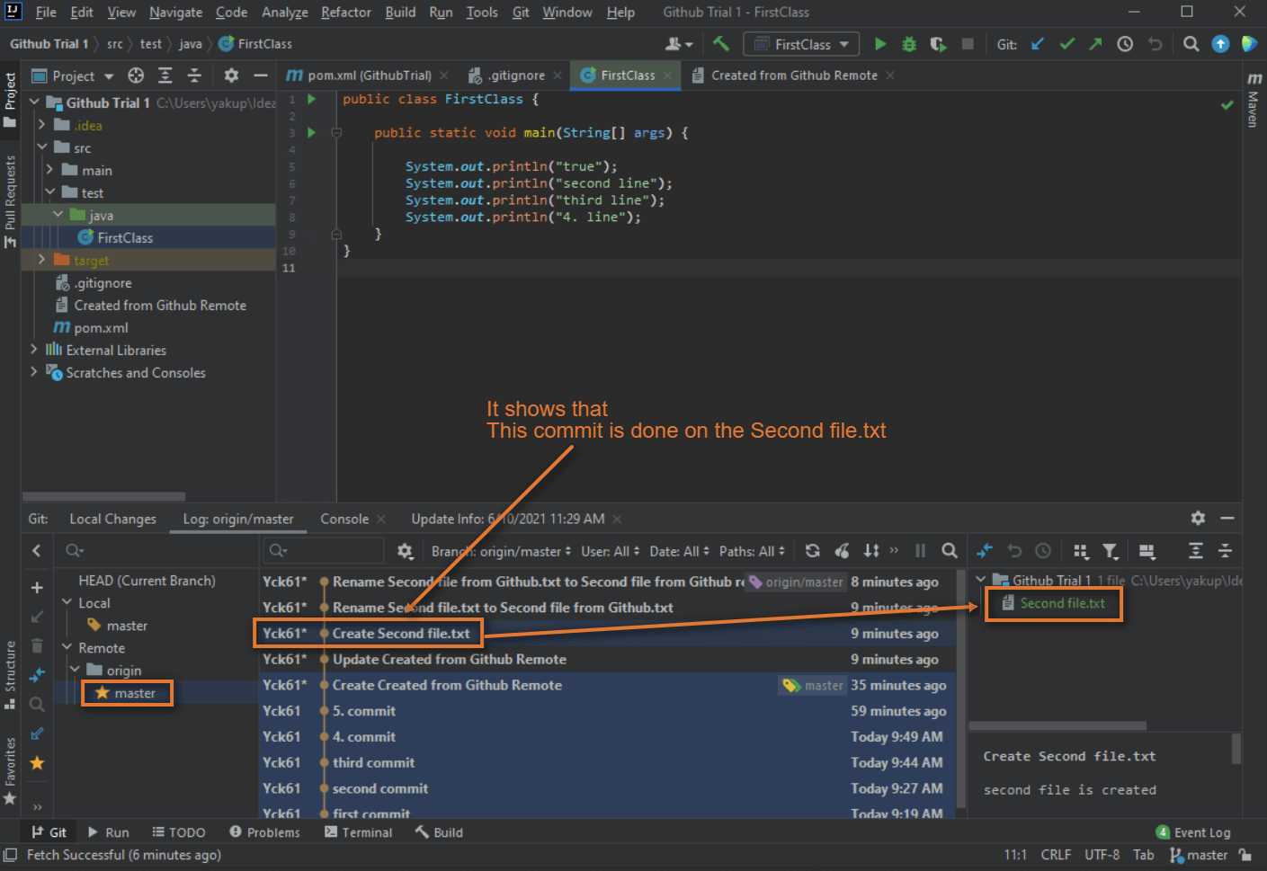

Slide 29
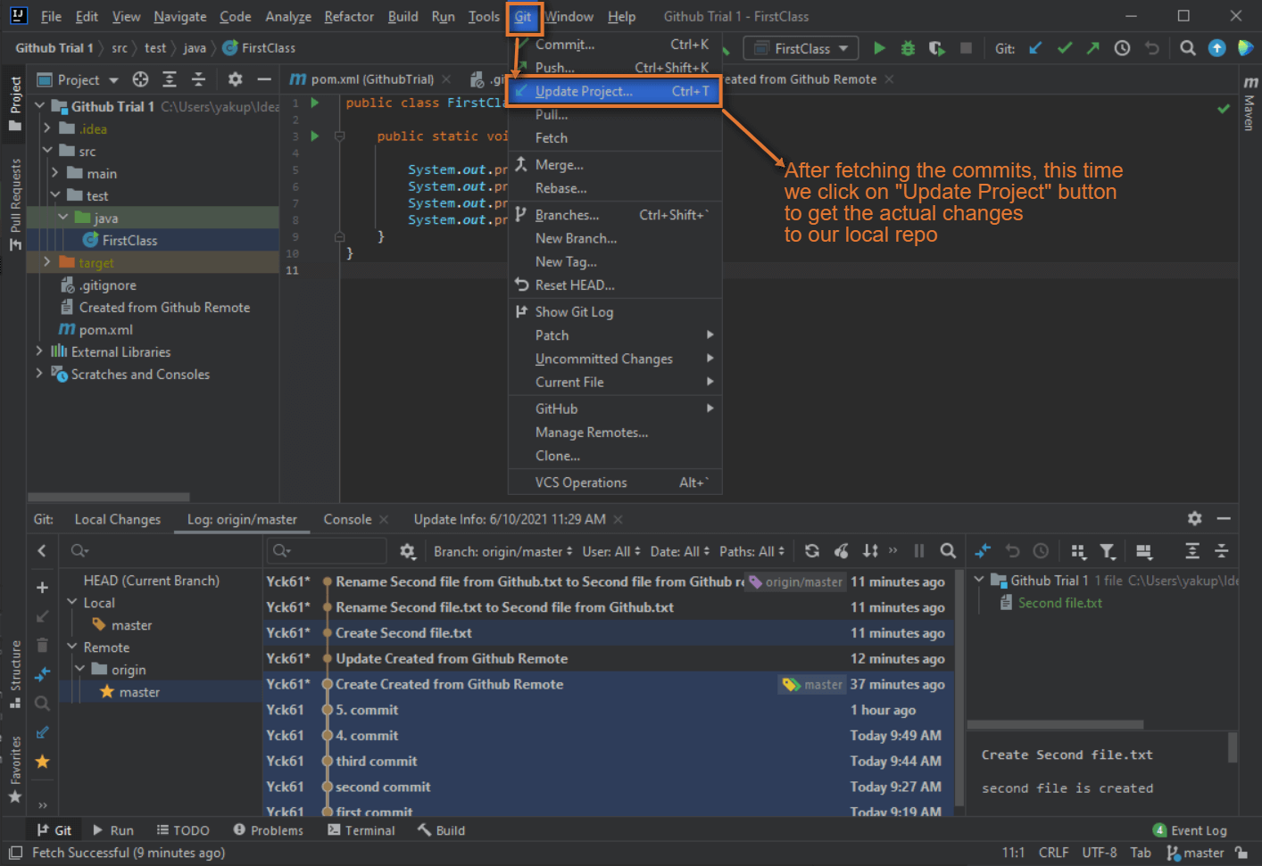

Slide 30
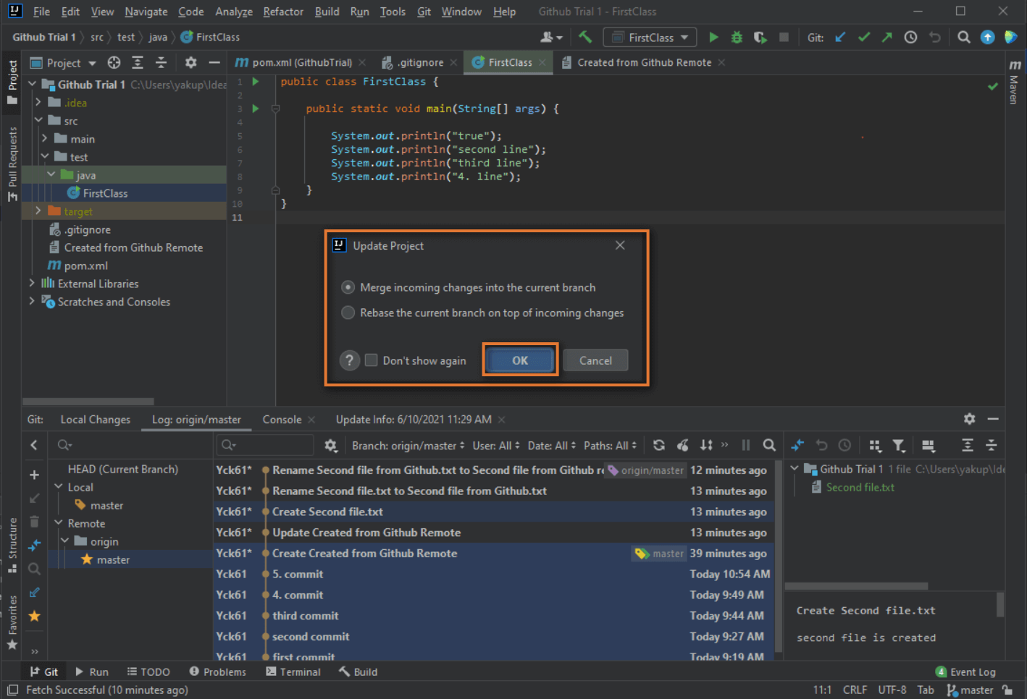

Slide 31
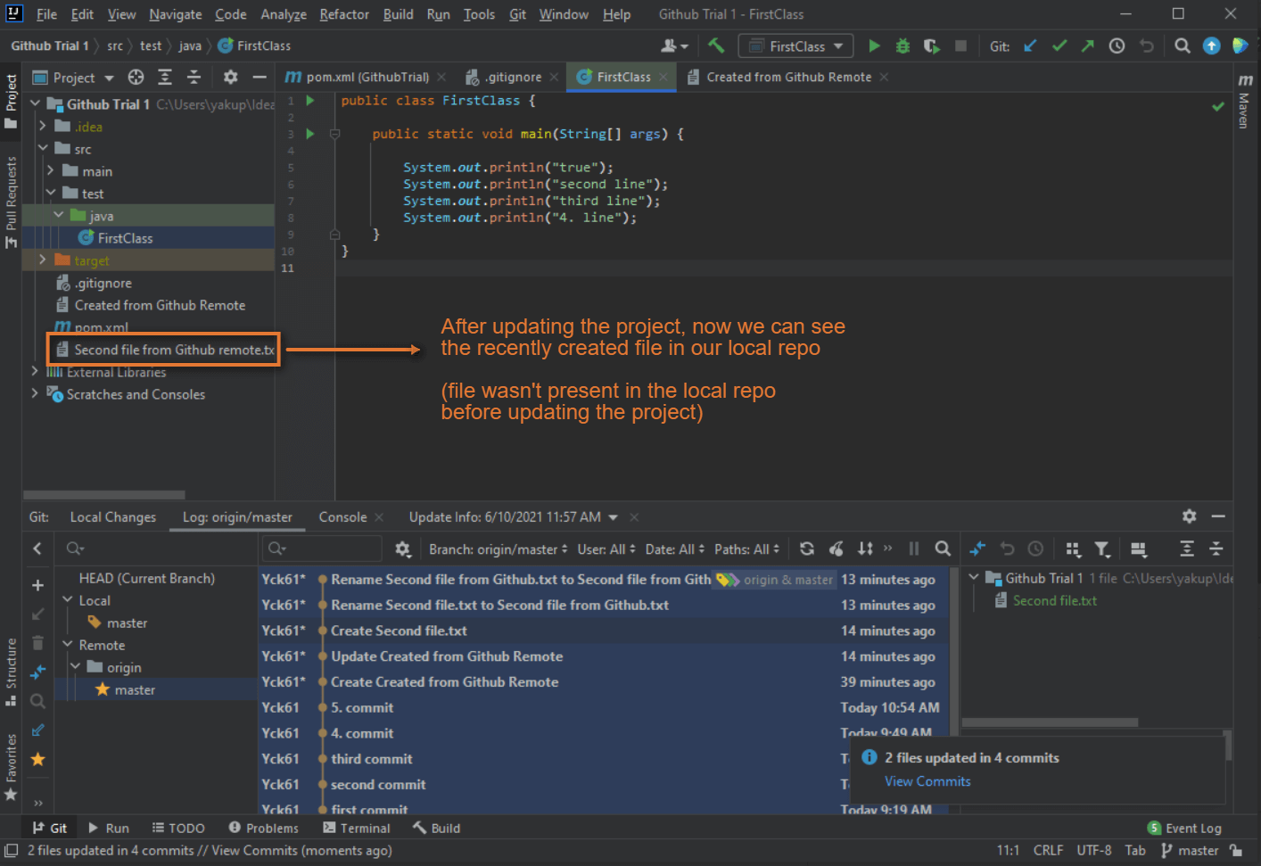

Slide 32
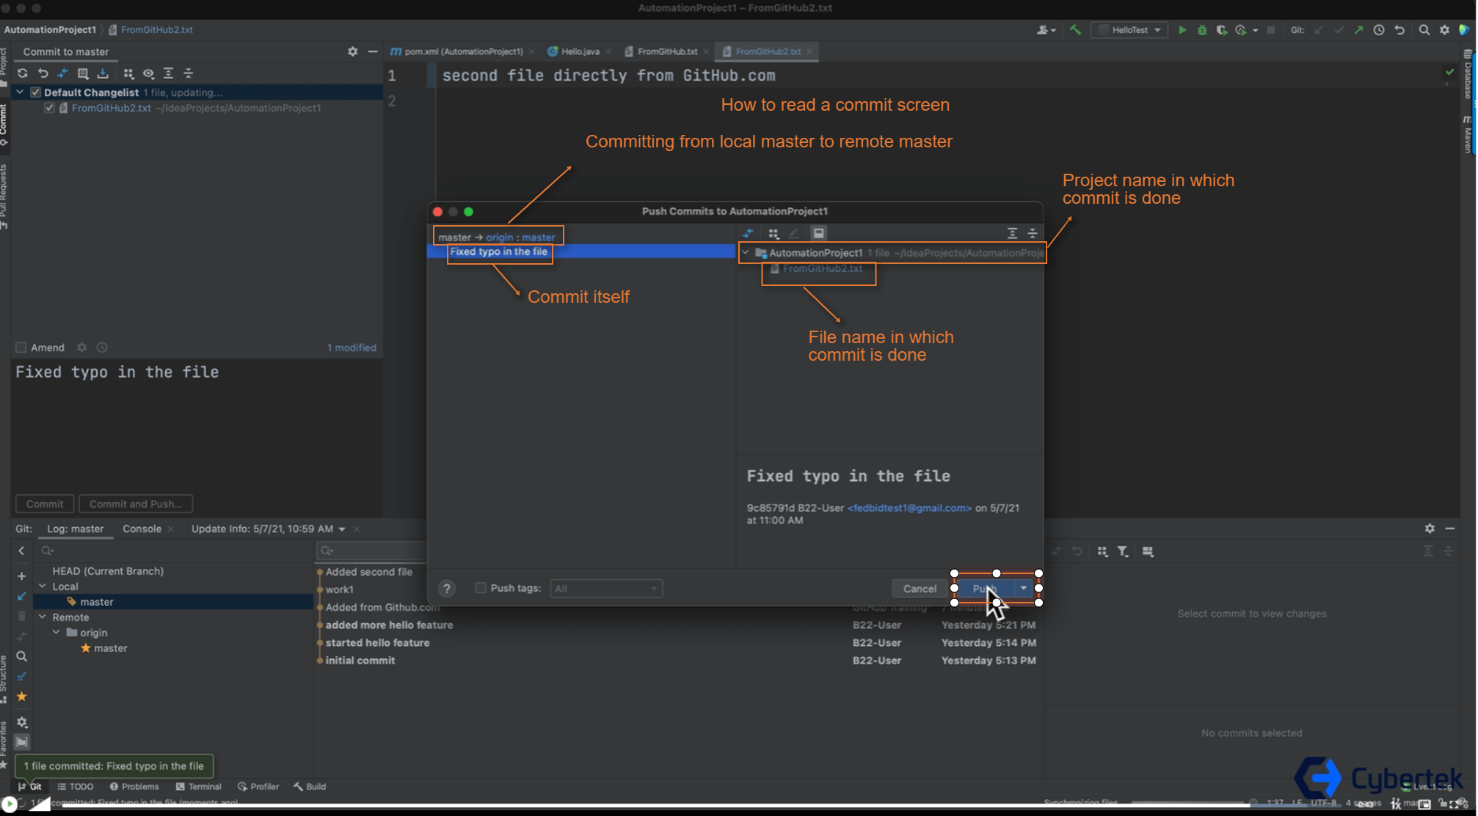

Slide 33
