Slide 1


Slide 2
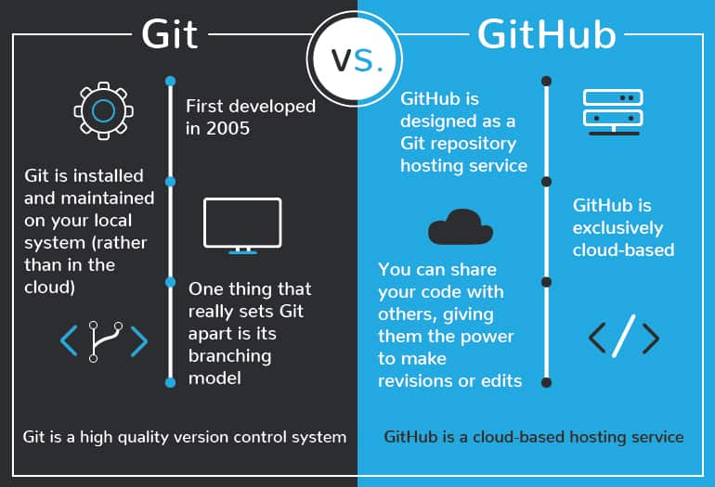
Notes:
-Differnce between git and GitHub?
Git and GitHub are related but distinct tools used in the world of software development.Git is a version control system that allows developers to track changes in their code. GitHub is a web-based hosting service for git repositories. In simple terms, you can use git without Github, but you cannot use GitHub without Git.Let me give you some more detail about difference between them:

Slide 3
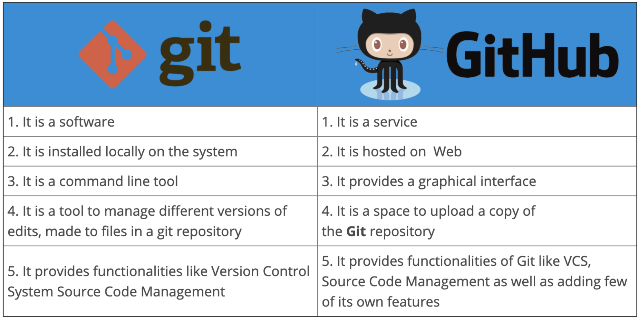
Notes:
Git:
Git is a distributed version control system (VCS) designed for tracking changes in source code during software development.
It was created by Linus Torvalds(Linus Torvalds is a Finnish-American software engineer best known as the creator and original developer of the Linux kernel, which is the core component of the Linux operating system) in 2005 and is open-source.
Git allows developers to track and manage changes to their codebase, collaborate with others, and work on different branches of a project.
It operates locally on your computer, meaning you can use Git to version control your projects without needing an internet connection.
GitHub:
GitHub is a web-based platform and service that provides hosting for Git repositories.
It was created in 2008 and is now owned by Microsoft.
GitHub allows developers to store and collaborate on their Git repositories in a centralized location on the internet.
It offers features such as issue tracking, pull requests, collaboration tools, and integrations with other development tools.

Slide 4
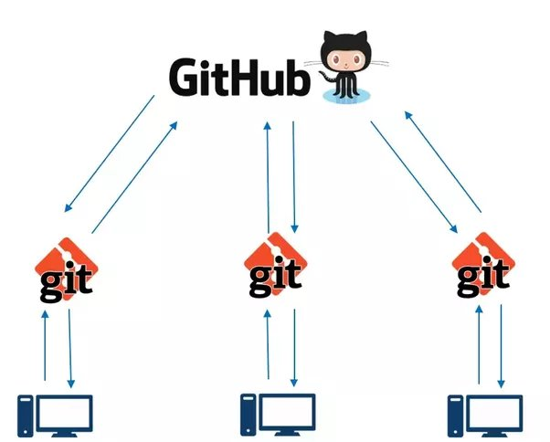
Notes:
In summary, Git is the version control system, and it's a command-line tool you can use on your computer. GitHub, on the other hand, is a web-based platform that hosts Git repositories and provides a range of collaboration and project management tools. Developers often use Git for local version control and then use GitHub to host and collaborate on their Git repositories in a shared online environment. However, it's worth noting that there are other Git repository hosting services besides GitHub, such as GitLab and Bitbucket.

Slide 5
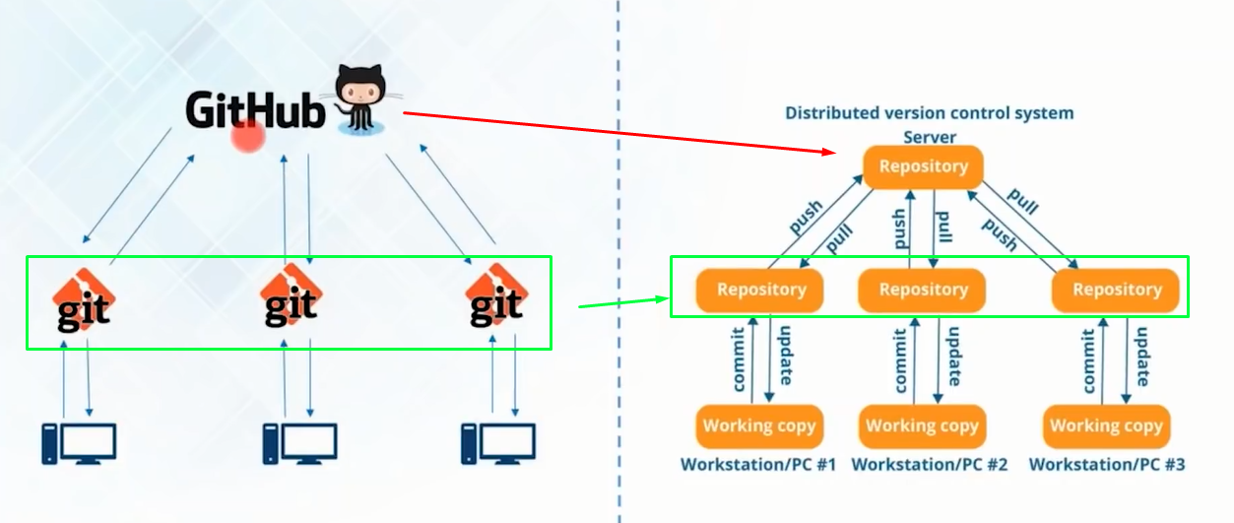
Notes:
In Git, a repository, often referred to as a "repo," is a data structure that stores and manages a collection of files and their complete version history. It serves as a central location for tracking changes to your project's source code or any other files.
There are two main types of repositories in Git: local and remote. A local repository is stored on your computer, while a remote repository is hosted on a server or a platform like GitHub, GitLab, or Bitbucket.
When you work on a project, the files you modify are part of your working directory. These changes can be staged and then committed to the repository.

Slide 6
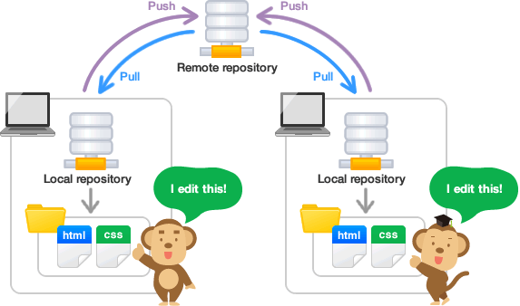
Notes:
Local Repository:
A local repository is a copy of a Git repository that resides on your computer.
It contains the entire project history, including all branches and commits.
You can work on and make changes to the code in your local repository without needing an internet connection.
It serves as your workspace for making changes, committing them, and preparing them to be shared with others.

Slide 7
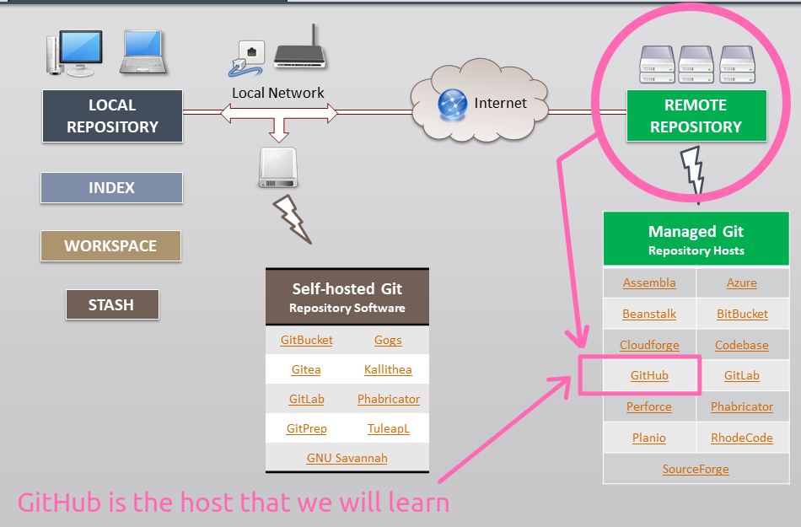
Notes:
Remote Repository:
A remote repository is a Git repository hosted on a remote server, such as GitHub.
It's a centralized location where you can store and collaborate on your code with others.
You can push your changes from your local repository to the remote repository to share your work with others.
It enables collaboration by allowing multiple people to work on the same project, share changes, and review each other's code.

Slide 8
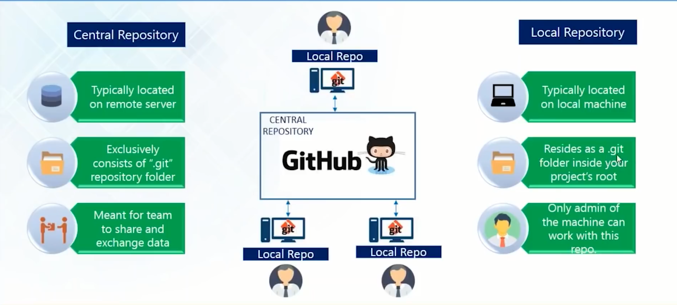
Notes:
Central Repository (sometimes used interchangeably with remote repository):
In the context of GitHub, a central repository often refers to the primary or official repository for a project.
It is typically the remote repository where the main development and collaboration occur.
The central repository is often considered the source of truth for a project, and contributors pull changes from and push changes to this repository.
In summary, the local repository is on your computer, the remote repository is hosted on a server like GitHub, and the central repository is often the primary repository for collaboration within a project. Developers work with the local repository, synchronize their changes with the remote repository, and the remote repository is often seen as the central hub for collaboration in the context of distributed version control systems like Git and platforms like GitHub.

