Slide 1
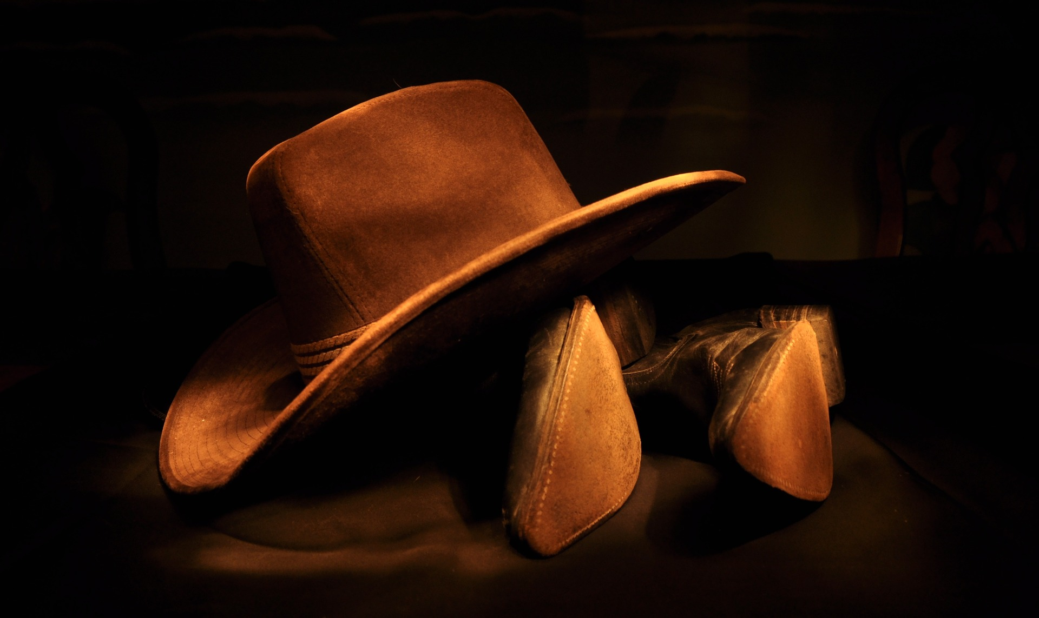

1 - TH Guest Ranch

Slide 2
2 - American Kids

