Slide 1
Drought Zooplankton Questions
Limiting to top taxa for four groups (P. forbesi, L. tetraspina, B. longirostris, H. longirostris)
Do we see regional changes in taxa BPUE?
Are there env parameters correlated with higher BPUE?
Does Drought impact the env parameters correlated with higher BPUE?
Are the env parameters for taxa changing, or moving?

Slide 2
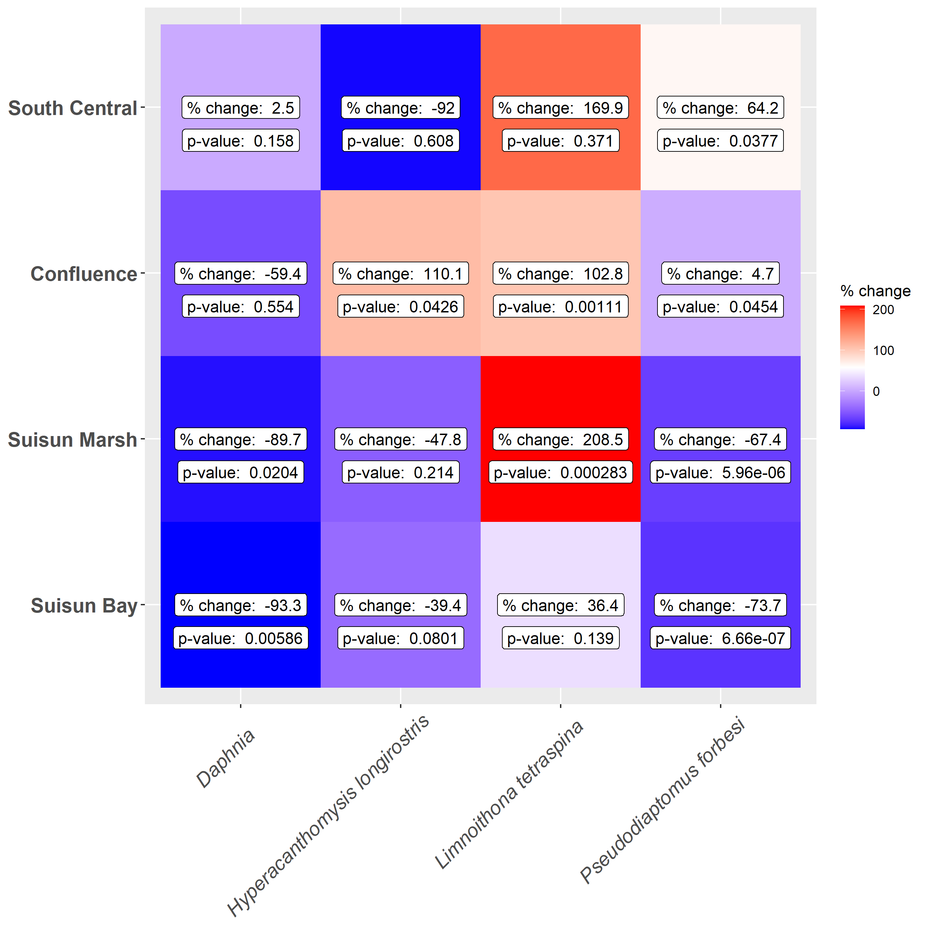
Regional Drought Changes
*
*
*
*
*
*
*
*
Notes:
The table and figure are useful, but I think a simpler table could just be, for species and region, does taxa BPUE increase or decrease during droughts?

Slide 3
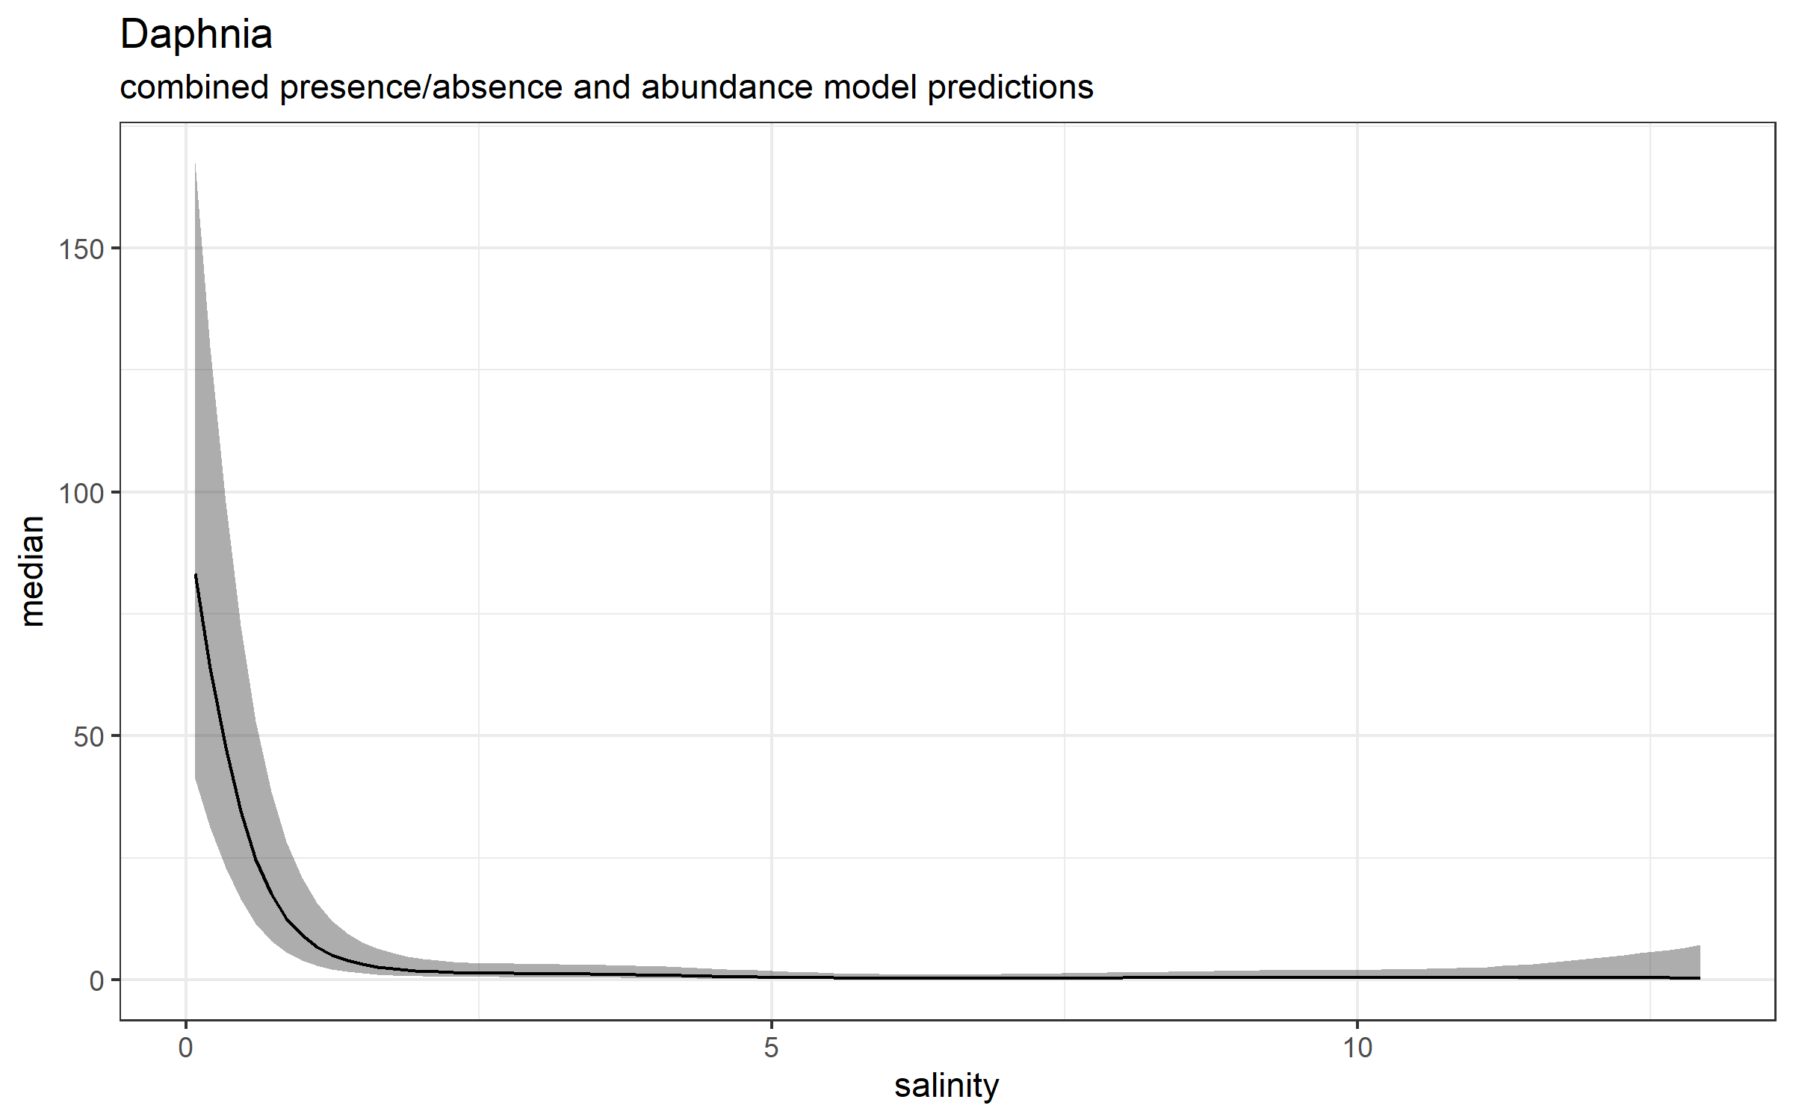
Models: Daphnia
Notes: currently filtered for just May – Nov
Presence/Absence
Family: binomial
Link function: logit
Formula:
Presence ~ s(salinity)
Parametric coefficients:
Estimate Std. Error z value Pr(>|z|)
(Intercept) -2.620 0.228 -11.49 <2e-16 ***
---
Signif. codes: 0 ‘***’ 0.001 ‘**’ 0.01 ‘*’ 0.05 ‘.’ 0.1 ‘ ’ 1
Approximate significance of smooth terms:
edf Ref.df Chi.sq p-value
s(salinity) 5.942 6.72 537.5 <2e-16 ***
---
Signif. codes: 0 ‘***’ 0.001 ‘**’ 0.01 ‘*’ 0.05 ‘.’ 0.1 ‘ ’ 1
R-sq.(adj) = 0.239 Deviance explained = 27.1%
UBRE = -0.32737 Scale est. = 1 n = 4249
Abundance of presence only
Family: Negative Binomial(0.666)
Link function: log
Formula:
BPUE ~ s(salinity) + s(month, k = 5) + s(Station, bs = "re")
Parametric coefficients:
Estimate Std. Error z value Pr(>|z|)
(Intercept) 4.9831 0.3592 13.87 <2e-16 ***
---
Signif. codes: 0 ‘***’ 0.001 ‘**’ 0.01 ‘*’ 0.05 ‘.’ 0.1 ‘ ’ 1
Approximate significance of smooth terms:
edf Ref.df Chi.sq p-value
s(salinity) 3.403 4.229 51.25 4.43e-10 ***
s(month) 3.903 3.994 450.49 < 2e-16 ***
s(Station) 13.114 14.000 1008.88 < 2e-16 ***
---
Signif. codes: 0 ‘***’ 0.001 ‘**’ 0.01 ‘*’ 0.05 ‘.’ 0.1 ‘ ’ 1
R-sq.(adj) = 0.161 Deviance explained = 61.1%
-REML = 5143.9 Scale est. = 1 n = 731

Slide 4
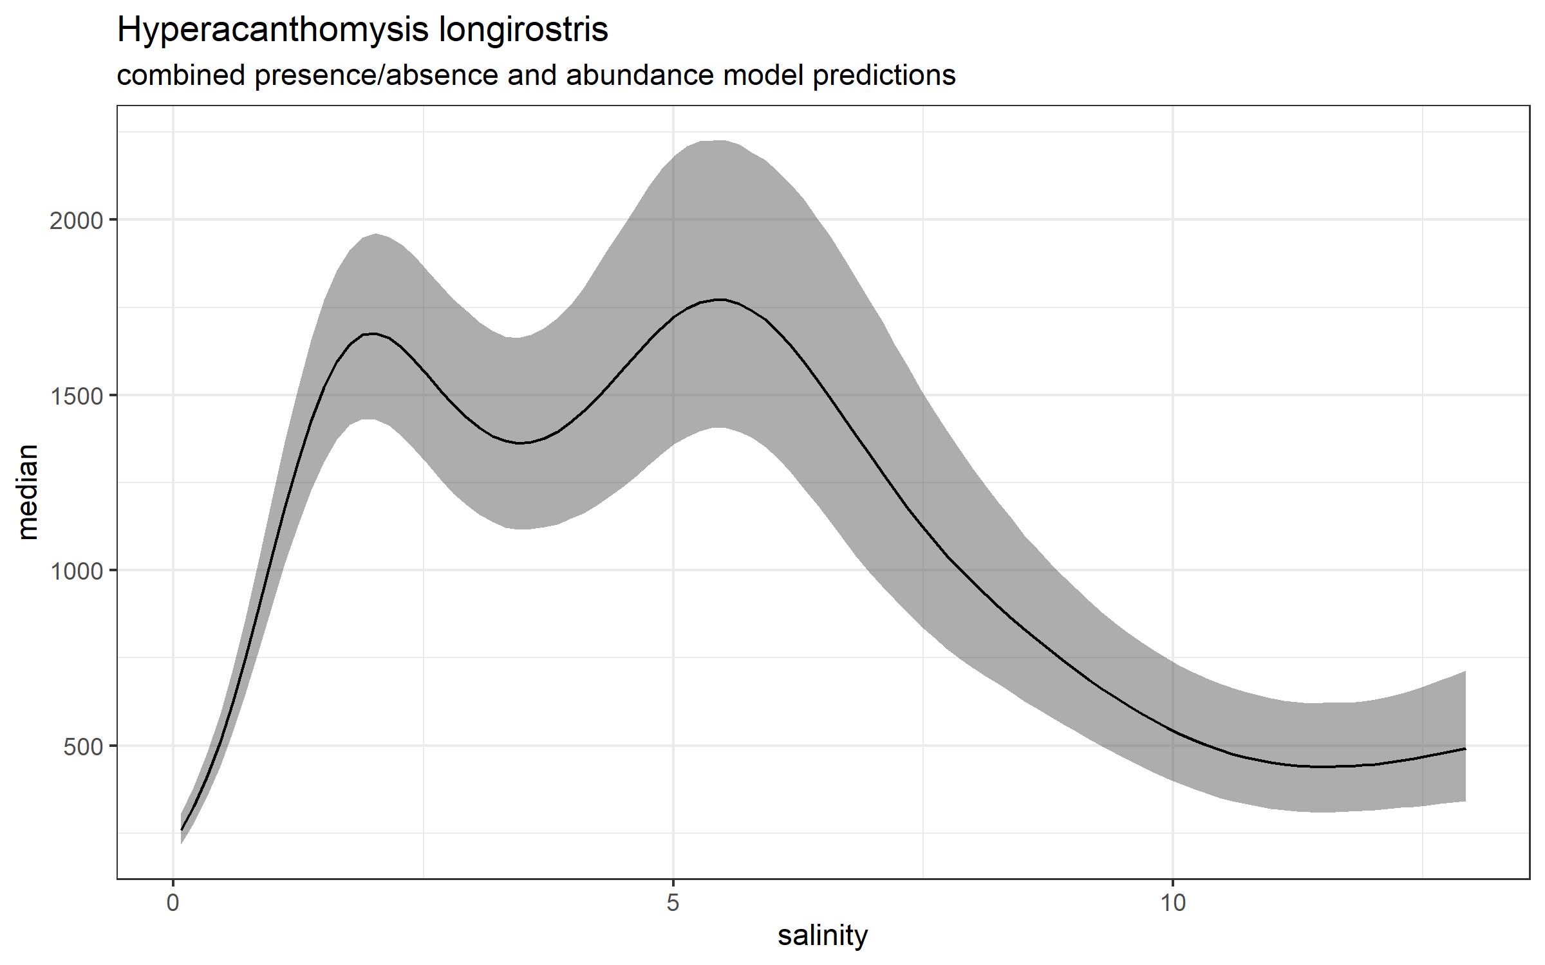
Models: Hyperacanthomysis longirostris
Presence/Absence
Family: binomial
Link function: logit
Formula:
Presence ~ s(salinity)
Parametric coefficients:
Estimate Std. Error z value Pr(>|z|)
(Intercept) -0.22970 0.03148 -7.296 2.97e-13 ***
---
Signif. codes: 0 ‘***’ 0.001 ‘**’ 0.01 ‘*’ 0.05 ‘.’ 0.1 ‘ ’ 1
Approximate significance of smooth terms:
edf Ref.df Chi.sq p-value
s(salinity) 8.059 8.751 150.1 <2e-16 ***
---
Signif. codes: 0 ‘***’ 0.001 ‘**’ 0.01 ‘*’ 0.05 ‘.’ 0.1 ‘ ’ 1
R-sq.(adj) = 0.035 Deviance explained = 2.74%
UBRE = 0.34084 Scale est. = 1 n = 4249
Notes: currently filtered for just May – Nov
Abundance of presence only
Family: Negative Binomial(0.331)
Link function: log
Formula:
BPUE ~ s(salinity) + s(month, k = 5)
Parametric coefficients:
Estimate Std. Error z value Pr(>|z|)
(Intercept) 7.39772 0.03996 185.1 <2e-16 ***
---
Signif. codes: 0 ‘***’ 0.001 ‘**’ 0.01 ‘*’ 0.05 ‘.’ 0.1 ‘ ’ 1
Approximate significance of smooth terms:
edf Ref.df Chi.sq p-value
s(salinity) 7.649 8.542 172.4 <2e-16 ***
s(month) 2.676 3.193 231.8 <2e-16 ***
---
Signif. codes: 0 ‘***’ 0.001 ‘**’ 0.01 ‘*’ 0.05 ‘.’ 0.1 ‘ ’ 1
R-sq.(adj) = 0.0634 Deviance explained = 13%
-REML = 14710 Scale est. = 1 n = 1892

Slide 5
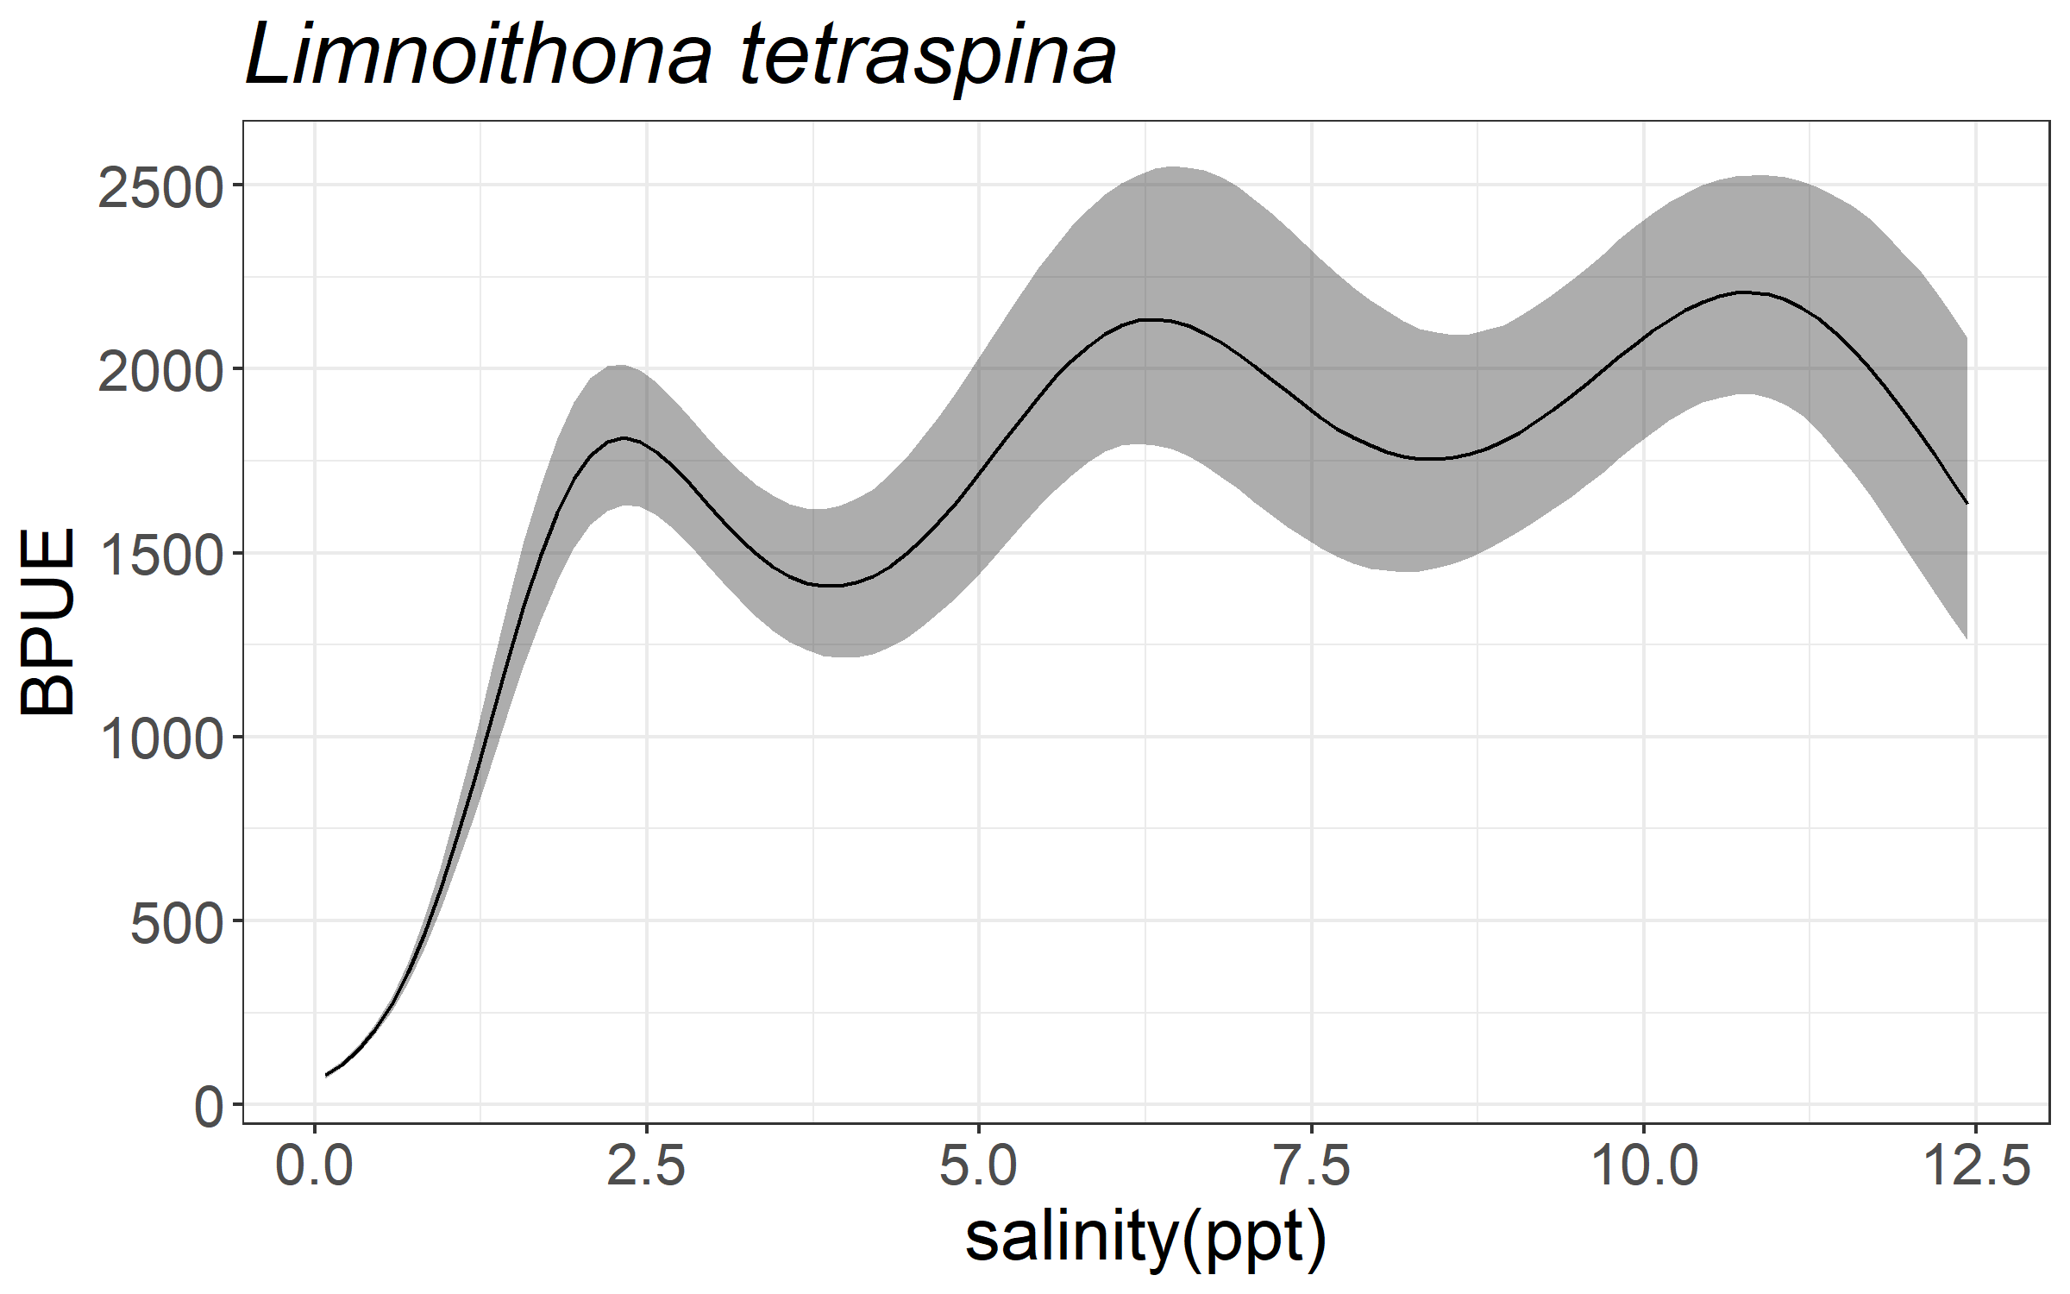
Models: Limnoithona tetraspina
Presence/Absence
Family: binomial
Link function: logit
Formula:
Presence ~ s(salinity)
Parametric coefficients:
Estimate Std. Error z value Pr(>|z|)
(Intercept) -0.42253 0.02527 -16.72 <2e-16 ***
---
Signif. codes: 0 ‘***’ 0.001 ‘**’ 0.01 ‘*’ 0.05 ‘.’ 0.1 ‘ ’ 1
Approximate significance of smooth terms:
edf Ref.df Chi.sq p-value
s(salinity) 8.488 8.923 242.3 <2e-16 ***
---
Signif. codes: 0 ‘***’ 0.001 ‘**’ 0.01 ‘*’ 0.05 ‘.’ 0.1 ‘ ’ 1
R-sq.(adj) = 0.0356 Deviance explained = 2.81%
UBRE = 0.31076 Scale est. = 1 n = 6827
Notes: currently filtered for just May – Nov
Abundance of presence only
Family: Negative Binomial(0.92)
Link function: log
Formula:
BPUE ~ s(salinity) + s(month, k = 5)
Parametric coefficients:
Estimate Std. Error z value Pr(>|z|)
(Intercept) 7.28671 0.01997 364.8 <2e-16 ***
---
Signif. codes: 0 ‘***’ 0.001 ‘**’ 0.01 ‘*’ 0.05 ‘.’ 0.1 ‘ ’ 1
Approximate significance of smooth terms:
edf Ref.df Chi.sq p-value
s(salinity) 8.745 8.981 2569.7 <2e-16 ***
s(month) 3.908 3.995 810.3 <2e-16 ***
---
Signif. codes: 0 ‘***’ 0.001 ‘**’ 0.01 ‘*’ 0.05 ‘.’ 0.1 ‘ ’ 1
R-sq.(adj) = 0.416 Deviance explained = 46.7%
-REML = 22650 Scale est. = 1 n = 2729

Slide 6
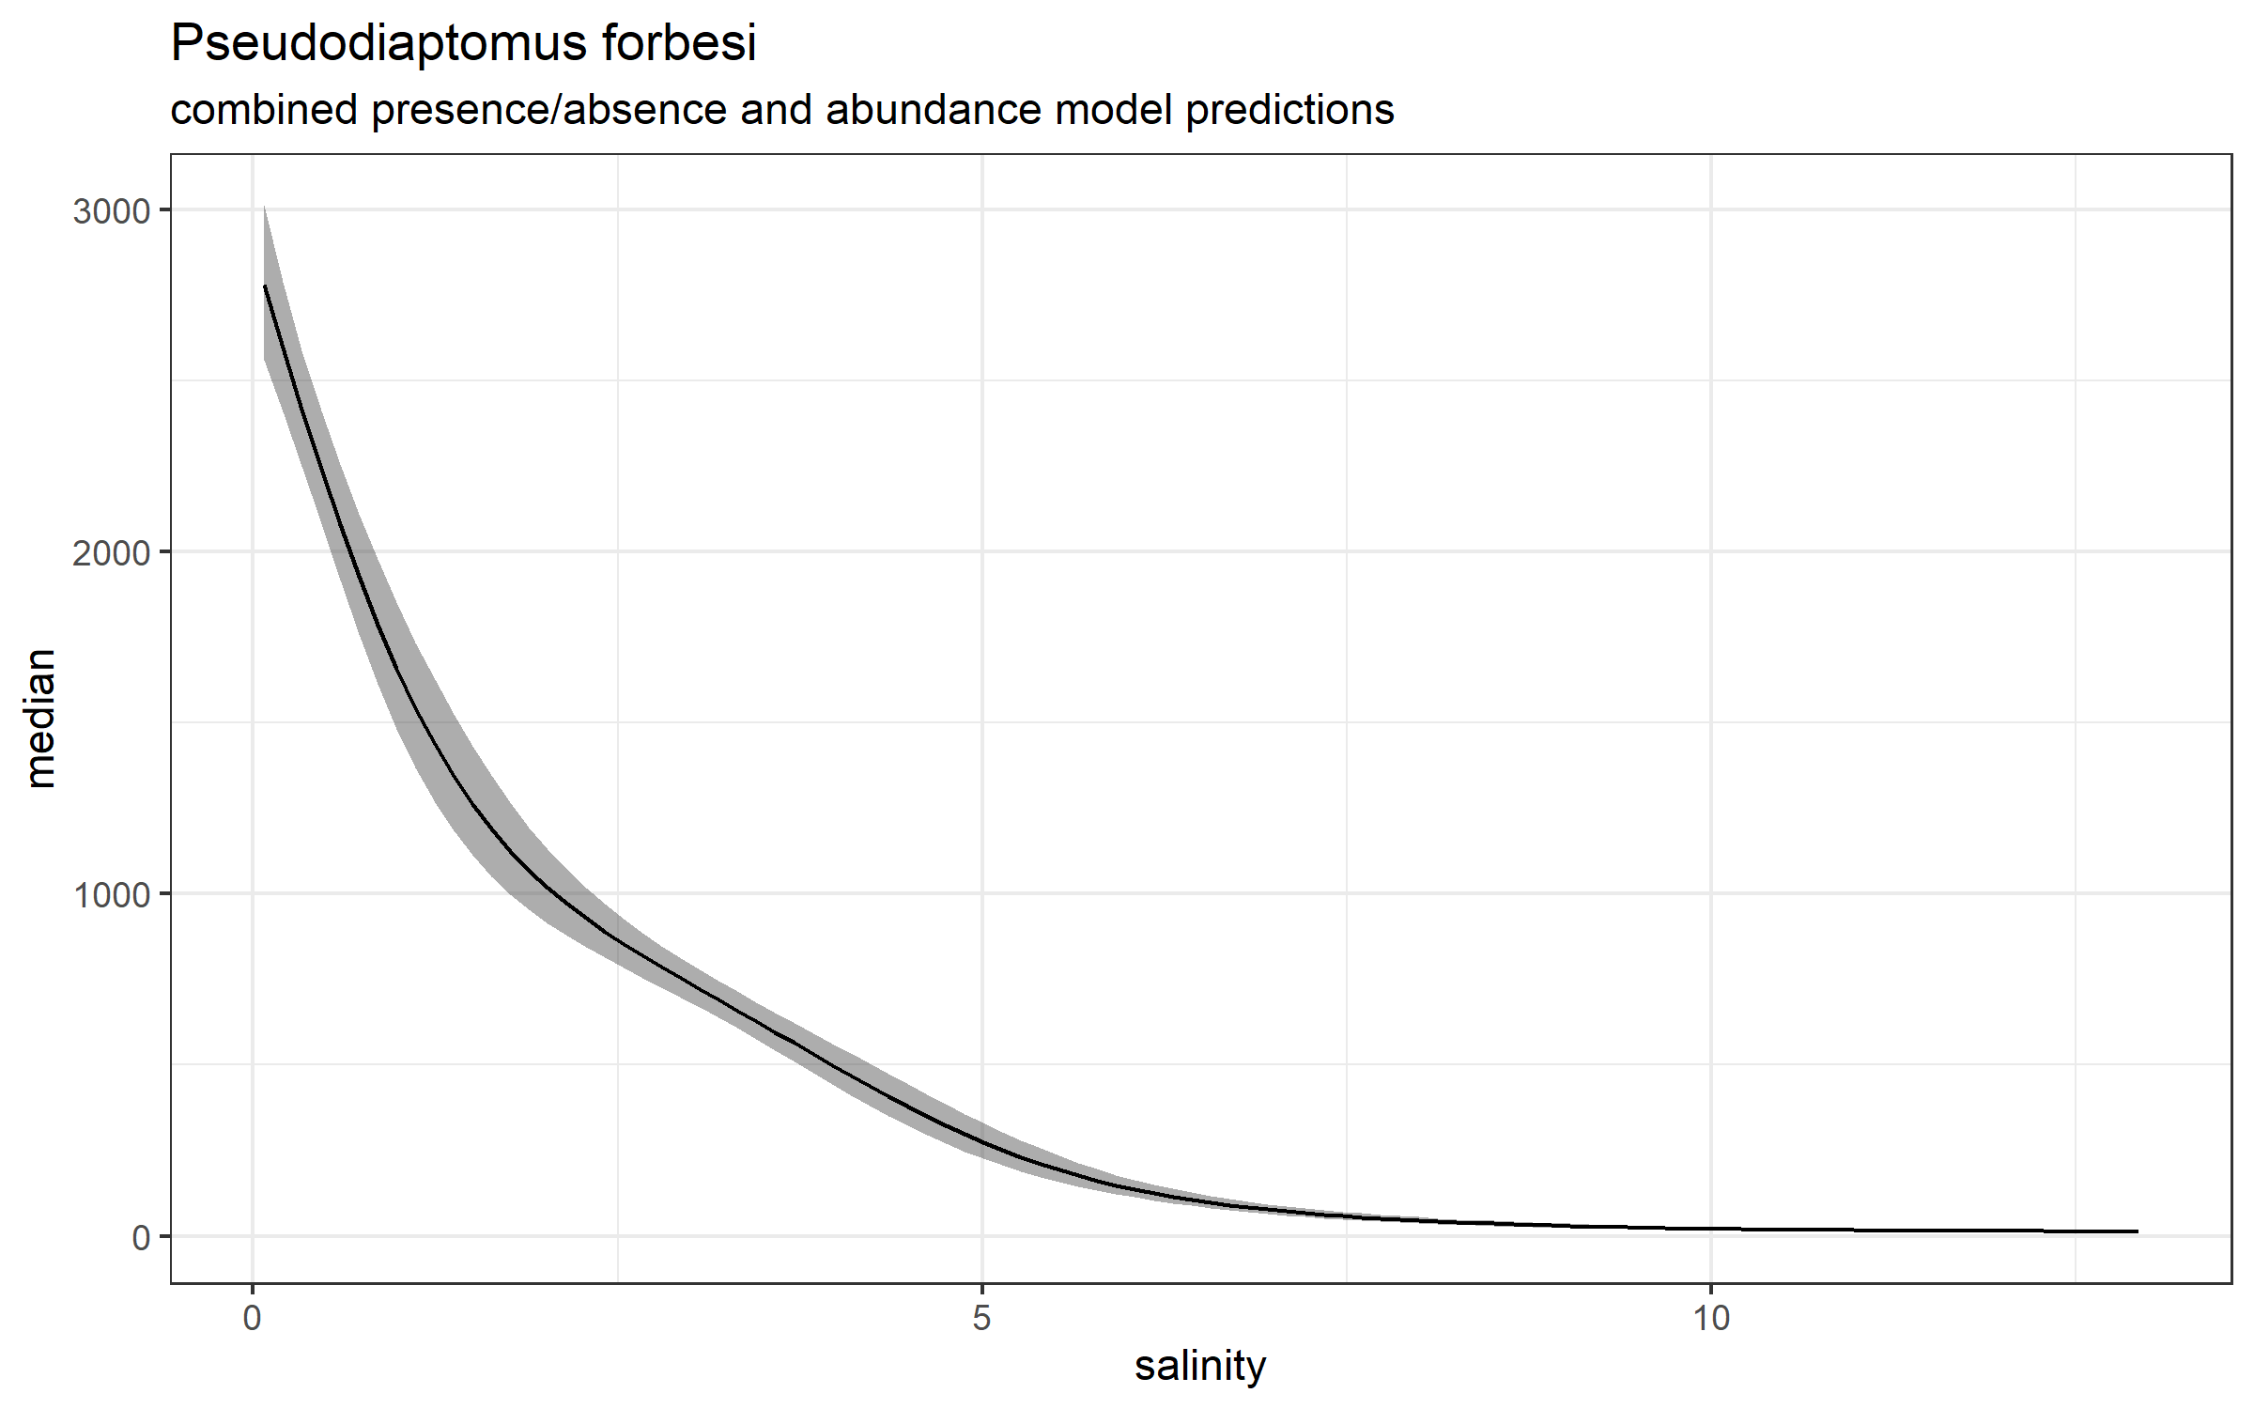
Models: Pseudodiaptomus forbesi
Presence/Absence
Family: binomial
Link function: logit
Formula:
Presence ~ s(salinity)
Parametric coefficients:
Estimate Std. Error z value Pr(>|z|)
(Intercept) 0.1015 0.0313 3.242 0.00119 **
---
Signif. codes: 0 ‘***’ 0.001 ‘**’ 0.01 ‘*’ 0.05 ‘.’ 0.1 ‘ ’ 1
Approximate significance of smooth terms:
edf Ref.df Chi.sq p-value
s(salinity) 8.209 8.83 149.9 <2e-16 ***
---
Signif. codes: 0 ‘***’ 0.001 ‘**’ 0.01 ‘*’ 0.05 ‘.’ 0.1 ‘ ’ 1
R-sq.(adj) = 0.0353 Deviance explained = 2.73%
UBRE = 0.35058 Scale est. = 1 n = 4249
Notes: currently filtered for just May – Nov
Abundance of presence only
Family: Negative Binomial(0.912)
Link function: log
Formula:
BPUE ~ s(salinity) + s(month, k = 5)
Parametric coefficients:
Estimate Std. Error z value Pr(>|z|)
(Intercept) 7.14181 0.02225 321 <2e-16 ***
---
Signif. codes: 0 ‘***’ 0.001 ‘**’ 0.01 ‘*’ 0.05 ‘.’ 0.1 ‘ ’ 1
Approximate significance of smooth terms:
edf Ref.df Chi.sq p-value
s(salinity) 6.264 7.420 5429.2 <2e-16 ***
s(month) 3.915 3.995 170.2 <2e-16 ***
---
Signif. codes: 0 ‘***’ 0.001 ‘**’ 0.01 ‘*’ 0.05 ‘.’ 0.1 ‘ ’ 1
R-sq.(adj) = 0.184 Deviance explained = 55%
-REML = 18159 Scale est. = 1 n = 2227

Slide 7
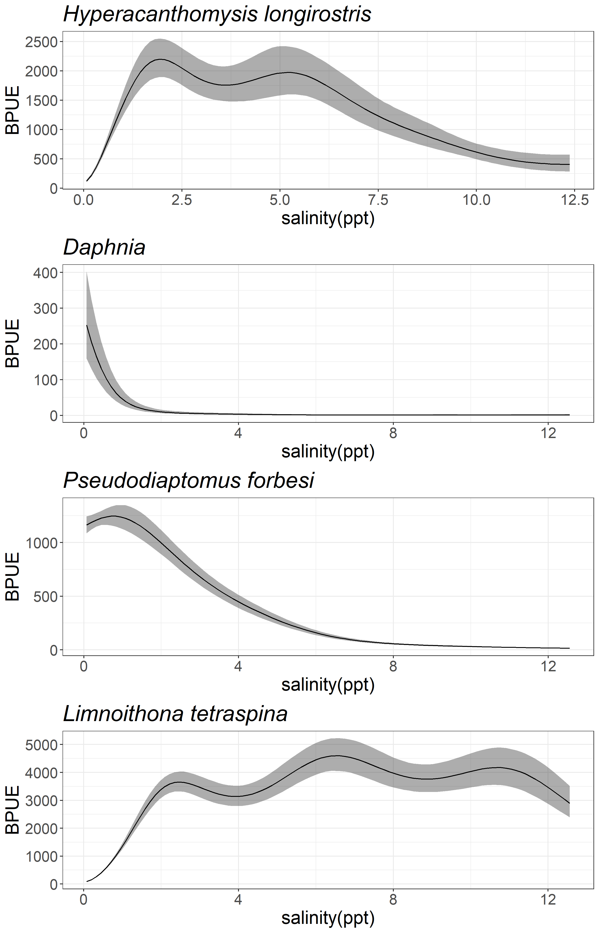
Models: Summary/Figure
Taxa | Model | P-value | R-sq.(adj)
Daphnia spp. | Presence ~ s(salinity) | <2e-16 | 0.239
Daphnia spp. | BPUE ~ s(salinity) + s(month, k = 5) + s(Station, bs = "re") | <2e-16 | 0.161
H. longirostris | Presence ~ s(salinity) | <2e-16 | 0.035
H. longirostris | BPUE ~ s(salinity) + s(month, k = 5) | <2e-16 | 0.0634
L. tetraspina | Presence ~ s(salinity) | <2e-16 | 0.0248
L. tetraspina | BPUE ~ s(salinity) + s(month, k = 5) | <2e-16 | 0.351
P. forbesi | Presence ~ s(salinity) | 0.00119 | 0.0353
P. forbesi | BPUE ~ s(salinity) + s(month, k = 5) | <2e-16 | 0.184

Slide 8
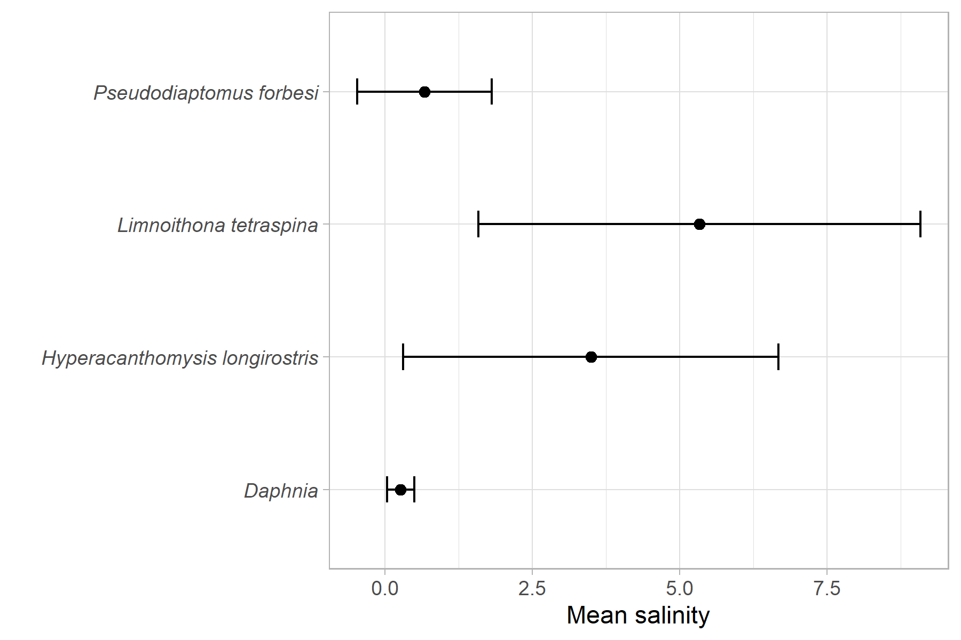
‘Preferred’ salinity ranges
Salinity range:
weighted mean +/- standard deviation

Slide 9
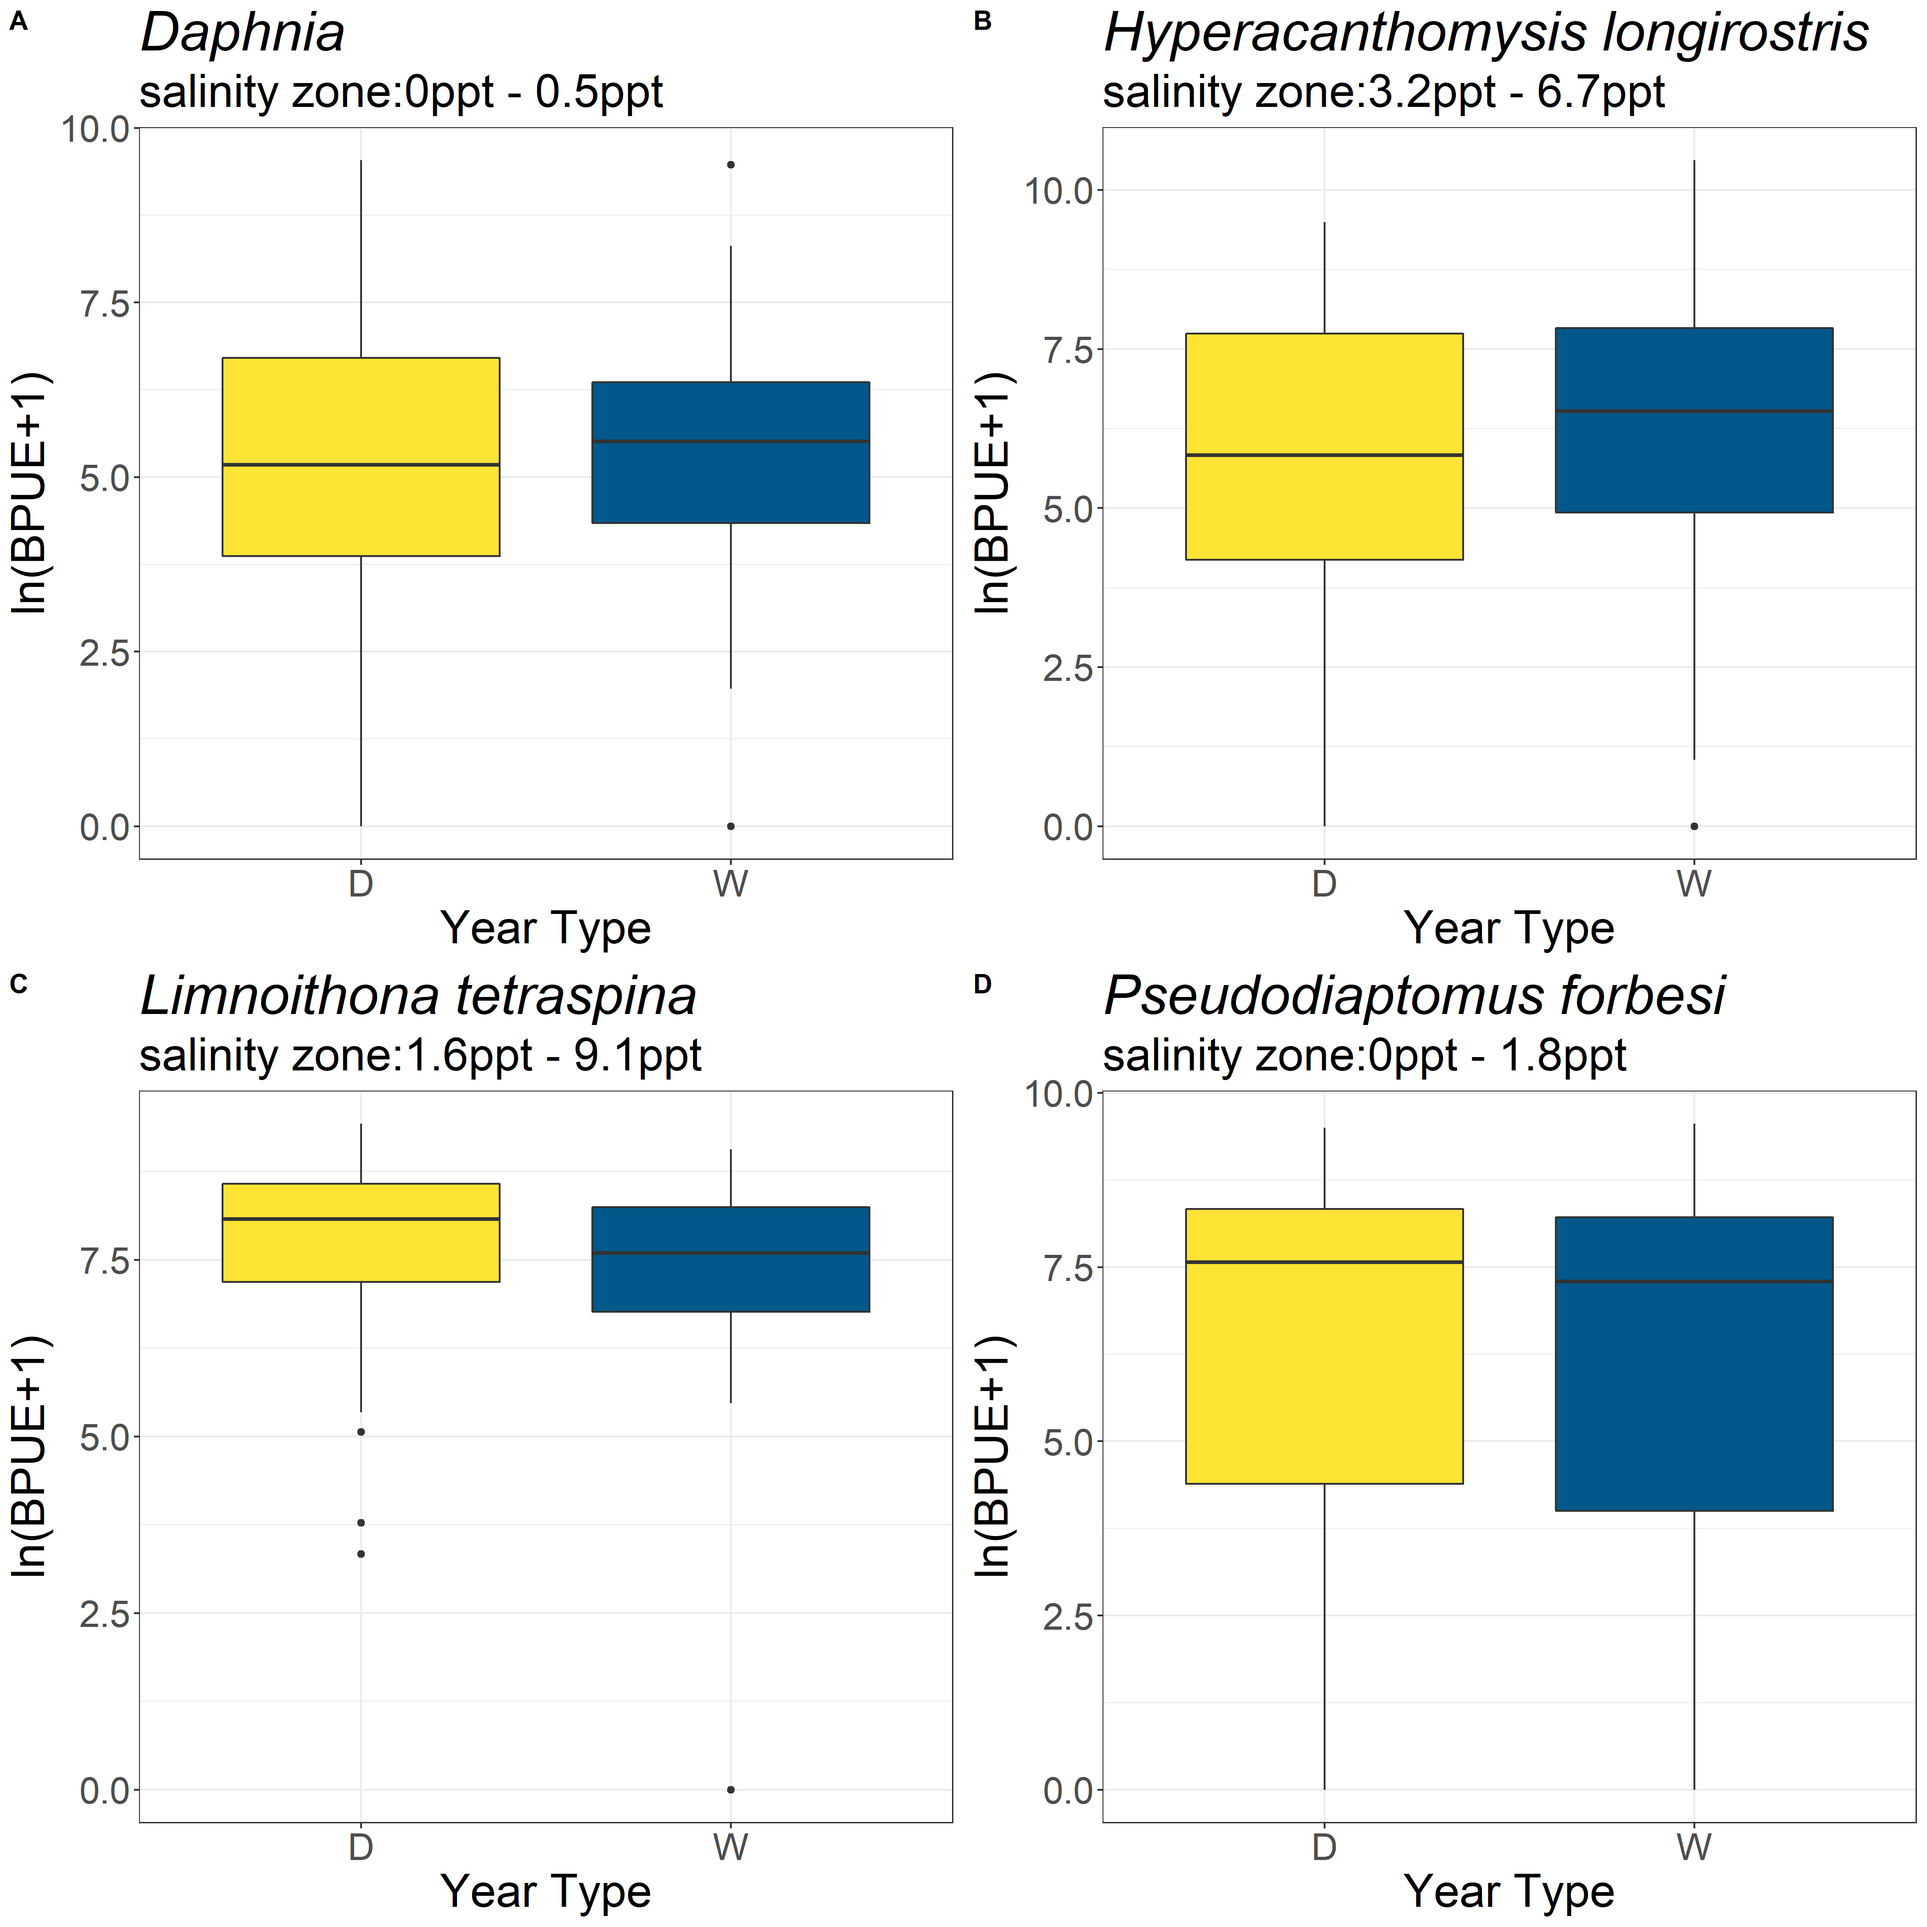
BPUE variance within ‘preferred’ salinity zone
Taxa | Model | W-D Tukey p-value
Daphnia | aov(log(BPUE + 1) ~ Drought) | 0.5612784
H. longirostris | aov(log(BPUE + 1) ~ Drought) | 0.309038
L. tetraspina | aov(log(BPUE + 1) ~ Drought) | 0.00552
P. forbesi | aov(log(BPUE + 1) ~ Drought) | 0.3829747

Slide 10
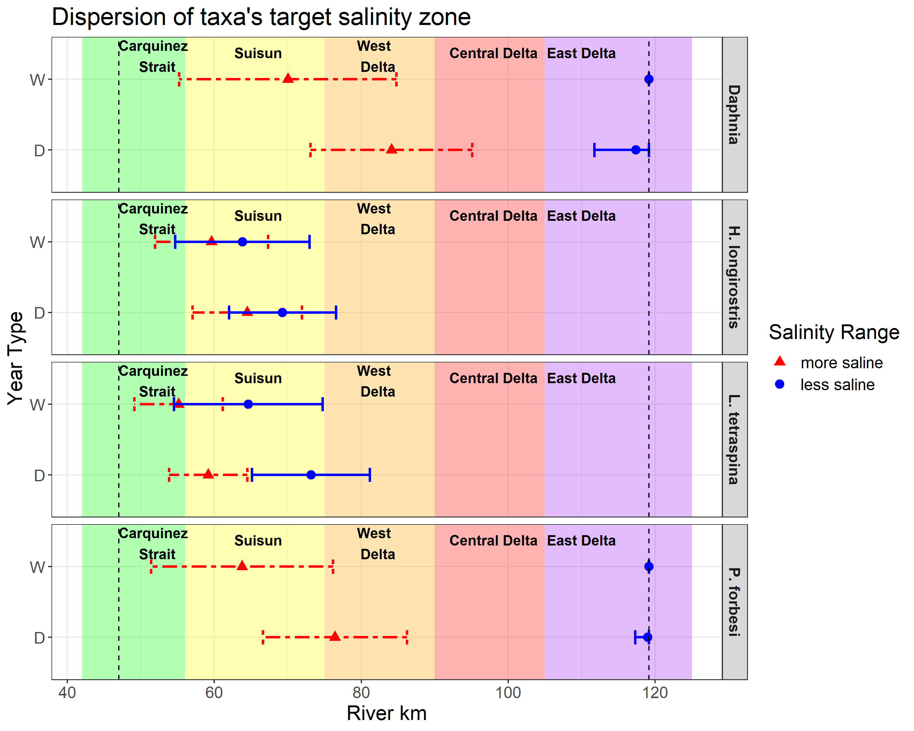

Slide 11
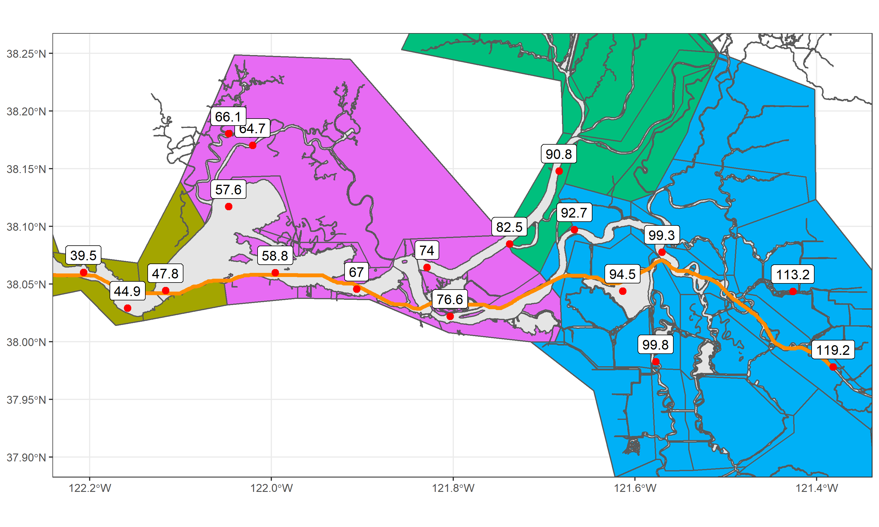

Slide 12
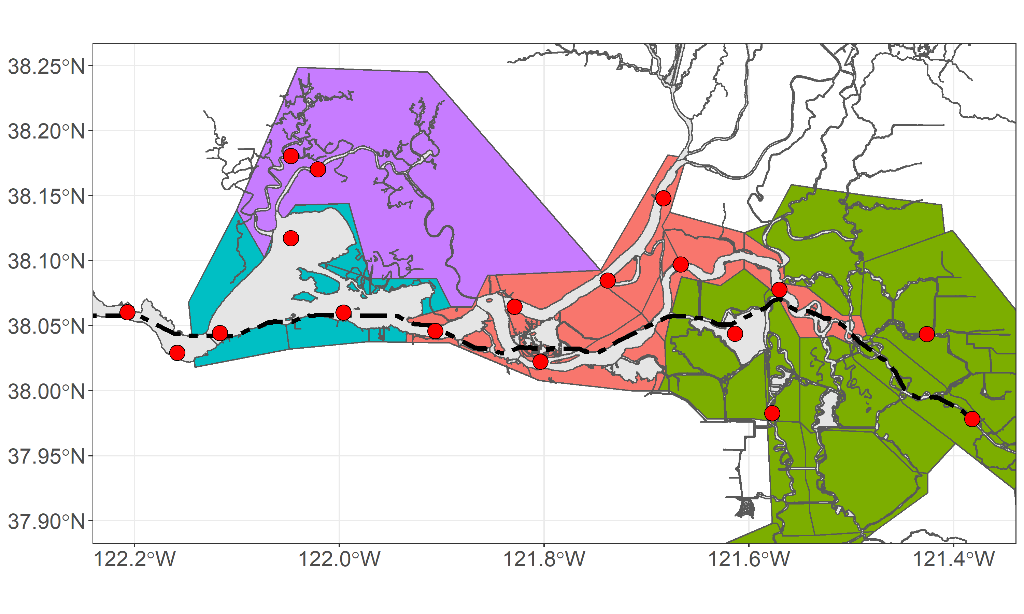
Suisun Marsh
40 RKM
100 RKM
Suisun Bay
Confluence
60 RKM
80 RKM
South Central
120 RKM

Slide 13
