Slide 1
Drought Zooplankton Questions
Limiting to top taxa for four groups (P. forbesi, L. tetraspina, B. longirostris, H. longirostris)
Do we see regional changes in taxa BPUE?
Are there env parameters correlated with higher BPUE?
Does Drought impact the env parameters correlated with higher BPUE?
Are the env parameters for taxa changing, or moving?

Slide 2
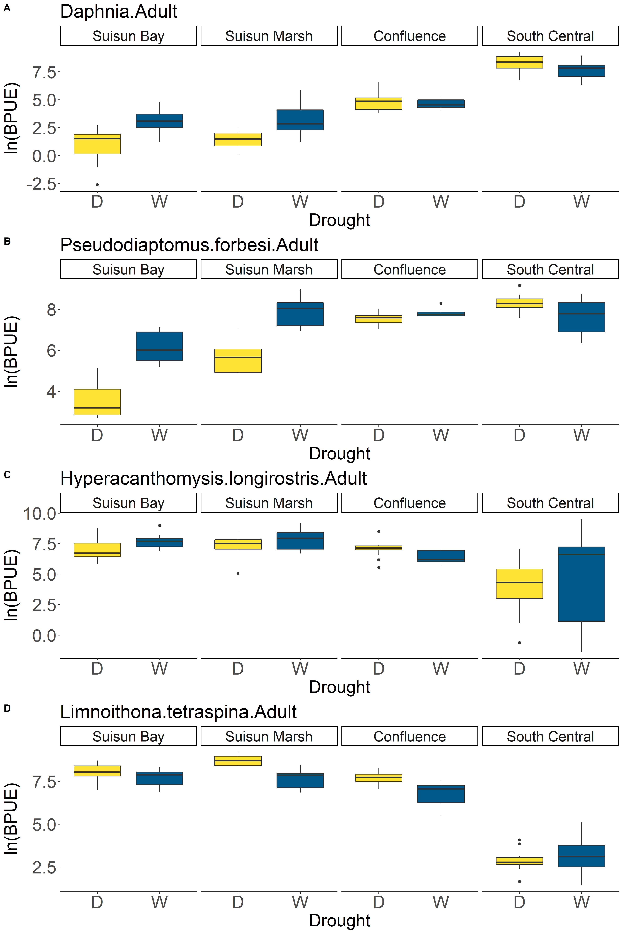
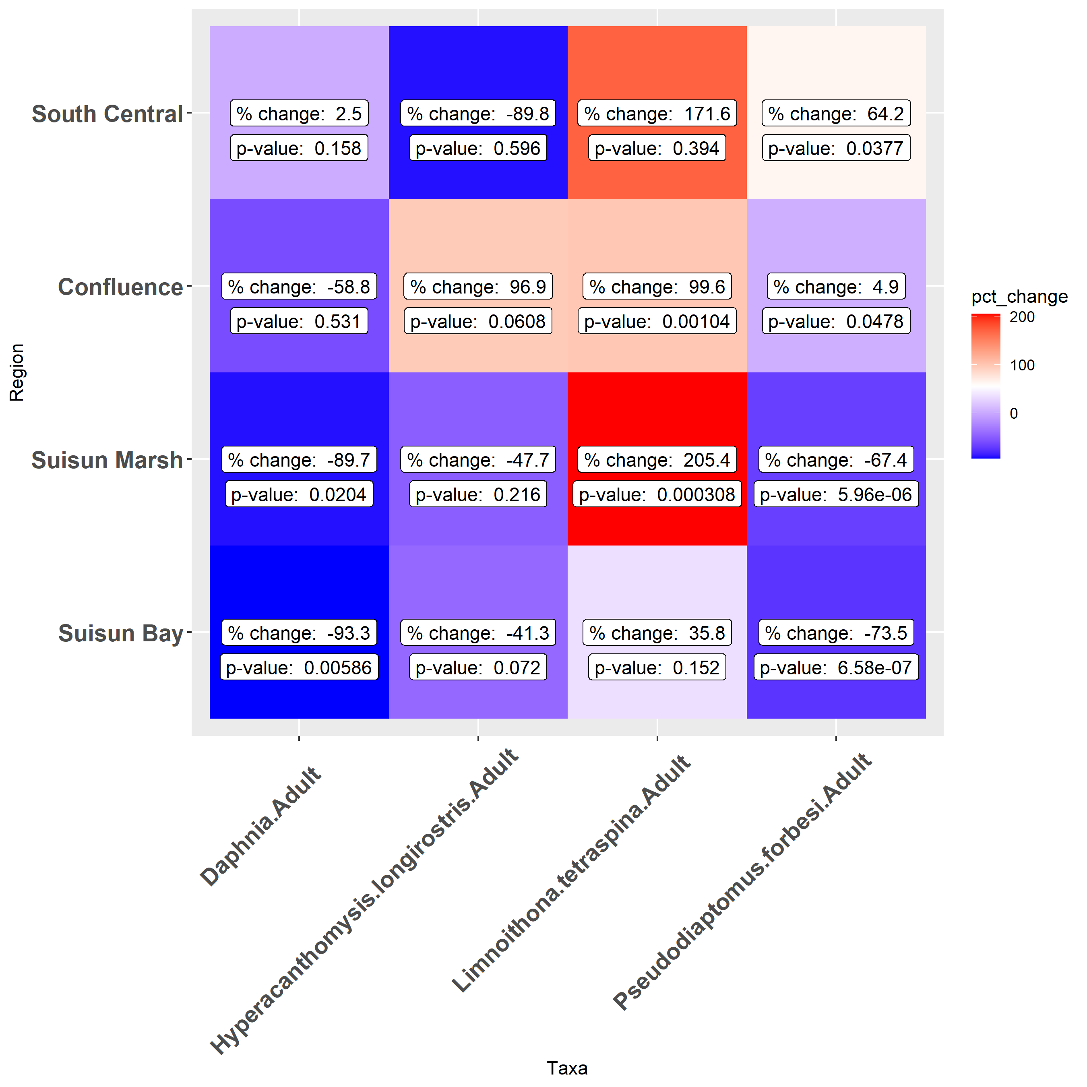
Regional Drought Changes
*
*
*
*
*
*
*
*
*
*
*
*
*
*
*
*
Notes:
The table and figure are useful, but I think a simpler table could just be, for species and region, does taxa BPUE increase or decrease during droughts?

Slide 3
Environmental GAMs
Example: Daphnia
Presence/Absence
Call:
glm(formula = Presence ~ salinity + ns(month, df = 2), family = "binomial",
data = d_pa)
Deviance Residuals:
Min 1Q Median 3Q Max
-1.4019 -0.6713 -0.1825 -0.0119 4.5829
Coefficients:
Estimate Std. Error z value Pr(>|z|)
(Intercept) 0.56076 0.09218 6.083 1.18e-09 ***
salinity -0.76617 0.05143 -14.896 < 2e-16 ***
ns(month, df = 2)1 -3.06174 0.22810 -13.423 < 2e-16 ***
ns(month, df = 2)2 -0.22034 0.15315 -1.439 0.15
---
Signif. codes: 0 ‘***’ 0.001 ‘**’ 0.01 ‘*’ 0.05 ‘.’ 0.1 ‘ ’ 1
(Dispersion parameter for binomial family taken to be 1)
Null deviance: 3901.5 on 4248 degrees of freedom
Residual deviance: 2820.1 on 4245 degrees of freedom
AIC: 2828.1
Number of Fisher Scoring iterations: 8
Presence only
m4.2<-gam(BPUE~s(salinity)+s(month,k=5),random = list(Station = ~1), niterPQL=40,family='nb',data=d_p)
Family: Negative Binomial(0.428)
Link function: log
Formula:
BPUE ~ s(salinity) + s(month, k = 5)
Parametric coefficients:
Estimate Std. Error z value Pr(>|z|)
(Intercept) 6.62377 0.05658 117.1 <2e-16 ***
---
Signif. codes: 0 ‘***’ 0.001 ‘**’ 0.01 ‘*’ 0.05 ‘.’ 0.1 ‘ ’ 1
Approximate significance of smooth terms:
edf Ref.df Chi.sq p-value
s(salinity) 8.885 8.996 533.4 <2e-16 ***
s(month) 3.724 3.953 231.0 <2e-16 ***
---
Signif. codes: 0 ‘***’ 0.001 ‘**’ 0.01 ‘*’ 0.05 ‘.’ 0.1 ‘ ’ 1
R-sq.(adj) = 0.062 Deviance explained = 34.6%
-REML = 5368.5 Scale est. = 1 n = 731
Notes:
currently filtered for just May – Nov
For glm, when

Slide 4
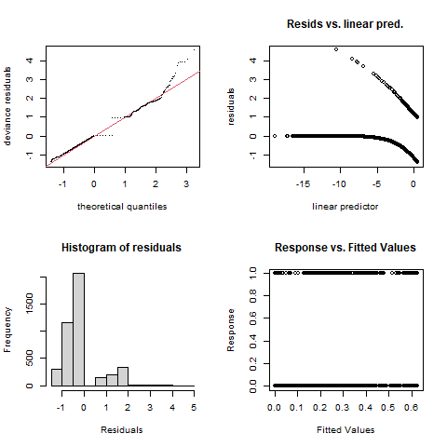
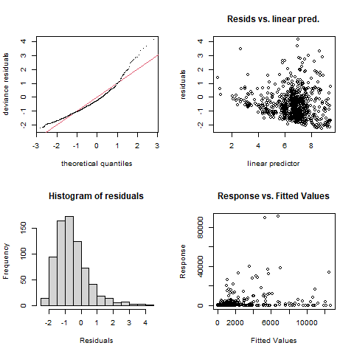
Environmental GAMs
Example: Daphnia
Logistic model (presence/absence)
Negative binomial (just presence)

Slide 5
Taxa | Binomial Presence Absence | Presence negative binomial
Daphnia | salinity, month | salinity, month
H. longirostris | salinity, month | Salinity, month
L. tetraspina | salinity, month | salinity, month
P. forebesi | salinity, month | salinity, month

Slide 6
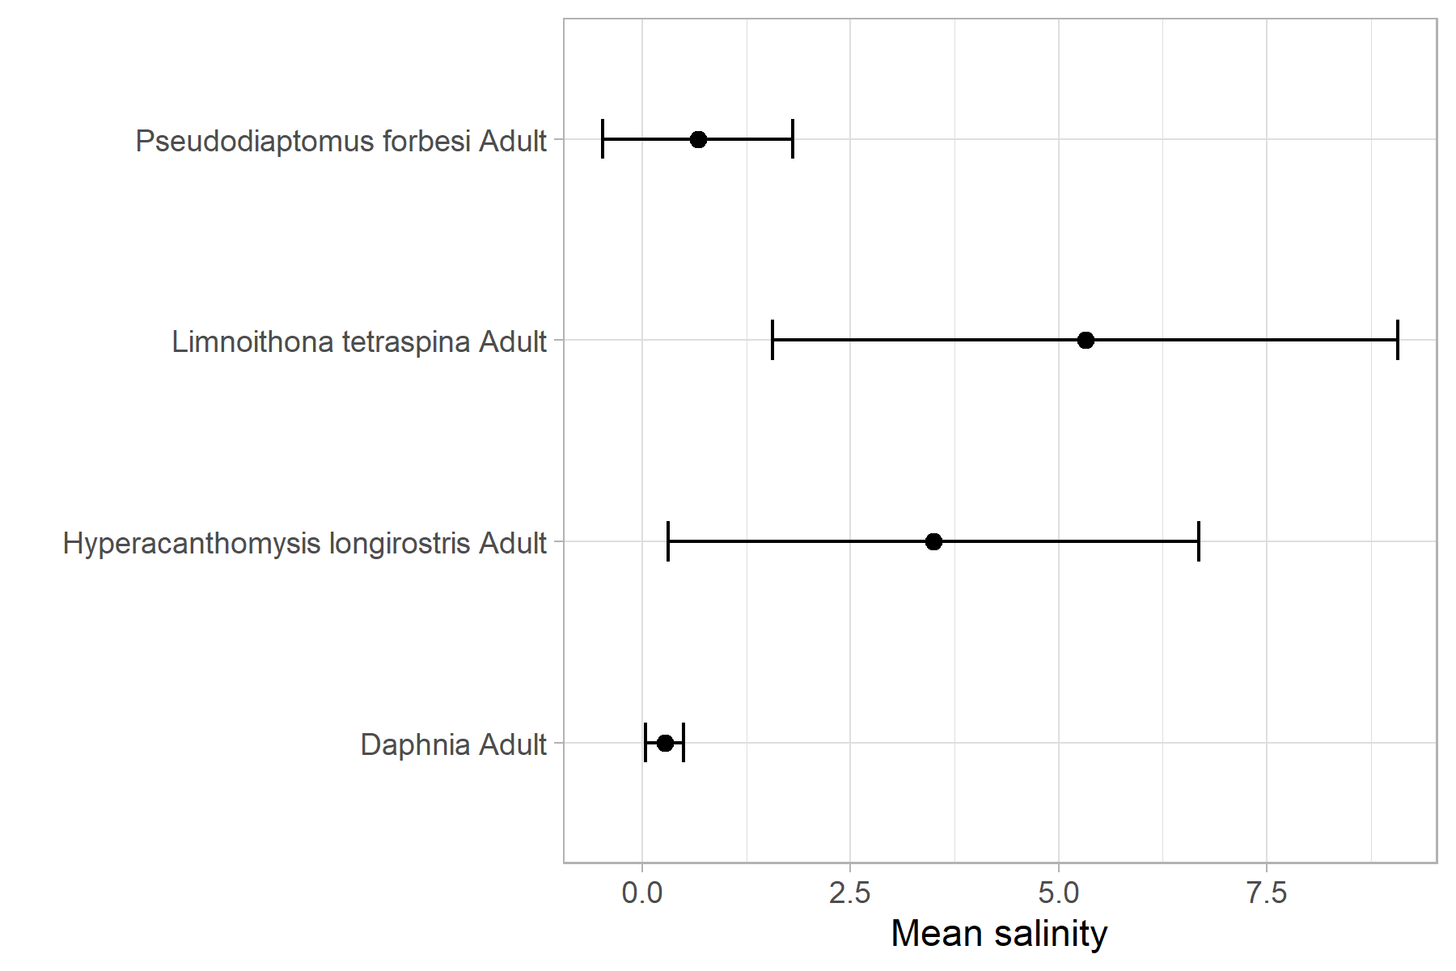
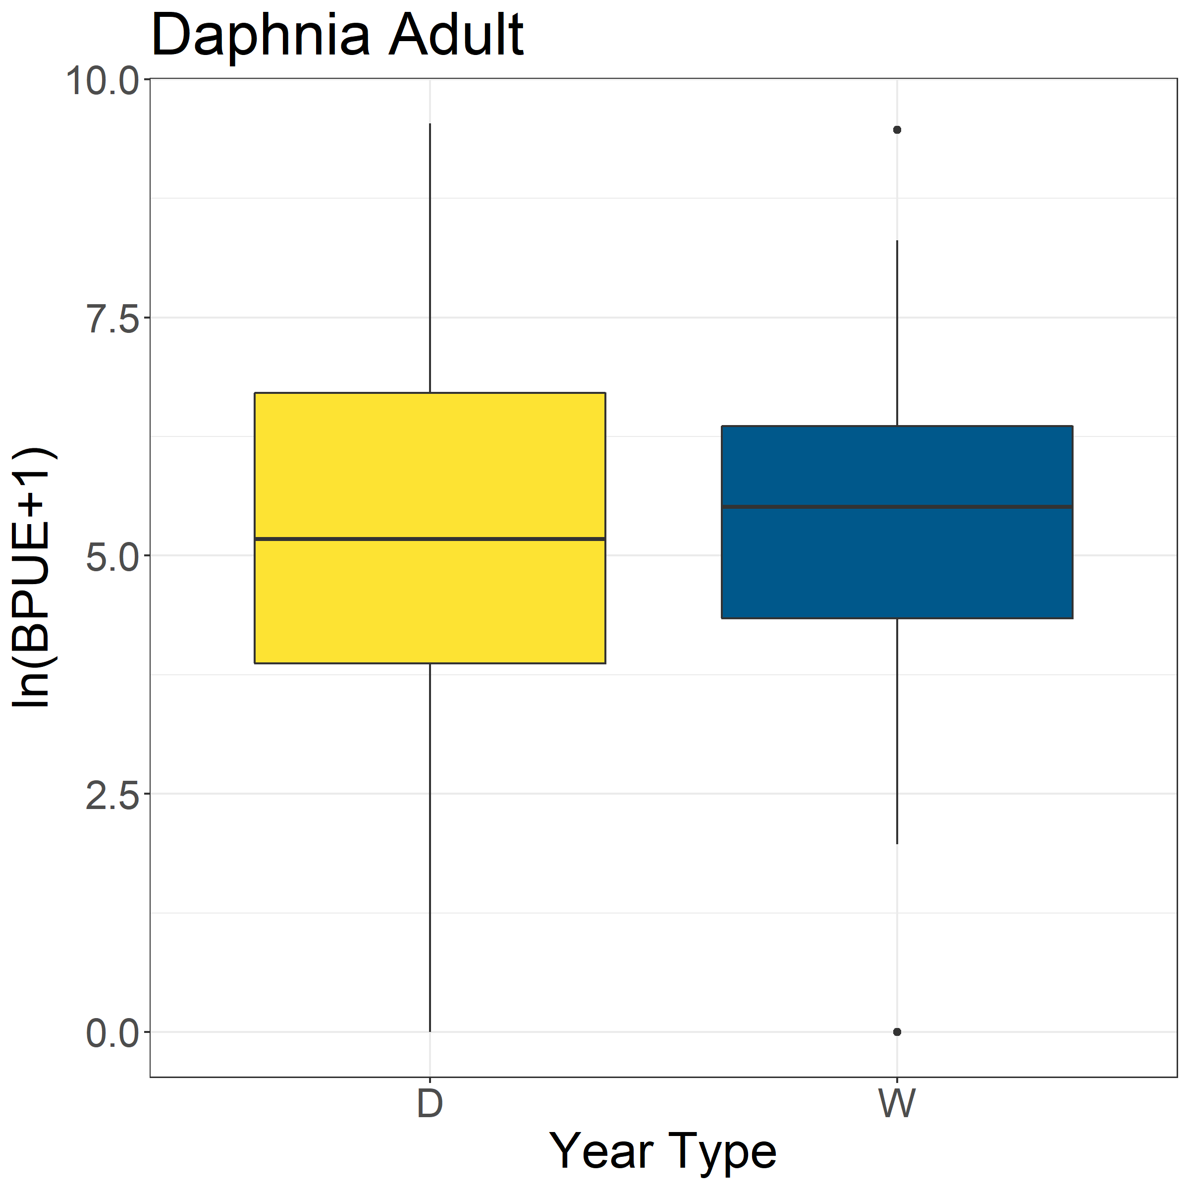
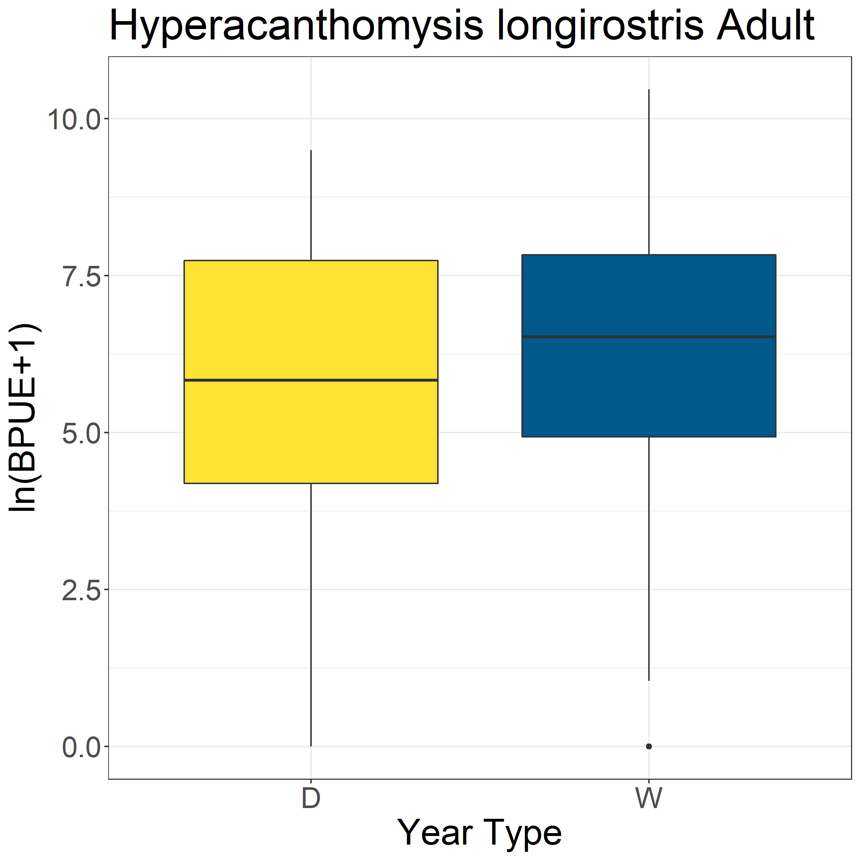
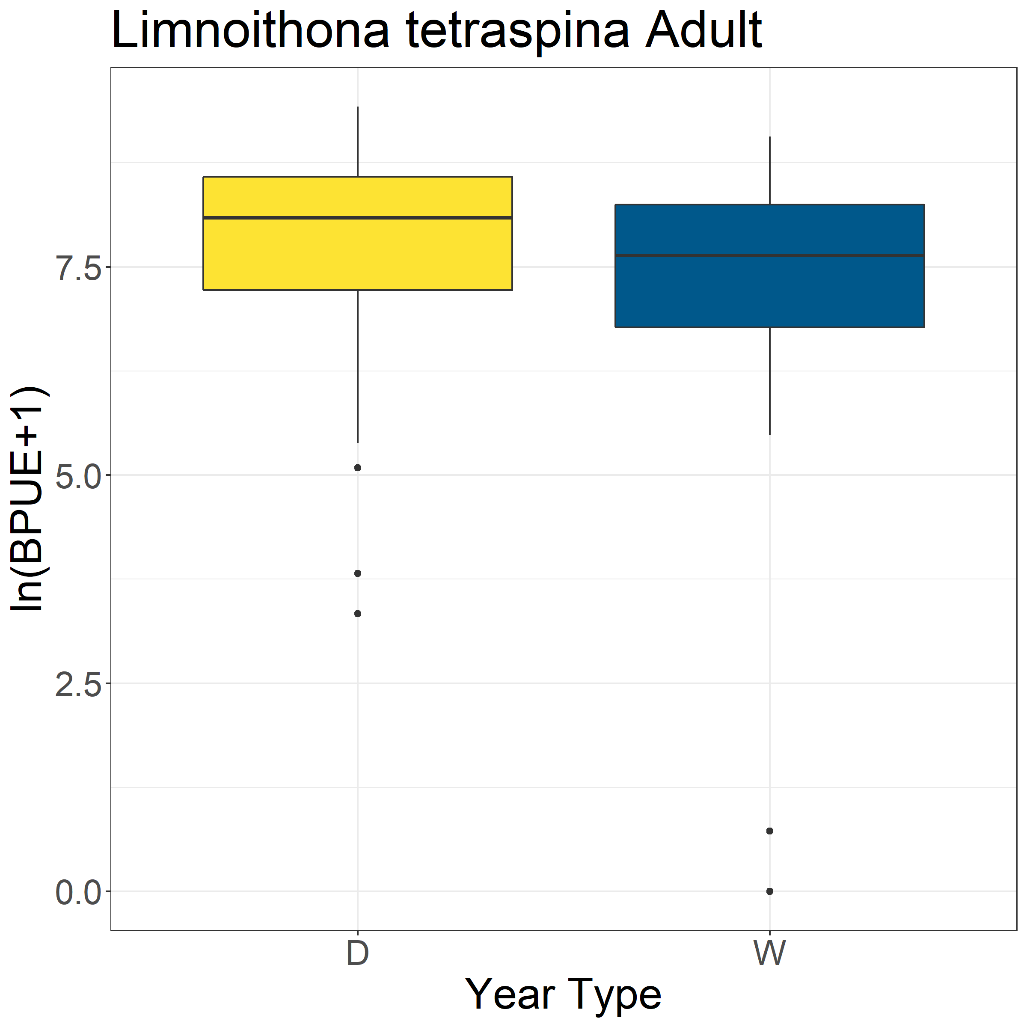
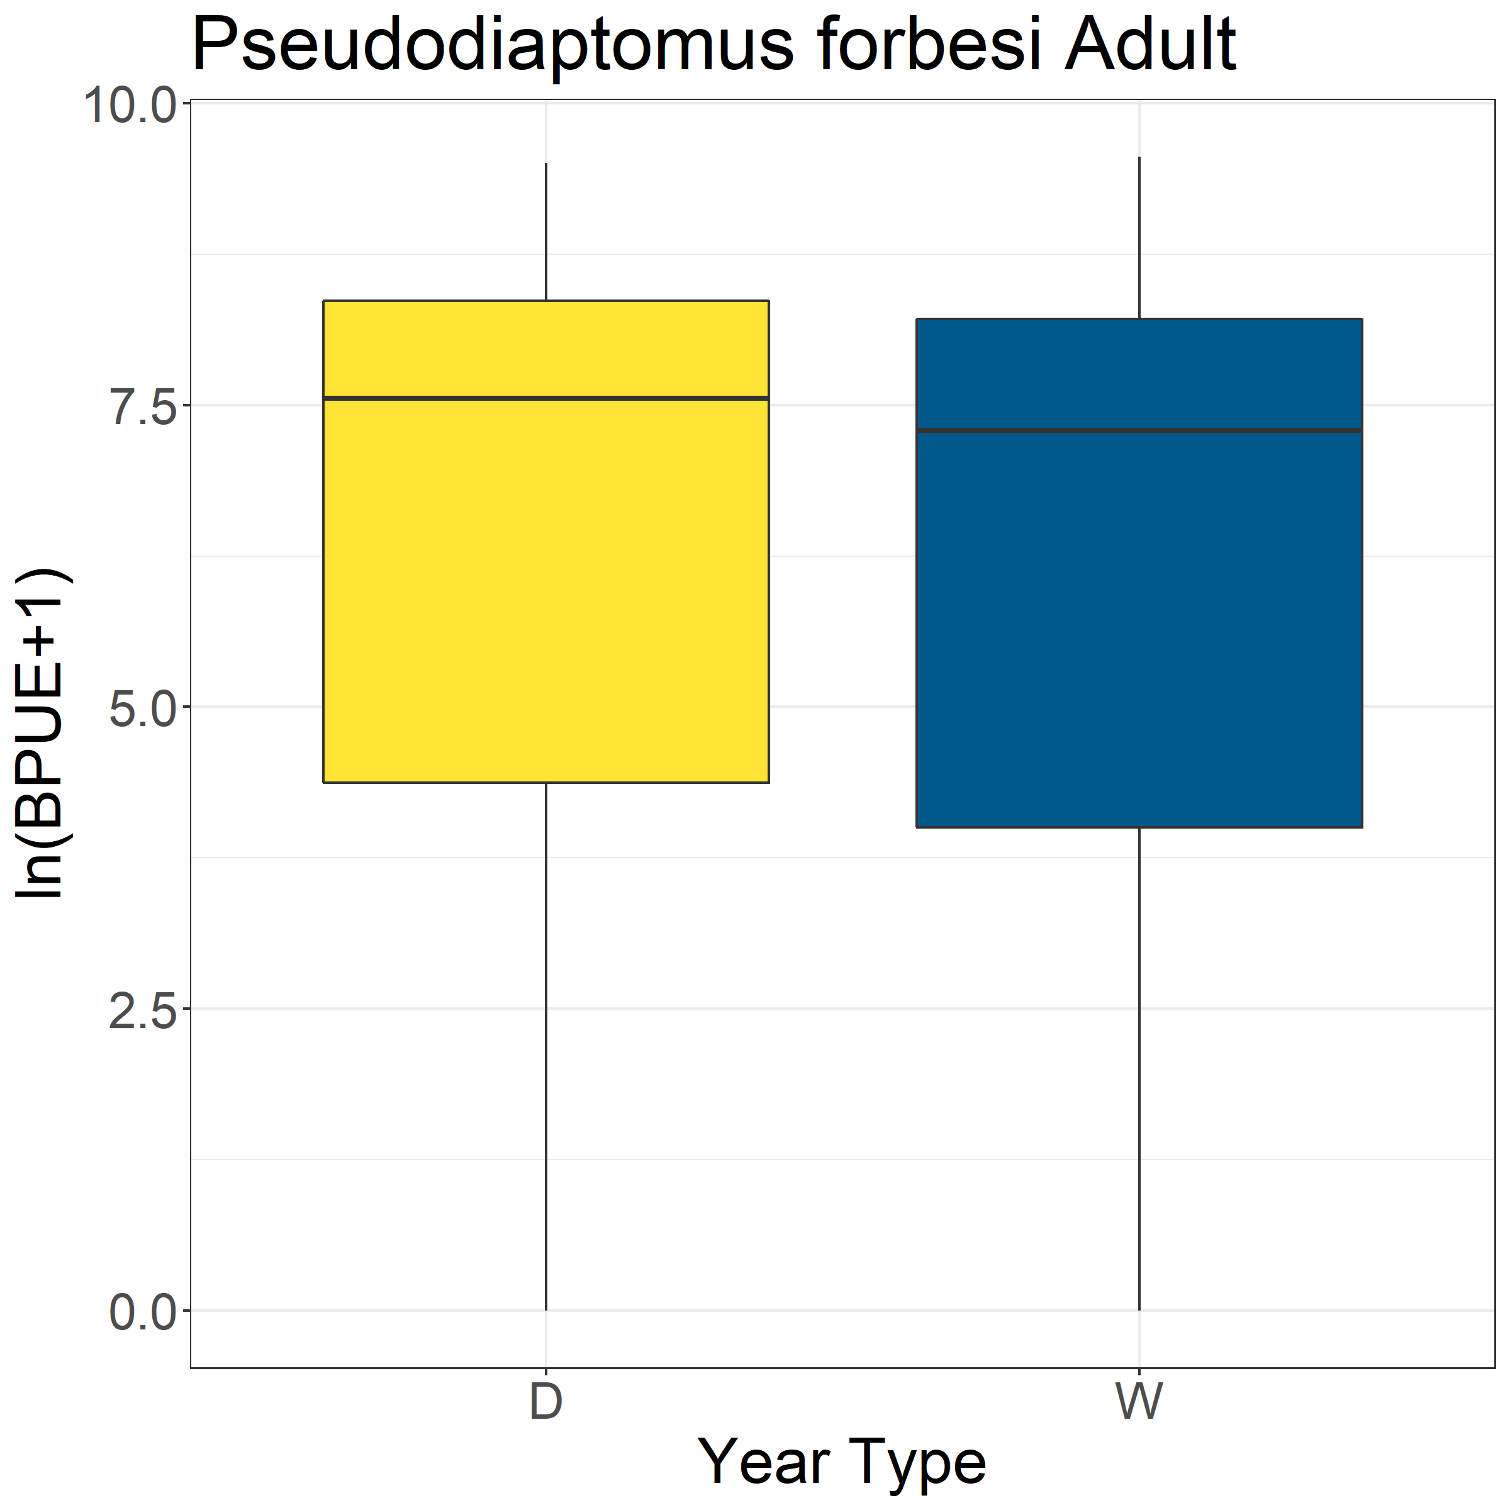
*

Slide 7
