Slide 1
Drought Zooplankton Questions
Limiting to top taxa for four groups (P. forbesi, L. tetraspina, B. longirostris, H. longirostris)
Do we see regional changes in taxa BPUE?
Are there env parameters correlated with higher BPUE?
Does Drought impact the env parameters correlated with higher BPUE?
Are the env parameters for taxa changing, or moving?

Slide 2
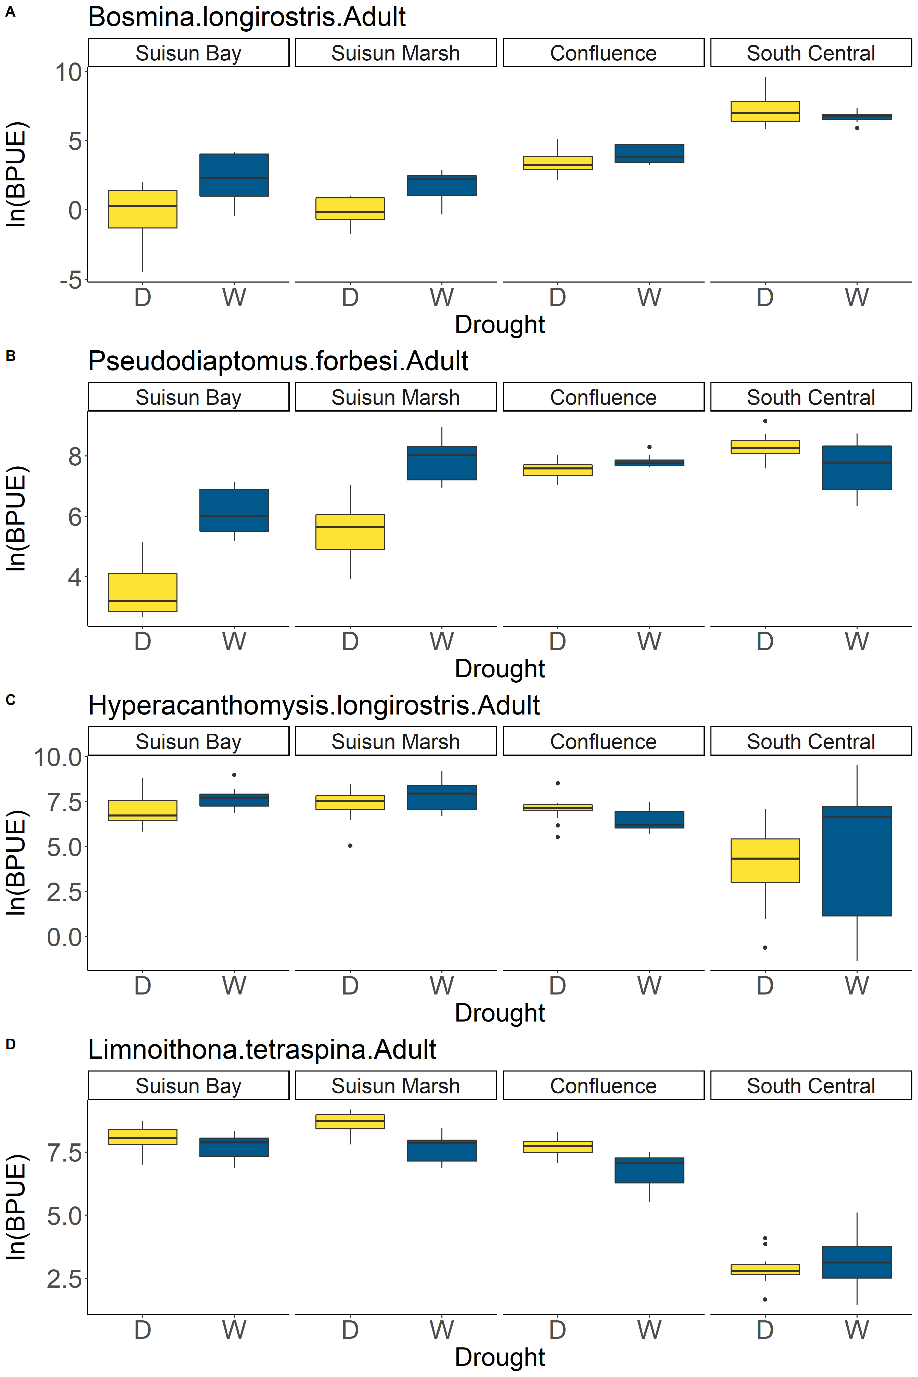
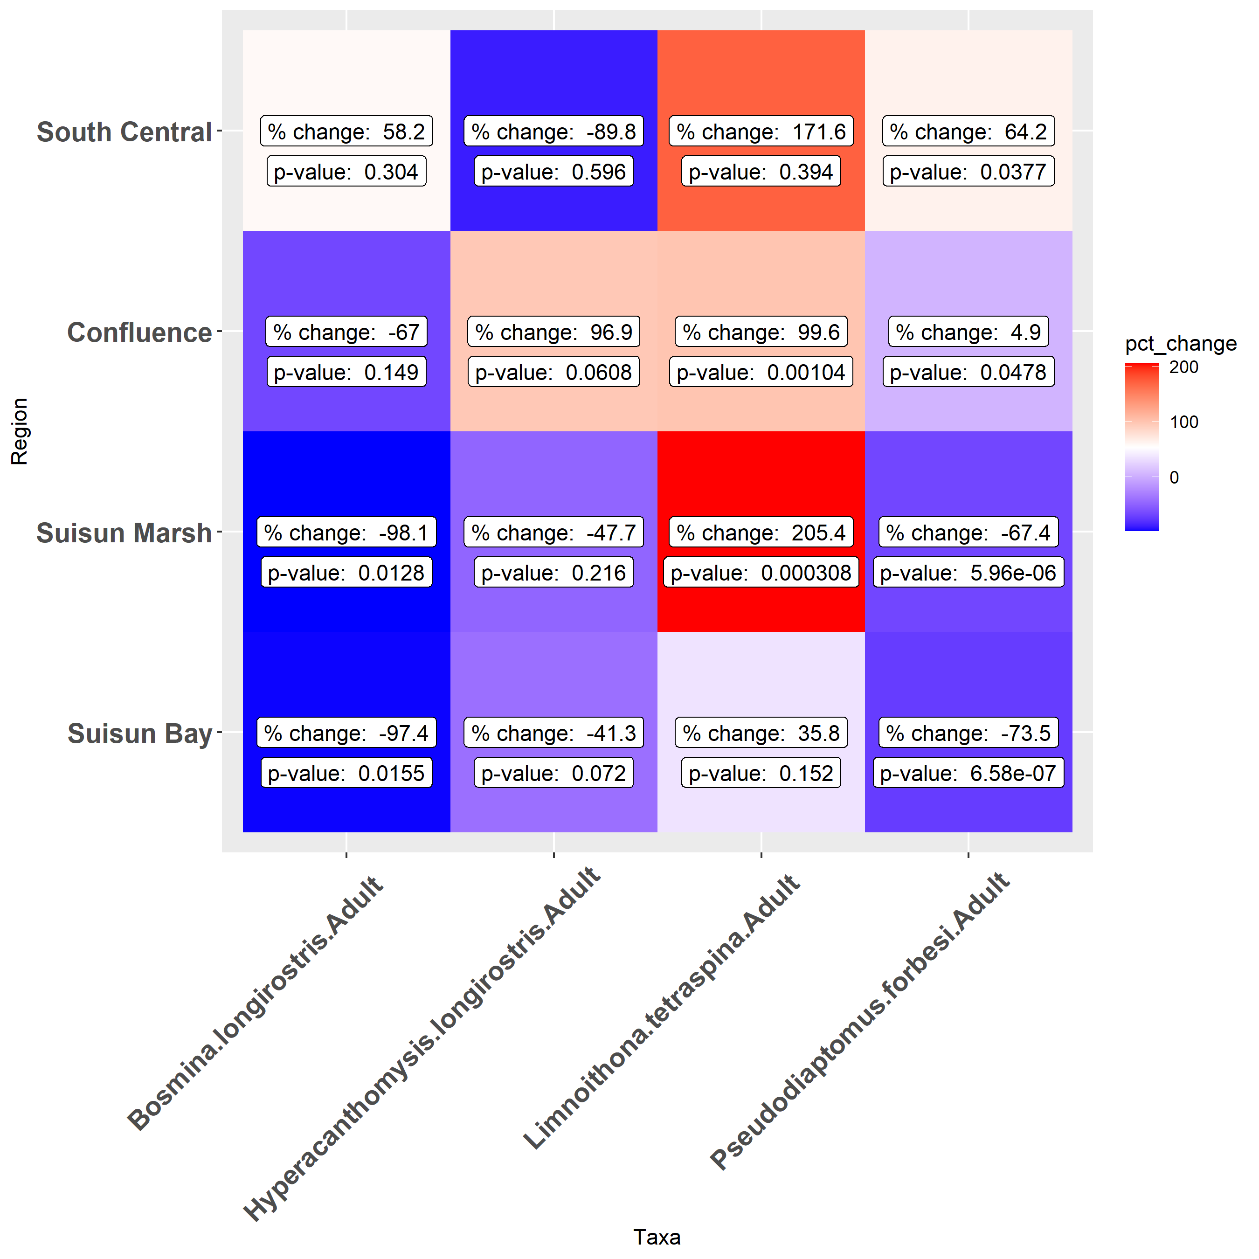
Regional Drought Changes
*
*
*
*
*
*
*
*
*
*
*
*
*
*
*
*
Notes:
The table and figure are useful, but I think a simpler table could just be, for species and region, does taxa BPUE increase or decrease during droughts?

Slide 3
Environmental GAMs
Example: B. longirostris
Presence/Absence
Call:
glm(formula = Presence ~ salinity + month, family = "binomial",
data = d_pa)
Deviance Residuals:
Min 1Q Median 3Q Max
-1.2411 -0.8850 -0.2342 1.1453 3.6835
Coefficients:
Estimate Std. Error z value Pr(>|z|)
(Intercept) -0.03588 0.15745 -0.228 0.820
salinity -0.54310 0.02613 -20.786 <2e-16 ***
month 0.01952 0.02000 0.976 0.329
---
Signif. codes: 0 ‘***’ 0.001 ‘**’ 0.01 ‘*’ 0.05 ‘.’ 0.1 ‘ ’ 1
(Dispersion parameter for binomial family taken to be 1)
Null deviance: 5022.4 on 4248 degrees of freedom
Residual deviance: 3877.5 on 4246 degrees of freedom
AIC: 3883.5
Number of Fisher Scoring iterations: 6
Presence only
Family: Negative Binomial(0.367)
Link function: log
Formula:
BPUE ~ s(salinity) + s(month, k = 5)
Parametric coefficients:
Estimate Std. Error z value Pr(>|z|)
(Intercept) 5.26800 0.04823 109.2 <2e-16 ***
---
Signif. codes: 0 ‘***’ 0.001 ‘**’ 0.01 ‘*’ 0.05 ‘.’ 0.1 ‘ ’ 1
Approximate significance of smooth terms:
edf Ref.df Chi.sq p-value
s(salinity) 8.806 8.989 644.58 <2e-16 ***
s(month) 1.008 1.017 79.18 <2e-16 ***
---
Signif. codes: 0 ‘***’ 0.001 ‘**’ 0.01 ‘*’ 0.05 ‘.’ 0.1 ‘ ’ 1
R-sq.(adj) = 0.0179 Deviance explained = 22.2%
-REML = 6868.5 Scale est. = 1 n = 1181

Slide 4
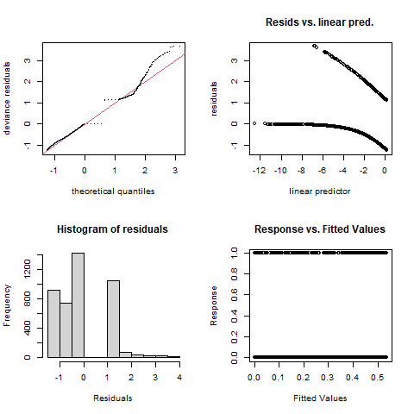
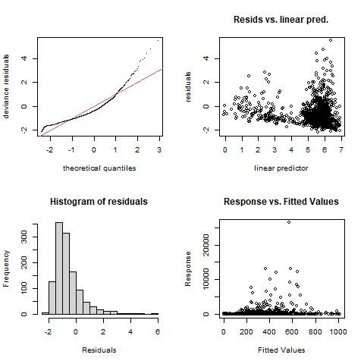
Environmental GAMs
Example: B. longirostris
Logistic model (presence/absence)
Negative binomial (just presence)

Slide 5
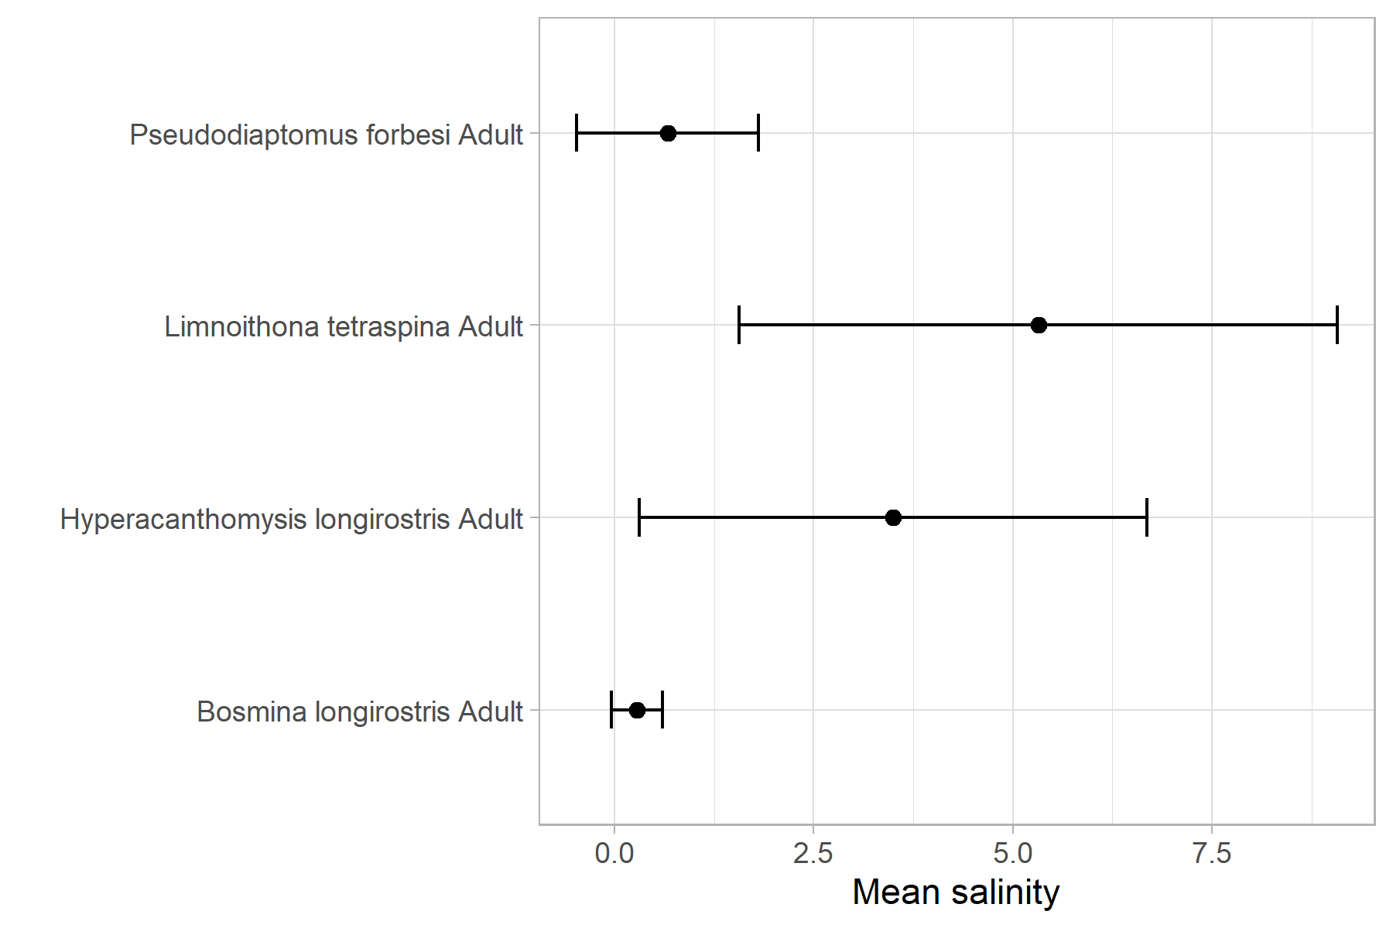
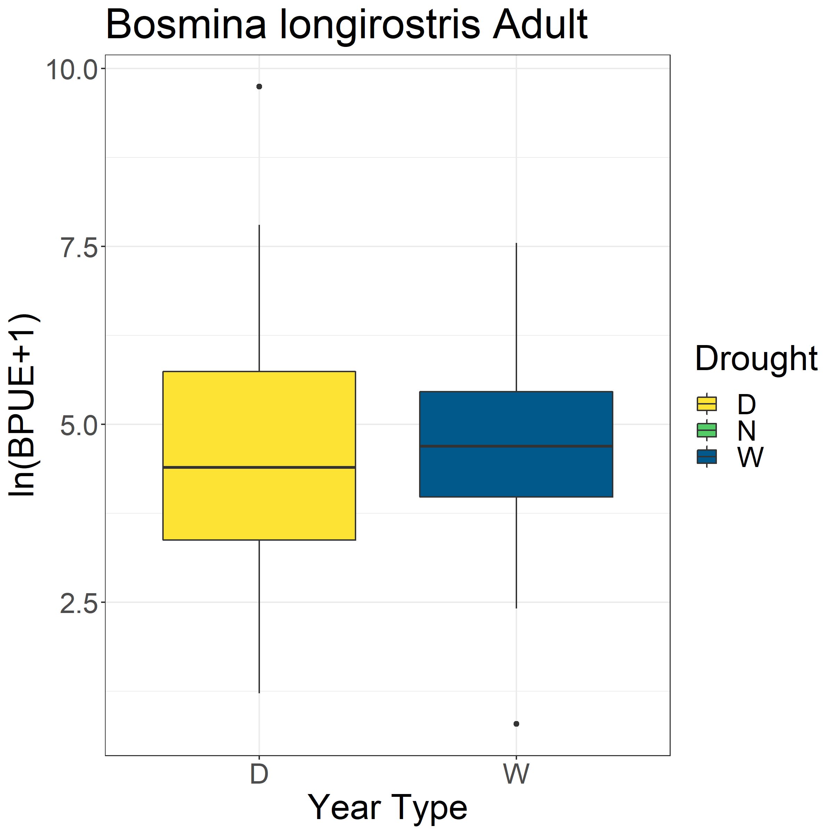
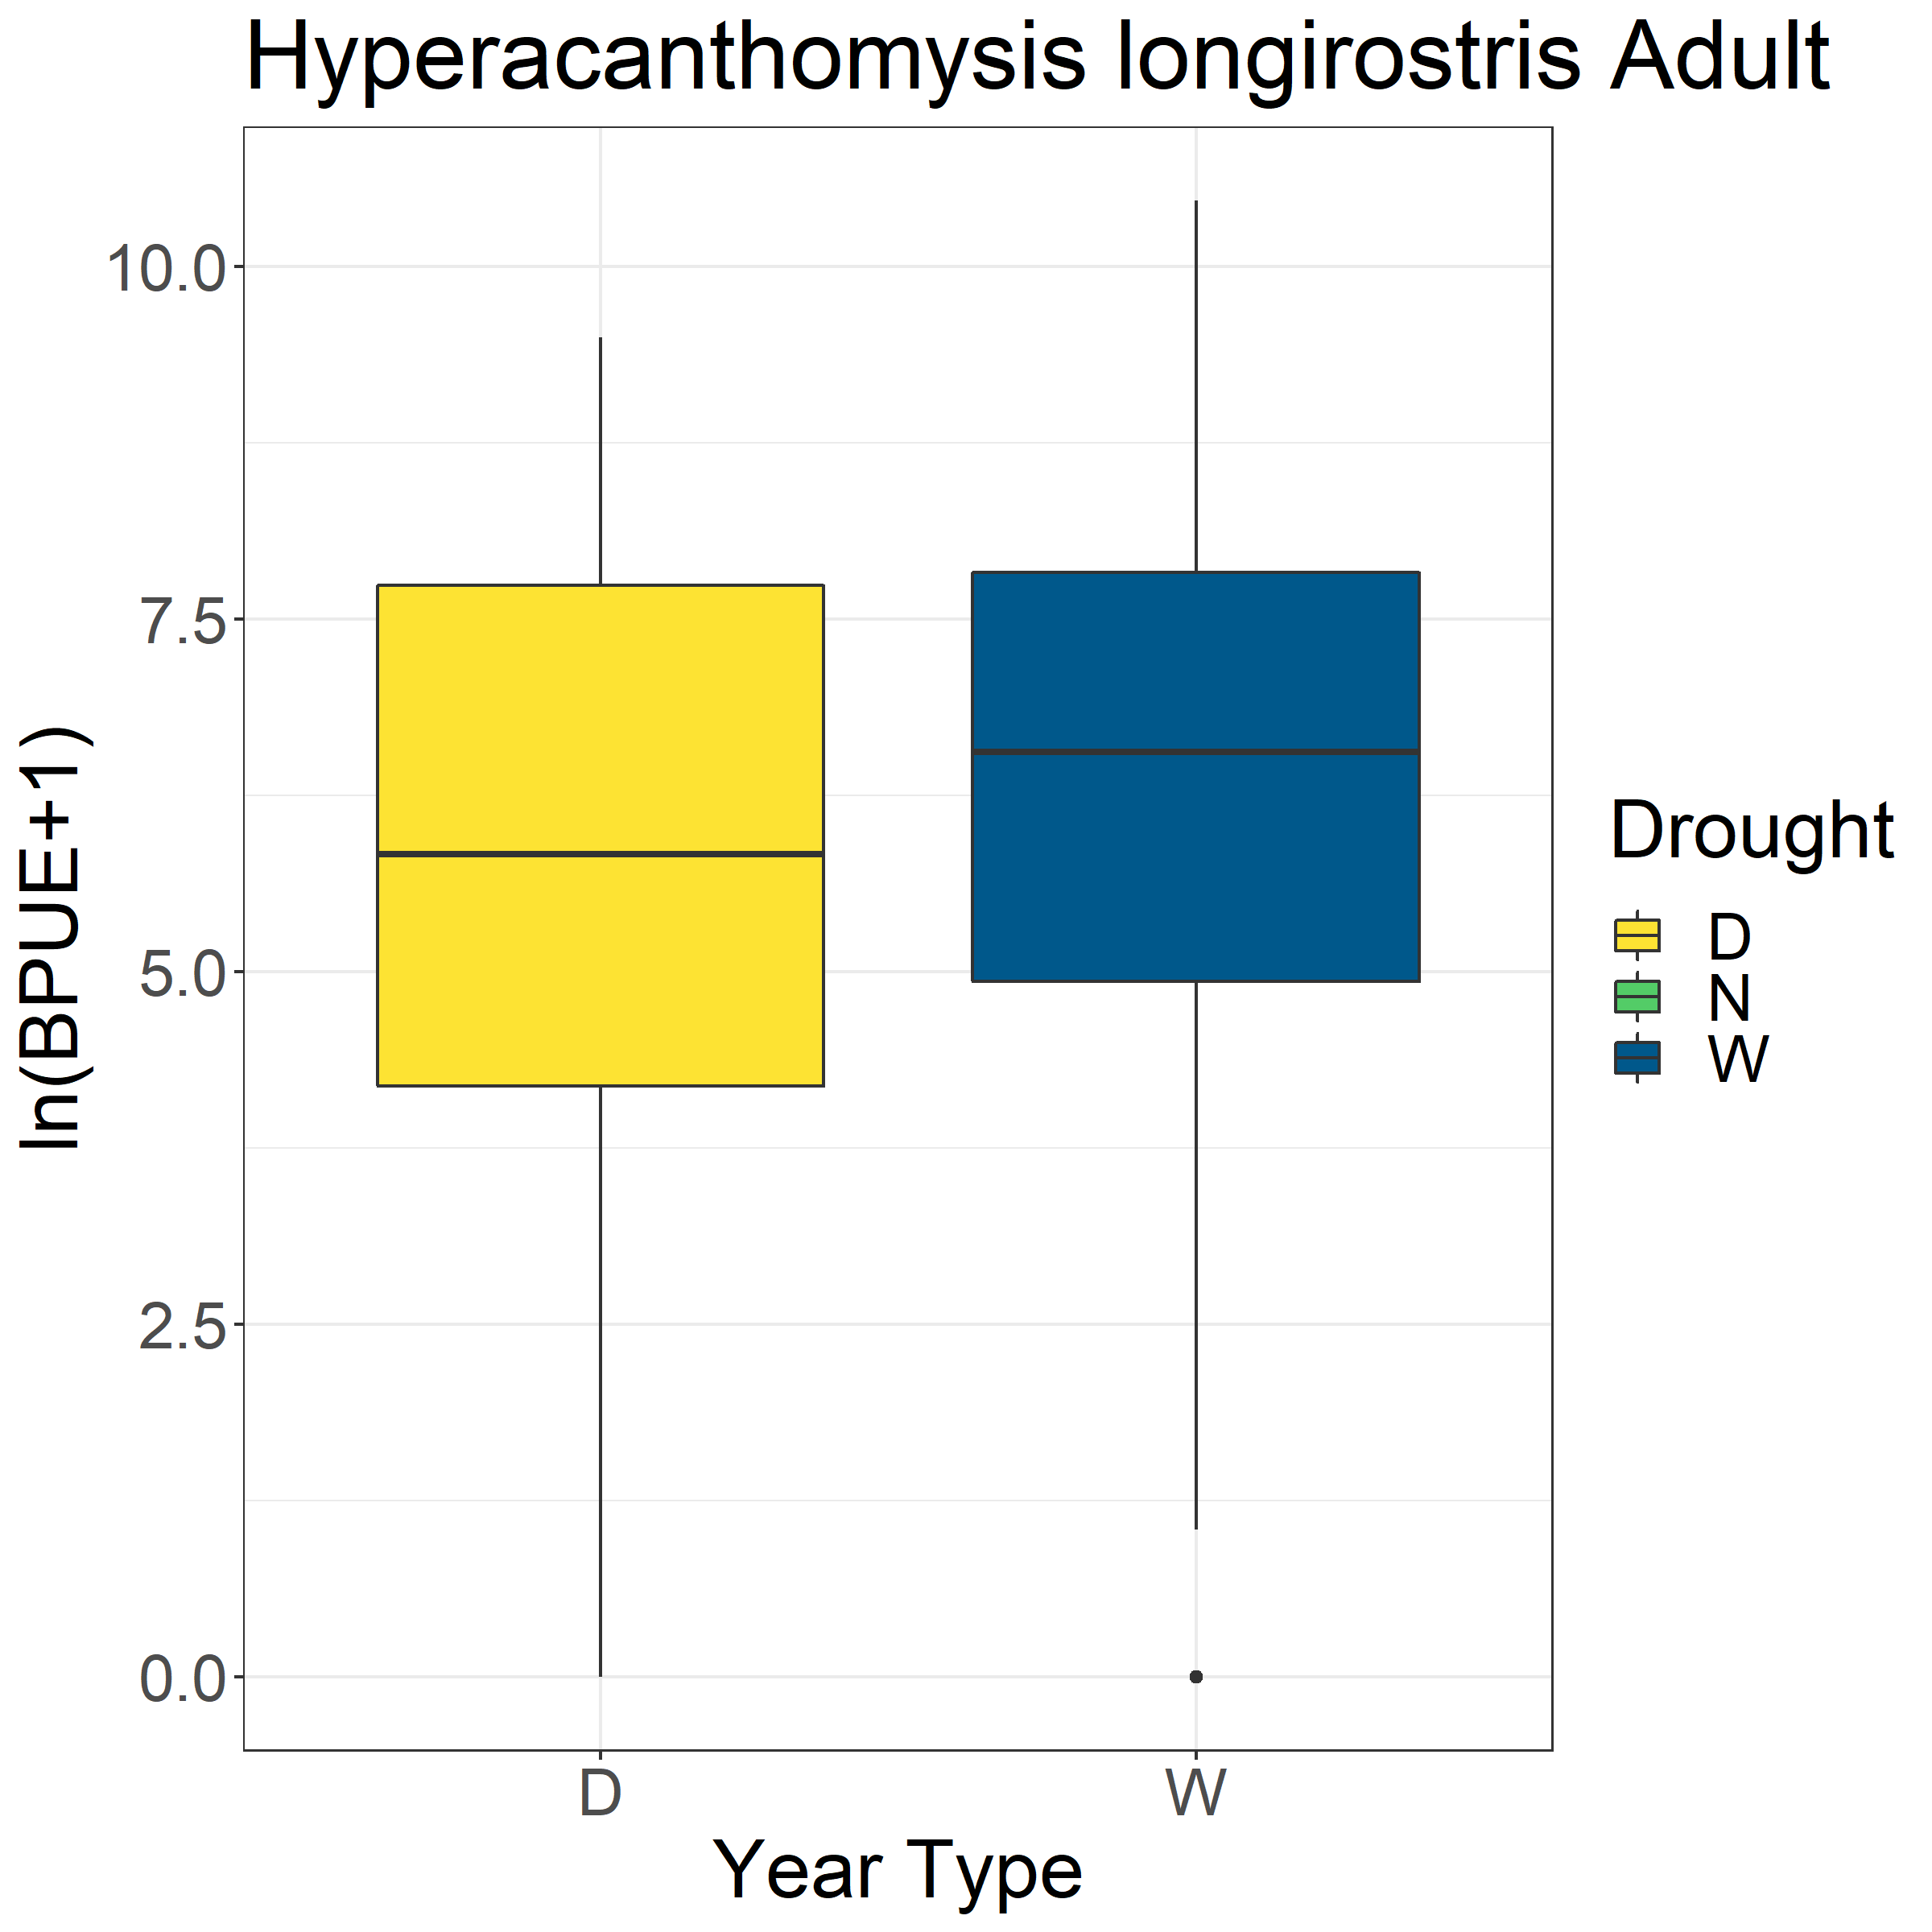
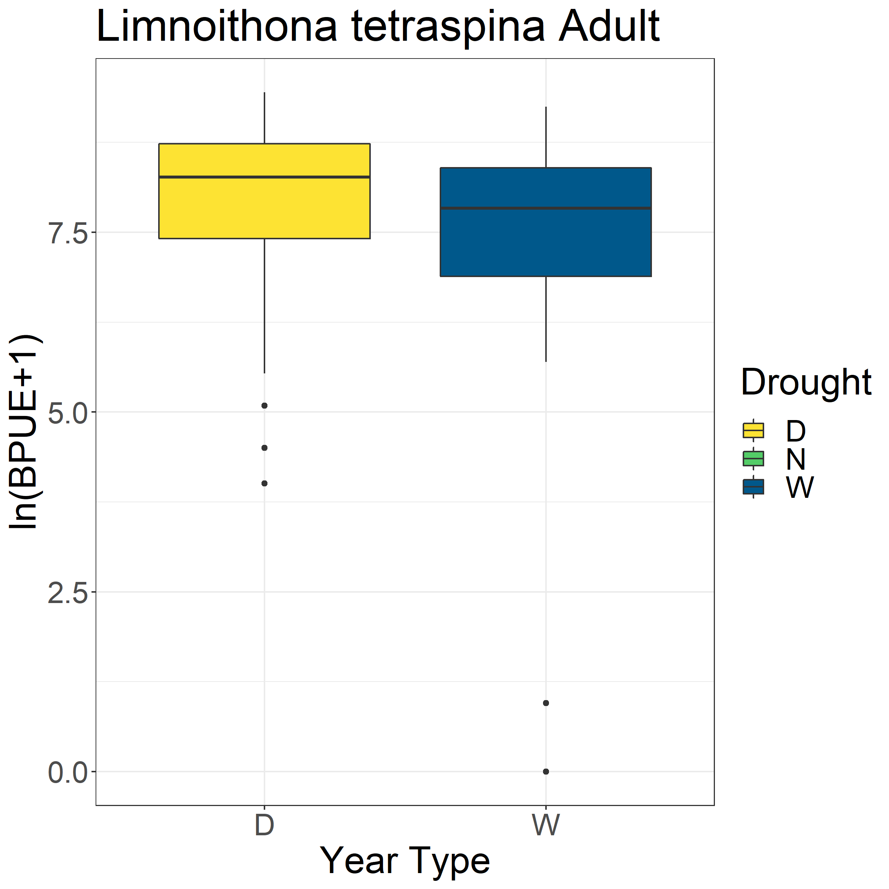
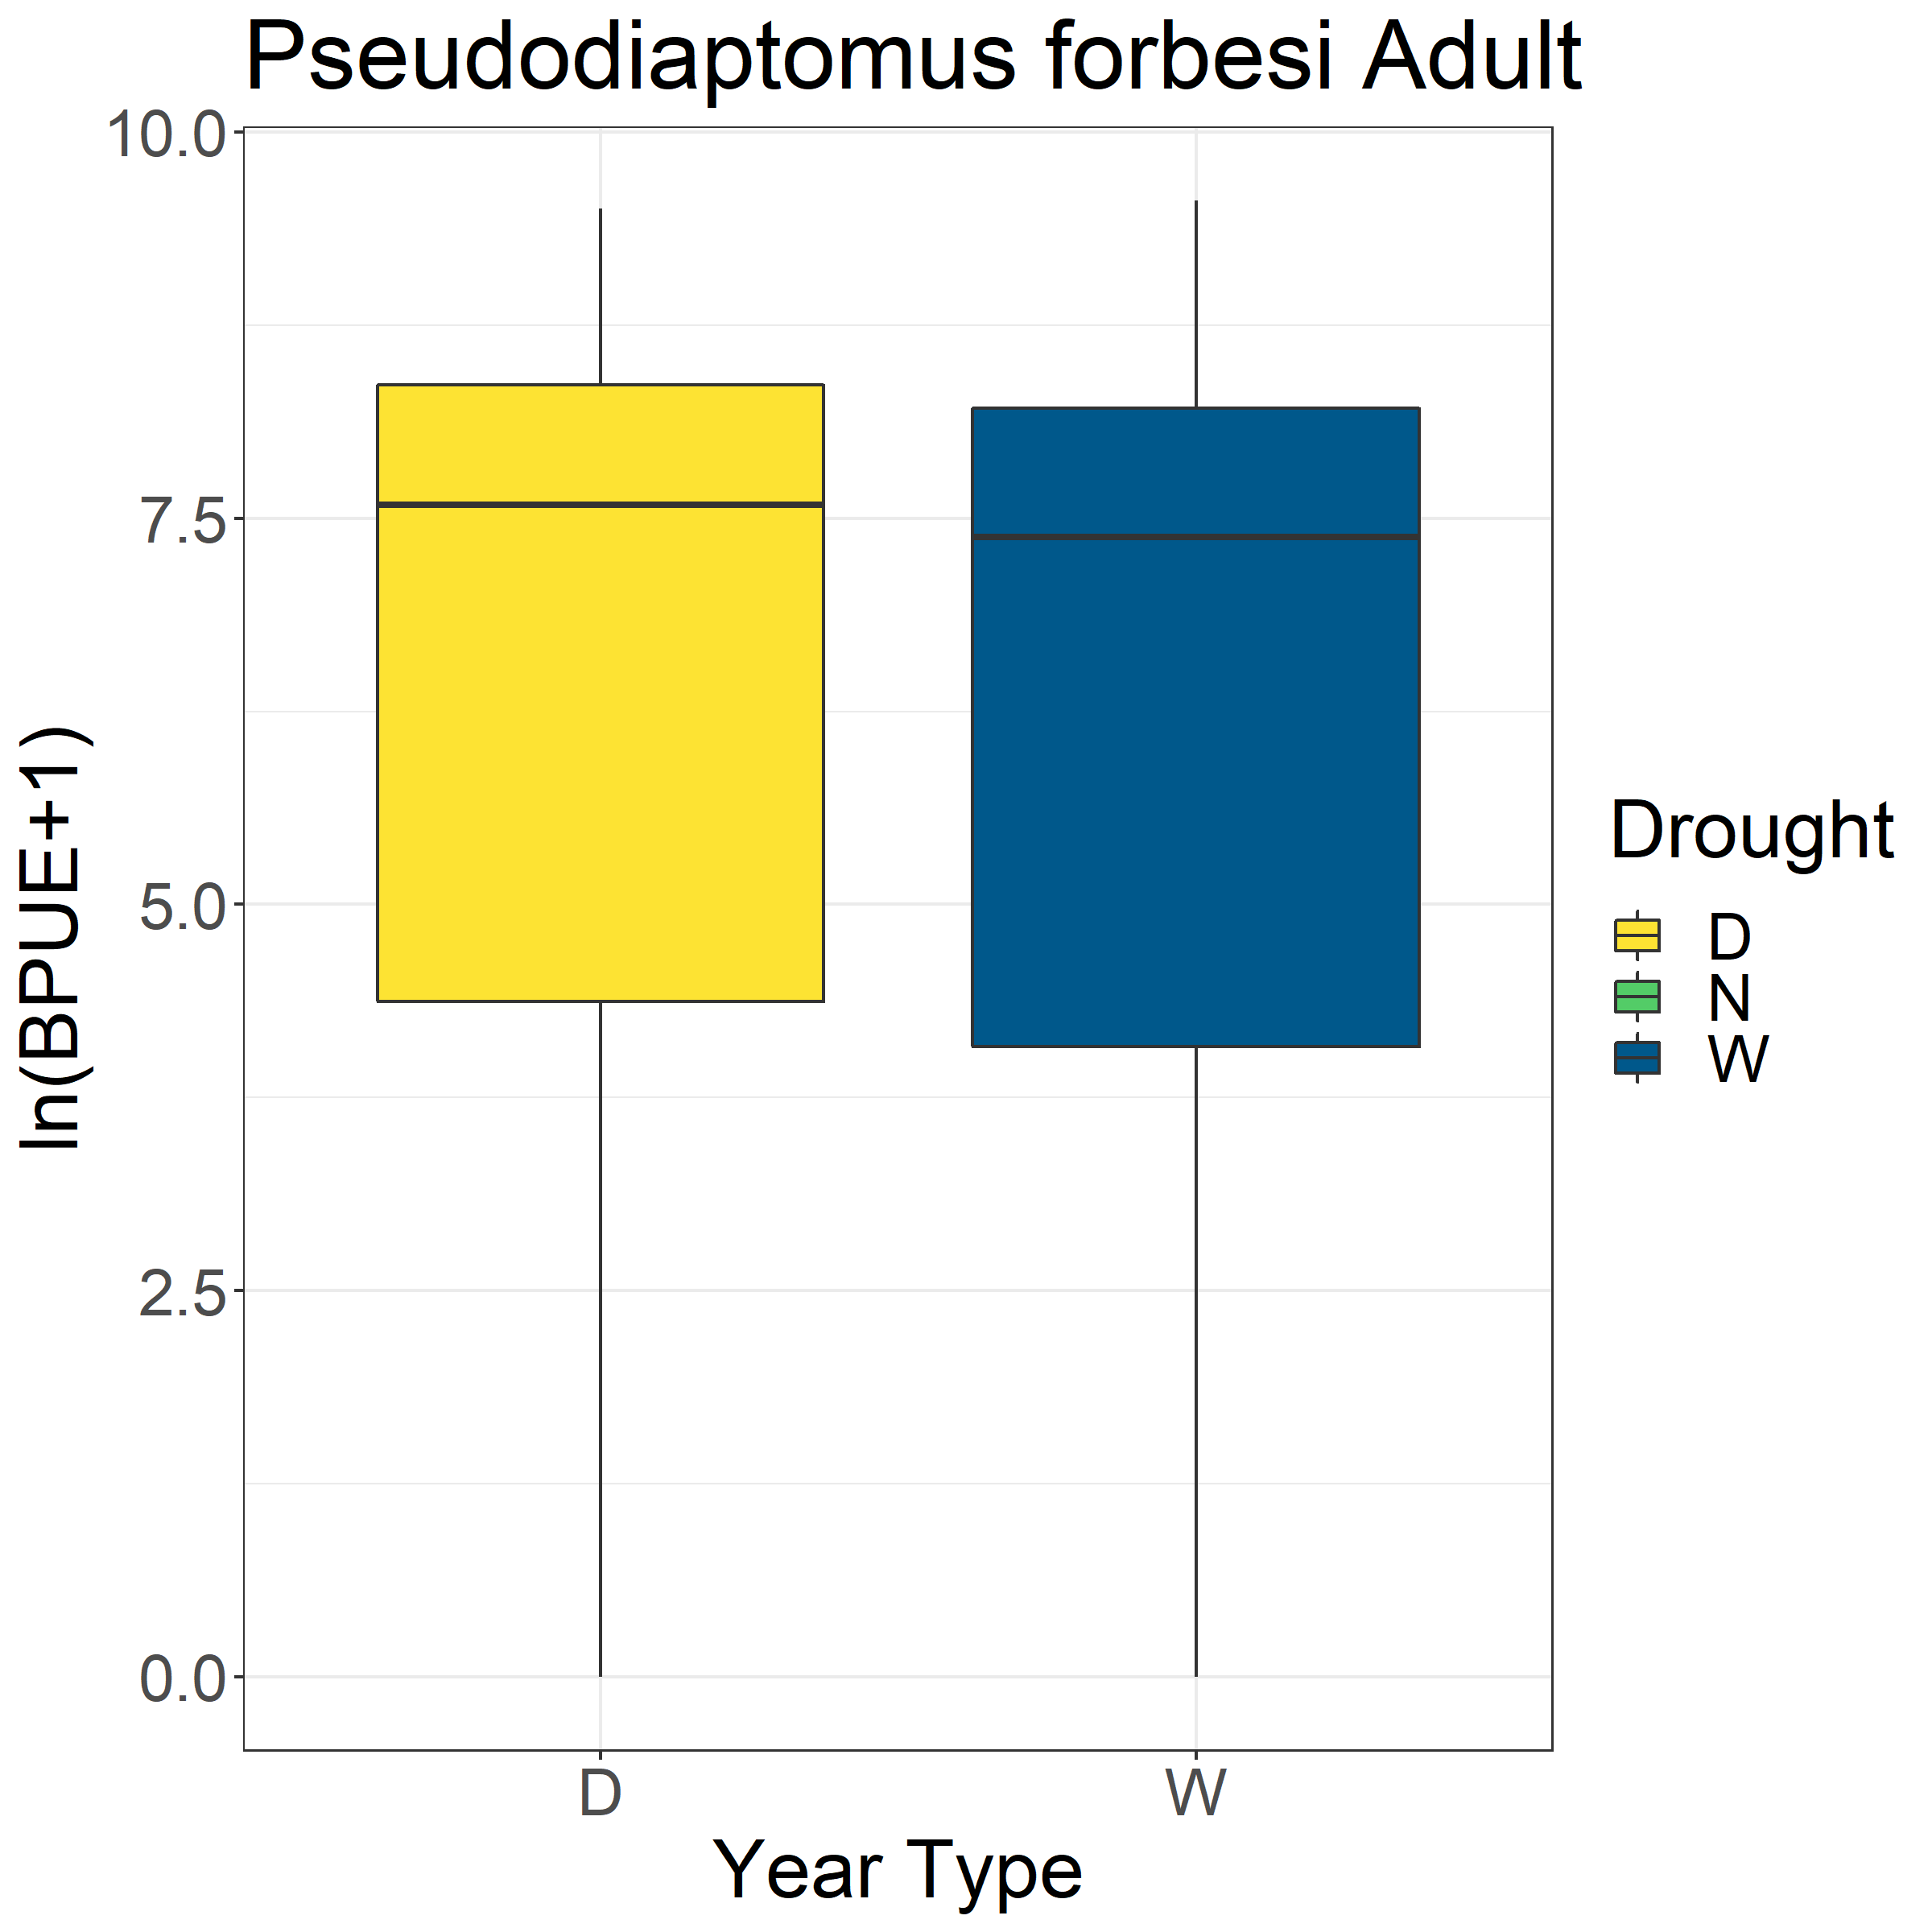
*

Slide 6
