Slide 1
Drought Zooplankton Questions
How does drought in the estuary impact zooplankton communities?
Do we see estuary-wide changes in taxa BPUE?
Do we see regional changes in taxa BPUE?
Are there env parameters correlated with higher BPUE?
Does Drought impact the env parameters correlated with higher BPUE?
Are the env parameters for taxa changing, or moving?

Slide 2
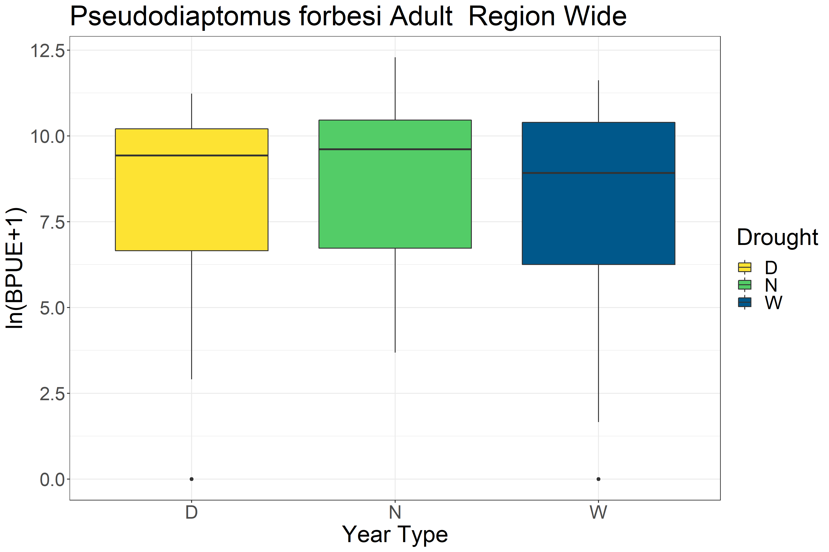
P=0.136

Slide 3
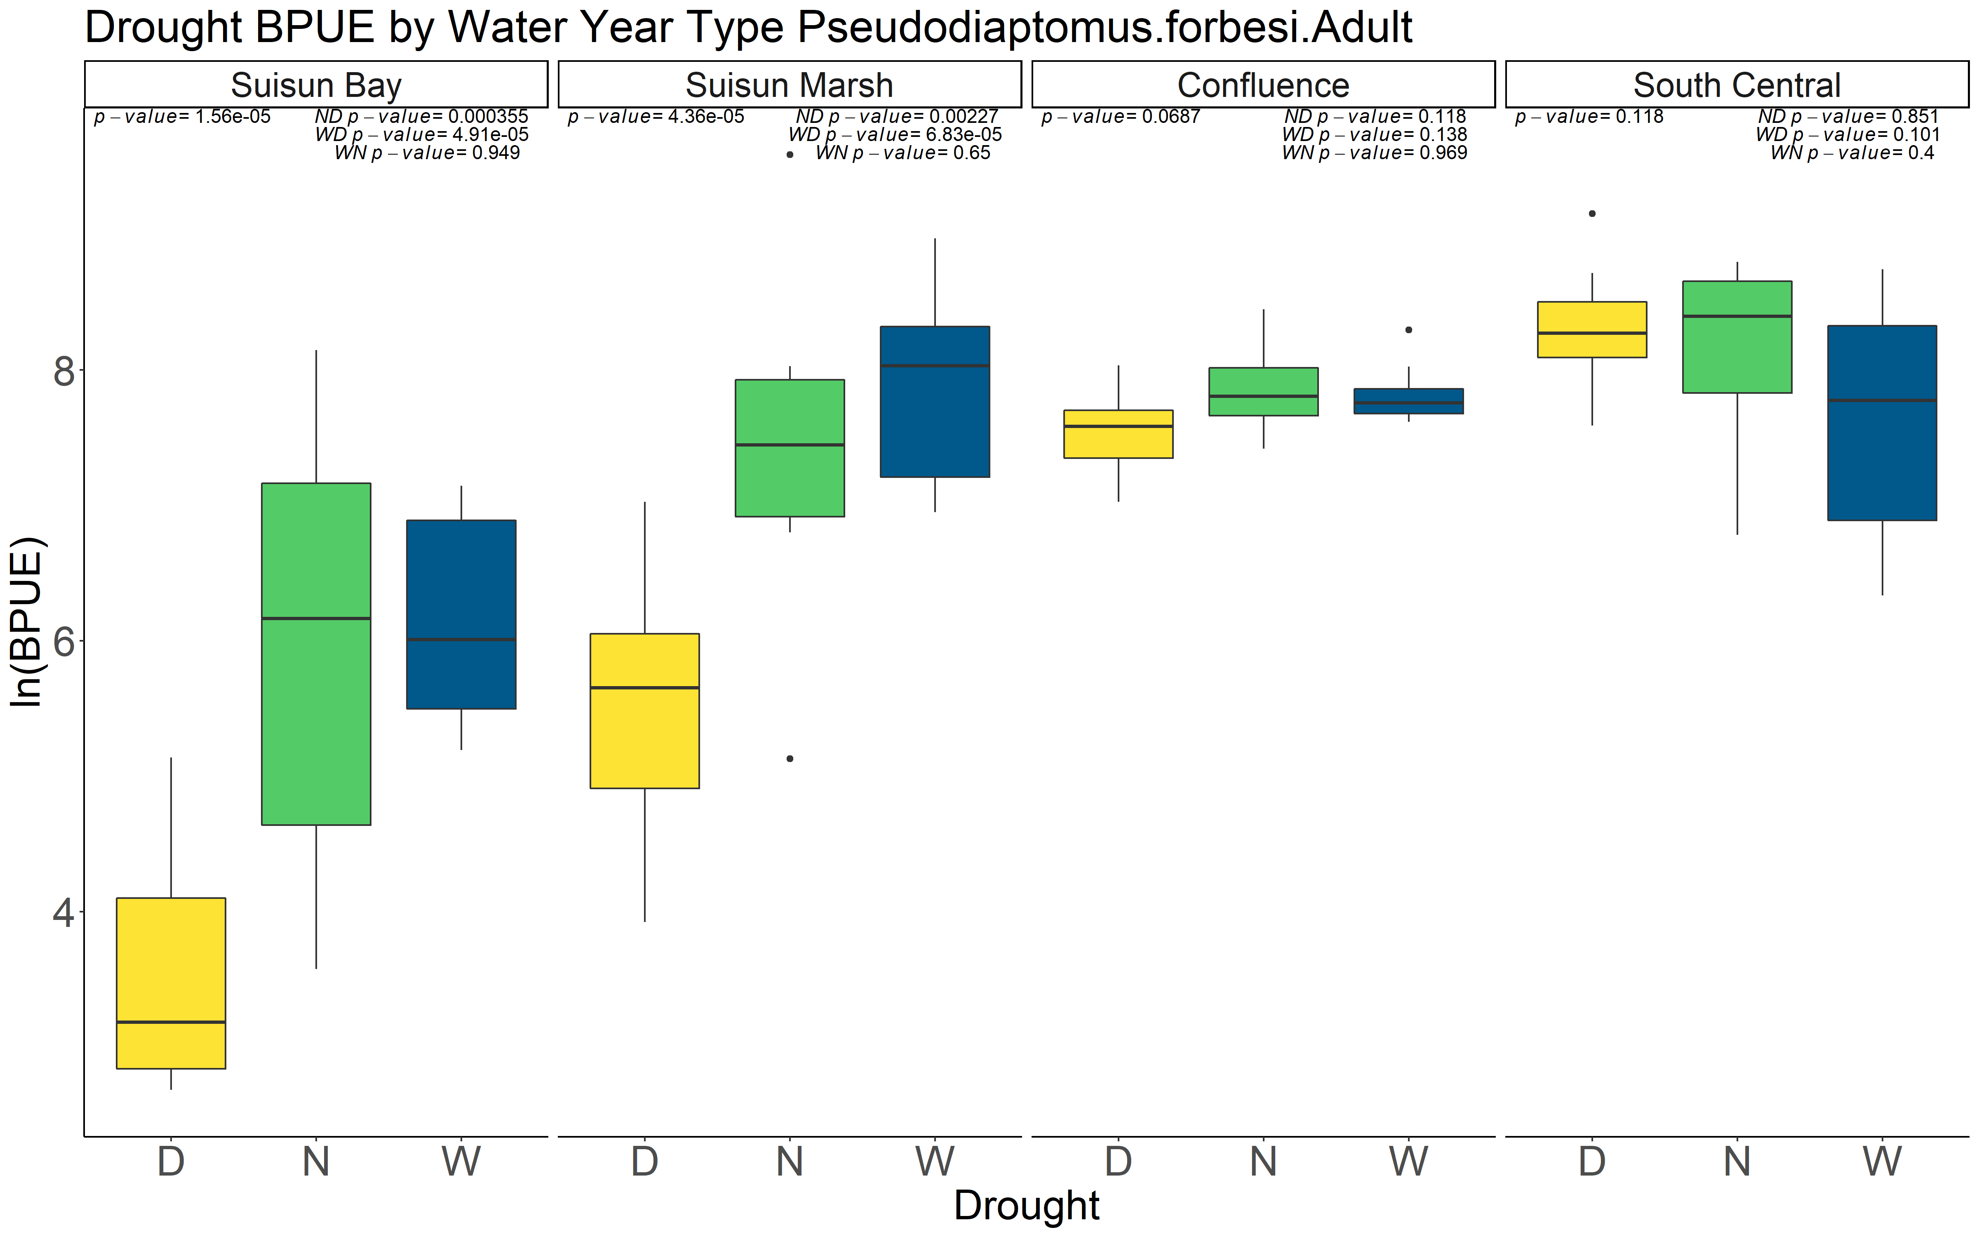
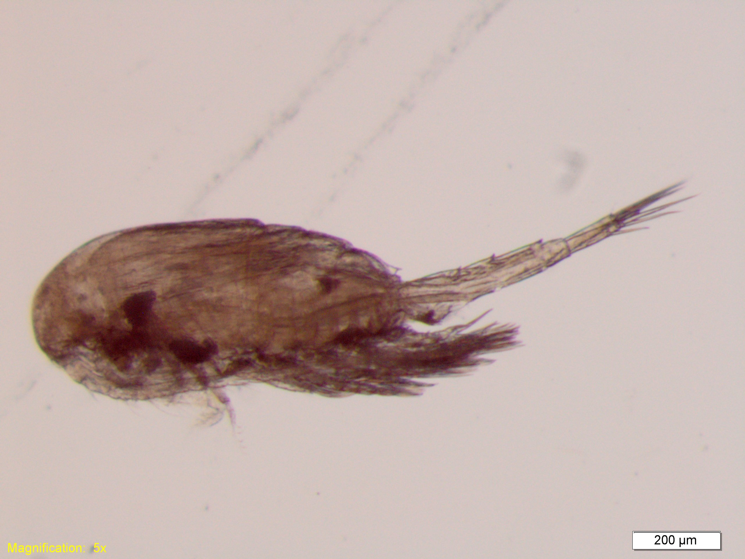
One taxa as an example: Pseudodiaptomus forbesi Year >1993

Slide 4
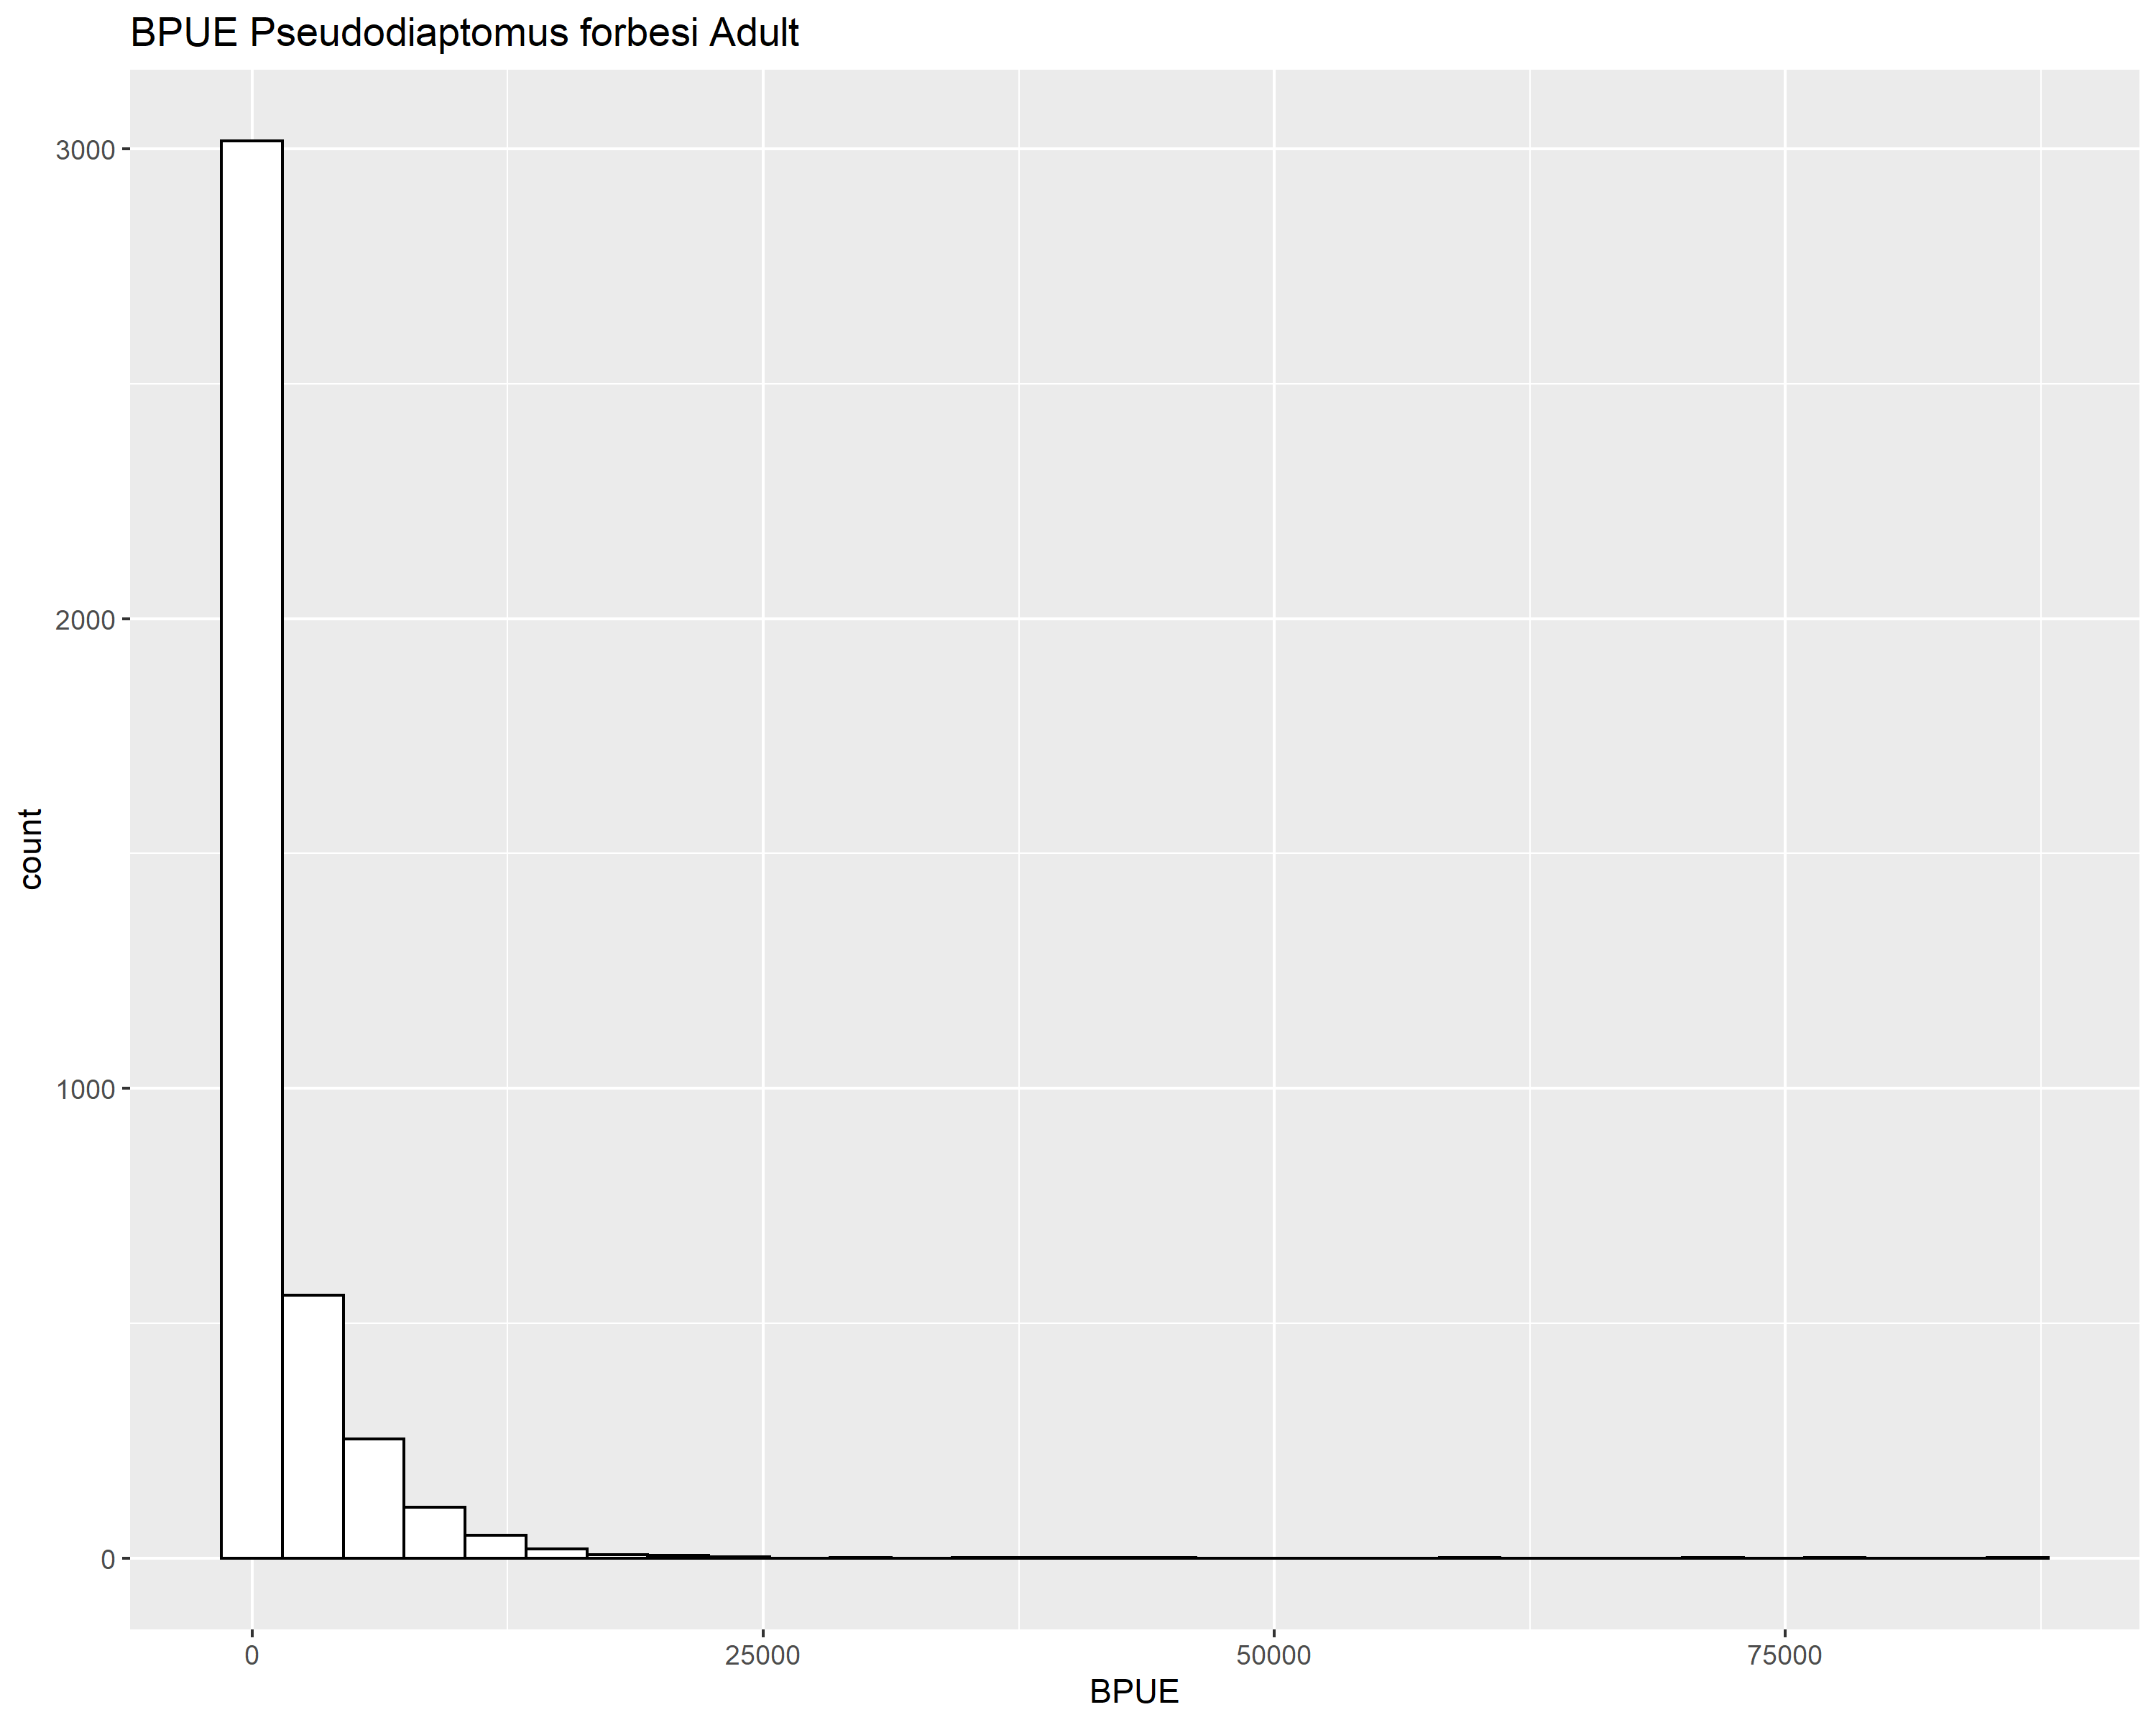
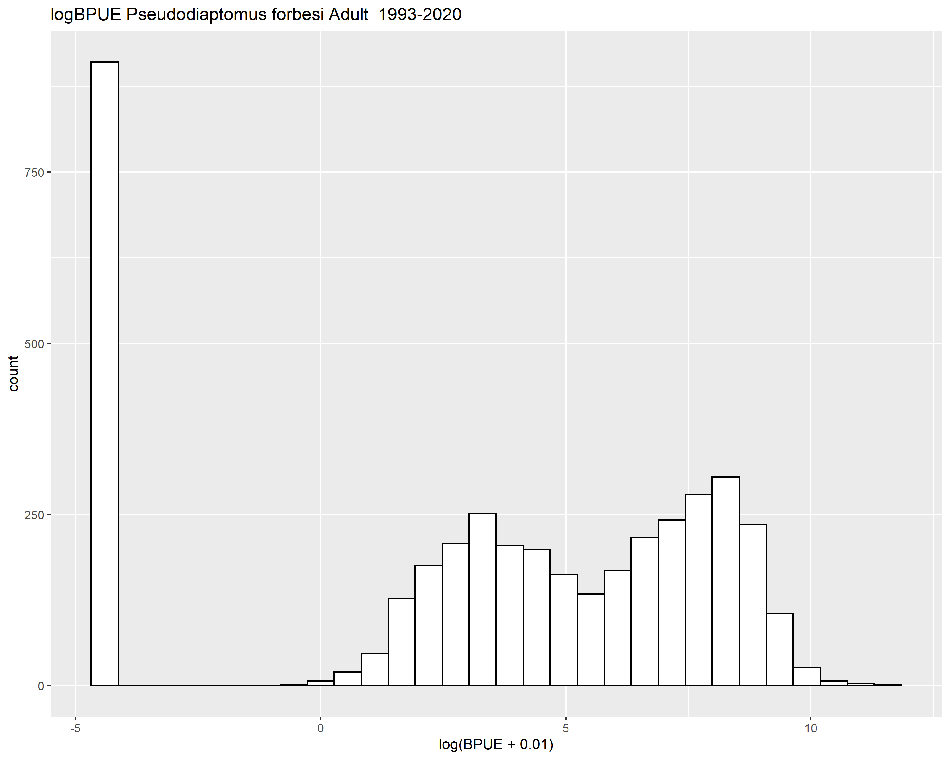

Slide 5
M1: BPUE ~ s(salinity)
Family: Negative Binomial(0.267)
Link function: log
Formula:
BPUE ~ s(salinity)
Parametric coefficients:
Estimate Std. Error z value Pr(>|z|)
(Intercept) 6.75037 0.03079 219.2 <2e-16 ***
---
Signif. codes: 0 ‘***’ 0.001 ‘**’ 0.01 ‘*’ 0.05 ‘.’ 0.1 ‘ ’ 1
Approximate significance of smooth terms:
edf Ref.df Chi.sq p-value
s(salinity) 5.45 6.59 2870 <2e-16 ***
---
Signif. codes: 0 ‘***’ 0.001 ‘**’ 0.01 ‘*’ 0.05 ‘.’ 0.1 ‘ ’ 1
R-sq.(adj) = 0.0531 Deviance explained = 21%
-REML = 27406 Scale est. = 1 n = 3956

Slide 6
M2: BPUE ~ s(salinity) + s(Temperature)
Family: Negative Binomial(0.346)
Link function: log
Formula:
BPUE ~ s(salinity) + s(Temperature)
Parametric coefficients:
Estimate Std. Error z value Pr(>|z|)
(Intercept) 6.2097 0.0271 229.1 <2e-16 ***
---
Signif. codes: 0 ‘***’ 0.001 ‘**’ 0.01 ‘*’ 0.05 ‘.’ 0.1 ‘ ’ 1
Approximate significance of smooth terms:
edf Ref.df Chi.sq p-value
s(salinity) 6.871 7.972 2318 <2e-16 ***
s(Temperature) 1.063 1.124 1883 <2e-16 ***
---
Signif. codes: 0 ‘***’ 0.001 ‘**’ 0.01 ‘*’ 0.05 ‘.’ 0.1 ‘ ’ 1
R-sq.(adj) = 0.301 Deviance explained = 39.4%
-REML = 26766 Scale est. = 1 n = 3956

Slide 7
M3: BPUE ~ s(salinity) + s(Temperature)+s(month, bs=“cc”)
Family: Negative Binomial(0.455)
Link function: log
Formula:
BPUE ~ s(salinity) + s(Temperature) + s(month, bs = "cc")
Parametric coefficients:
Estimate Std. Error z value Pr(>|z|)
(Intercept) 5.79118 0.02374 244 <2e-16 ***
---
Signif. codes: 0 ‘***’ 0.001 ‘**’ 0.01 ‘*’ 0.05 ‘.’ 0.1 ‘ ’ 1
Approximate significance of smooth terms:
edf Ref.df Chi.sq p-value
s(salinity) 6.237 7.399 2973.6 <2e-16 ***
s(Temperature) 7.441 8.430 440.9 <2e-16 ***
s(month) 7.830 8.000 1716.4 <2e-16 ***
---
Signif. codes: 0 ‘***’ 0.001 ‘**’ 0.01 ‘*’ 0.05 ‘.’ 0.1 ‘ ’ 1
R-sq.(adj) = 0.311 Deviance explained = 54.1%
-REML = 26156 Scale est. = 1 n = 3956

Slide 8
M4: BPUE ~ s(salinity) + s(Temperature)+s(month, bs=“cc”)+s(Station, bs=‘re’)
Family: Negative Binomial(0.484)
Link function: log
Formula:
BPUE ~ s(salinity) + s(Temperature) + s(month) + s(Station, bs = "re")
Parametric coefficients:
Estimate Std. Error z value Pr(>|z|)
(Intercept) 5.7497 0.1012 56.82 <2e-16 ***
---
Signif. codes: 0 ‘***’ 0.001 ‘**’ 0.01 ‘*’ 0.05 ‘.’ 0.1 ‘ ’ 1
Approximate significance of smooth terms:
edf Ref.df Chi.sq p-value
s(salinity) 6.057 7.231 1286.5 <2e-16 ***
s(Temperature) 6.323 7.557 268.8 <2e-16 ***
s(month) 8.713 8.971 1697.2 <2e-16 ***
s(Station) 12.561 14.000 225.7 <2e-16 ***
---
Signif. codes: 0 ‘***’ 0.001 ‘**’ 0.01 ‘*’ 0.05 ‘.’ 0.1 ‘ ’ 1
R-sq.(adj) = 0.329 Deviance explained = 56.9%
-REML = 26034 Scale est. = 1 n = 3956

Slide 9
Model Comparison AIC
df AIC
m1 7.796612 54798.12
m2 11.095922 53512.14
m3 24.511708 52247.09
m4 37.406014 51986.71

Slide 10
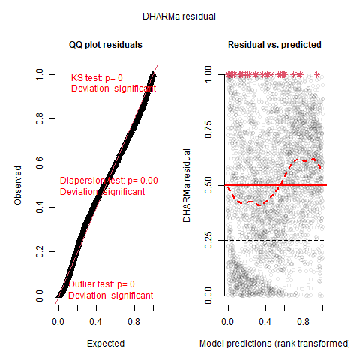
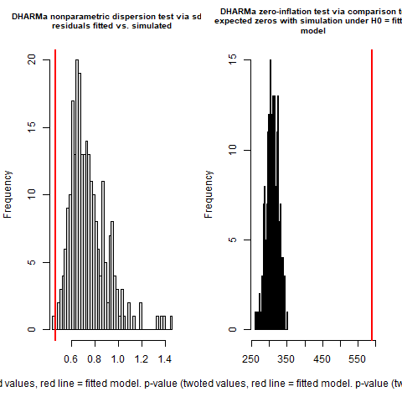
M4 residuals
M4: BPUE ~ s(salinity) + s(Temperature)+s(month, bs=“cc”)+s(Station, bs=‘re’)

Slide 11
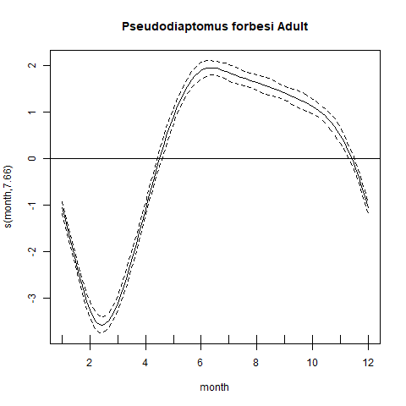
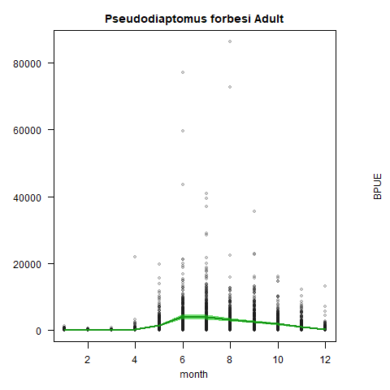
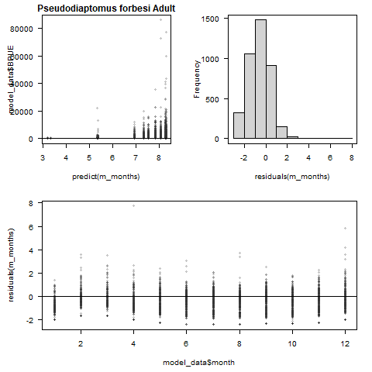
Single Smoother gams
M1: BPUE ~ s(month, bs=‘cc’, family=‘nb’)
Deviance explained = 31.6%

Slide 12
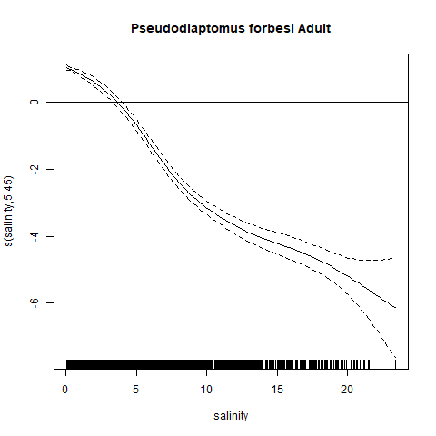
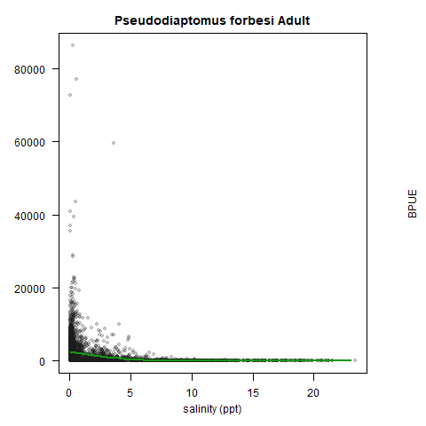
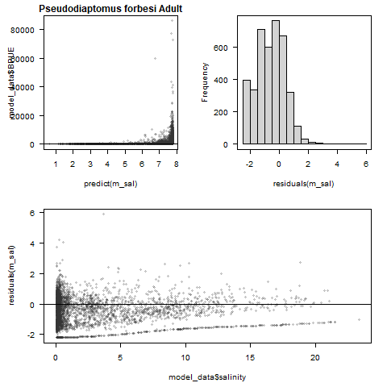
Single Smoother gams
M1: BPUE ~ s(salinity, family=‘nb’)
Deviance explained = 21%

Slide 13
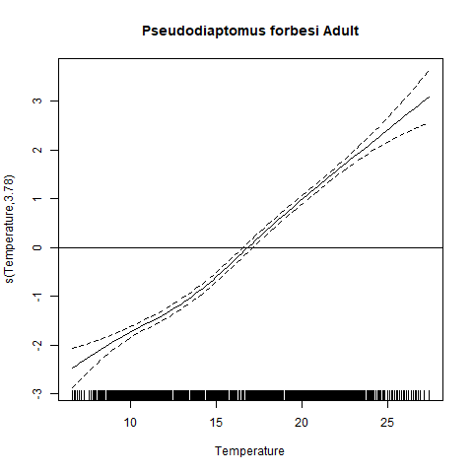
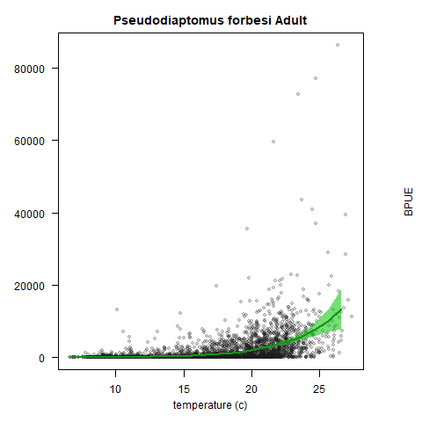
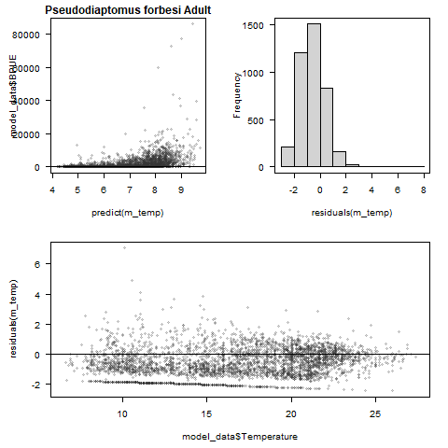
Single Smoother gams
M1: BPUE ~ s(temperature, family=‘nb’)
Deviance explained = 24.6%

Slide 14
Next Analysis steps
Salinity and temperature are of course correlated with the month
The BPUE of P forbesi is highest from May – November
Examine gam of BPUE by salinity between months of May and November
P. forbesi BPUE is highest in salinity < 5ppt
Compare effect of drought on BPUE for samples collected between 0 – 5ppt

Slide 15
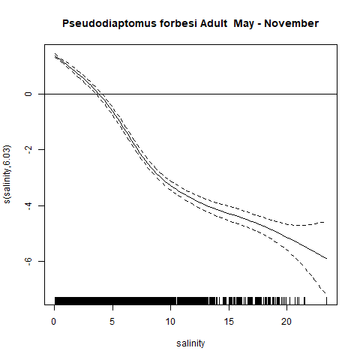
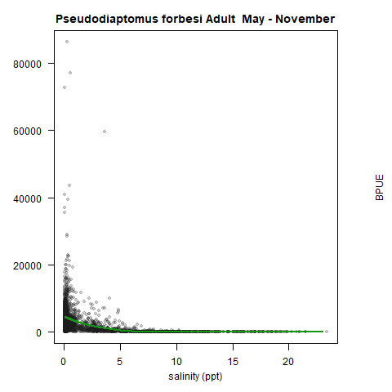
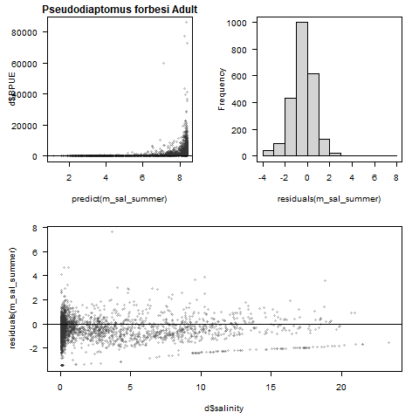
M1: BPUE ~ s(salinity) for May - November
Limiting the model to the May – November, deviance explained by salinity increases from 21% to 48%

Slide 16
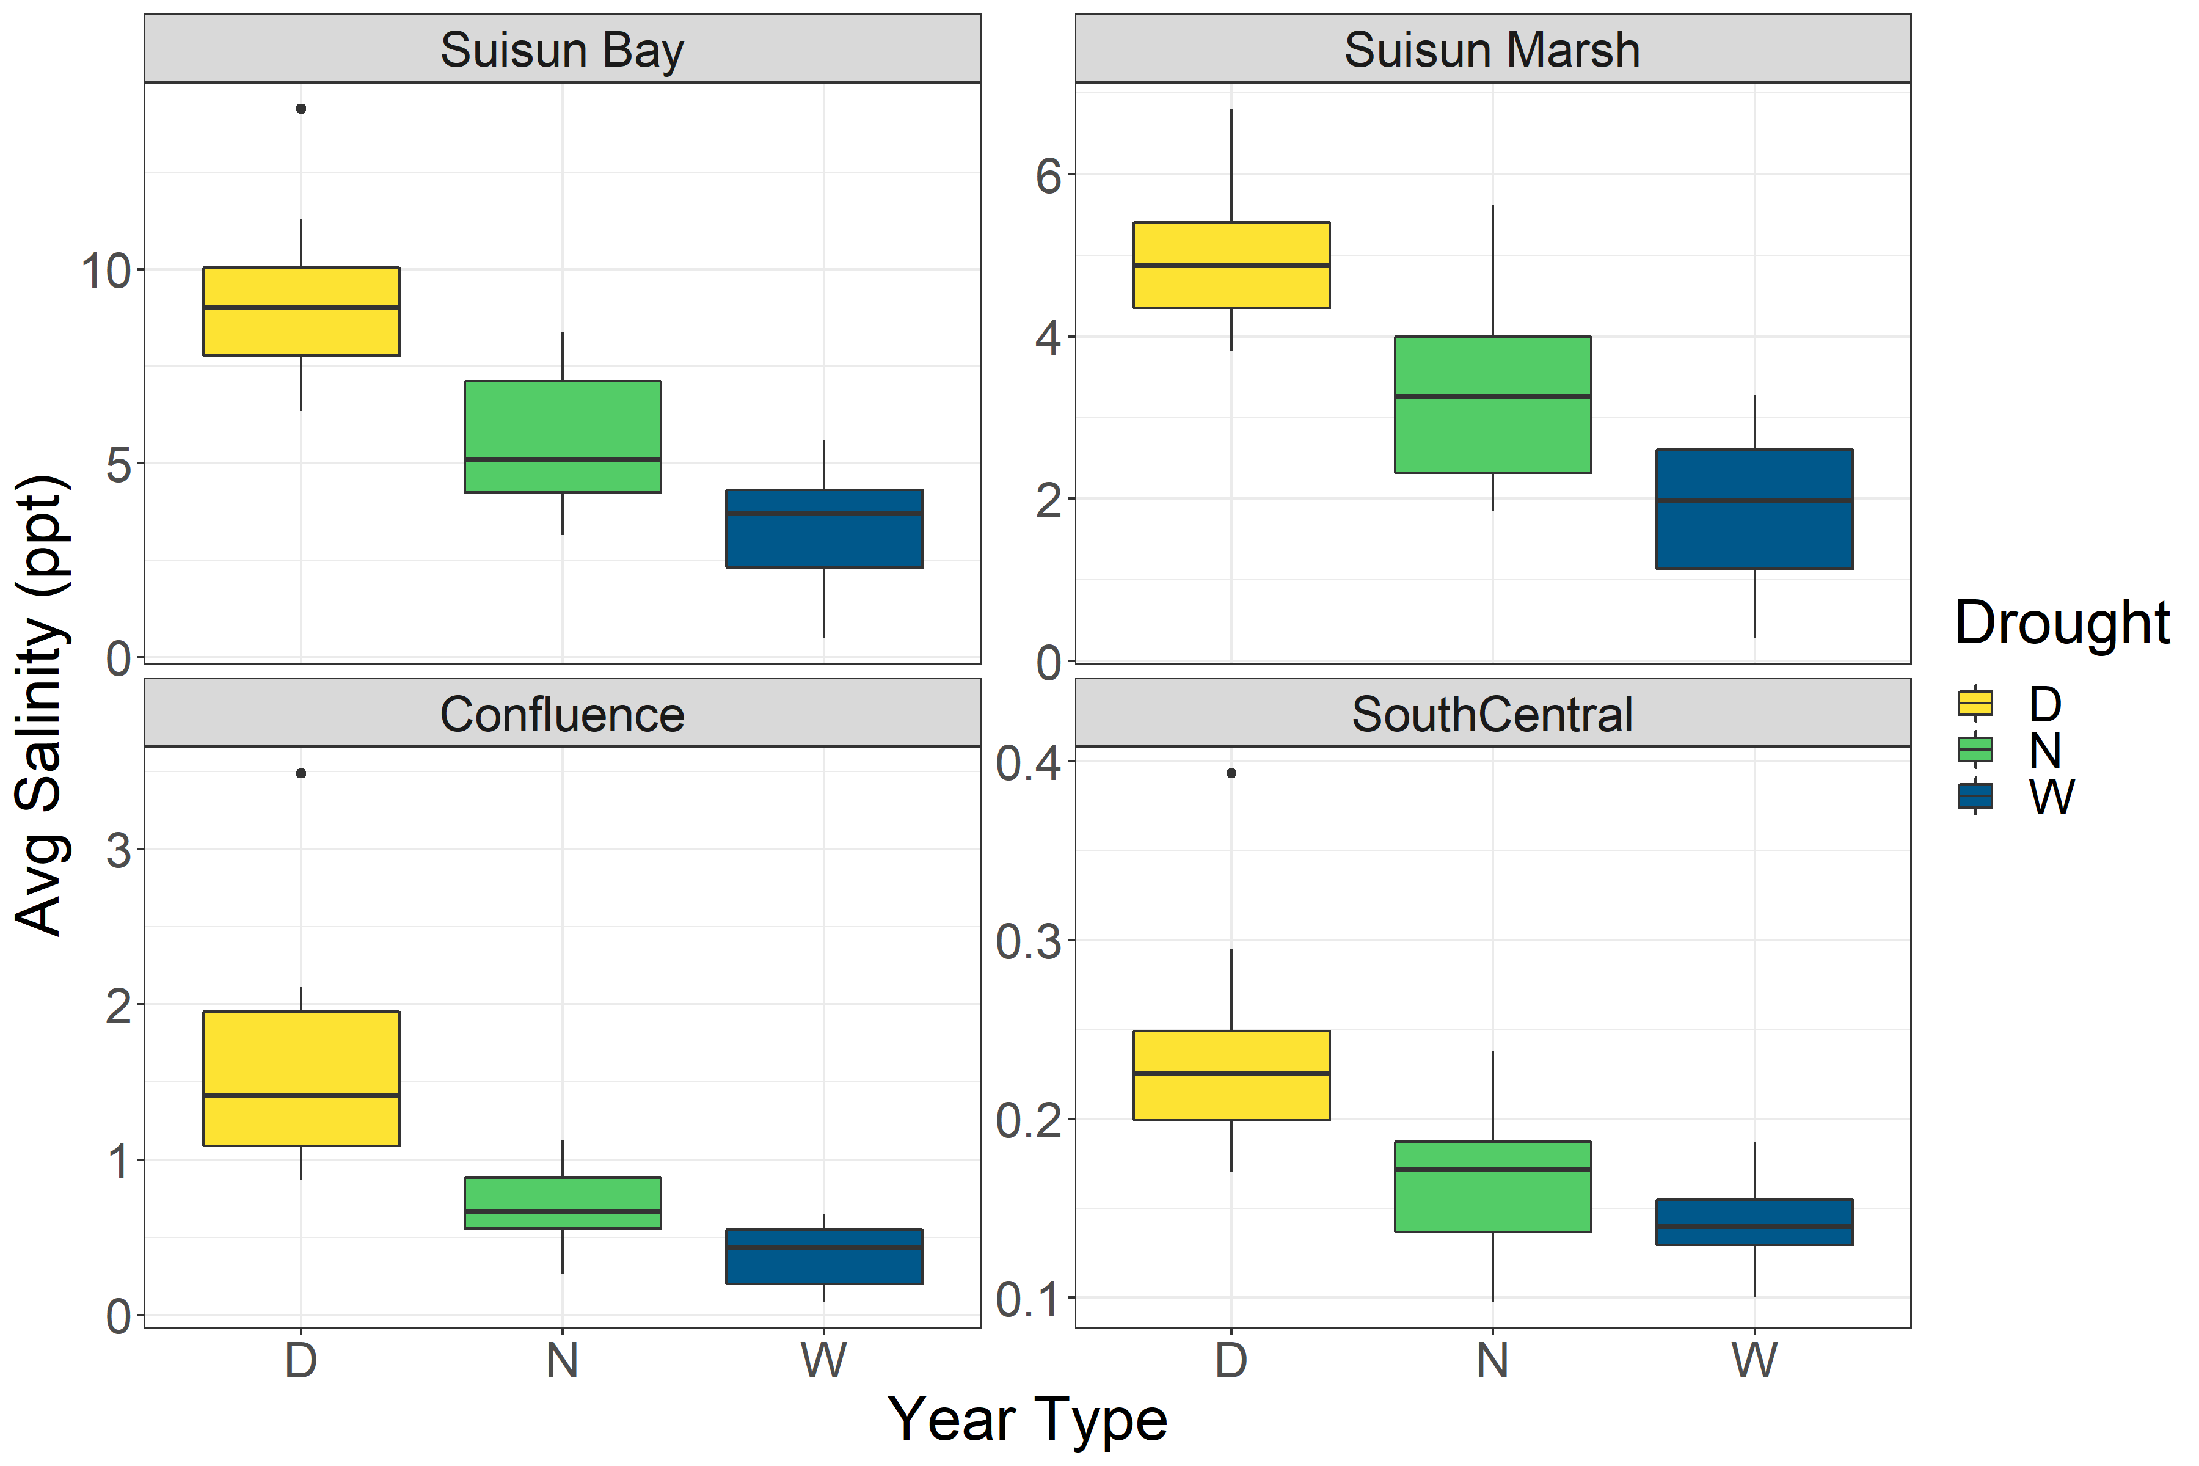

Slide 17
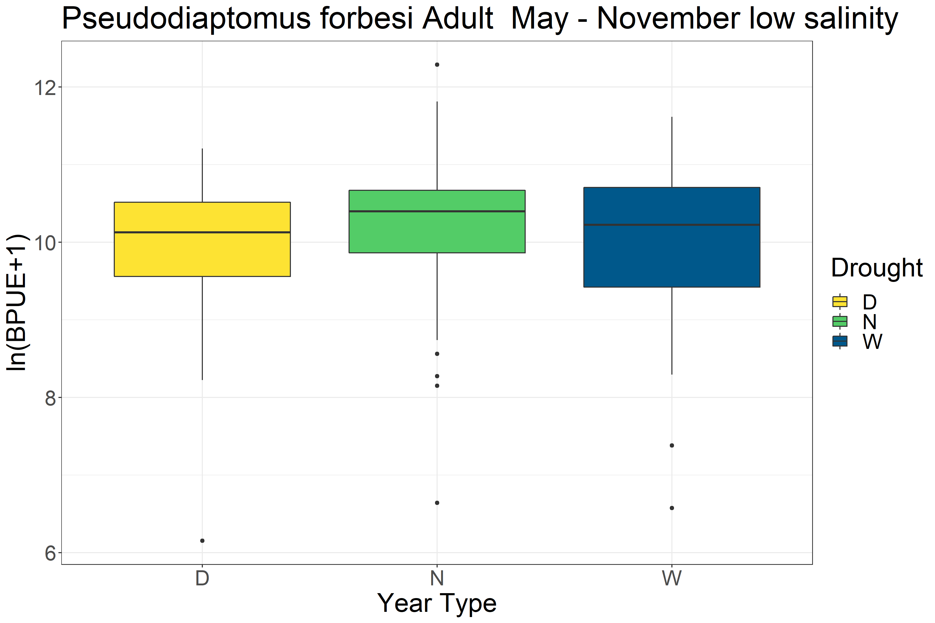
P=0.048
TukeyHSD shows significant difference between Drought and Normal years
There is no large difference in P forbesi BPUE between Drought and Wet years within their preferred salinity zone (<5ppt). To me this suggests that within that salinity zone, there is no difference in P forbesi BPUE between Drought and Wet years, and regional changes in BPUE are driven by changes or movement in that salinity zone.

Slide 18
Here we can see that in Suisun Bay and Suisun Marsh, the regions with significant changes in P forbesi BPUE between year types, salinity in both areas increases to near or above 5ppt. during drought years.

