Slide 1
Drought Zooplankton Questions
Limiting to top taxa for four groups (P. forbesi, L. tetraspina, B. longirostris, H. longirostris)
Do we see regional changes in taxa BPUE?
Are there env parameters correlated with higher BPUE?
Does Drought impact the env parameters correlated with higher BPUE?
Are the env parameters for taxa changing, or moving?

Slide 2
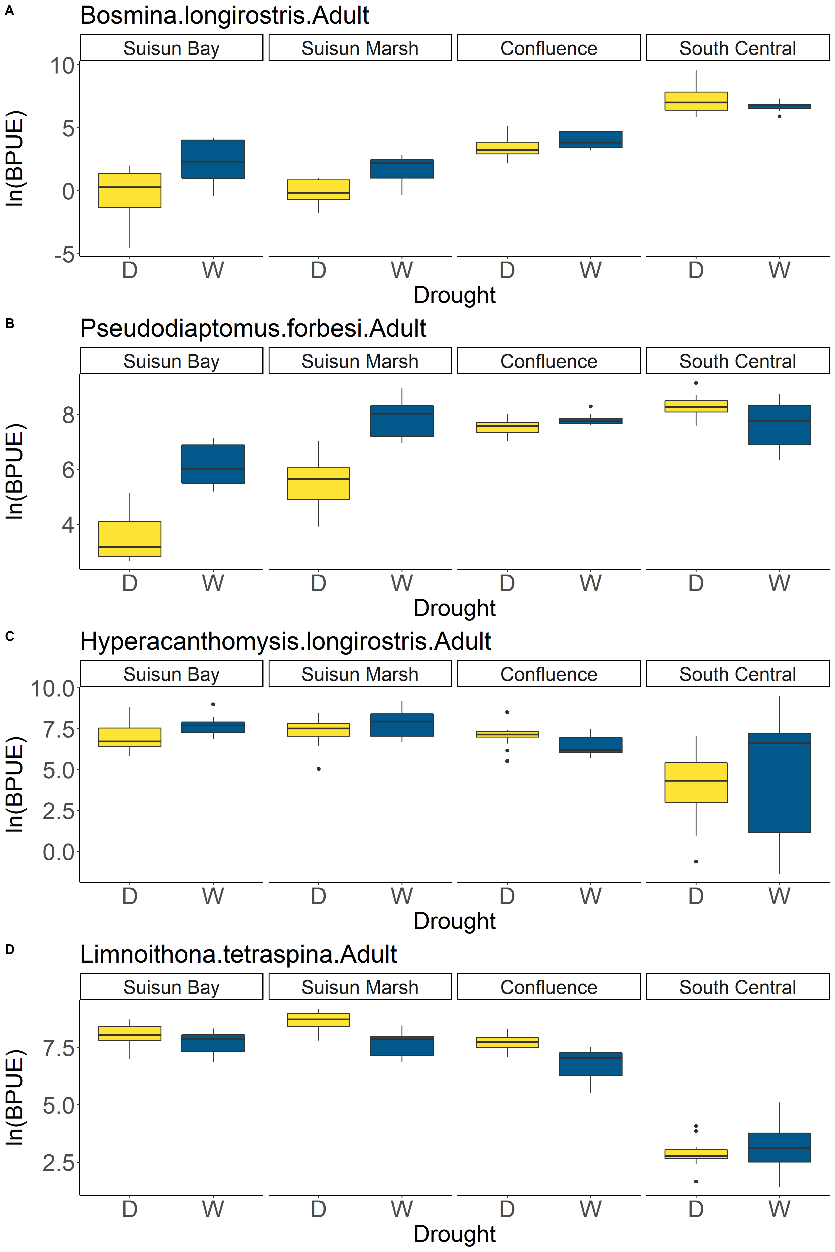
Regional Drought Changes
*
*
Taxa | Region | p1
Bosmina.longirostris.Adult | Confluence | 0.149
Bosmina.longirostris.Adult | South Central | 0.304
Bosmina.longirostris.Adult | Suisun Bay | 0.0155
Bosmina.longirostris.Adult | Suisun Marsh | 0.0128
Pseudodiaptomus.forbesi.Adult | Confluence | 0.0478
Pseudodiaptomus.forbesi.Adult | South Central | 0.0377
Pseudodiaptomus.forbesi.Adult | Suisun Bay | 6.58E-07
Pseudodiaptomus.forbesi.Adult | Suisun Marsh | 5.96E-06
Hyperacanthomysis.longirostris.Adult | Confluence | 0.0608
Hyperacanthomysis.longirostris.Adult | South Central | 0.596
Hyperacanthomysis.longirostris.Adult | Suisun Bay | 0.072
Hyperacanthomysis.longirostris.Adult | Suisun Marsh | 0.216
Limnoithona.tetraspina.Adult | Confluence | 0.00104
Limnoithona.tetraspina.Adult | South Central | 0.394
Limnoithona.tetraspina.Adult | Suisun Bay | 0.152
Limnoithona.tetraspina.Adult | Suisun Marsh | 0.000308
*
*
*
*
*
*
Notes:
The table and figure are useful, but I think a simpler table could just be, for species and region, does taxa BPUE increase or decrease during droughts?

Slide 3
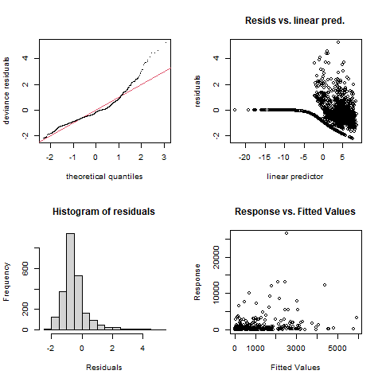
Bosmina longirostris model
Family: Negative Binomial(0.277)
Link function: log
Formula:
BPUE ~ s(salinity) + s(month, k = 5) + s(scaled_temp) + s(Station,
bs = "re")
Parametric coefficients:
Estimate Std. Error z value Pr(>|z|)
(Intercept) 1.6224 0.3663 4.429 9.47e-06 ***
---
Signif. codes: 0 ‘***’ 0.001 ‘**’ 0.01 ‘*’ 0.05 ‘.’ 0.1 ‘ ’ 1
Approximate significance of smooth terms:
edf Ref.df Chi.sq p-value
s(salinity) 6.469 7.003 858.14 < 2e-16 ***
s(month) 3.882 3.991 127.59 < 2e-16 ***
s(scaled_temp) 3.520 4.504 22.43 0.000314 ***
s(Station) 13.334 14.000 415.01 < 2e-16 ***
---
Signif. codes: 0 ‘***’ 0.001 ‘**’ 0.01 ‘*’ 0.05 ‘.’ 0.1 ‘ ’ 1
R-sq.(adj) = 0.126 Deviance explained = 64.1%
-REML = 7387.1 Scale est. = 1 n = 2340

Slide 4
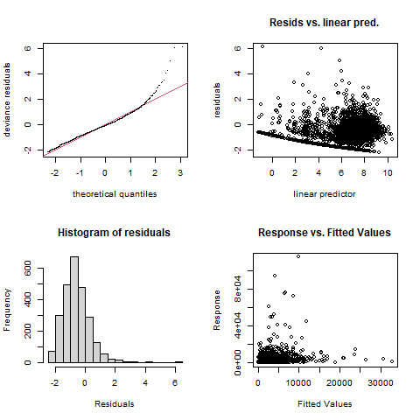
Hyperacanthomysis longirostris model
Family: Negative Binomial(0.402)
Link function: log
Formula:
BPUE ~ s(salinity) + s(month, k = 5) + s(scaled_temp) + s(Station,
bs = "re")
Parametric coefficients:
Estimate Std. Error z value Pr(>|z|)
(Intercept) 6.2866 0.4605 13.65 <2e-16 ***
---
Signif. codes: 0 ‘***’ 0.001 ‘**’ 0.01 ‘*’ 0.05 ‘.’ 0.1 ‘ ’ 1
Approximate significance of smooth terms:
edf Ref.df Chi.sq p-value
s(salinity) 6.959 8.050 149.68 < 2e-16 ***
s(month) 3.228 3.682 197.69 < 2e-16 ***
s(scaled_temp) 3.947 5.025 27.35 5.34e-05 ***
s(Station) 15.680 16.000 930.59 < 2e-16 ***
---
Signif. codes: 0 ‘***’ 0.001 ‘**’ 0.01 ‘*’ 0.05 ‘.’ 0.1 ‘ ’ 1
R-sq.(adj) = 0.0776 Deviance explained = 30.9%
-REML = 14462 Scale est. = 1 n = 1891

Slide 5
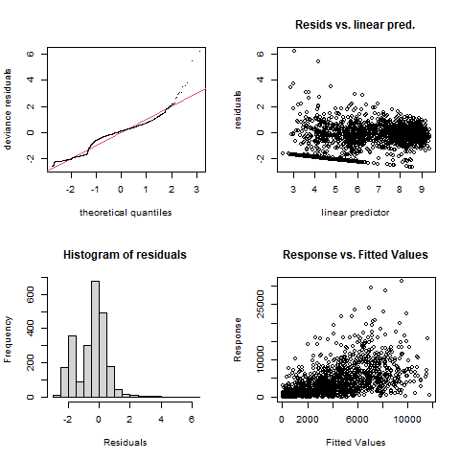
Limnoithona tetraspina model
Family: Negative Binomial(0.367)
Link function: log
Formula:
BPUE ~ s(salinity) + s(month, k = 5) + s(scaled_temp) + s(Station,
bs = "re")
Parametric coefficients:
Estimate Std. Error z value Pr(>|z|)
(Intercept) 6.7231 0.2553 26.34 <2e-16 ***
---
Signif. codes: 0 ‘***’ 0.001 ‘**’ 0.01 ‘*’ 0.05 ‘.’ 0.1 ‘ ’ 1
Approximate significance of smooth terms:
edf Ref.df Chi.sq p-value
s(salinity) 8.540 8.941 434.91 < 2e-16 ***
s(month) 3.410 3.804 74.72 5.19e-15 ***
s(scaled_temp) 3.442 4.408 10.06 0.0539 .
s(Station) 13.377 14.000 325.15 < 2e-16 ***
---
Signif. codes: 0 ‘***’ 0.001 ‘**’ 0.01 ‘*’ 0.05 ‘.’ 0.1 ‘ ’ 1
R-sq.(adj) = 0.46 Deviance explained = 41.7%
-REML = 17372 Scale est. = 1 n = 2356

Slide 6
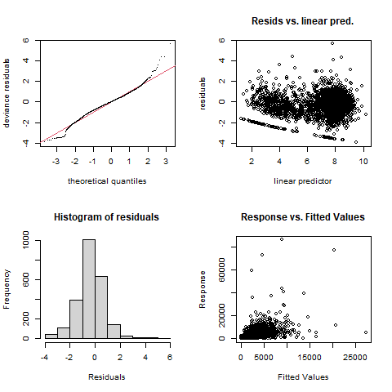
Pseudodiaptomus forbesi model
Family: Negative Binomial(0.782)
Link function: log
Formula:
BPUE ~ s(salinity) + s(month, k = 5) + s(scaled_temp) + s(Station,
bs = "re")
Parametric coefficients:
Estimate Std. Error z value Pr(>|z|)
(Intercept) 6.9004 0.0926 74.52 <2e-16 ***
---
Signif. codes: 0 ‘***’ 0.001 ‘**’ 0.01 ‘*’ 0.05 ‘.’ 0.1 ‘ ’ 1
Approximate significance of smooth terms:
edf Ref.df Chi.sq p-value
s(salinity) 6.058 7.238 1587.7 <2e-16 ***
s(month) 3.918 3.996 180.3 <2e-16 ***
s(scaled_temp) 1.018 1.036 100.2 <2e-16 ***
s(Station) 12.243 14.000 206.5 <2e-16 ***
---
Signif. codes: 0 ‘***’ 0.001 ‘**’ 0.01 ‘*’ 0.05 ‘.’ 0.1 ‘ ’ 1
R-sq.(adj) = 0.266 Deviance explained = 56.2%
-REML = 18478 Scale est. = 1 n = 2340

Slide 7
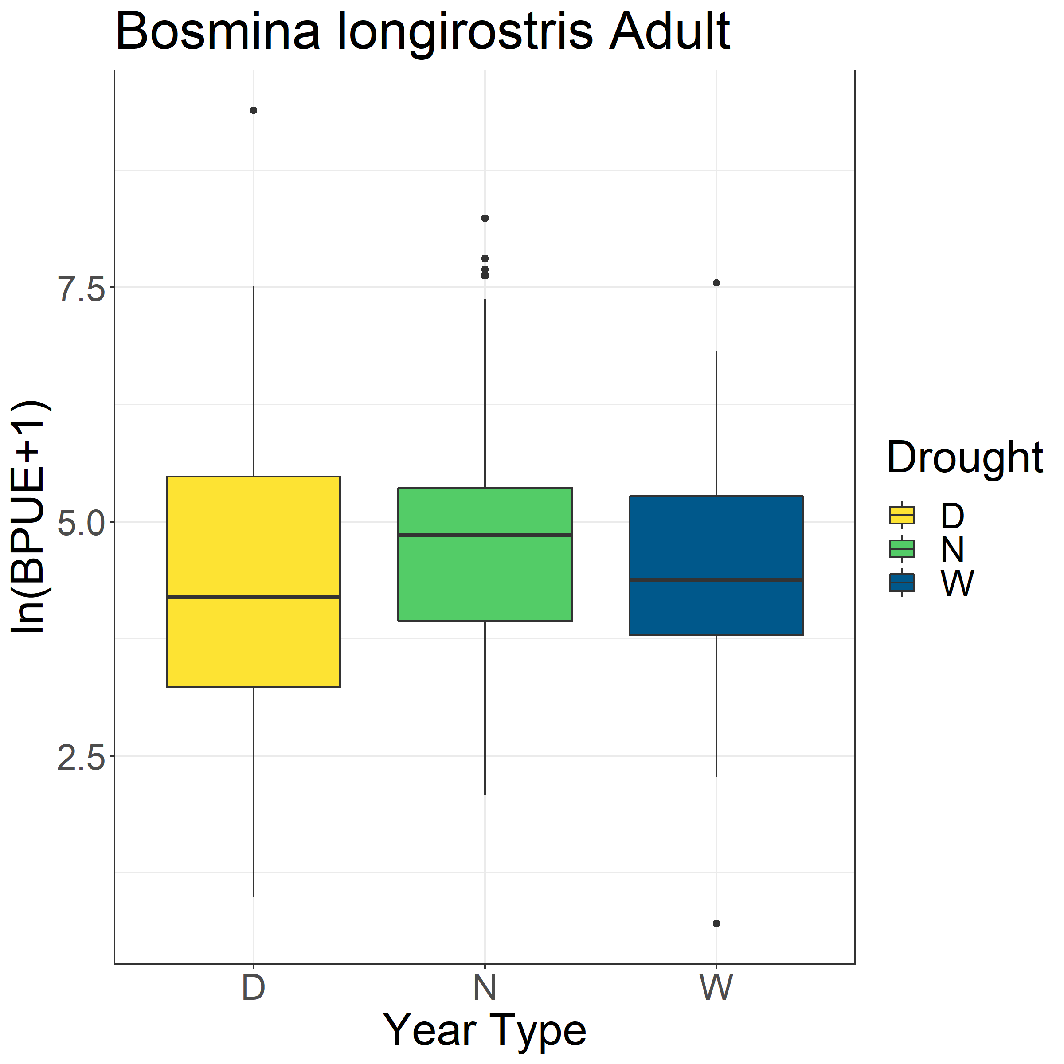
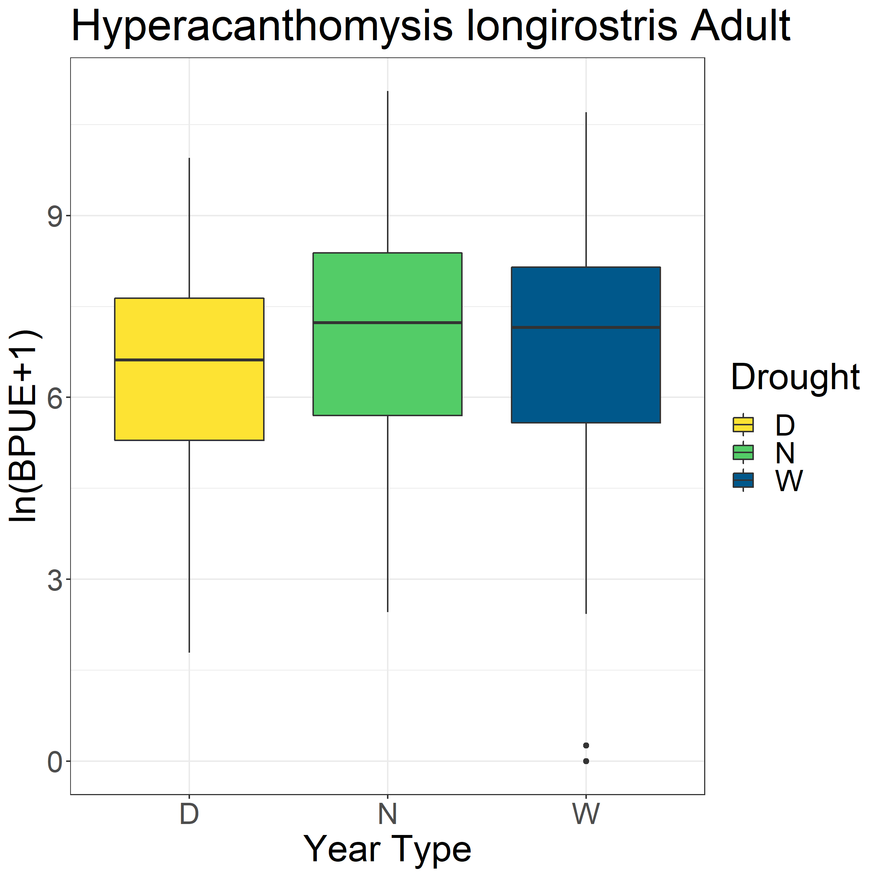
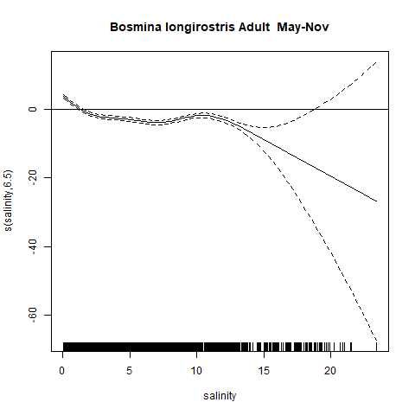
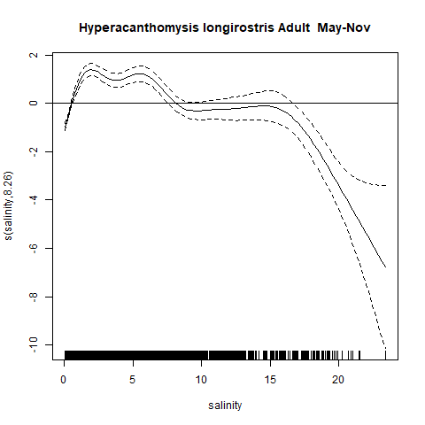
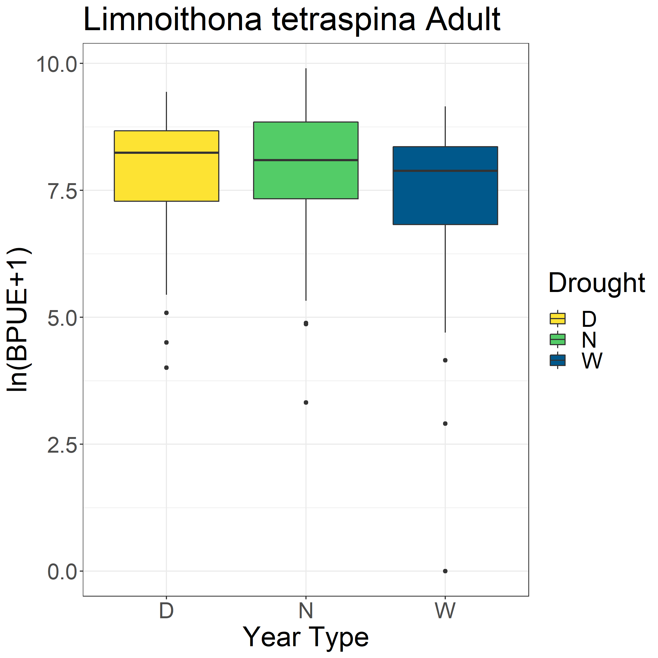
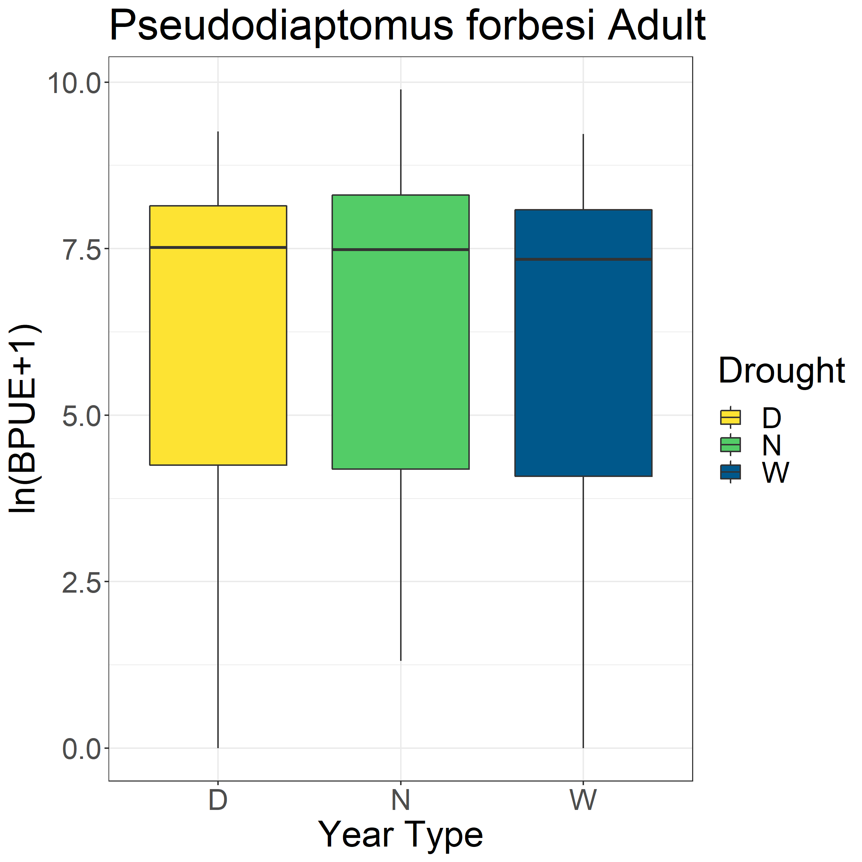
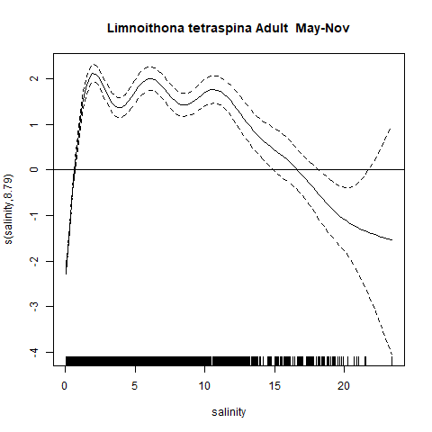
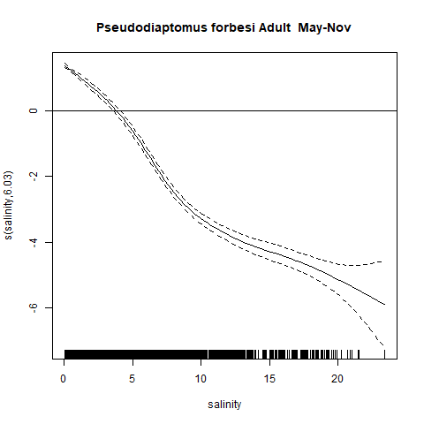
A
A
A
A
B
AB
AB
A
B
A
A
A

Slide 8
