Slide 1
Drought Zooplankton Questions
Limiting to top taxa for four groups (P. forbesi, L. tetraspina, B. longirostris, H. longirostris)
Do we see regional changes in taxa BPUE?
Are there env parameters correlated with higher BPUE?
Does Drought impact the env parameters correlated with higher BPUE?
Are the env parameters for taxa changing, or moving?

Slide 2
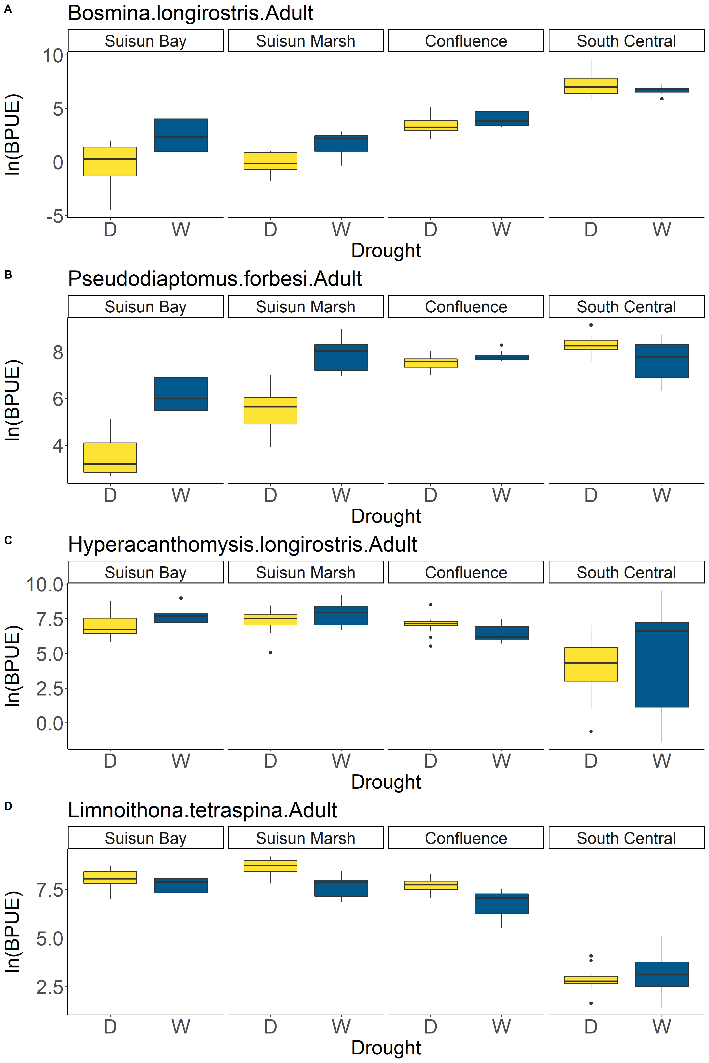
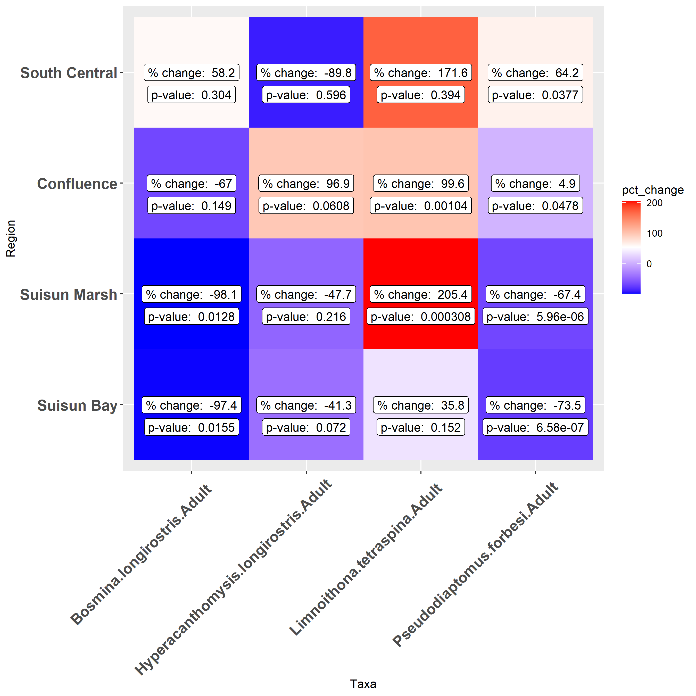
Regional Drought Changes
*
*
*
*
*
*
*
*
*
*
*
*
*
*
*
*
Notes:
The table and figure are useful, but I think a simpler table could just be, for species and region, does taxa BPUE increase or decrease during droughts?

Slide 3
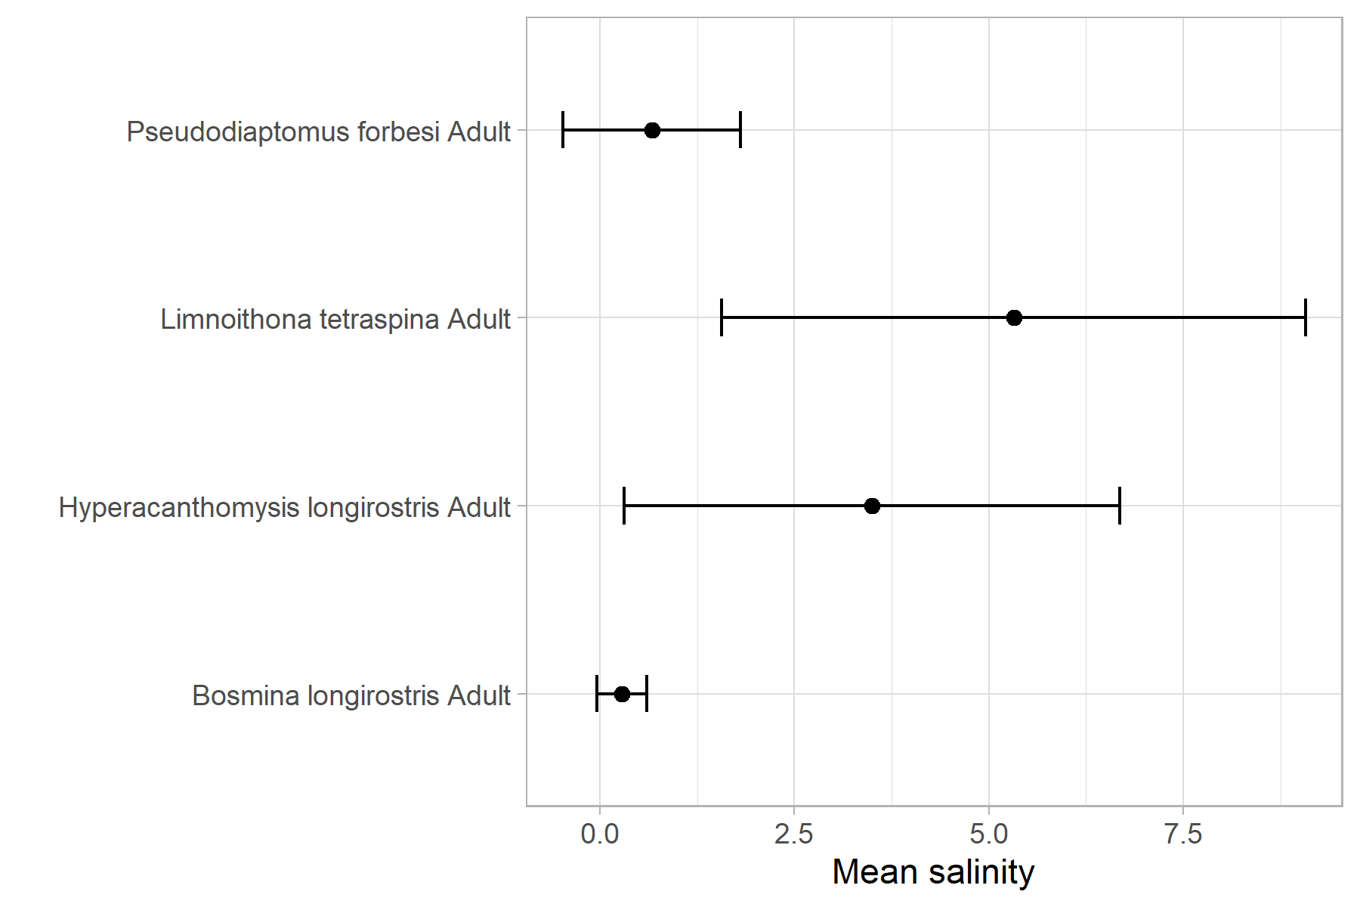
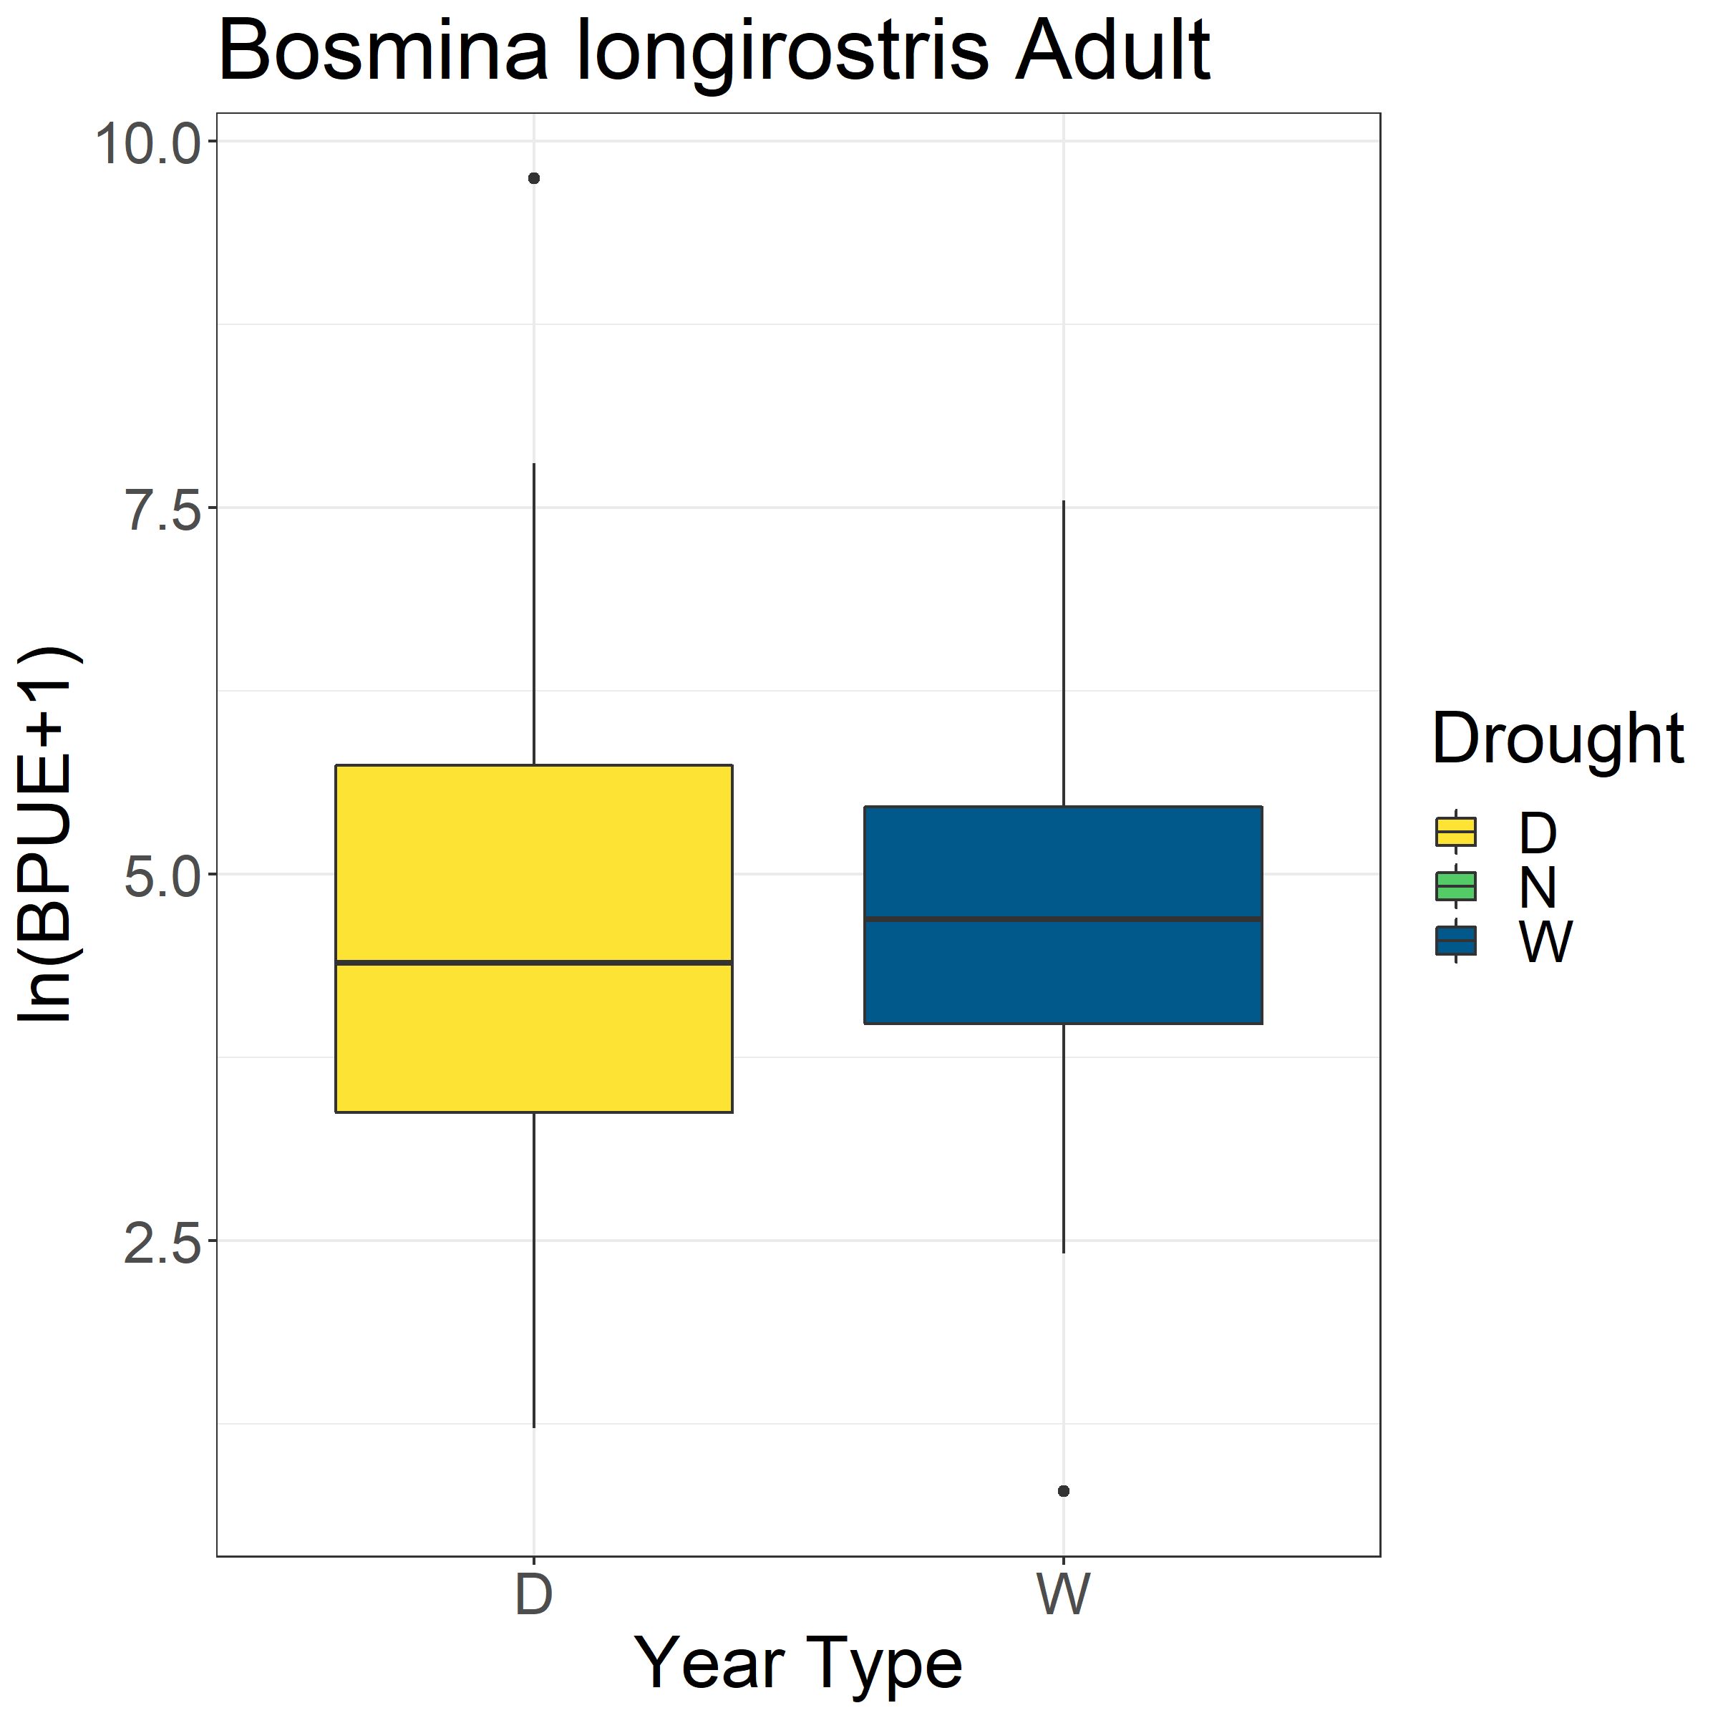
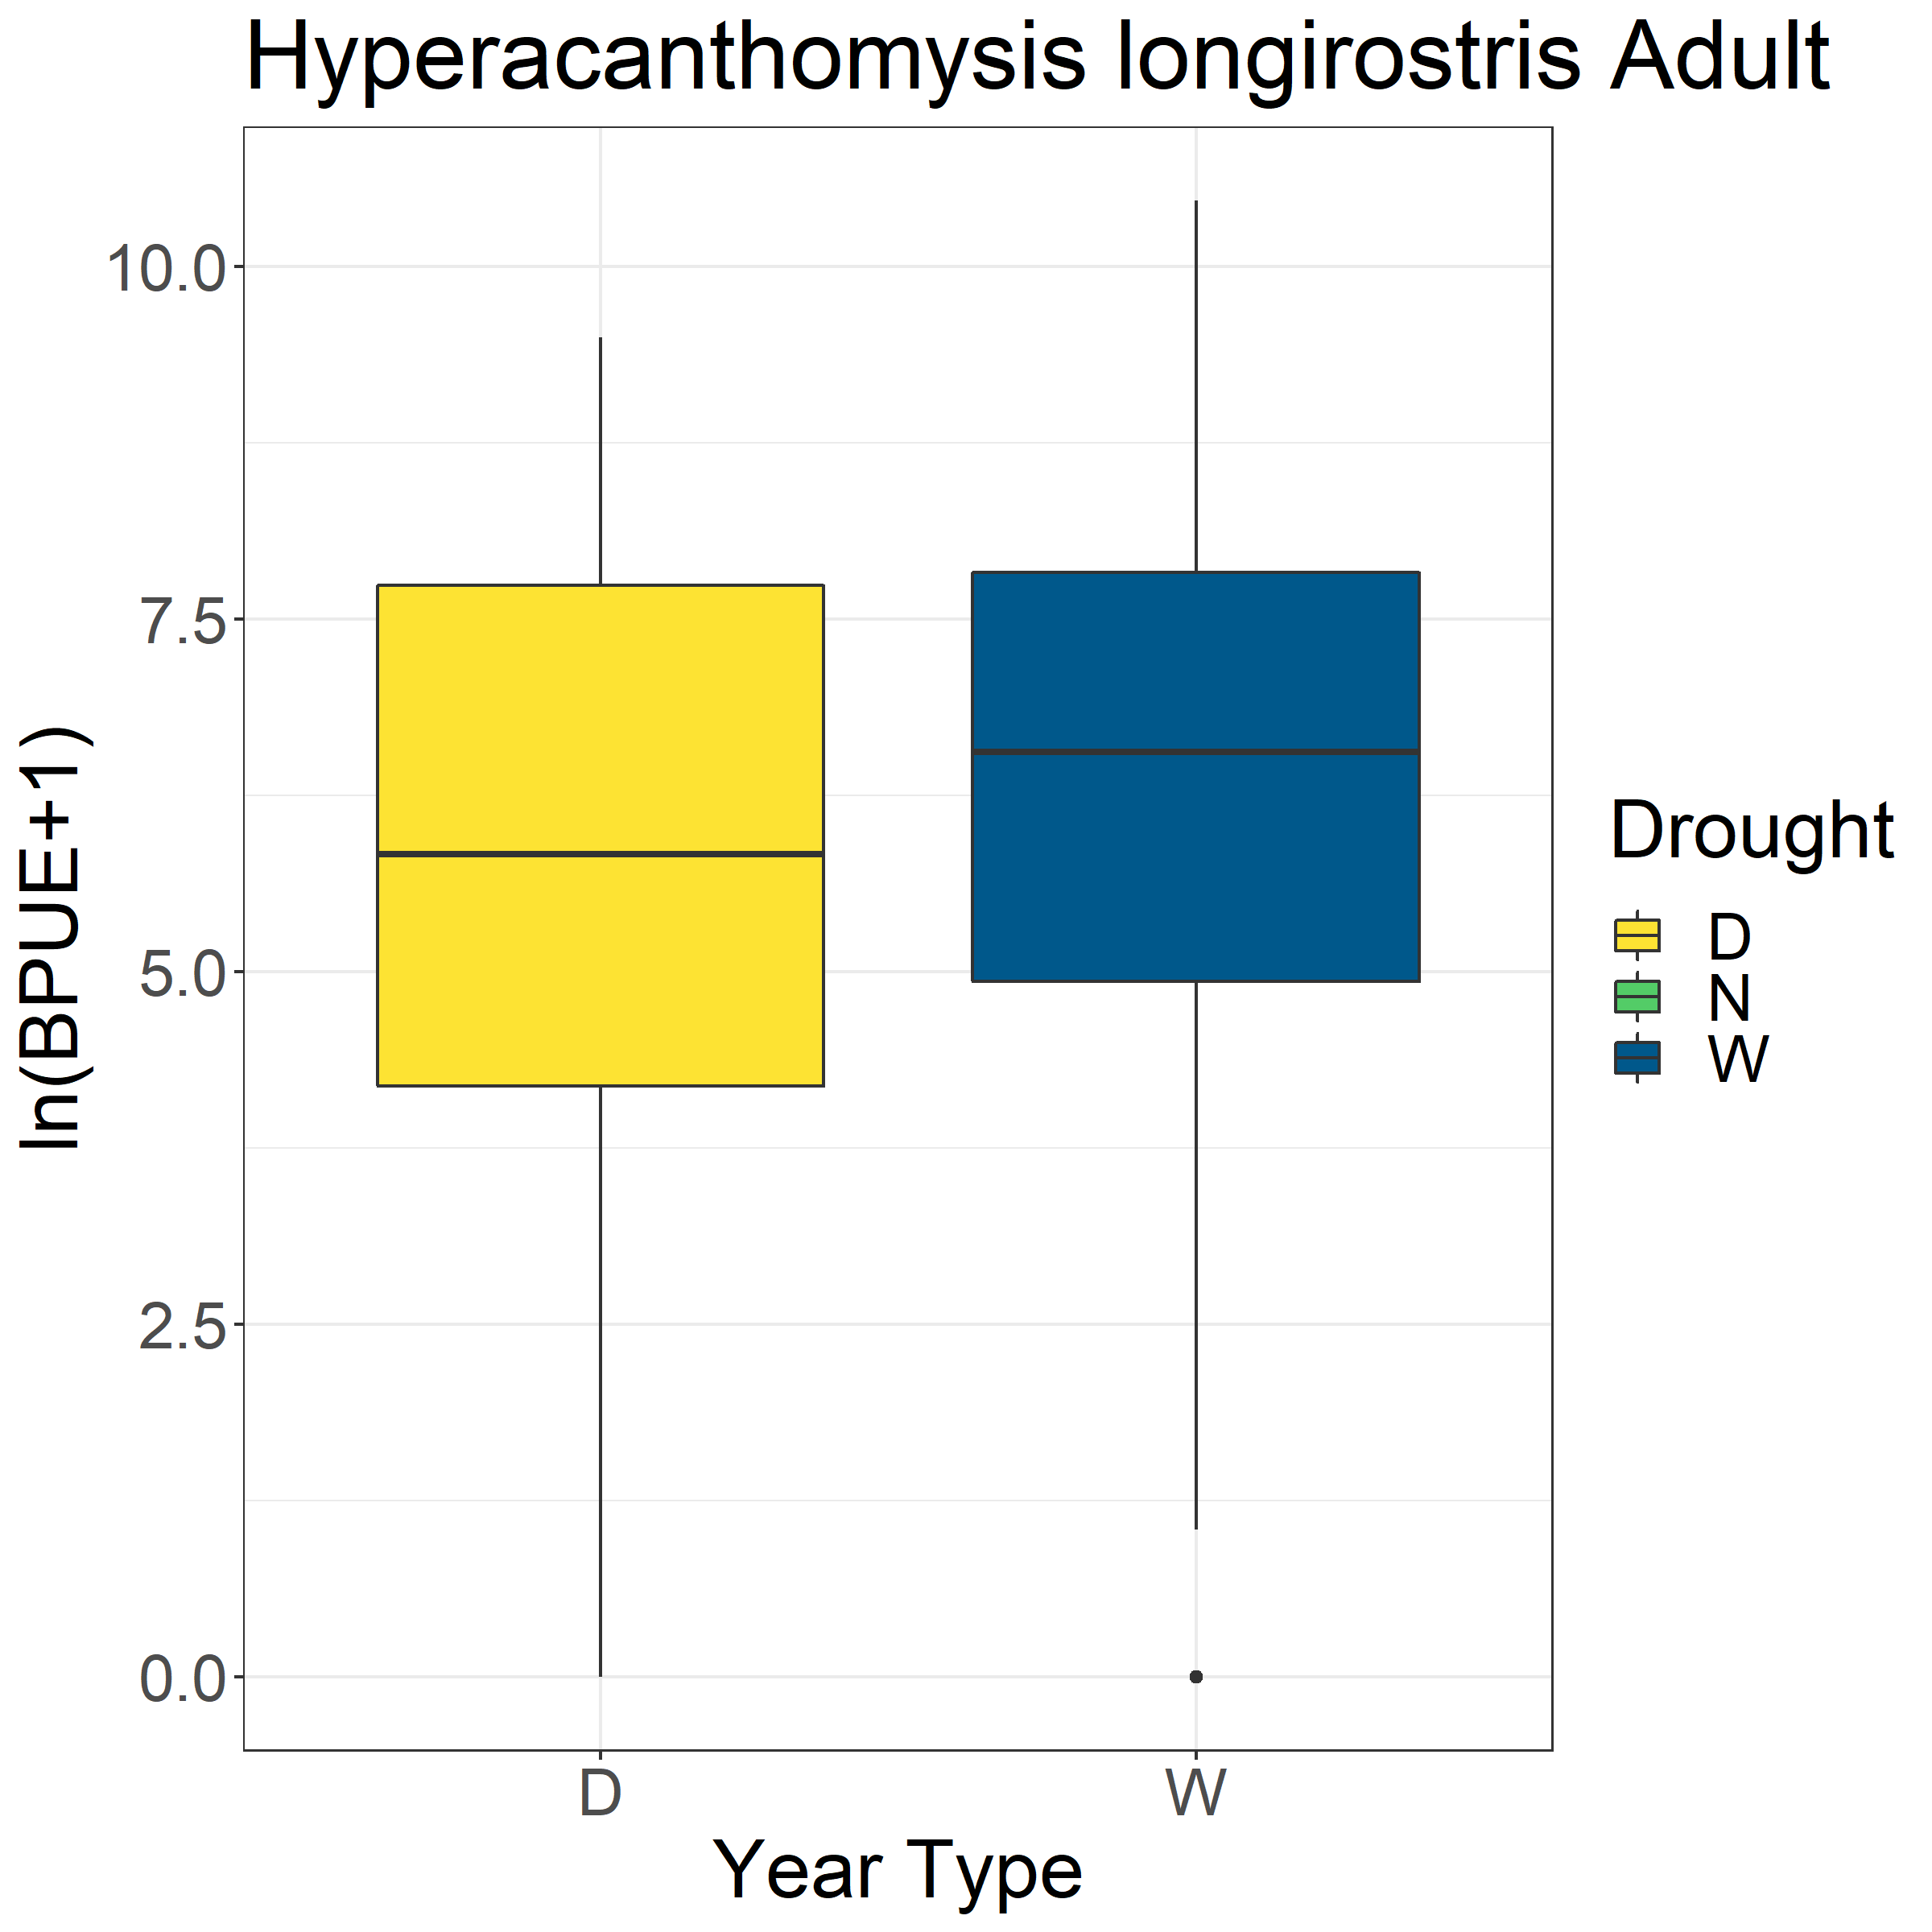
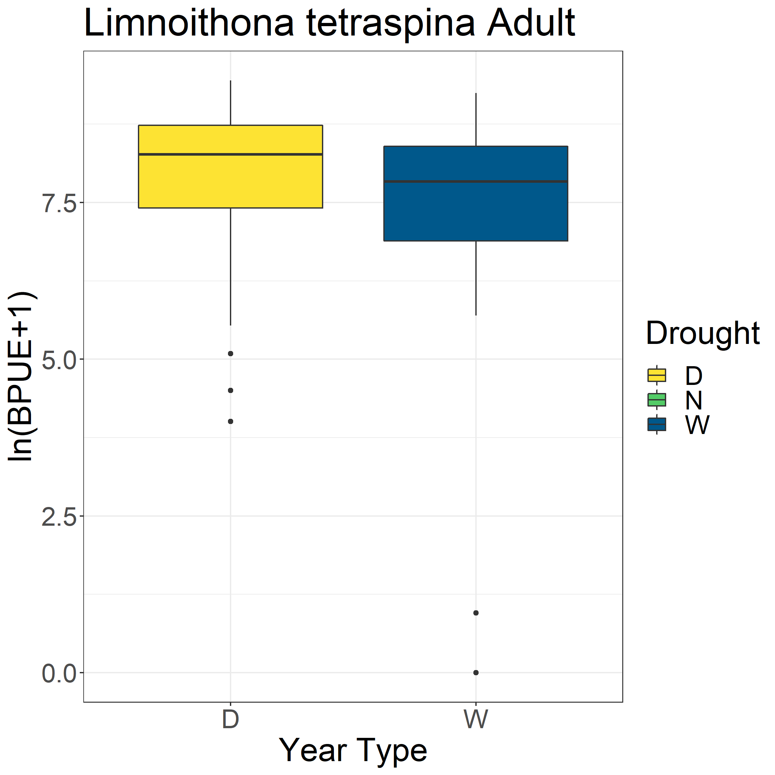
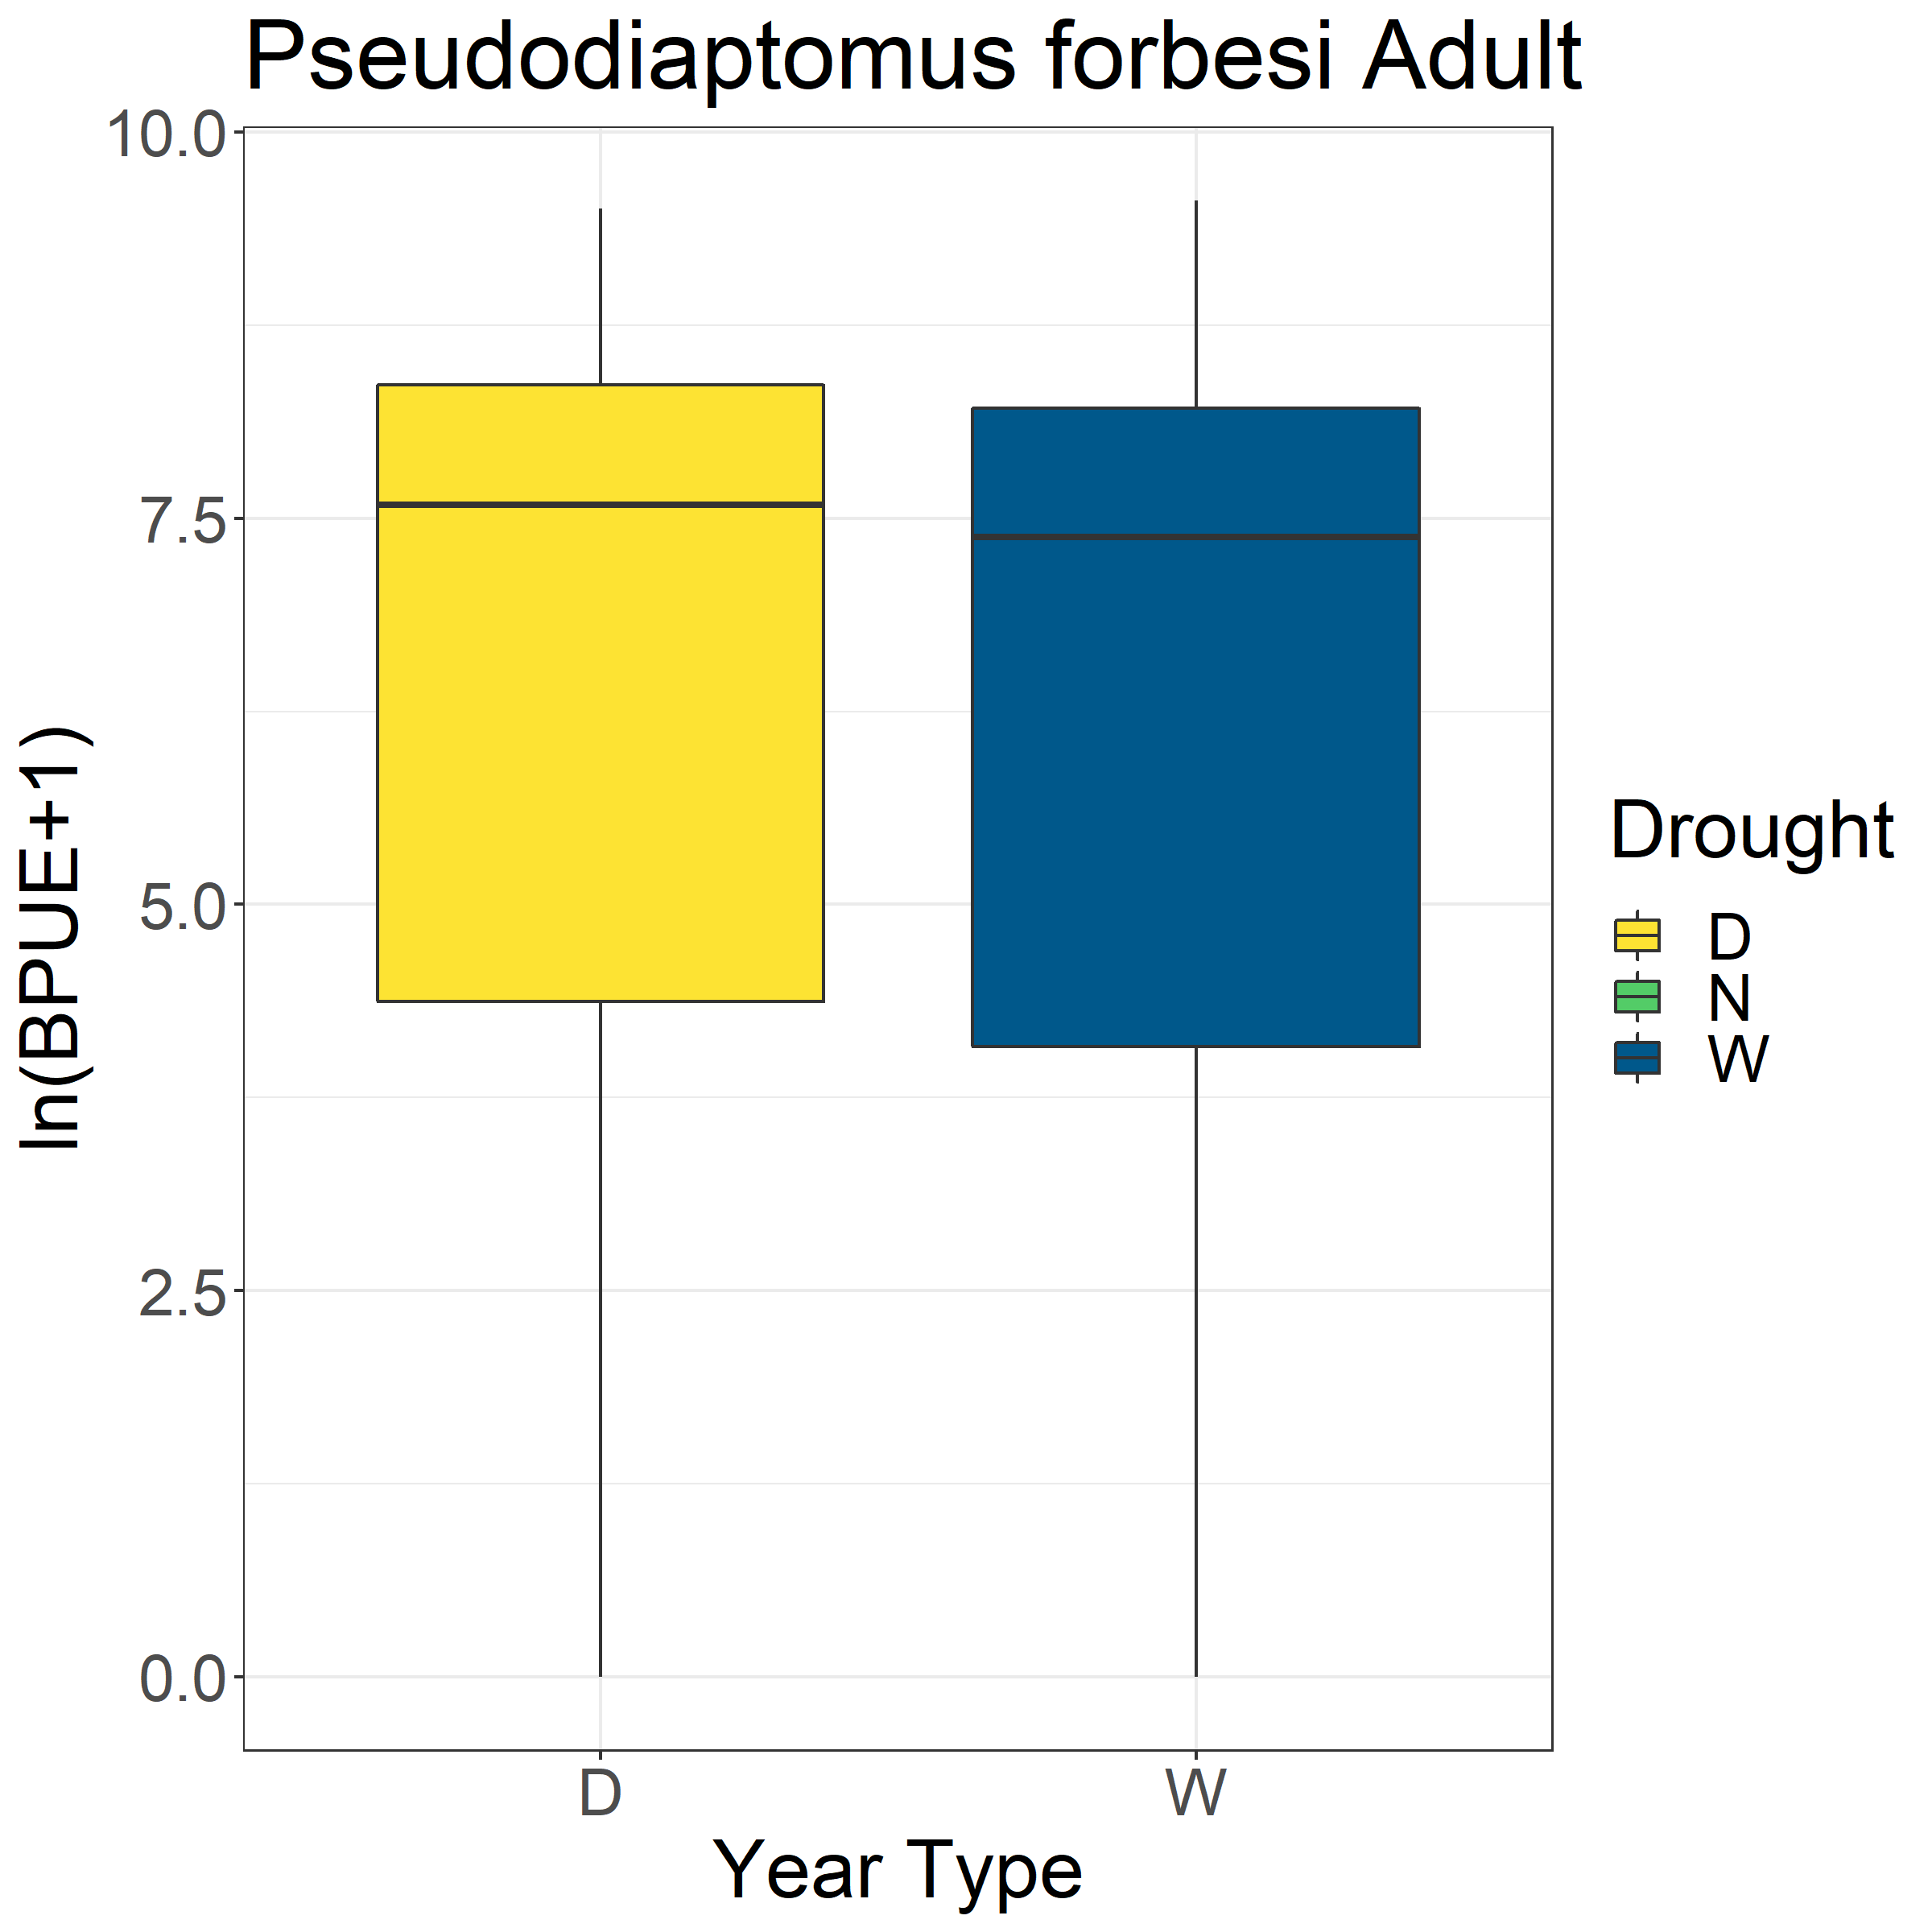
*

Slide 4
