Slide 1

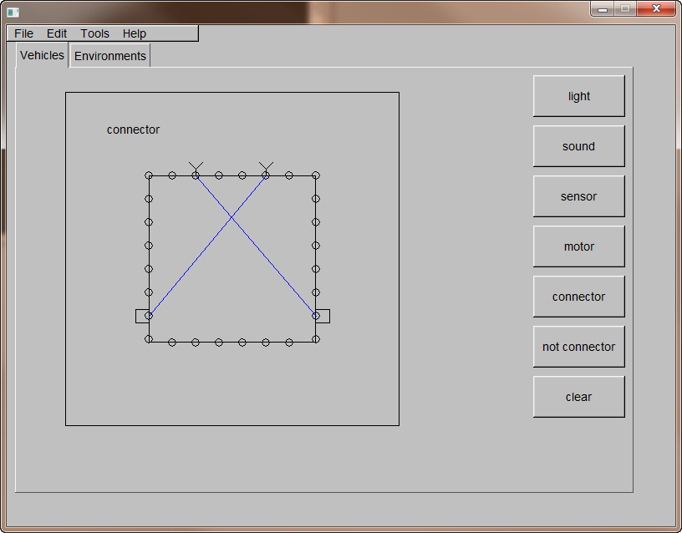
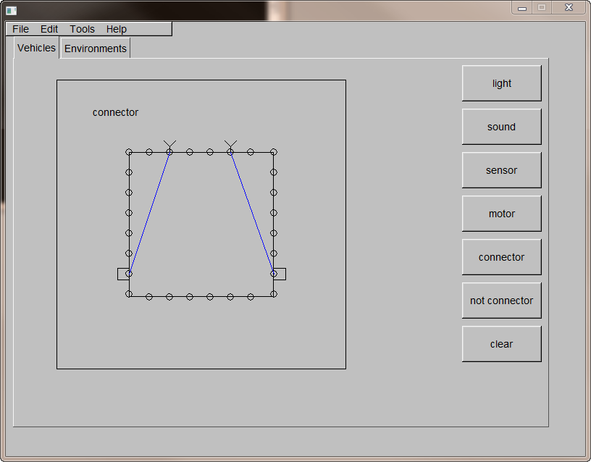
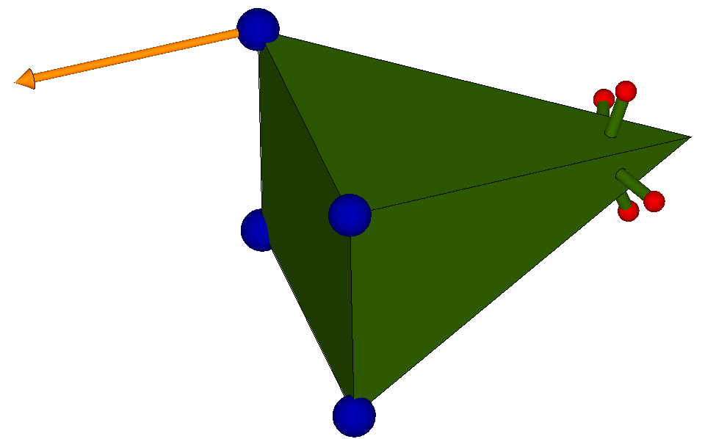
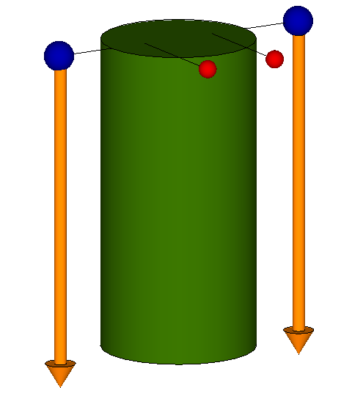
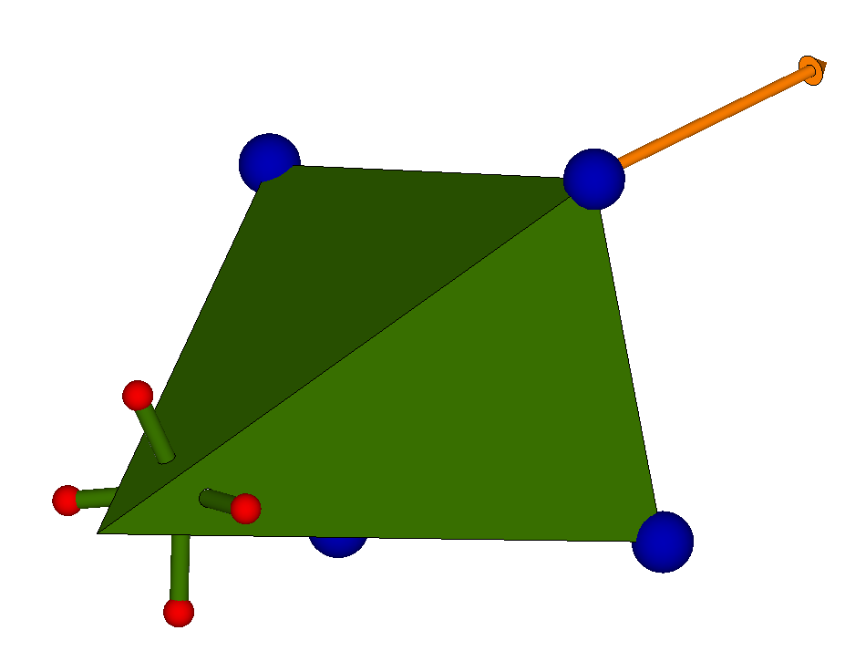
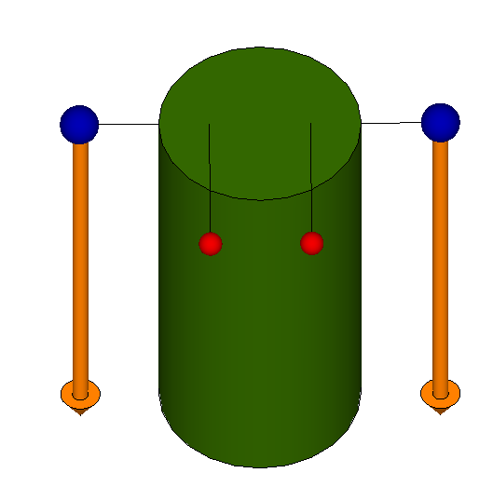
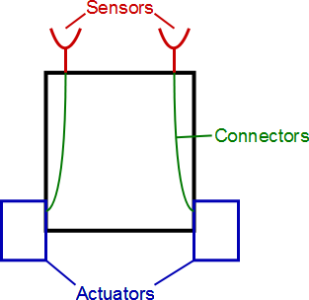
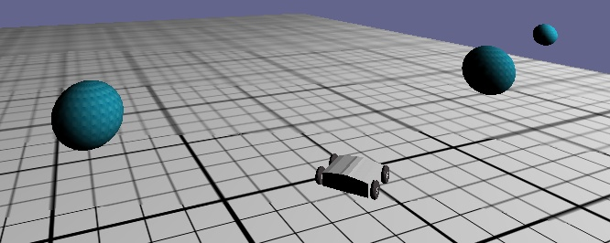
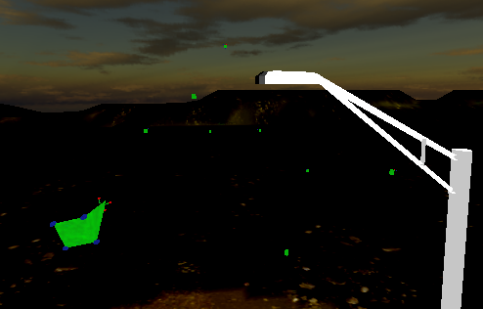
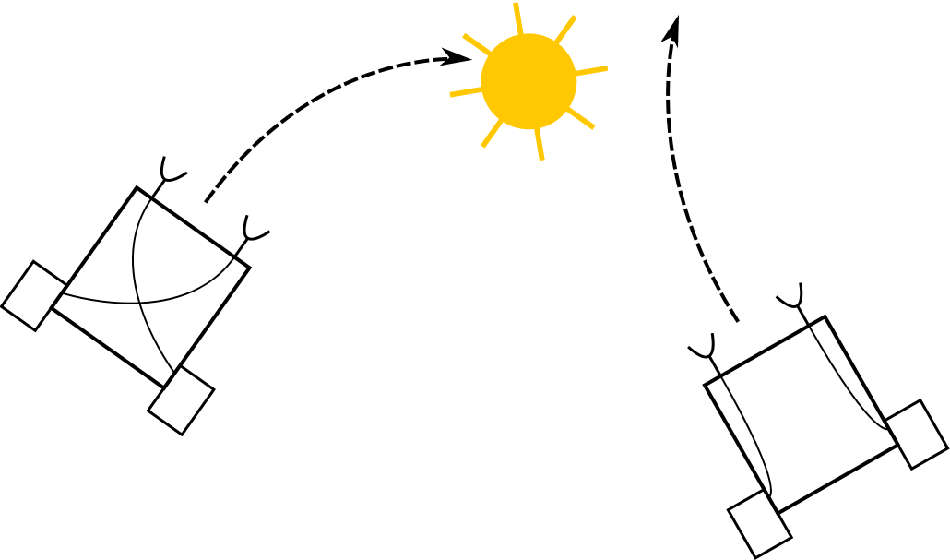
Artificial Life using the Connectionist Agent Paradigm
Arthur Carroll and G. Michael Youngblood
Overview
Authoring Tool
Extension to 3 Dimensional Agents
We present a new paradigm for controlling agents in games and simulations using connectionist networks. These networks can either be simple software models of analog circuits or artificial neural networks. It is also possible to combine the two to form a hybrid agent. This study is exploring three questions in particular:
1. Can the authorial burden of creating agents be simplified using said connectionist paradigm?
2. Can the directly mathematical nature of this architecture produce a performance increase when compared to more traditional agent control algorithms based on state space searches?
3. Can a general theorem be derived which explains the emergent behavior of simple and complex connectionist agents.
To facilitate the creation of agents we have created an agent authoring tool as part of this research. The authoring tool allows a user to create agents via the connectionist paradigm by placing sensors, actuators, and connectors directly on model. The user can create an environment comprising of simple geometric shapes and place stimuli and agents into this environment.
The connectionist paradigm can also be extended to agents which operate in 3 dimensions. These agents can be used to emulate the behavior of biological flying agents. We are exploring creating an artificial life simulator consisting of flying insects and winged predators. This experiment has two purposes:
To explore the applying these principles to 3D agents.
To evaluate the time investment required for creating 3D agents.
This study is largely inspired by the works of Valentino Braintenberg, namely his seminal publication, a book titled “Vehicles: Experiments in Synthetic Psychology”. While this book covers many subjects, the core concept of the book is that complex emotions and behaviors can be emulated using very simple models. This involves wiring sensors directly to actuators through wires. The wires pass the signal output of the sensor to the actuator through a transfer function.
Simulator
To visualize the results of this research we have created a simulator to test the behavior of agents. The simulator allows the user to load environments and observe the agent’s behavior.
A Simple
Agent
Winged Predator (Bat) Model
Flying Bug Model
Love
Hate
An agent navigating an environment
Reactive Engine
The Reactive engine is the core component of this research, it is the program which simulates the circuitry inside each agent. The engine operates separately from the authoring tool and simulator to facilitate its use in a broad range of applications. The engine has four core components: A file loader, vehicle simulator, physics engine, and expression parser.
Artificial Life Simulation of Bats and Bugs

