Slide 1

Predicting Churn in Telecommunication
Strategic Thinking – CA2
Semester 2
CCT College Dublin
Arthur Claudino Gomes de Assis (2023146)
©CCT College Dublin 2023

Slide 2

Business understanding and data visualization
Churn is a common problem in the telecommunications business and refers to customers who cancel or do not renew their contract with a telecommunications company in a given period. Churn is a very important indicator for telecommunications companies since it is much more expensive to attract new customers than to retain existing ones.
Price
Product/Market Fit
User Experience
Customer Experience
Other Causes

Slide 3
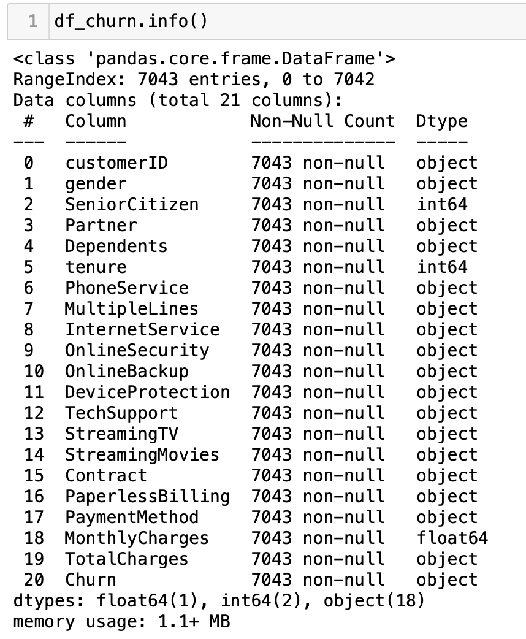
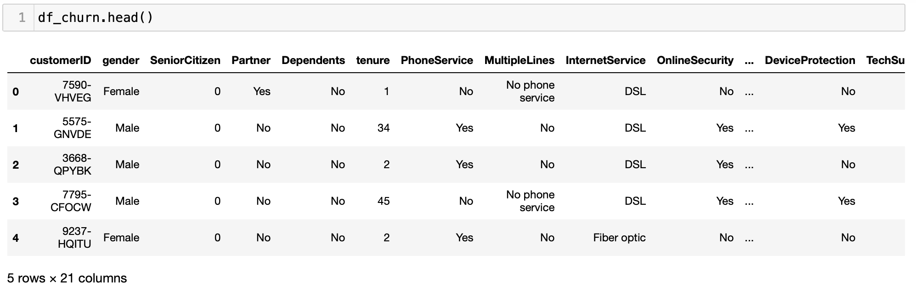
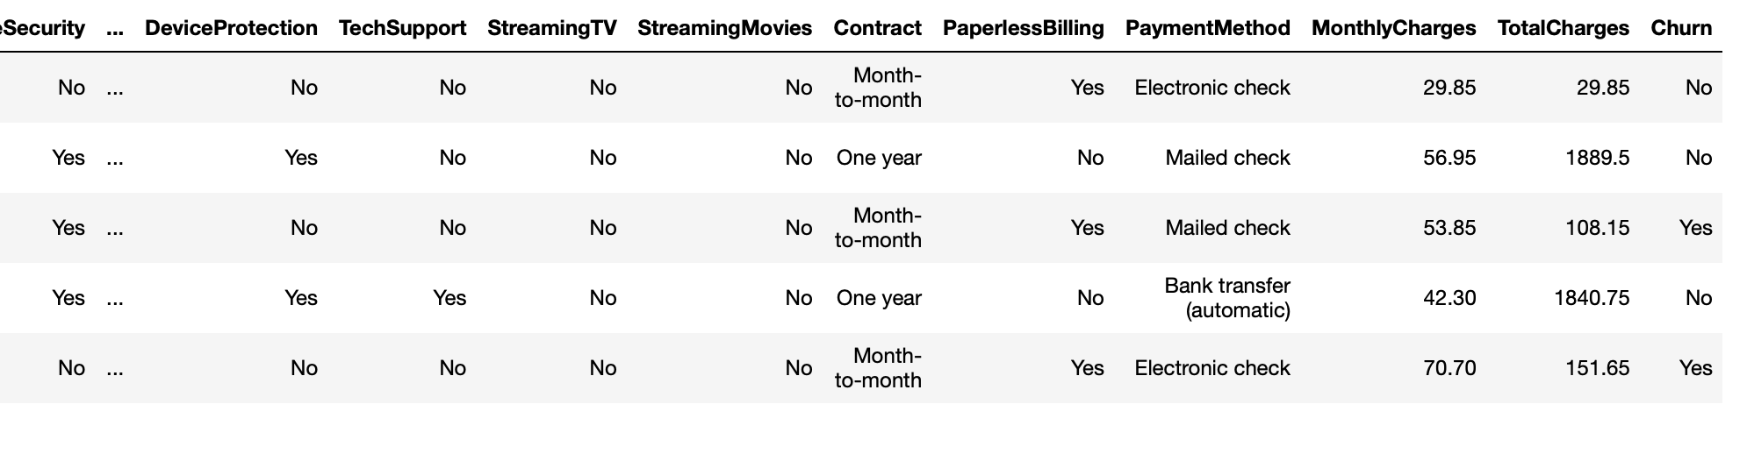
The dataset
Dataset was very much clean, only the column Total Charges had some blank spaces identified in the same rows where tenure was 0. Therefore, they was replaced by 0 also.

Slide 4
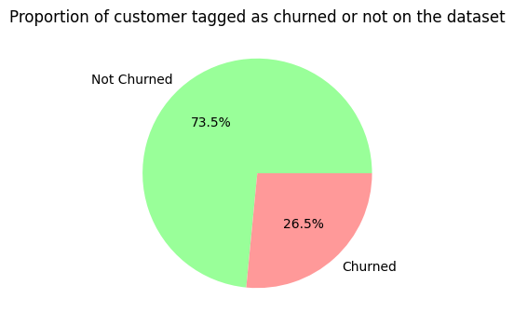
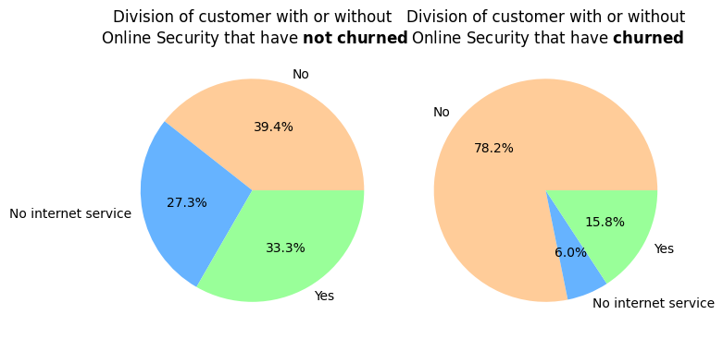
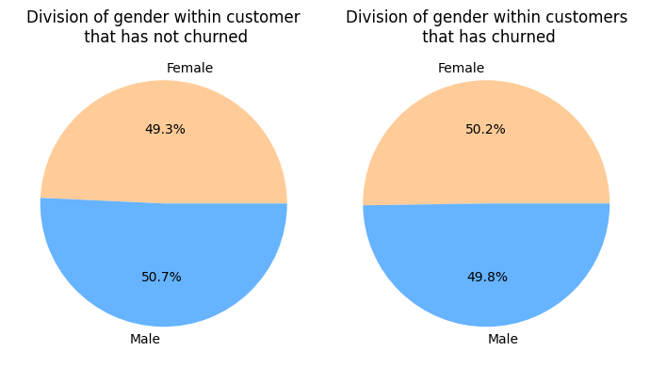
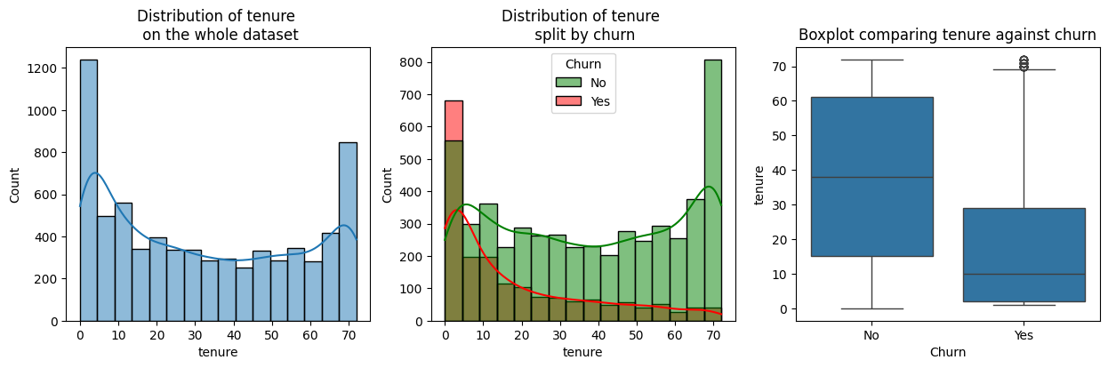
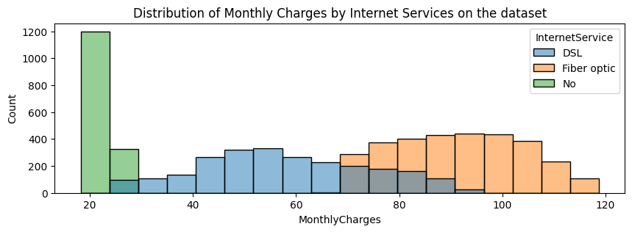
Exploratory data Analysis
Extra services reduces the chances of churn.
2/3 of customer that have churned had fiber optic service.
Online Security, Tech Support and Device Protection seem to influence churn the most.

Slide 5
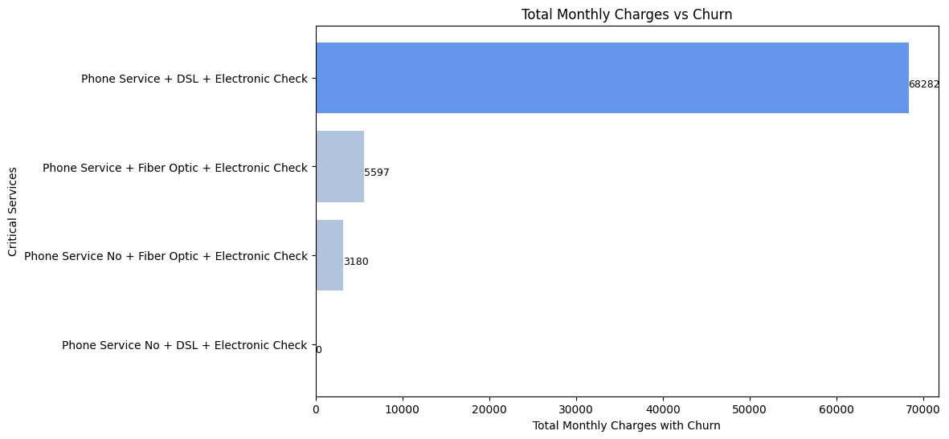
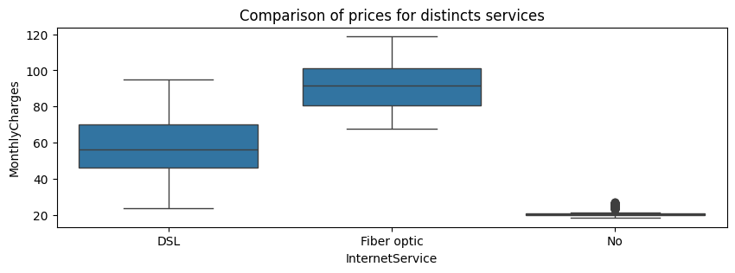
Exploratory Data Analysis
Total loss for churn: 139,131.
Loss just in customer with Phone Service, DSL internet and Electronic Check: 68,282. (49%)

Slide 6
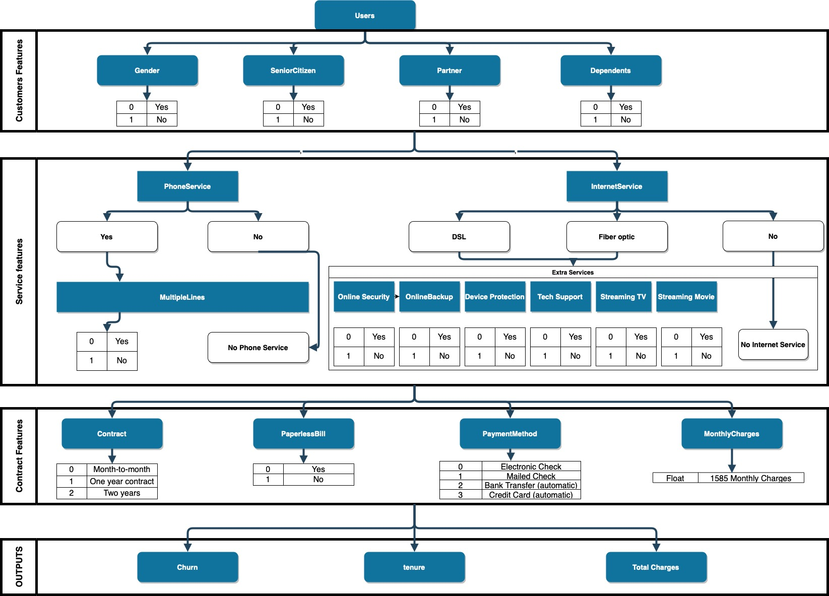
Data Structure

Slide 7
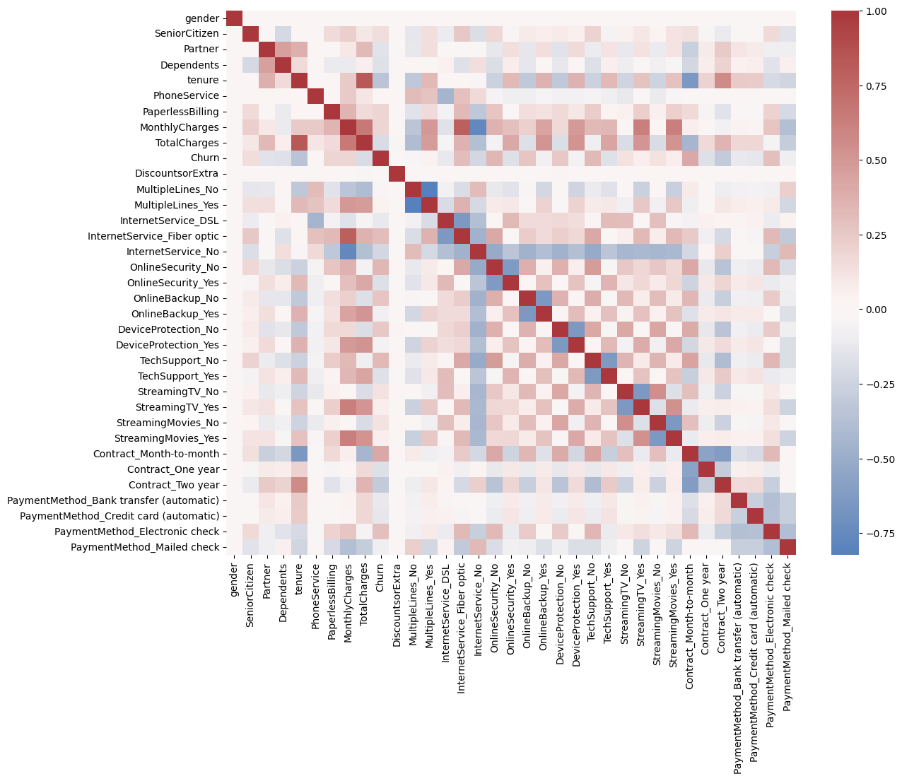
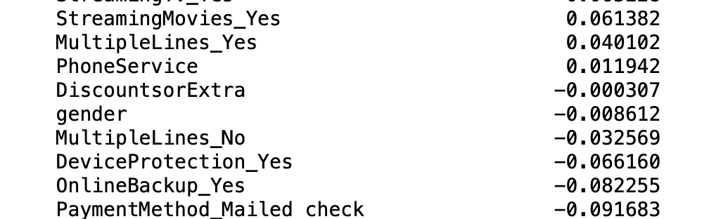
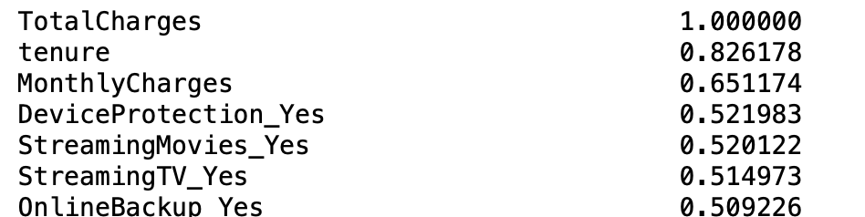
Correlation Matrix
Correlation with Churn
Correlation with Total Charges
Notes:
Speak about the Chi Squared test thar was performed as well.

Slide 8
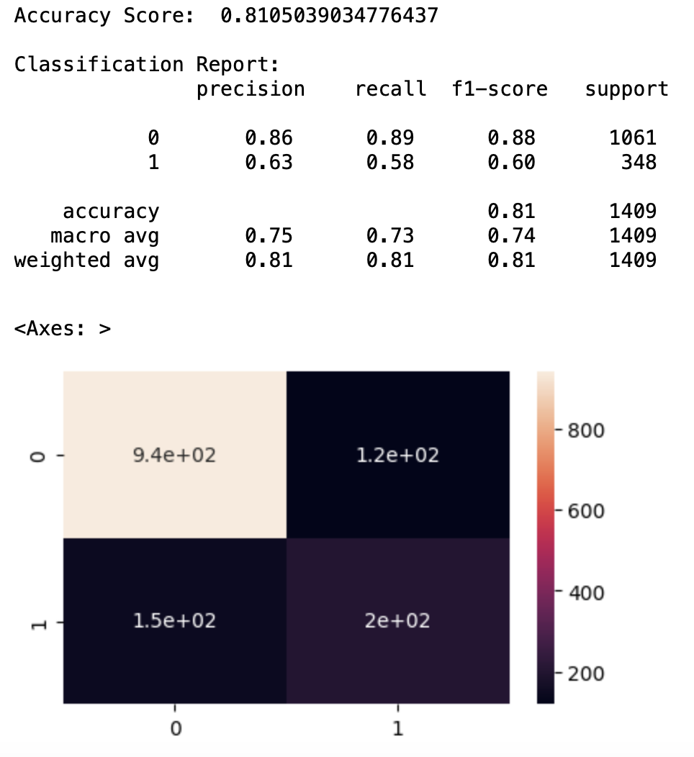
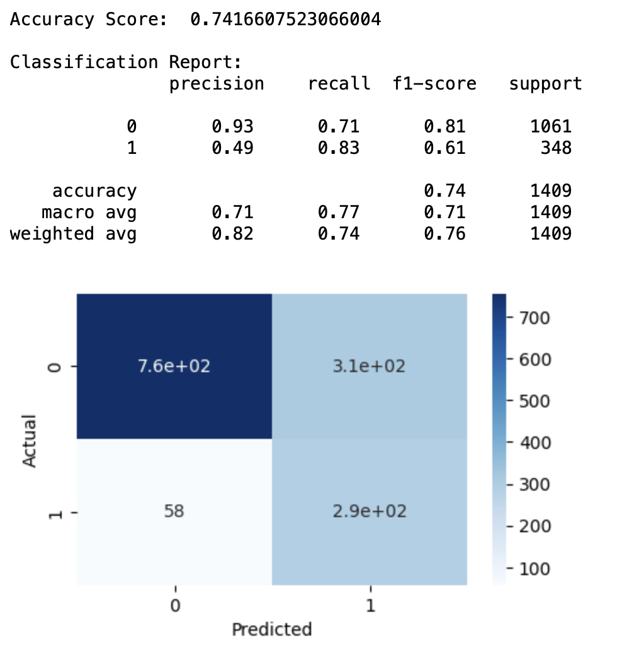
Modelling
Changing on business understanding
Reduce Churn!
Focus on false negatives.
Focus on Recall
False positives are target

Slide 9
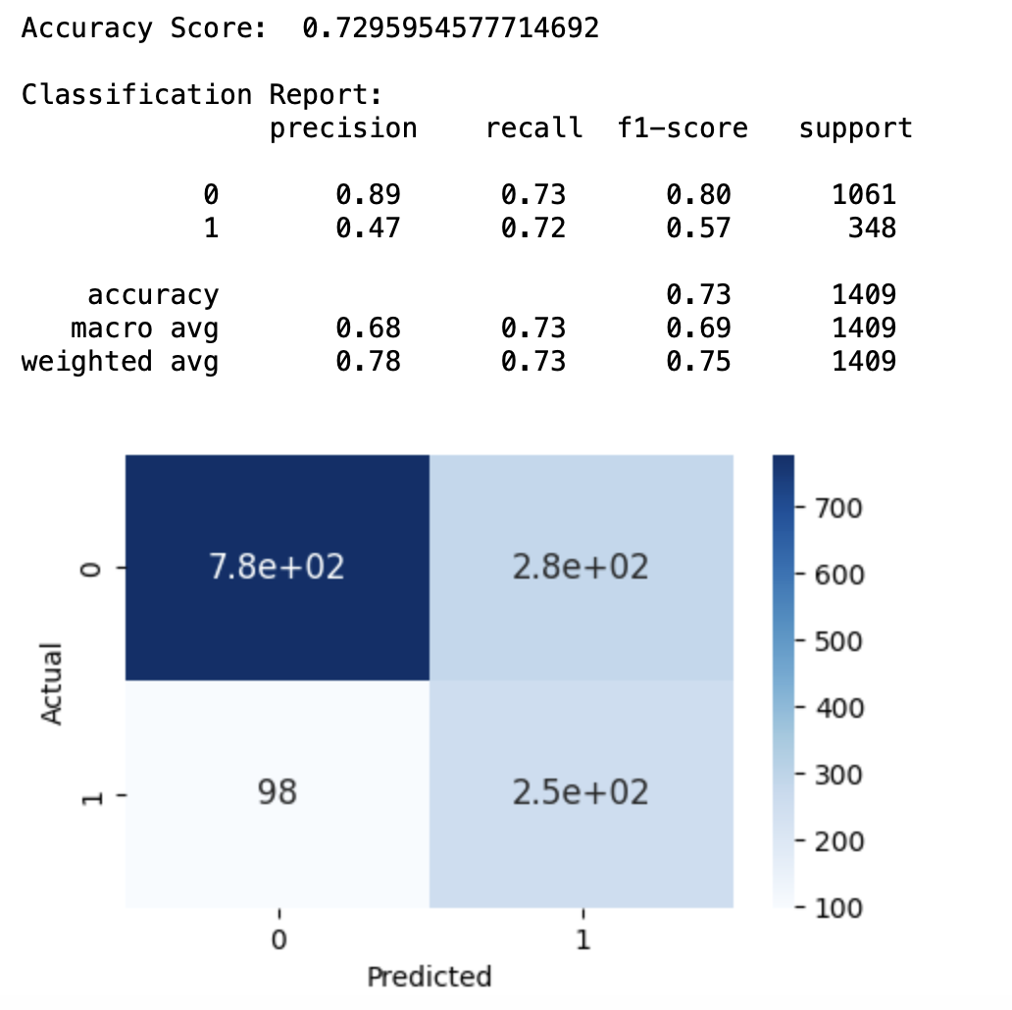
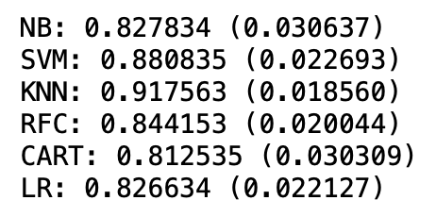
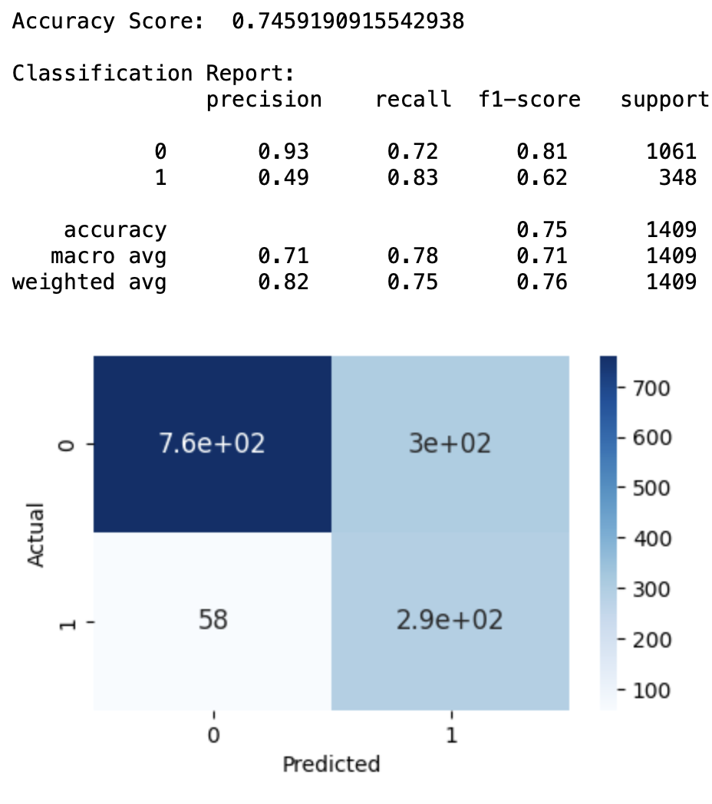
Modelling – Applying Smote

Slide 10
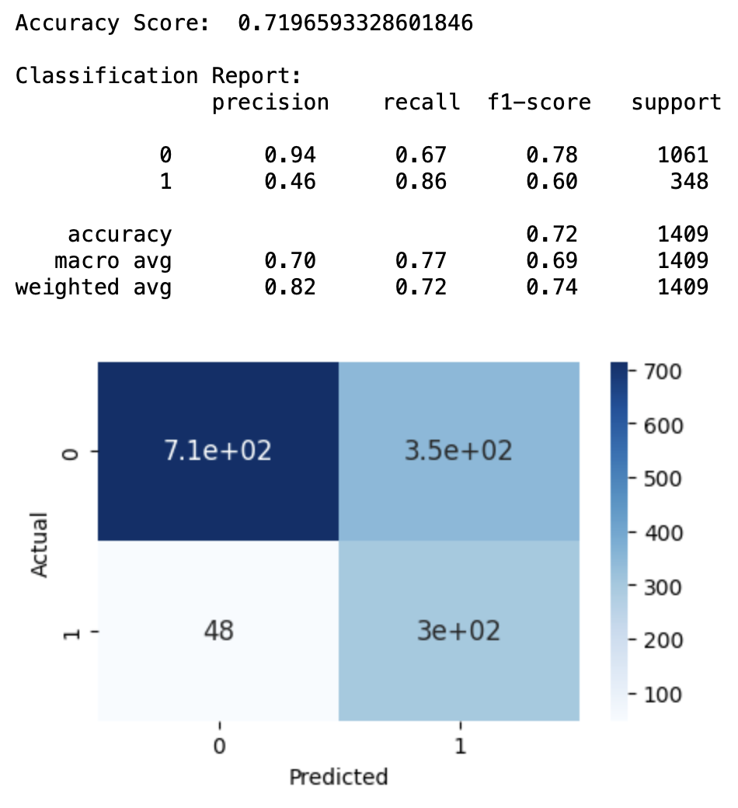
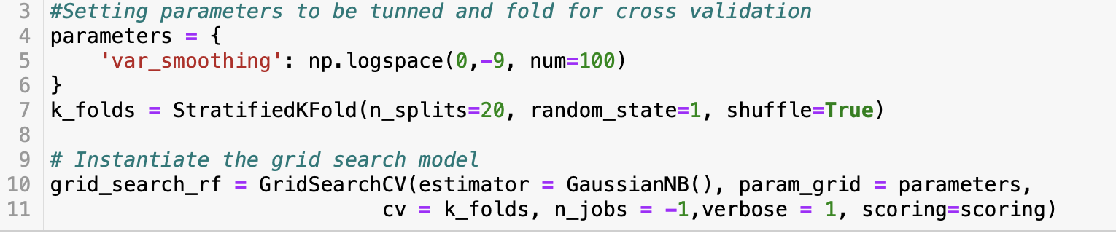
Modelling – Hyperparameter Tunning

Slide 11
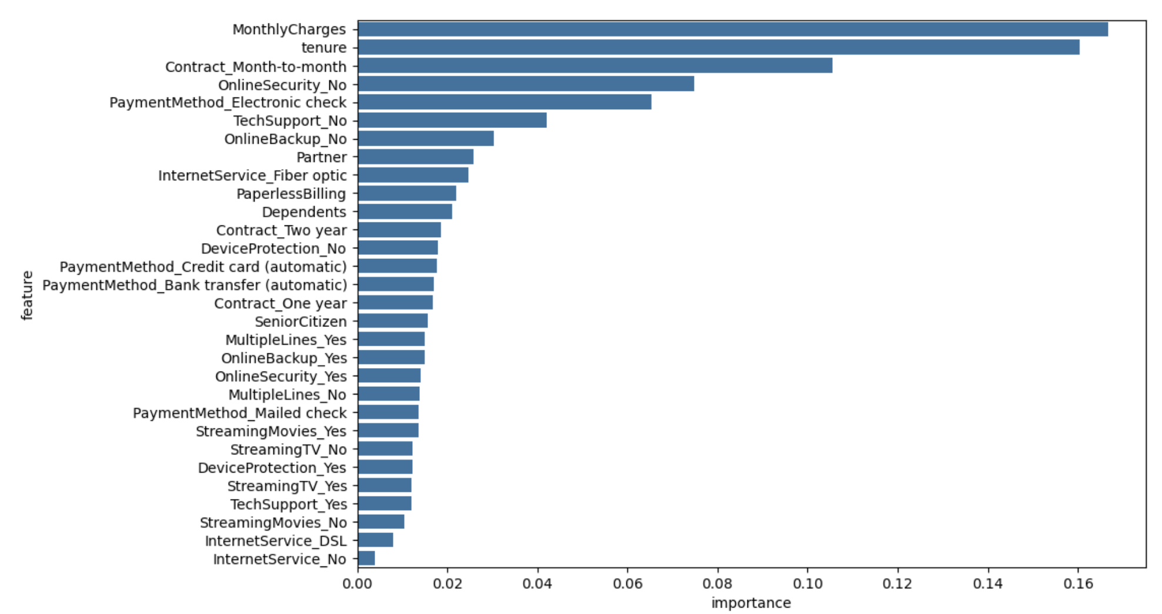
Features Importance

Slide 12
Conclusion and next steps
Most important features to churn:
Type of internet
Contract
Payment type
Extra service
Best model: Gaussian Naïve Bayes optimized with Grid Search
Split the dataset by internet type and analyze it separately.
Correlations among variables.
Verify Another models.

Slide 13
References
Dino, L., 2022. Medium. [Online] Available at: https://medium.com/@24littledino/two-sample-chi-square-test-in-python-b9f2db89dc2b [Accessed 16 11 2023].
Jain, K., 2021. Analytics Vidhya. [Online] Available at: https://medium.com/analytics-vidhya/how-to-improve-naive-bayes-9fa698e14cba [Accessed 18 11 2023]
Jain, R., 2020. Medium. [Online] Available at: https://medium.com/@ritesh.110587/correlation-between-categorical-variables-63f6bd9bf2f7 [Accessed 15 11 2023].
Kübler, R., 2021. Towards Data Science. [Online] Available at: https://towardsdatascience.com/learning-by-implementing-gaussian-naive-bayes-3f0e3d2c01b2 [Accessed 17 11 2023].
Sharma, A., 2021. Analytics Vidhya. [Online] Available at: https://www.analyticsvidhya.com/blog/2021/01/gaussian-naive-bayes-with-hyperpameter-tuning/ [Accessed 15 11 2023].
Stack Overflow [online] (May 10, 2021) Available at: https://stackoverflow.com/questions/67474348/how-do-i-create-a-bar-chart-with-percentage-values-in-python-plotly-express
GeeksforGeeks [online] (16 Jul, 2020) Available at: https://www.geeksforgeeks.org/python-binomial-distribution/?ref=gcse
Scribbr [online] Published on November 5, 2020 by Pritha Bhandari. Available at: https://www.scribbr.com/statistics/standard-normal-distribution/
Kaggle, Updated 5 Years Ago by Blastchar [online] Available at: https://www.kaggle.com/datasets/blastchar/telco-customer-churn
W3Schools, Copyright 1999-2023 by Refsnes Data [online] Available at: https://www.w3schools.com/statistics/statistics_standard_normal_distribution.php

Slide 14
Thank you!

