Slide 1

Forecasting Electrical Demand in Spain
Machine Learning – CA1
Semester 2
CCT College Dublin
Arthur Claudino Gomes de Assis (2023146)
©CCT College Dublin 2023

Slide 2
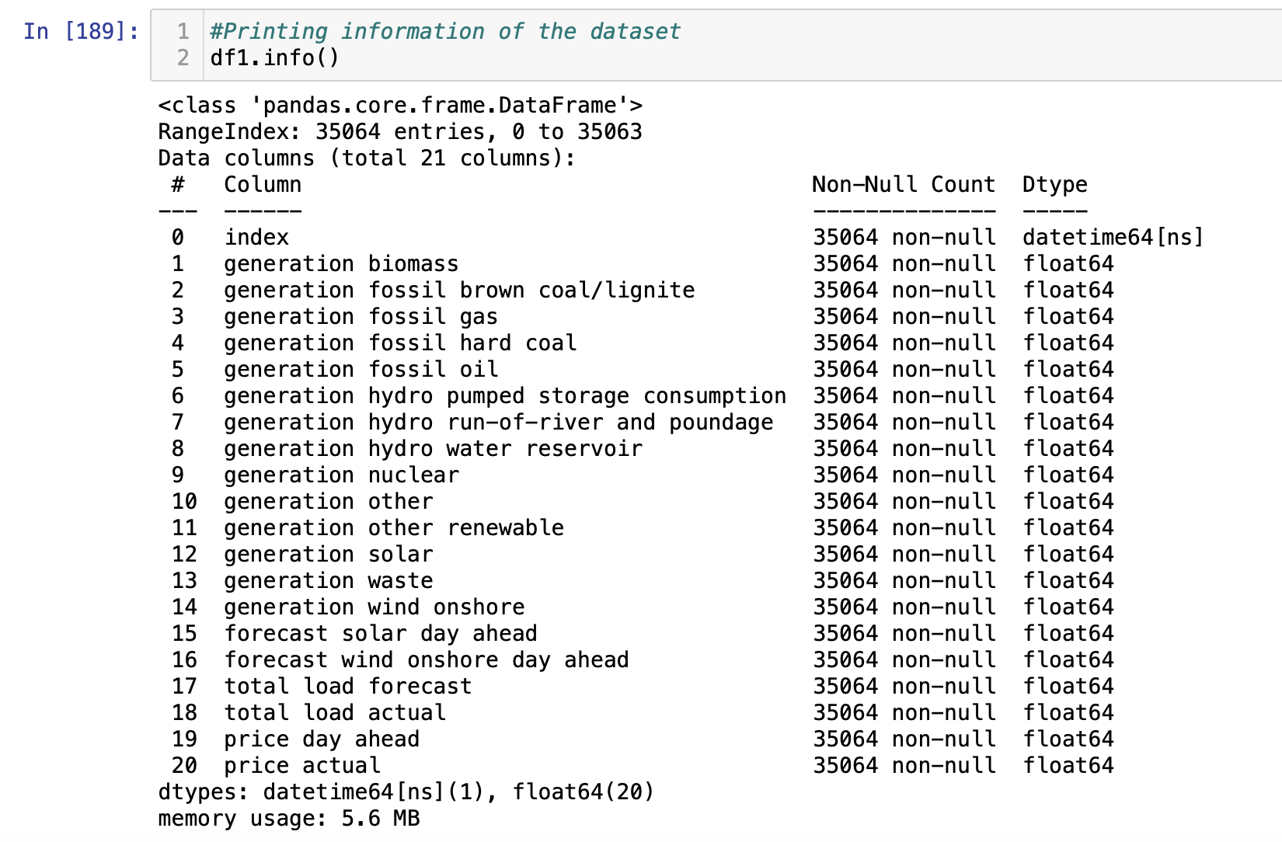
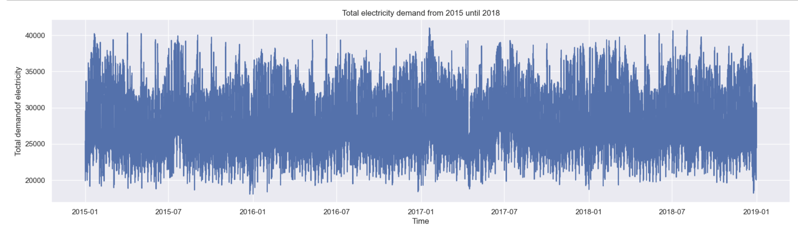
Business understanding and data visualization
Allocating resources properly;
Avoid waste of energy;
Supply demand avoiding blackouts;
Tackling issues of climate change.

Slide 3
Method performed
Clean and prepare data
Transform date series in standard
Solve null and duplicate values
EDA
Analyse different visualizations of the data
Analyse different seasonalities
Create a baseline
Create baseline to compare models developed
Plot them and create metric to compare models
Fit models and compare
Fit models using the training data and get predictions.
Compare models with testing dataset.
Plot all the graphs and compare metrics.
Decide which models would be tried.

Slide 4
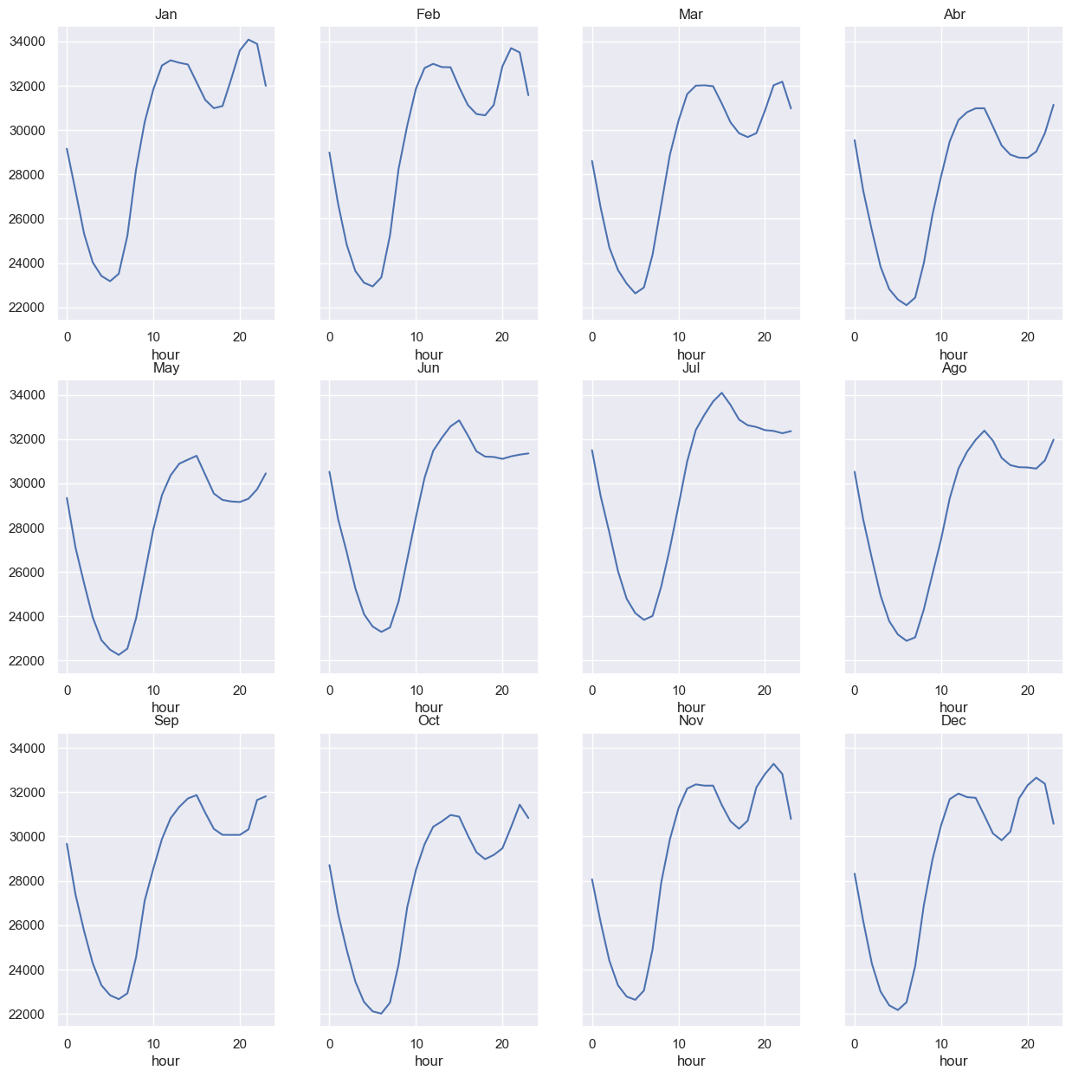
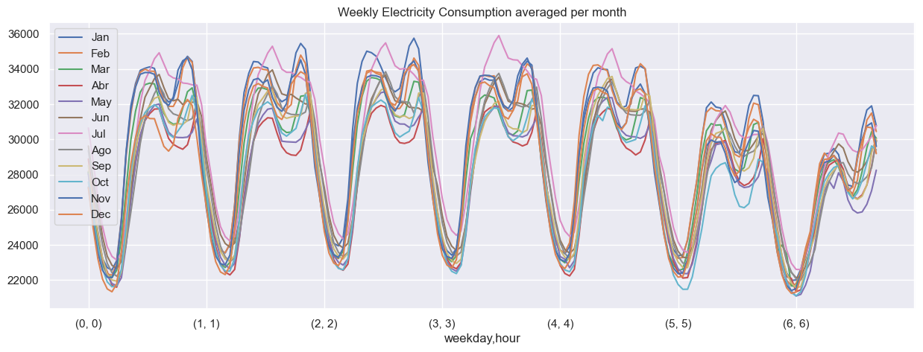
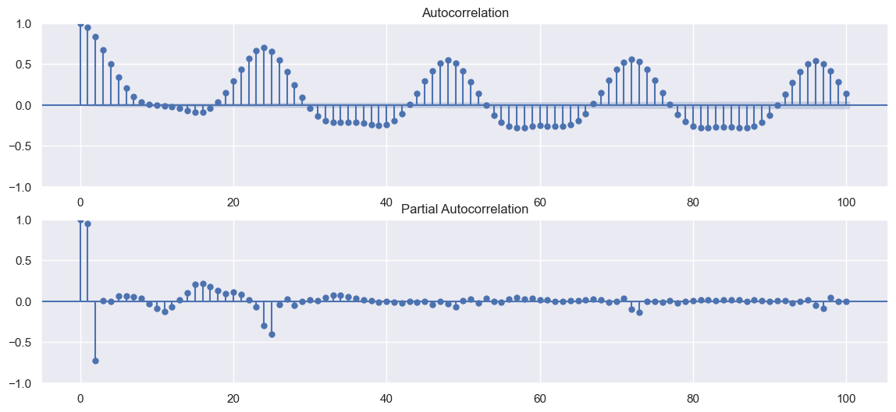
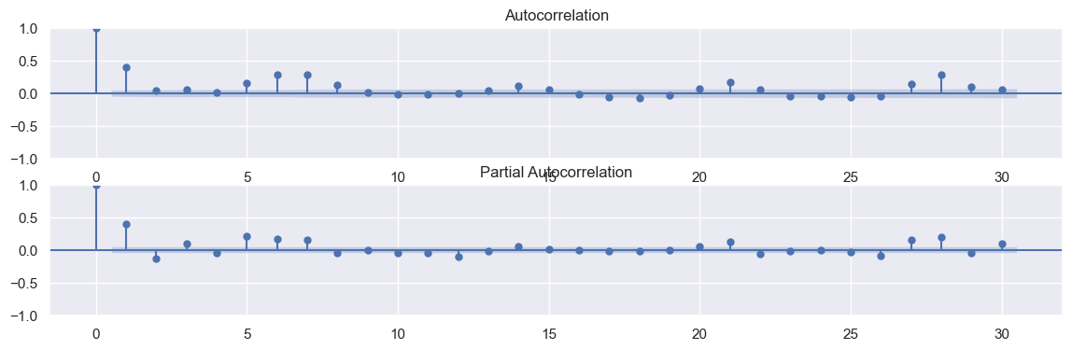
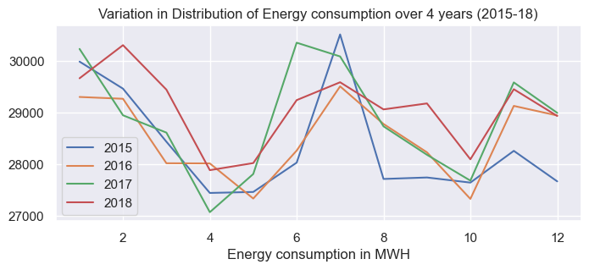
Analyzing seasonalities
3 Seasonalities found:
1- Daily – 24 h;
2 – Weekly – 168h;
3 – Yearly – 8766 h

Slide 5
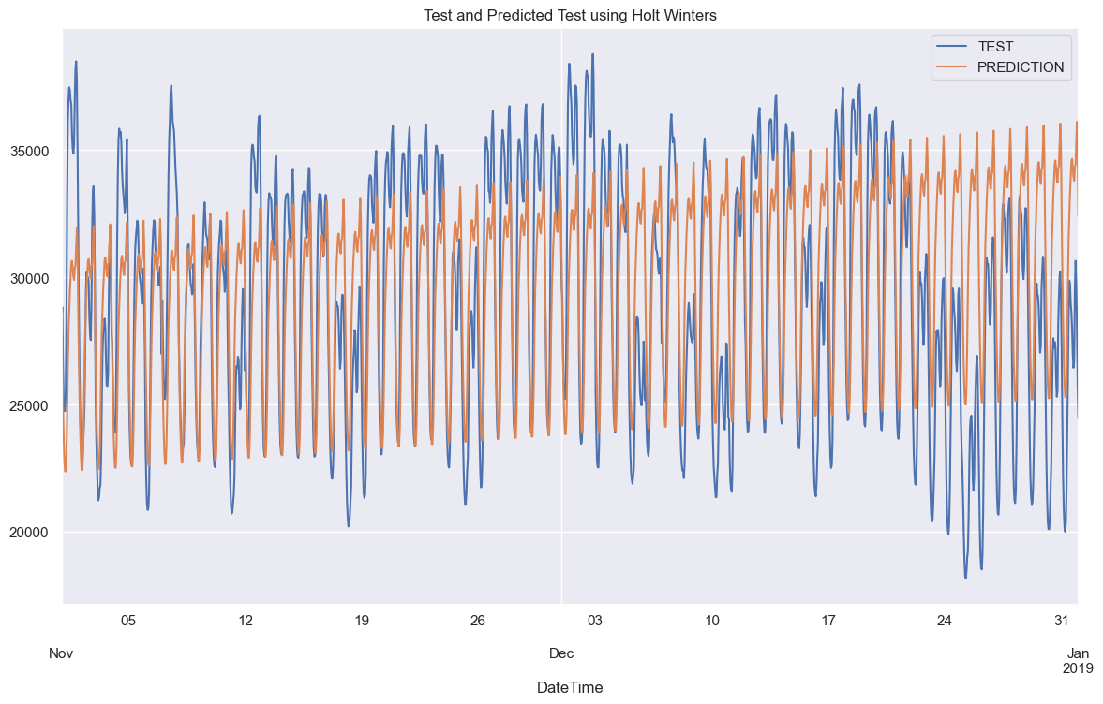
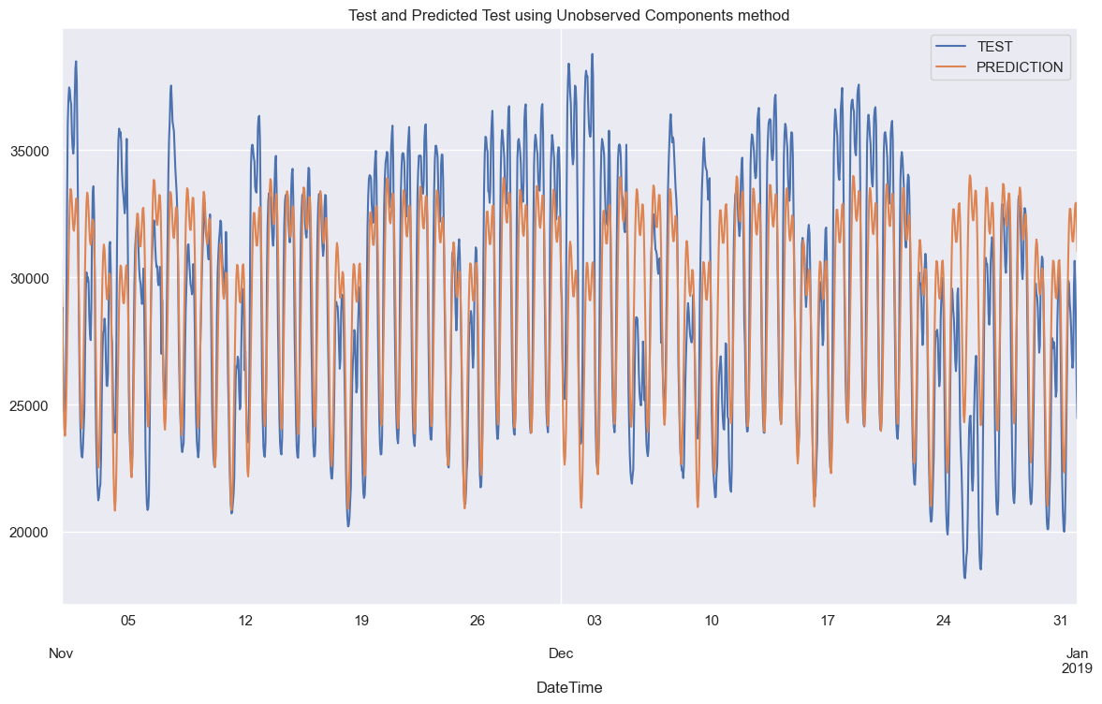
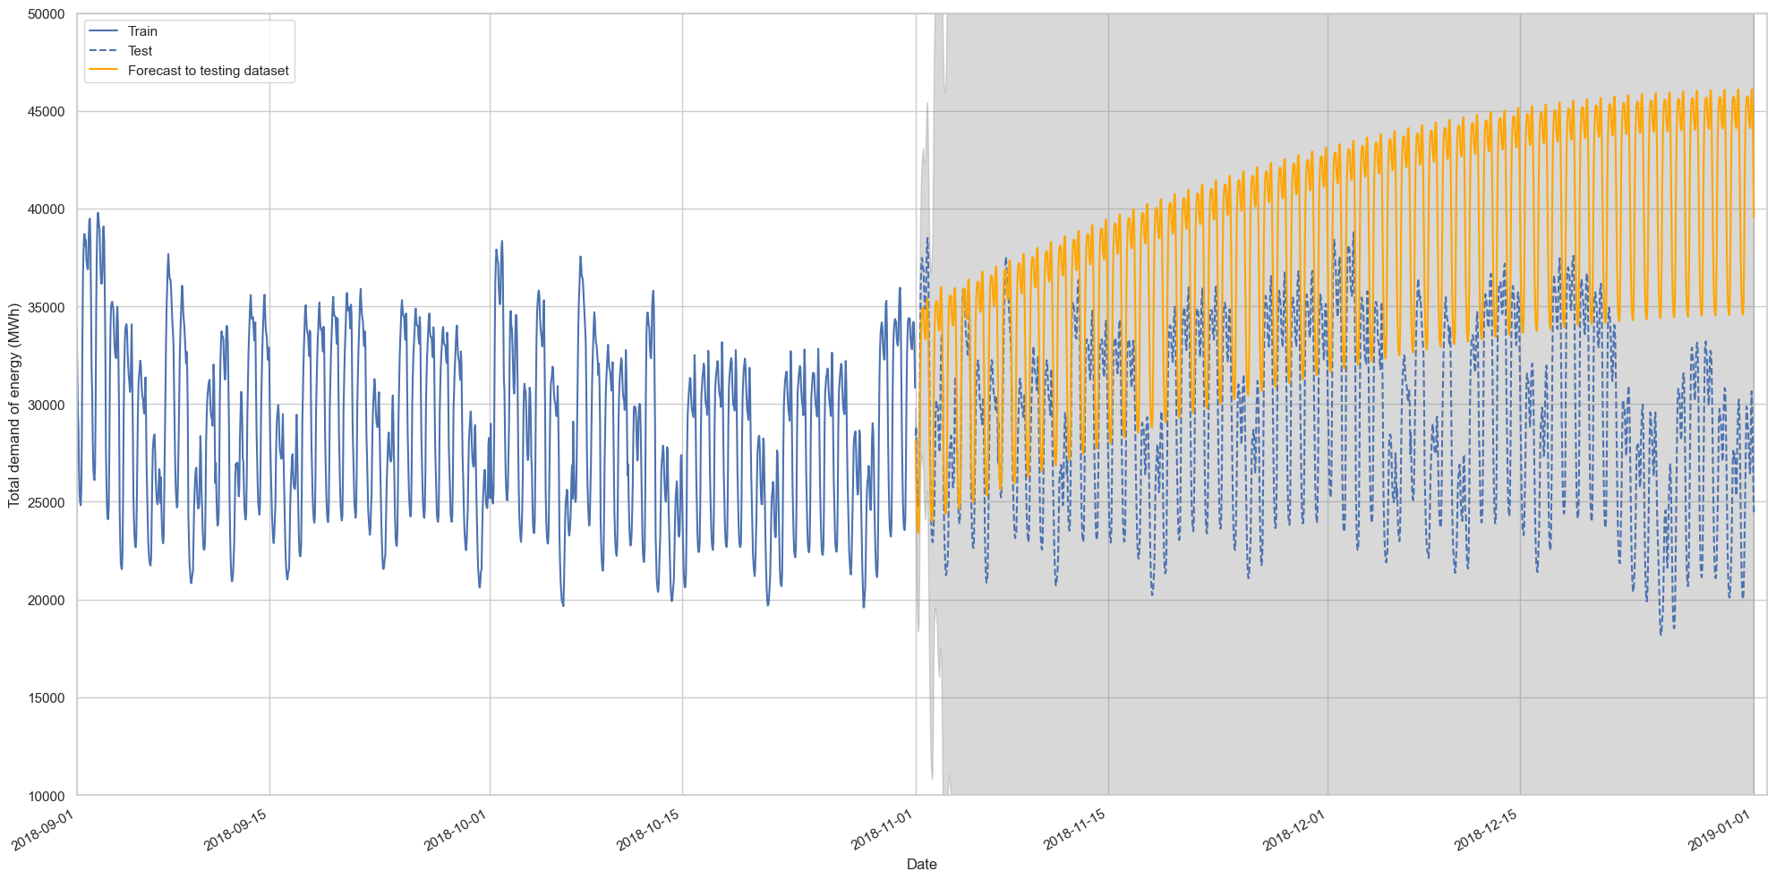
Models fit and results
Holt-Winters Exponencial Smoothing:
MAE: 2916.93
MSE: 13079513.55
R Squared: 0.4197
R Squared: 9030.17
MSE: 101904299.13
MAE: -3.52
SARIMA:
Unobserved components model:
MAE: 2324.05
MSE: 9064405.04
R Squared: 0.5978

Slide 6
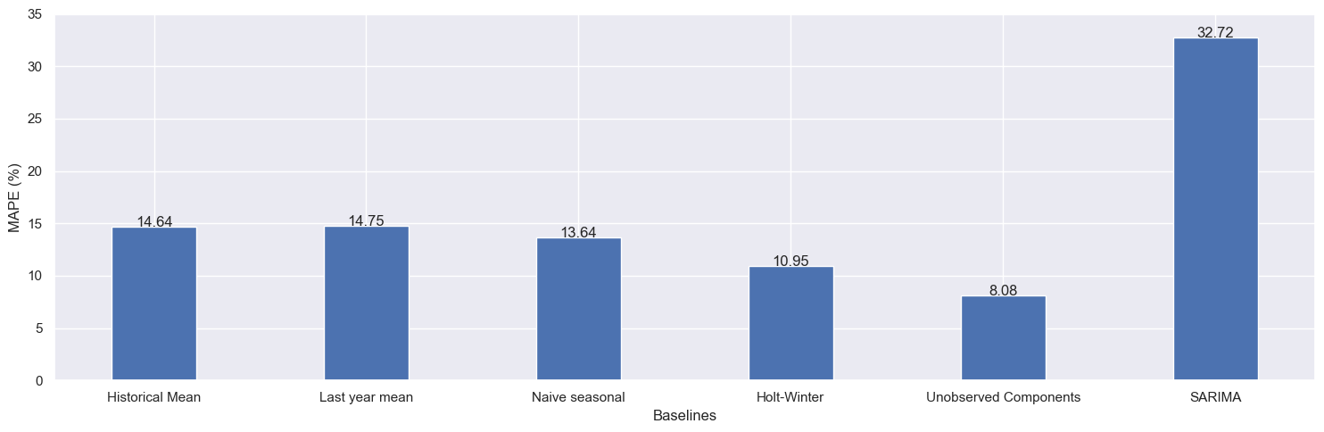
Results and Conclusions
High complex seasonality was handled well by the method Unobserved Components.
Improvements on the model should be expected when including external variables such as temperature and identifying working and non working days.
Although model is not enough for an accurate prediction, it is a good starting point to work towards more accurate models.

