Slide 1
Exercise 2
Arthur Garmider

Slide 2
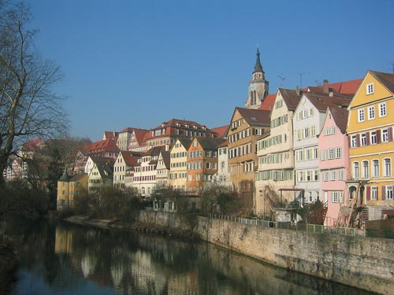
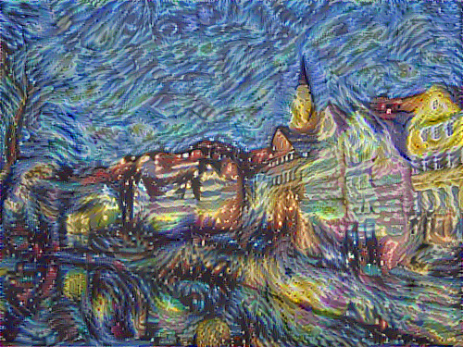
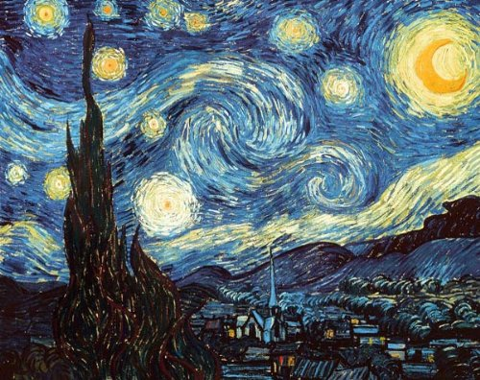
VGG CONTENT = 0.01 STYLE = 1 LR = 2.0 ITERS = 300
Text

Slide 3


VGG CONTENT = 0.01 STYLE = 1 LR = 2.0 ITERS = 300
Text

Slide 4

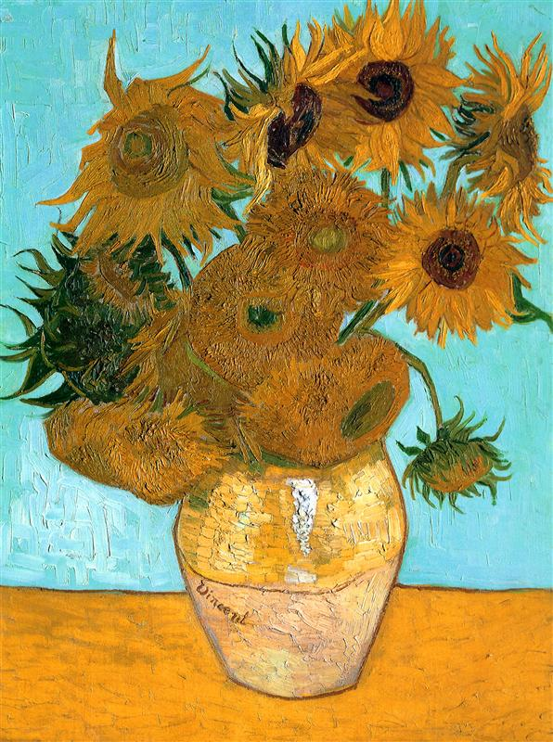
VGG CONTENT = 0.01 STYLE = 1 LR = 2.0 ITERS = 300
Text

Slide 5
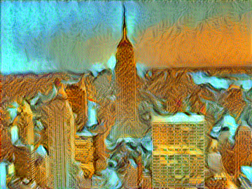
ALEX CONTENT = 0.01 STYLE = 1000 LR = 2.0 ITERS = 300
Text

Slide 6
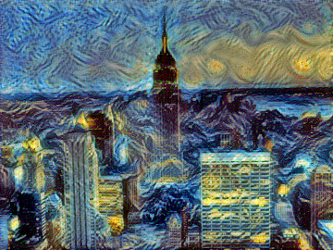
ALEX CONTENT = 0.01 STYLE = 1000 LR = 2.0 ITERS = 300
Text

Slide 7
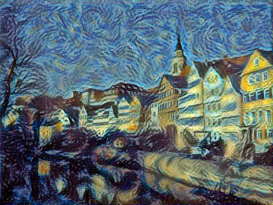
ALEX CONTENT = 0.01 STYLE = 1000 LR = 2.0 ITERS = 300
Text

Slide 8
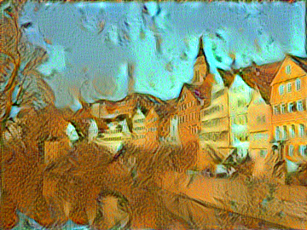
ALEX CONTENT = 0.01 STYLE = 1000 LR = 2.0 ITERS = 300
Text

Slide 9
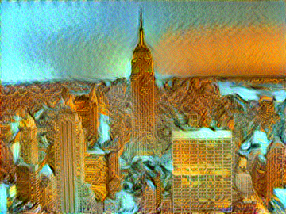
ALEX CONTENT = 10 STYLE = 1000 LR = 5.0 ITERS = 300
Text

Slide 10
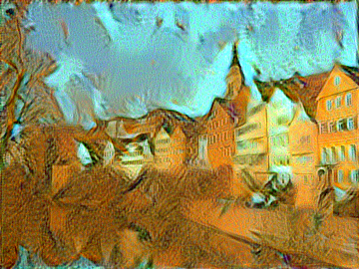
ALEX CONTENT = 0.1 STYLE = 1000 LR = 5.0 ITERS = 300
Text

