Slide 1

Your success is our success
Postman Scripting
Funny Gorilla诙猩猩-IT培训

Slide 2
Learning Objectives
JavaScripting introduction
Postman JavaScripts
How Postman organize test scripts
Different ways of running test scripts

Slide 3
JavaScripting Introduction

Slide 4
Postman JavaScripting

Slide 5
Postman JavaScript introduction
Postman JavaScript - pm
DSL
Debugging
https://learning.postman.com/docs/writing-scripts/intro-to-scripts/

Slide 6
Demo – JavaScript

Slide 7
Test Scripting
Postman JavaScript introduction
Test script types
Execution order of script
https://learning.postman.com/docs/writing-scripts/intro-to-scripts/

Slide 8
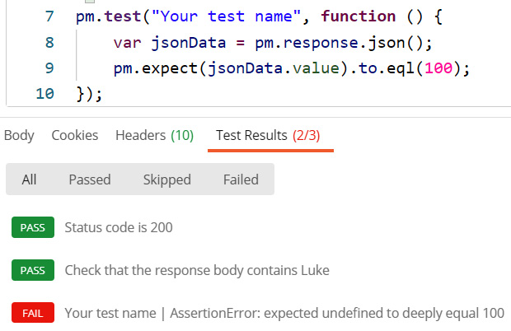
Postman JavaScript introduction
Postman JavaScript
Test function
Assertion

Slide 9
pm.test()
DSL: pm.response.to.have()
assertion: pm.expect(“something”).to.equal(“something”)
Debugging: console.log()

Slide 10
Demo – Postman JavaScript

Slide 11
Test Scripting Types
1
Pre-request script
2
Test script
https://learning.postman.com/docs/writing-scripts/intro-to-scripts/

Slide 12
Pre-request scripts
Prepare for next request
Get executed before request sent out
3 level scope
Collection
Pre-request script
Folder
Pre-request script
Request
Pre-request script

Slide 13
Common use cases
Pass data between requests
Build request flow

Slide 14
Demo – Pre-request script

Slide 15
Test scripts
Check response message
Get executed after response received
3 level scope
Collection
Test script
Folder
Test script
Request
Test script

Slide 16
Demo – Check response message
Check status code
1
pm.test(“Status code 200", function () {
pm.response.to.have.status (200);
});
Check header
2
pm.test(“Header Content-Type", function () {
pm.response.to.have.header ("Content-Type", "application/json");
});
Check the response body
3
pm.test(“Body checking", function () {
var jsonData = pm.response.json();
pm.expect(pm.response.text()).to.include("string_to_search");
});

Slide 17
Execution Order of Scripts
Collection
Pre-request script
Folder
Pre-request script
Request
Response
Request
Pre-request script
Collection
Test script
Folder
Test script
Request
Test script
https://learning.postman.com/docs/writing-scripts/intro-to-scripts/

Slide 18
Demo – Execution of Order of Scripts

Slide 19
Run test scripts
Manually run test script
Automate script testing by Newman

Slide 20
Demo – Manually run API Tests

Slide 21
Automating testing by Newman
https://learning.postman.com/docs/running-collections/intro-to-collection-runs/

Slide 22
Newman Introduction
Postman's collection runner engine that sends API requests, receives the response, and then runs your test against the response.
It is like postman's command line companion that generates specified reports.
It is extensible and so can be integrated into continuous integration (CI/CD) servers and build systems.
Benefits of using Newman
➢ Makes it easy to run a collection of tests using command line 
➢ Gives the ability to run a collection of tests written in postman right from most build tools 
➢ Enables generating and storing report directly from the command line after Installing Newman.

Slide 23
Demo – Newman

Slide 24
References
https://learning.postman.com/docs/introduction/overview/
https://learning.postman.com/docs/writing-scripts/script-references/test-examples/

Slide 25

Your success is our success
Contact
Mail: info@funnygorilla.com.au
Linkedin: https://mt.linkedin.com/in/songqing-gu-2ba9034b/de
Web Chat: FunnyGorilla
Phone: 0420891343

