Slide 1

Your success is our success
Postman Introduction
Funny Gorilla诙猩猩-IT培训

Slide 2
Learning Objectives
API Testing Tools
How Postman organize test scripts
Test script introduction
Different ways of running test scripts

Slide 3
API Testing Tools

Slide 4
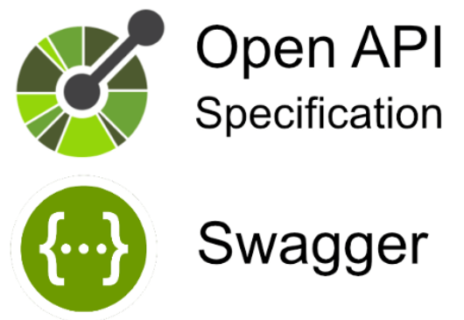




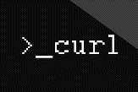
API Testing tools
API service description
HTML/CSS/JS
Web Tier
JSON/Http
SQL/JDBC
Business Tier
Database Tier

Slide 5
How Postman organize test scripts

Slide 6

Credit card
Account management
Order management
Inventory management
Credit checking
Data Centre/Cloud
Customer management
API

Slide 7
Credit card
Account management
Order management
Inventory management
Credit checking
Data Centre/Cloud
Customer management
API

Slide 8
Behaviour driven development

Slide 9

cURL Introduction

Slide 10
cURL Demo – Get, Post, Put, Delete
Sample API endpoint:
https://jsonplaceholder.typicode.com/users

Slide 11

How does Postman organize scripts
http://{{base_url}}/api/v1/customers/
Test
http://test:8080/api/v1/customers/
Workspace
SIT
http://sit:8080/api/v1/customers/
Collection
Project – application APIs
UAT
http://uat:8080/api/v1/customers/
Environment
Deployment environment variables
testEV
[base_url = test ]
sitEV
[base_url = sit]

Slide 12
Demo – Workspace, Collection
Sample API endpoint: https://jsonplaceholder.typicode.com/users

Slide 13
Environment
Application needs to be deployed in different environments along its testing journey

Slide 14
Demo – Environment

Slide 15
Test script introduction

Slide 16
Different ways of running test scripts

Slide 17
References
https://learning.postman.com/docs/introduction/overview/
https://learning.postman.com/docs/writing-scripts/script-references/test-examples/

Slide 18
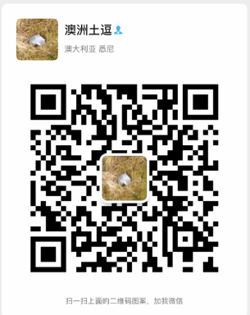
Your success is our success
Contact
Mail: info@funnygorilla.com.au
Linkedin: https://mt.linkedin.com/in/songqing-gu-2ba9034b/de
Web Chat: FunnyGorilla
Phone: 0420891343

