Slide 1

Your success is our success
Introduction to Variable
Funny Gorilla诙猩猩-IT培训

Slide 2
Learning Objectives
Variable definition
Variable Scope
Test scripts introduction
Different ways of running test scripts

Slide 3
Variable definition

Slide 4
Variables
A variable is a symbolic representation of data that enables you to access a value.
Parameterize Requests
pass data between requests and tests

Slide 5
Variable Type
Default type
automatically assigned to variables. This type is shown as plain text and doesn't have extra properties.
Secret type
masks the initial and current values for all workspace members and can be used to prevent unintentional disclosure of sensitive data, including API secrets, passwords, tokens, and keys.

Slide 6
Variable scope

Slide 7
Variable Scope
Global
Used in data driven testing
collection
script
environment
workspace
data
collection
local
Up to selection by collection

Slide 8
Some rules
Lower variables override higher variables
global
collection
environment
data
local

Slide 9
Global Variables
When to use?
Sample examples

Slide 10
Collection Variables
When to use?
Sample examples

Slide 11
Environment Variables
When to use?
Sample examples

Slide 12
Environment
Application needs to be deployed in different environments along its testing journey
When to use?
Sample examples

Slide 13

How does Postman organize testing
http://{{base_url}}/api/v1/customers/
Test
http://test:8080/api/v1/customers/
Workspace
SIT
http://sit:8080/api/v1/customers/
Collection
Project – application APIs
UAT
http://uat:8080/api/v1/customers/
Environment
Deployment environment variables
testEV
[base_url = test ]
sitEV
[base_url = sit]

Slide 14
Demo – Environment

Slide 15
Data Variables
When to use?
Sample examples

Slide 16
Data Variables
When to use?
Sample examples

Slide 17
Local Variables
When to use?
Sample examples

Slide 18
Local Variables
When to use?
Sample examples

Slide 19
Define Variables in scripts
// set a global variable
pm.globals.set("variable_key", "variable_value");
// set a collection variable
pm.collectionVariables.set("variable_key", "variable_value");
// se an environment variable
pm.environment.set("variable_key", "variable_value");
// set a local variable
pm.variables.set("variable_key", "variable_value");
// unset a variable
pm.environment.unset("variable_key");

Slide 20
Using Variables in scripts
// -- access a variable at any scope including local
pm.variables.get("variable_key");
// -- access a global variable
pm.globals.get("variable_key");
// -- access a collection variable
pm.collectionVariables.get("variable_key");
//-- access an environment variable
pm.environment.get("variable_key");

Slide 21
Demo – Variables

Slide 22
References
https://learning.postman.com/docs/introduction/overview/
https://learning.postman.com/docs/writing-scripts/script-references/test-examples/

Slide 23
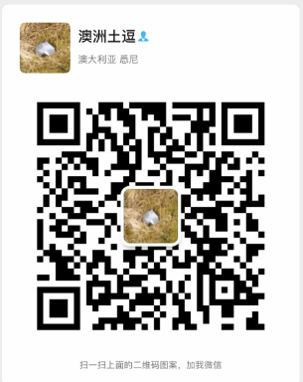
Your success is our success
Contact
Mail: info@funnygorilla.com.au
Linkedin: https://mt.linkedin.com/in/songqing-gu-2ba9034b/de
Web Chat: FunnyGorilla
Phone: 0420891343

