Slide 1

Your success is our success
Postman Introduction
Funny Gorilla诙猩猩-IT培训

Slide 2
Learning Objectives
API Testing Tools
How Postman organize test scripts
Test scripts introduction
Different ways of running test scripts

Slide 3
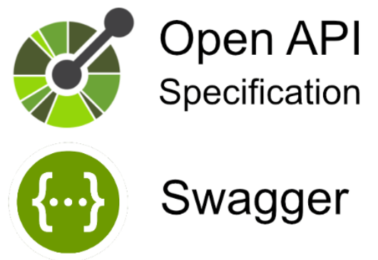





API Testing tools
API service description
HTML/CSS/JS
Web Tier
JSON/Http
SQL/JDBC
Business Tier
Database Tier

Slide 4

Credit card
Account management
Order management
Inventory management
Credit checking
Data Centre/Cloud
Customer management
API

Slide 5
Credit card
Account management
Order management
Inventory management
Credit checking
Data Centre/Cloud
Customer management
API

Slide 6
cURL Demo – Get, Post, Put, Delete
Sample API endpoint:
https://jsonplaceholder.typicode.com/users

Slide 7

How does Postman organize scripts
http://{{base_url}}/api/v1/customers/
Test
http://test:8080/api/v1/customers/
Workspace
SIT
http://sit:8080/api/v1/customers/
Collection
Project – application APIs
UAT
http://uat:8080/api/v1/customers/
Environment
Deployment environment variables
testEV
[base_url = test ]
sitEV
[base_url = sit]

Slide 8
Demo – Workspace, Collection
Sample API endpoint:
https://jsonplaceholder.typicode.com/users

Slide 9
Environment
Application needs to be deployed in different environments along its testing journey

Slide 10
Demo – Environment

Slide 11
Variable - Parameterize Requests
Variable types: default type, secrete type
Variable Scope:
Used in data driven testing
Global
collection
script
environment
workspace
data
local
collection
Up to selection by collection

Slide 12
Lower variables override higher variables
global
collection
environment
data
local

Slide 13
Demo – Variables

Slide 14
Test Scripting Introduction

Slide 15
Test Scripting
Postman JavaScript introduction
Test script types
Execution order of script
https://learning.postman.com/docs/writing-scripts/intro-to-scripts/

Slide 16
Postman JavaScript introduction
Postman JavaScript - pm
DSL – domain specific language
Debugging
https://learning.postman.com/docs/writing-scripts/intro-to-scripts/

Slide 17
Test Scripting Types
1
Pre-request script
2
Test script
https://learning.postman.com/docs/writing-scripts/intro-to-scripts/

Slide 18
Pre-request scripts
Prepare for next request
Get executed before request sent out
3 level scope
Collection
Pre-request script
Folder
Pre-request script
Request
Pre-request script

Slide 19
Common use cases
Pass data between requests
Build request flow

Slide 20
Demo – Pre-request script

Slide 21
Test scripts
Check response message
Get executed after response received
3 level scope
Collection
Test script
Folder
Test script
Request
Test script

Slide 22
Demo – Check response message
Check status code
1
pm.test(“Status code 200", function () {
pm.response.to.have.status (200);
});
Check header
2
pm.test(“Header Content-Type", function () {
pm.response.to.have.header ("Content-Type", "application/json");
});
Check the response body
3
pm.test(“Body checking", function () {
var jsonData = pm.response.json();
pm.expect(pm.response.text()).to.include("string_to_search");
});

Slide 23
Execution Order of Scripts
Collection
Pre-request script
Folder
Pre-request script
Request
Response
Request
Pre-request script
Collection
Test script
Folder
Test script
Request
Test script
https://learning.postman.com/docs/writing-scripts/intro-to-scripts/

Slide 24
Demo – Execution of Order of Scripts

Slide 25
Run test scripts
Manually run test script
Automate script testing by Newman

Slide 26
Demo – Manually run API Tests

Slide 27
Automating testing by Newman
https://learning.postman.com/docs/running-collections/intro-to-collection-runs/

Slide 28
Newman Introduction
Postman's collection runner engine that sends API requests, receives the response, and then runs your test against the response.
It is like postman's command line companion that generates specified reports.
It is extensible and so can be integrated into continuous integration (CI/CD) servers and build systems.
Benefits of using Newman
➢ Makes it easy to run a collection of tests using command line 
➢ Gives the ability to run a collection of tests written in postman right from most build tools 
➢ Enables generating and storing report directly from the command line after Installing Newman.

Slide 29
Demo – Newman

Slide 30
References
https://learning.postman.com/docs/introduction/overview/
https://learning.postman.com/docs/writing-scripts/script-references/test-examples/

Slide 31

Your success is our success
Contact
Mail: info@funnygorilla.com.au
Linkedin: https://mt.linkedin.com/in/songqing-gu-2ba9034b/de
Web Chat: FunnyGorilla
Phone: 0420891343

