Slide 1

Your success is our success
Preparing Testing Data
Funny Gorilla诙猩猩-IT培训

Slide 2
Learning Objectives
Test types
Considerations when drafting test cases
Common steps to design API testing
Execution sequence

Slide 3
Equivalence Class Partitioning (ECP)

Slide 4
Test Data source
Dynamic data
Static data
API call
Manual input
Testing data generation tool
CSV file
Excel file
Database

Slide 5
Data driven testing

Slide 6
Flat files – csv, json, excel …
https://community.postman.com/t/api-testing-a-beginners-view-data-driven-testing-in-postman/20302
https://raghwendra-sonu.medium.com/data-driven-testing-with-postman-using-csv-and-json-files-c4f112015eb3
https://www.numpyninja.com/post/data-driven-testing-in-postman-1#:~:text=%E2%80%9CData%2DDriven%20Testing%20in%20Postman,data%20from%20a%20different%20file.
https://www.guru99.com/data-driven-testing.html

Slide 7
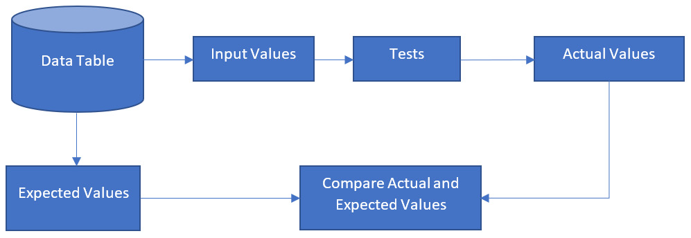
Data driven testing - Database

Slide 8
Data driven testing - Demo

Slide 9
References
https://learning.postman.com/docs/writing-scripts/script-references/test-examples/

Slide 10
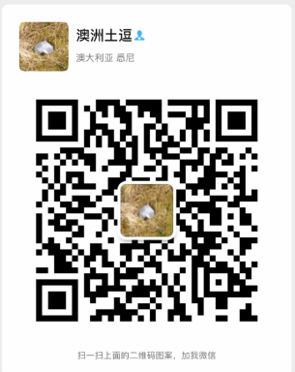
Your success is our success
Contact
Mail: info@funnygorilla.com.au
Linkedin: https://mt.linkedin.com/in/songqing-gu-2ba9034b/de
Web Chat: FunnyGorilla
Phone: 0420891343

