Slide 1

Your success is our success
Design Testing Framework
Funny Gorilla诙猩猩-IT培训

Slide 2
Learning Objectives
Considerations when drafting test cases
Common steps to design API testing
Build framework

Slide 3
Common steps to design API testing

Slide 4
Step 01: Explore API
Read openapi file if it exists
Understand API Spec
Create Entity Relationship diagram
Understand relationship between entities
Map out endpoints, action, response codes
Create Endpoint mapping table

Slide 5
Step 02: Create a Collection & folder structure
For workflow
Create a test structure
Organize the tests
Share variables

Slide 6
Step 03: Create test cases
Equivalence Class Partitioning (ECP)
Define test case
divide set of test condition into a partition which should be considered the same.
Follow test template

Slide 7

Test Case Template
Test Case ID Test Case Description Pre-Conditions Test Steps Test Data Expected Result Post Conditions Actual Result Status
Excel file
https://www.guru99.com/jira-tutorial-a-complete-guide-for-beginners.html

Slide 8
Considerations when drafting Test Cases
Align with Rest API technical nature?
What kind of things do I want to check for each request?
How can I reduce the number of inputs to the test while still getting good coverage?
Am I using variables and environments efficiently?
Will these checks be stable and consistent?
Will these checks actually fail if something goes wrong?
What will happen when this test is run multiple times?
How to make testing data consistent?

Slide 9

Step 04: Prepare testing data
Equivalence Class Partitioning (ECP)
Define data source
CSV
Excel
DB

Slide 10
Step 05: Build common framework
Review if variables are in proper scope
Review if test cases are organized in logic way
Review if test scripts are executed in right scope
Review testing data strategy
Define common functions and put in right scope to maximize the usage

Slide 11
Step 06: Documenting collection

Slide 12
Step 07: Push to Github

Slide 13
Step 08: Integrate with CI Pipelie

Slide 14
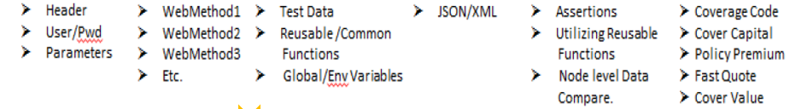
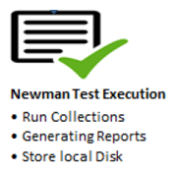
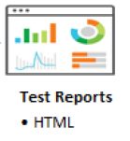
Execution Sequence
Request
Prerequisite Script
Request/
Response
Functional
Scripts
Authentication
Collection
Test Scripts

Slide 15
References
https://learning.postman.com/docs/writing-scripts/script-references/test-examples/

Slide 16
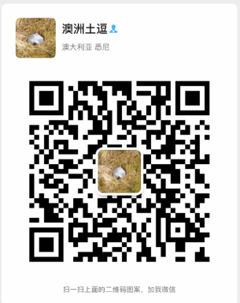
Your success is our success
Contact
Mail: info@funnygorilla.com.au
Linkedin: https://mt.linkedin.com/in/songqing-gu-2ba9034b/de
Web Chat: FunnyGorilla
Phone: 0420891343

