Slide 1
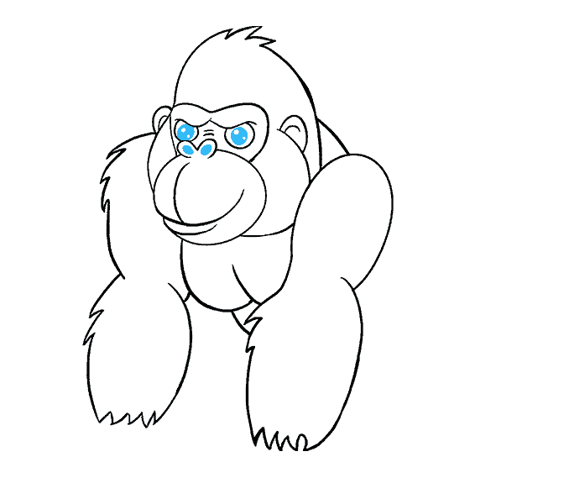
Your success is our success
Advanced Features
Funny Gorilla诙猩猩-IT培训

Slide 2
Learning Objectives
By the end of this learning module, you will be able to understand:
Use API specification in Postman
Create mocks from an OAS
Create tests from am OAS

Slide 3
Setting up a mock server
To do

Slide 4
Use API Specification in Postman
Creating mocks from an OAS
Creating tests from an OAS

Slide 5
References
https://learning.postman.com/docs/introduction/overview/
https://learning.postman.com/docs/writing-scripts/script-references/test-examples/

Slide 6
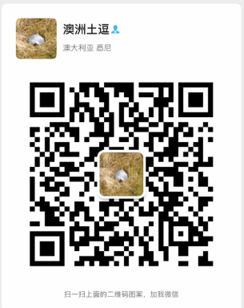
Your success is our success
Contact
Mail: info@funnygorilla.com.au
Linkedin: https://mt.linkedin.com/in/songqing-gu-2ba9034b/de
Web Chat: FunnyGorilla
Phone: 0420891343

