Slide 1
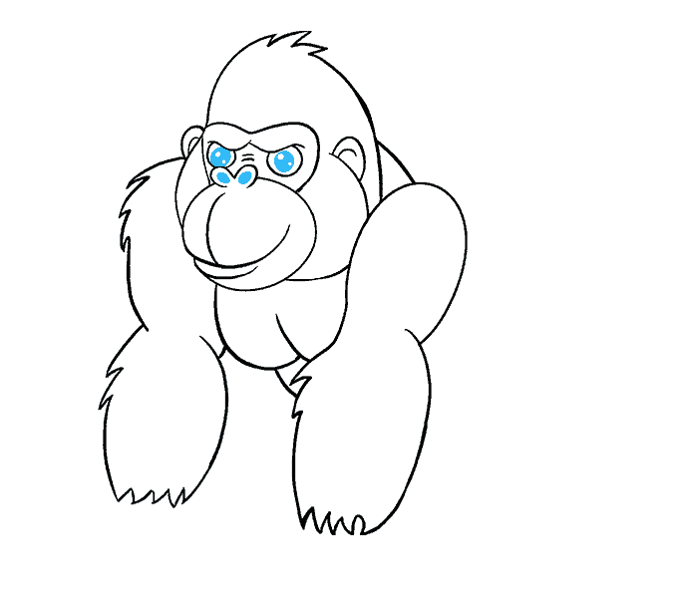
Funny Gorilla诙猩猩-IT培训
Your success is our success
Playwright APIs

Slide 2
Playwright APIs

Slide 3
Browser
BrowserContext
Text Selector
Page
CSS Selector
XPath Selector
Select visible
mouse
keyboard
Route
Locator
Selector
Select element
(container other elements)
Select element
In Shadow DOM
Chained Selector
Notes:
Utilizing a design pattern like POM can help reduce code duplication and enhance maintainability issues.
Moreover, we can use POM for including reusable robust locating and waiting strategies.

Slide 4
How to create a Locator
Avoid overly specific selectors:
Be mindful of dynamic content:
Prioritize user-visible attributes:
Use selector chaining:
Use waitForSelector cautiously:
Avoid using indexes

Slide 5
Best Practices for using Playwright Selectors
Avoid overly specific selectors:
Be mindful of dynamic content:
Prioritize user-visible attributes:
Use selector chaining:
Use waitForSelector cautiously:
Avoid using indexes

Slide 6
References
https://www.browserstack.com/guide/design-patterns-in-selenium
https://www.guru99.com/page-object-model-pom-page-factory-in-selenium-ultimate-guide.html

Slide 7
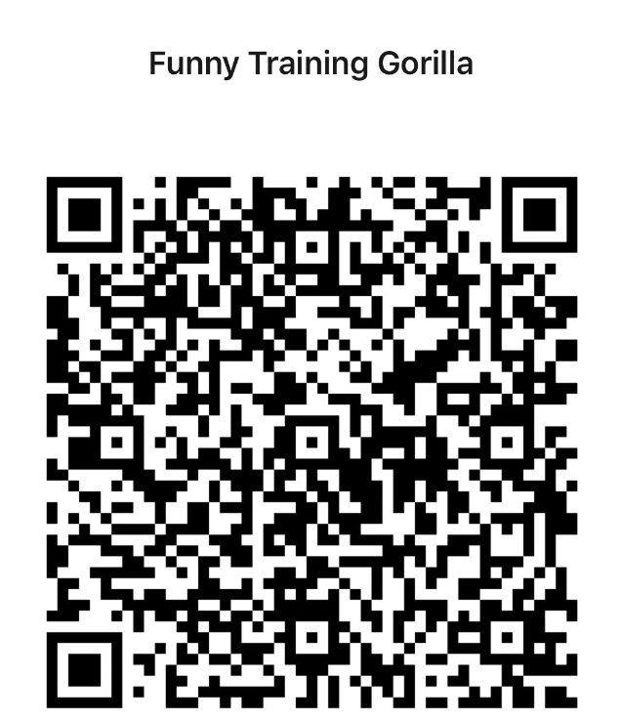
Contact
WebSite: www.funnygorilla.com.au
Mail: info@funnygorilla.com.au
Linkedin: https://mt.linkedin.com/in/songqing-gu-2ba9034b/de
WebChat: Funny Training Gorilla
Phone: 0420891343

