Slide 1

Funny Gorilla诙猩猩-IT培训
Your success is our success
Design Patterns
Page Object Model

Slide 2
Page Object Model Pattern
Design Patterns

Slide 3
the limitations?
Why Design Patterns?
Vanilla
@Test
void testVanillaBasicLogin() {
driver.get(“someURL");
driver.findElement(By.id("username")).sendKeys("user");
driver.findElement(By.id("password")).sendKeys("user");
driver.findElement(By.cssSelector("button")).click();
Assertions.assertTrue(driver.findElement(By.id("success")).isDisplayed());
}
@Test
void testVanillaBasicLoginFailure() {
driver.get(“someURL");
driver.findElement(By.id("username")).sendKeys("bad-user");
driver.findElement(By.id("password")).sendKeys("bad-password");
driver.findElement(By.cssSelector("button")).click();
Assertions.assertTrue(driver.findElement(By.id("invalid")).isDisplayed());
}

Slide 4
The limitations
Vanilla
Repeated implementation
UI can be changed
flakiness
Test Case 01
UI handling logic
Testing handling logic
HTML
Page
Test Case 02
UI handling logic
Testing handling logic
Notes:
Utilizing a design pattern like POM can help reduce code duplication and enhance maintainability issues.
Moreover, we can use POM for including reusable robust locating and waiting strategies.

Slide 5
Page Object Model Pattern
single place to change in case of UI changes
UI handling logic
Locators
HTML
Page
Page Object
Test Case
UI handling logic
Actions
Testing handling logic
Test Logic
Testing logic
Notes:
Utilizing a design pattern like POM can help reduce code duplication and enhance maintainability issues.
Moreover, we can use POM for including reusable robust locating and waiting strategies.

Slide 6
Page Object Model Pattern Separation of UI handling logic from test logic
single place to change
in case of UI changes
Page Object
HTML
Page
Test Case - 1
Action - 1
Locator
Test Case - 2
Action - 2
Testing logic
Wrap UI handling logic into an object
Notes:
Utilizing a design pattern like POM can help reduce code duplication and enhance maintainability issues.
Moreover, we can use POM for including reusable robust locating and waiting strategies.

Slide 7
Page Object Model Pattern
Better code organization
Improved test stability
Increased reusability
Easier collaboration
Separation of
UI handling logic
from test logic
Notes:
Utilizing a design pattern like POM can help reduce code duplication and enhance maintainability issues.
Moreover, we can use POM for including reusable robust locating and waiting strategies.

Slide 8
Page Object
responsible for locating elements on a page
represent objects on a page, not an entire page
Web locators
Web actions
tell you about the state of a page
perform business tasks or simulate user behavior
present state in business terms
hide wait conditions and other incidental implementation details

Slide 9
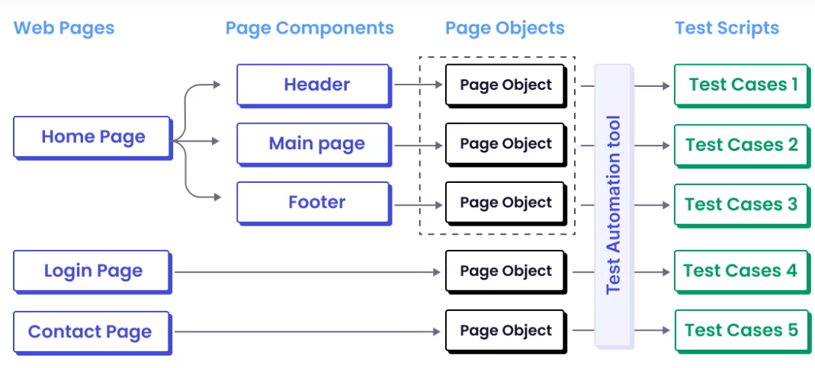
Conceptual Model
Notes:
Utilizing a design pattern like POM can help reduce code duplication and enhance maintainability issues.
Moreover, we can use POM for including reusable robust locating and waiting strategies.

Slide 10
Implementation Model
single place to change in case of UI changes
Base Page Class
Login Page class
display Page class
Cart Page class
Login Test Logic
Display Test Logic
Cart Test Logic
Notes:
Utilizing a design pattern like POM can help reduce code duplication and enhance maintainability issues.
Moreover, we can use POM for including reusable robust locating and waiting strategies.

Slide 11
Playwright POM Implementation
Notes:
Utilizing a design pattern like POM can help reduce code duplication and enhance maintainability issues.
Moreover, we can use POM for including reusable robust locating and waiting strategies.

Slide 12
To do
Notes:
Utilizing a design pattern like POM can help reduce code duplication and enhance maintainability issues.
Moreover, we can use POM for including reusable robust locating and waiting strategies.

Slide 13
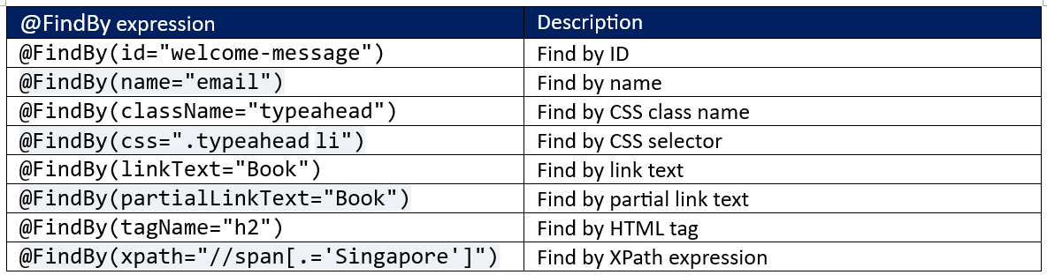
Notes:
Utilizing a design pattern like POM can help reduce code duplication and enhance maintainability issues.
Moreover, we can use POM for including reusable robust locating and waiting strategies.

Slide 14
POM Demo
Notes:
Utilizing a design pattern like POM can help reduce code duplication and enhance maintainability issues.
Moreover, we can use POM for including reusable robust locating and waiting strategies.

Slide 15
References
https://www.browserstack.com/guide/design-patterns-in-selenium
https://www.guru99.com/page-object-model-pom-page-factory-in-selenium-ultimate-guide.html

Slide 16

Contact
WebSite: www.funnygorilla.com.au
Mail: info@funnygorilla.com.au
Linkedin: https://mt.linkedin.com/in/songqing-gu-2ba9034b/de
WebChat: Funny Training Gorilla
Phone: 0420891343

