Slide 1

Funny Gorilla诙猩猩-IT培训
Your success is our success
Selenium Introduction

Slide 2
Mind map

Slide 3
Agenda
Big Picture
How Selenium Works Logically
POM
XPath
How Selenium Works Physically
Selenium Test
Demo – Mouse Action

Slide 4


Web application architecture
HTML/CSS/JS
JSON/Http
API
SQL/JDBC
API
Web Tier
Database Tier
Business Tier

Slide 5



Big Picture
Content
HTML
Format
CSS
Web Page
Interact
with backend
JavaScript
POM
Selenium emulates human to interact with browser

Slide 6
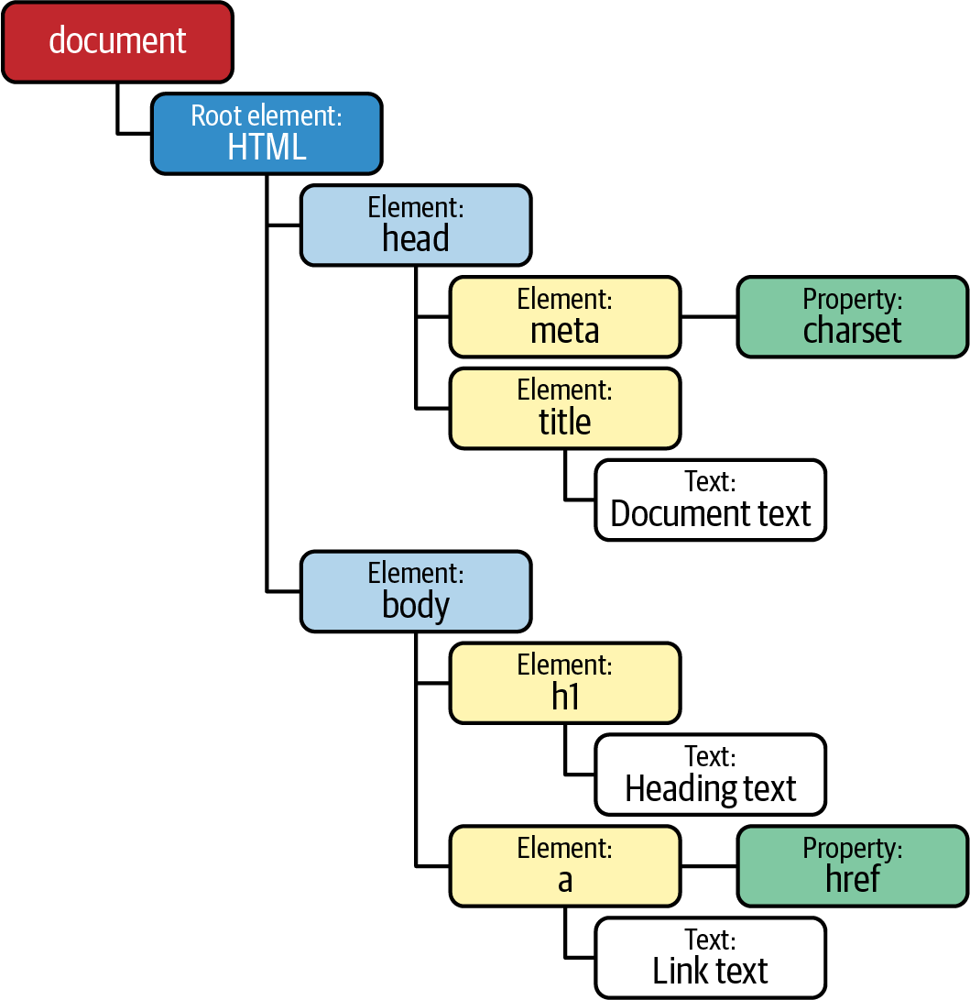
Understand Web Page Object Model (POM)
HTML + CSS + JavaScript
<HTML>
<HEAD>
<TITLE>Your Title Here</TITLE>
</HEAD>
<BODY BGCOLOR="FFFFFF">
<CENTER><IMG SRC="clouds.jpg" ALIGN="BOTTOM"> </CENTER>
<HR>
<a href="http://somegreatsite.com">Link Name</a>
is a link to another nifty site
<H1>This is a Header</H1>
<H2>This is a Medium Header</H2>
Send me mail at <a href="mailto:support@yourcompany.com">support@company.com</a>.
<P> This is a new paragraph!
<P> <B>This is a new paragraph!</B>
<BR> <B><I>This is a new sentence without a paragraph break, in bold italics.</I></B>
<HR>
</BODY>
</HTML>

Slide 7
How Selenium Works
Selenium emulates human to interact with browser

Slide 8

HTML
CSS
JavaScript
HTML Source File
http protocol
http://www.google.com
Selenium Java Code
?
Selenium WebDriver
Web App Server
Json wire protocol
Web Page
Selenium emulates human to interact with browser

Slide 9
Take human actions

Slide 10
Compound Locators
Relative Locators
Mouse Action
Keyboard Action
Location strategy
1
3
POM
2
Take actions
Locate the right place
tag
Xpath,
element,
attributes (Id, name, class
link text
CSS Selectors
etc
User Gestures
WebElement methods
Waiting strategy
Open/close window
Click
Summit
Select
navigate
etc.

Slide 11
Location Strategies

Slide 12
Location Strategy
Method | Syntax | Description
By ID | driver.findElement(By.id (<element ID>)) | Locates an element using the ID attribute
By name | driver.findElement(By.name (<element name>)) | Locates an element using the Name attribute
By class name | driver.findElement(By.className (<element class>)) | Locates an element using the Class attribute
By tag name | driver.findElement(By.tagName (<htmltagname>)) | Locates an element using the HTML tag
By link text | driver.findElement(By.linkText (<linktext>)) | Locates a link using link text
By partial link text | driver.findElement(By.partialLinkText (<linktext>)) | Locates a link using the link's partial text
By CSS | driver.findElement(By.cssSelector (<css selector>)) | Locates an element using the CSS selector
By XPath | driver.findElement(By.xpath (<xpath>)) | Locates an element using XPath query
Chrome Developer Tool
https://yizeng.me/2014/03/23/evaluate-and-validate-xpath-css-selectors-in-chrome-developer-tools/

Slide 13
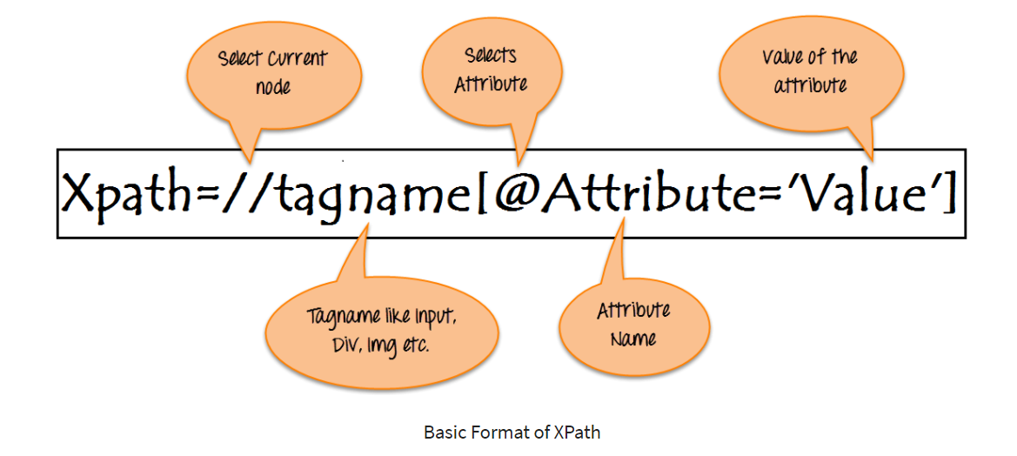
XPath

Slide 14
Take Human Actions
Mouse Action
Keyboard Action
User Gestures
Waiting strategy

Slide 15
Common Selenium Action
Mouse Action
Keyboard Action
User Gestures
Waiting strategy

Slide 16
Common Selenium Action
driver.get("URL") | To navigate to an application.
element.sendKeys("inputtext") | Enter some text into an input box
element.clear() | Clear the contents from the input box.
select.deselectAll() | Deselect all OPTIONs from the first SELECT on the page.
select.selectByVisibleText("some text") | Select the OPTION with the input specified by the user.
driver.switchTo().window("windowName") | Move the focus from one window to another.
driver.switchTo().frame("frameName") | Swing from frame to frame.
https://www.tutorialspoint.com/selenium/selenium_webdriver.htm

Slide 17
Interaction
Text Box Interaction
Radio Button Selection
Check Box Selection
Drop Down Item Selection
Synchronization
Drag & Drop
Keyboard Actions
Mouse Actions
Multi Select
Find All Links

Slide 18
Java Implementation
1. Understand Web page source file: Page Object Model (POM)
2. Locate POM object: XPath, Id, name, etc.
https://www.guru99.com/xpath-selenium.html
3. Take action against selected element

Slide 19
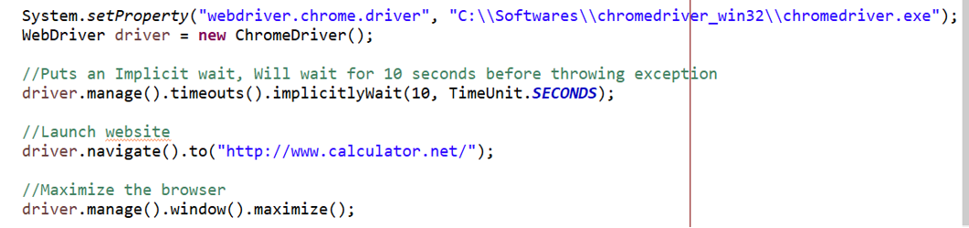
Selenium Java Part 1 - Setup

Slide 20
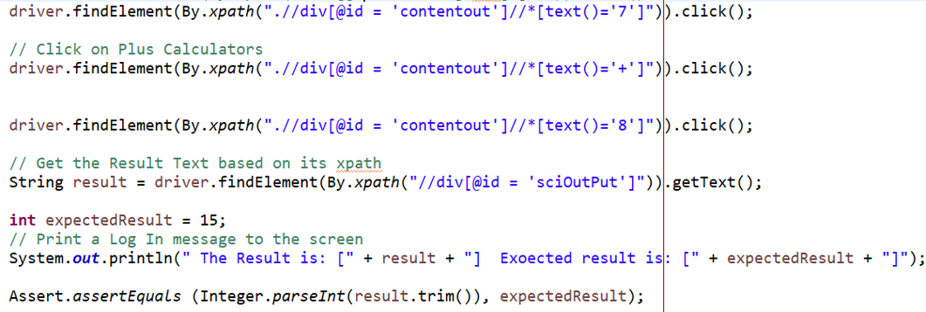
Part 2 – execute human actions

Slide 21
Part 3 – close window

Slide 22
Selenium Architecture

Slide 23
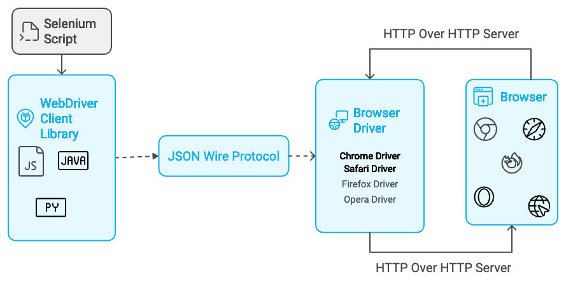

Slide 24
Put Everything Together

Slide 25
Selenium Environment Setup – Standalone Grid
Download Seleniue Grid
https://www.selenium.dev/downloads/
Download Chrome Driver
https://chromedriver.chromium.org/downloads
Download and configure Maven
https://maven.apache.org/download.cgi
Prepare eclipse
https://www.browserstack.com/guide/selenium-with-java-for-automated-test

Slide 26
References
Maven
Eclipse
https://www.vogella.com/tutorials/Eclipse/article.html
Java
XPath
https://www.guru99.com/xpath-selenium.html
Selenium tutorial
https://www.selenium.dev/documentation/webdriver/getting_started/
https://www.browserstack.com/guide/selenium-with-java-for-automated-test
https://www.tutorialspoint.com/selenium/selenium_webdriver.htm
https://www.lambdatest.com/blog/selenium-webdriver-tutorial-with-examples/
Code sample
https://www.lambdatest.com/blog/selenium-webdriver-tutorial-with-examples/

Slide 27

Contact
Your success is our success
Mail: info@funnygorilla.com.au
Linkedin: https://mt.linkedin.com/in/songqing-gu-2ba9034b/de
Web Chat: FunnyGorilla
Phone: 0420891343

