Slide 1

Your success is our success
TDD & JUnit
Funny Gorilla诙猩猩-IT培训

Slide 2
Agenda
Big Picture
How Selenium Works Logically
POM
XPath
How Selenium Works Physically
Selenium Test
Demo – Mouse Action

Slide 3
Execution – TDD Junit framework
Junit 4
Run as
Junit Test Cases
Junit 5
Junit 5 with Selenium-Jupiter
TestNG

Slide 4
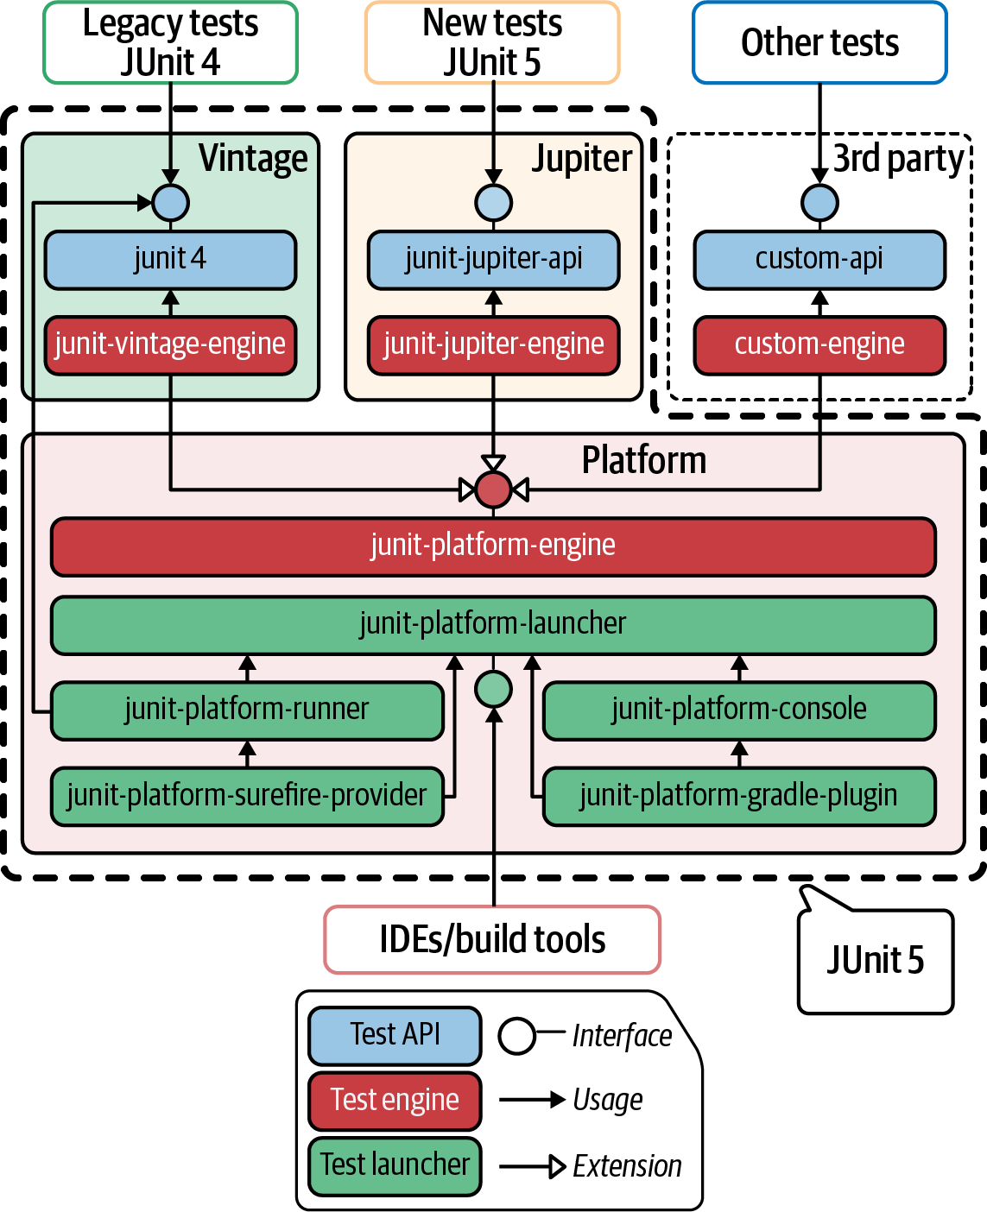
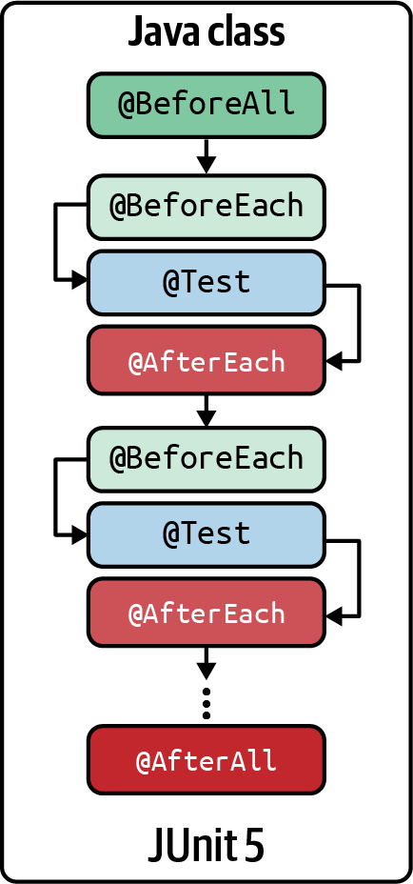
Junit 5

Slide 5
Put Everything Together

Slide 6
References
Maven
Eclipse
https://www.vogella.com/tutorials/Eclipse/article.html
Java
XPath
https://www.guru99.com/xpath-selenium.html
Selenium tutorial
https://www.selenium.dev/documentation/webdriver/getting_started/
https://www.browserstack.com/guide/selenium-with-java-for-automated-test
https://www.tutorialspoint.com/selenium/selenium_webdriver.htm
https://www.lambdatest.com/blog/selenium-webdriver-tutorial-with-examples/
Code sample
https://www.lambdatest.com/blog/selenium-webdriver-tutorial-with-examples/

Slide 7
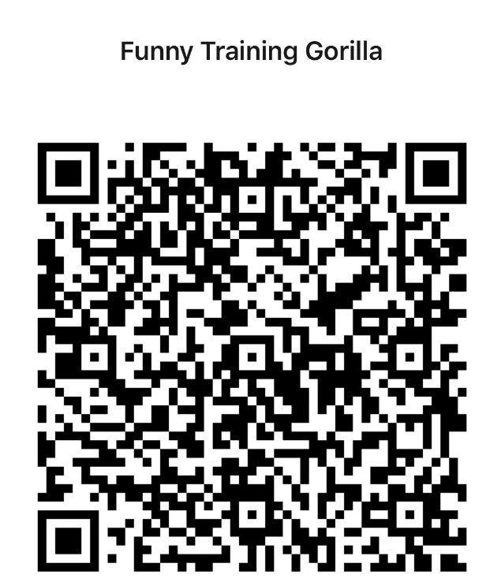
Contact
WebSite: www.funnygorilla.com.au
Mail: info@funnygorilla.com.au
Linkedin: https://mt.linkedin.com/in/songqing-gu-2ba9034b/de
WebChat: Funny Training Gorilla
Phone: 0420891343

