Slide 1

Funny Training Gorilla 澳洲土逗-IT培训
Your success is our success
Introduction to BDD

Slide 2
Agenda
Big Picture
How Selenium Works Logically
POM
XPath
How Selenium Works Physically
Selenium Test
Demo – Mouse Action

Slide 3
Gherkin

Slide 4
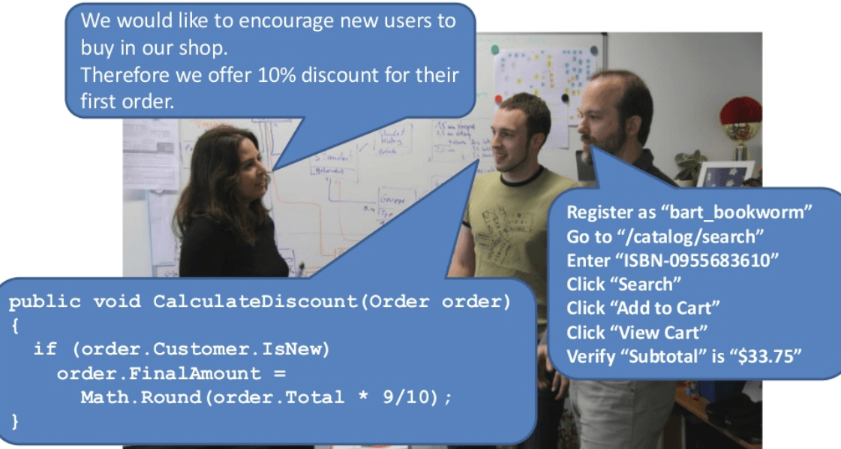

Slide 5
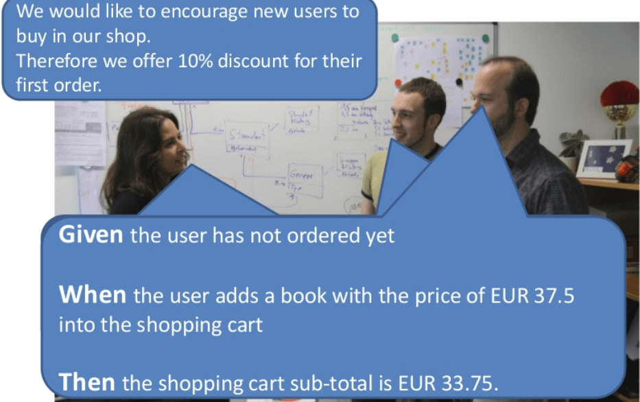

Slide 6
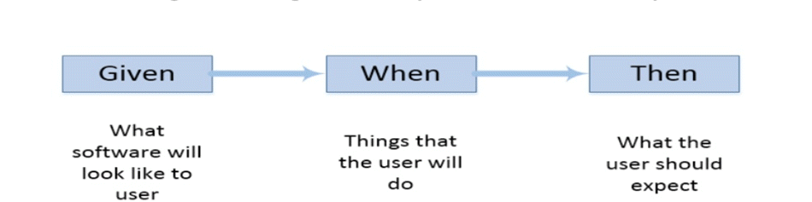
Gherkin

Slide 7
Cucumber

Slide 8
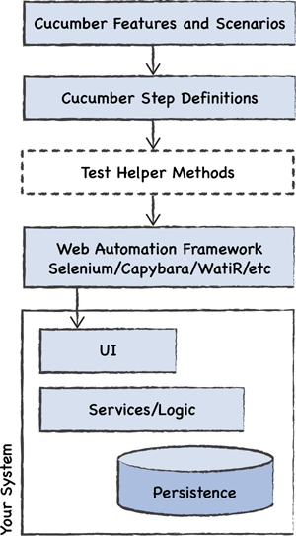
Cucumber
Stack

Slide 9
Put
Everything
Together

Slide 10
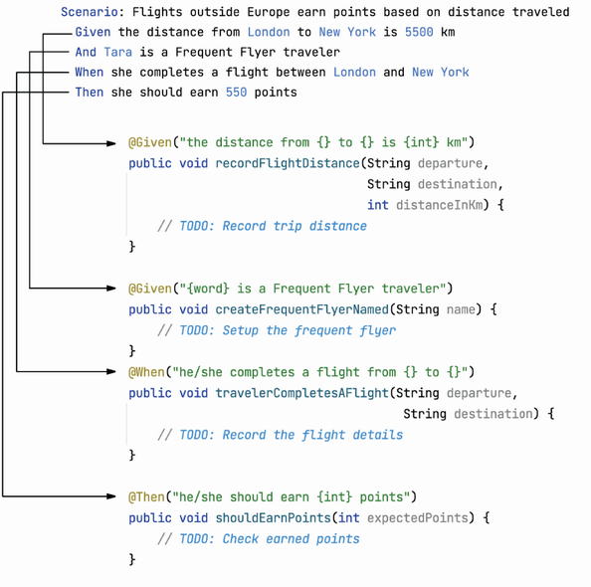

Slide 11
References
XPath
https://www.guru99.com/xpath-selenium.html
Selenium tutorial
https://www.browserstack.com/guide/selenium-with-java-for-automated-test
https://www.tutorialspoint.com/selenium/selenium_webdriver.htm
https://www.softwaretestinghelp.com/docker-selenium-tutorial/

Slide 12
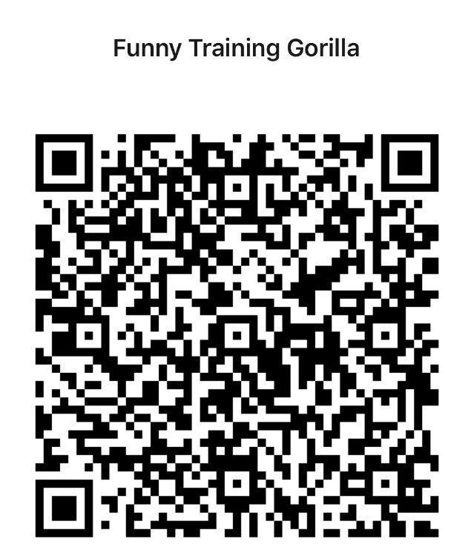
Contact
WebSite: www.funnygorilla.com.au
Mail: info@funnygorilla.com.au
Linkedin: https://mt.linkedin.com/in/songqing-gu-2ba9034b/de
WebChat: Funny Training Gorilla
Phone: 0420891343

