Slide 1
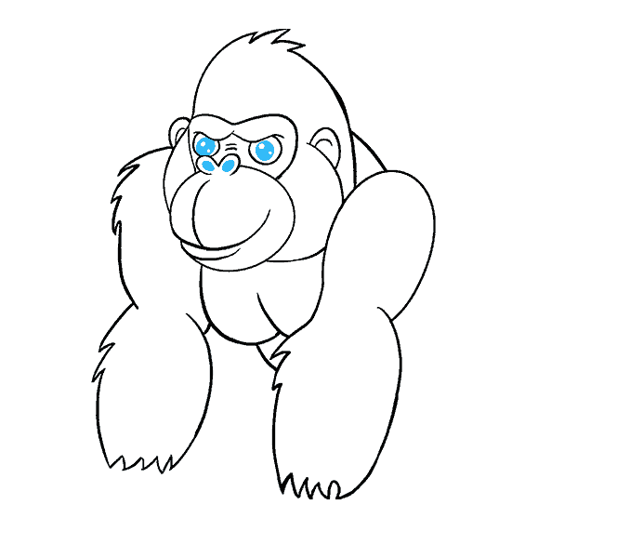
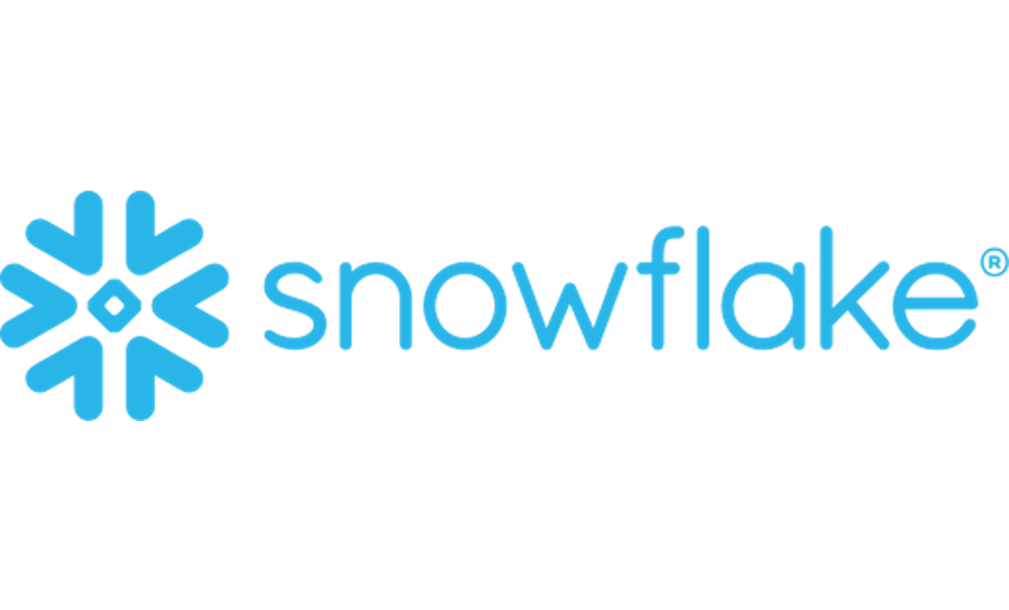
Architecture of Snowflake
Your success is our success
Funny Gorilla 诙猩猩
Notes:
Notes for title slide

Slide 2
Learning Objectives
Snowflake architecture
Cloud service layer
Computer layer
Storage layer

Slide 3
Characteristics

Slide 4
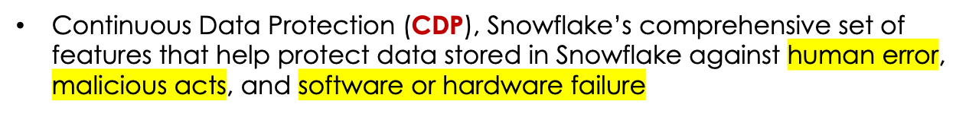
Characteristics

Slide 5
Snowflake architecture
Shared disk architecture
Shared nothing architecture
Snowflake architecture

Slide 6
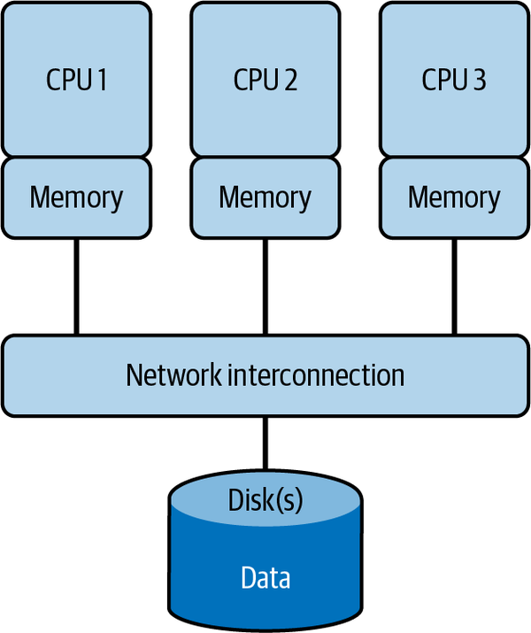
Shared-disk architecture
it requires complex on-disk locking mechanisms to ensure data consistency which, in turn, causes bottlenecks
The data accessed by each cluster node is consistently available because all data modifications are written to the shared disk.

Slide 7
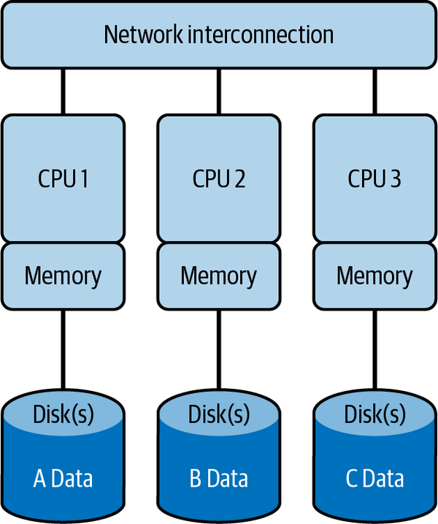
Shared-nothing architecture
Storage and compute are scaled together, was designed in response to the bottleneck created by the shared-disk architecture.
distributed cluster nodes along with the associated disk storage, CPU, and memory requires data to be shuffled between nodes, which adds overhead

Slide 8
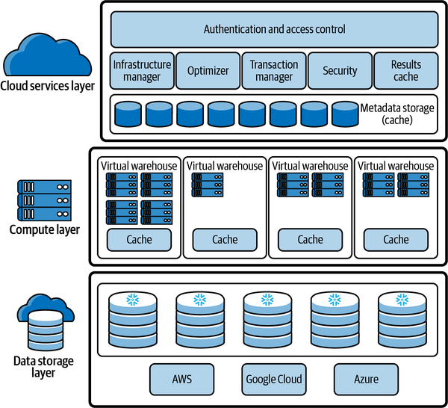
Snowflake architecture

Slide 9
Cloud service layer

Slide 10
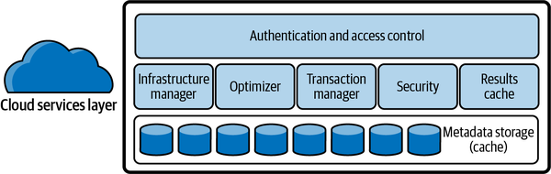
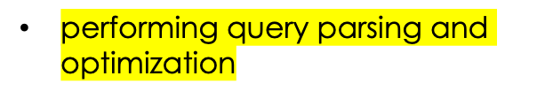
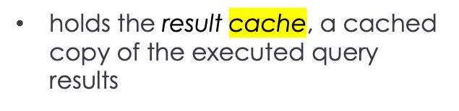
Cloud service layer
coordinate activities such as authentication, access control, and encryption.
includes management functions for handling infrastructure and metadata
cloud services layer runs across multiple availability zones

Slide 11
Computer layer

Slide 12
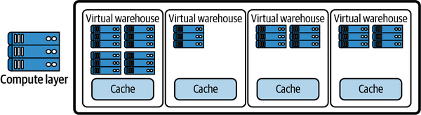
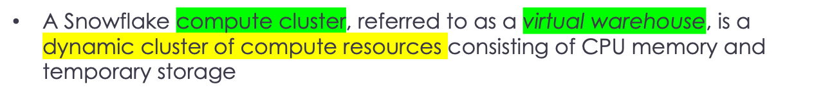
Computer layer
any virtual warehouse can access the same data as another, without any contention or impact on performance of the other warehouses
each Snowflake virtual warehouse operates independently and does not share compute resources with other virtual warehouses

Slide 13
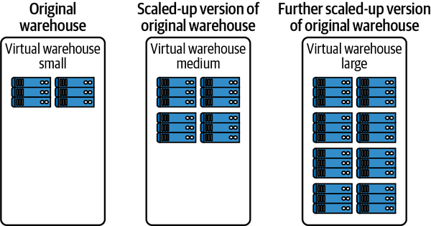
Scaling up Virtual Warehouse
A Snowflake compute cluster is defined by its size, with size corresponding to the number of servers in the virtual warehouse cluster

Slide 14
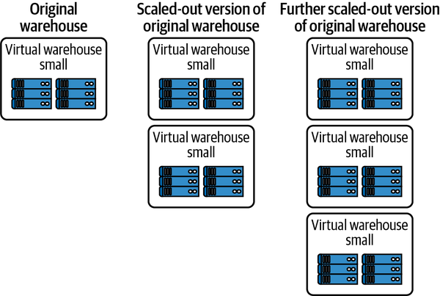
Scaling out Virtual Warehouse

Slide 15
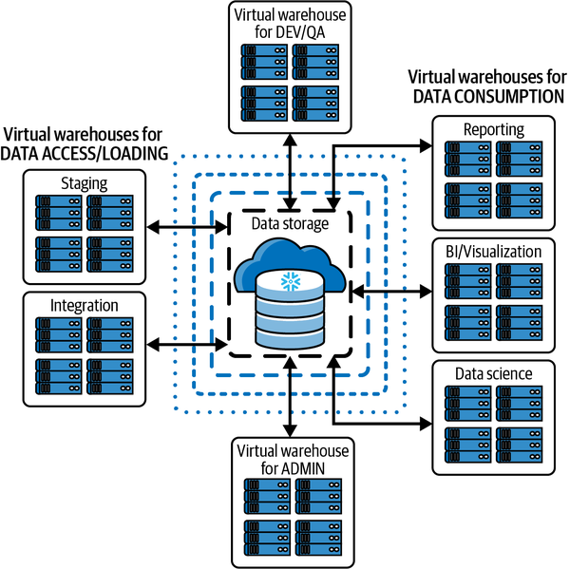
Separation of workload
Several options exist to efficiently handle workloads of varying size.
One way is to separate the workloads by assigning different virtual warehouses to different users or groups of users

Slide 16
Storage layer

Slide 17
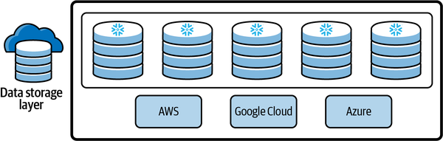
the remote disk layer - The specific provider used for data storage is the one you selected when you created your Snowflake account

Slide 18
Cache
Query result cache
Meta data cache
Virtual Warehouse Local Disk Cache

Slide 19
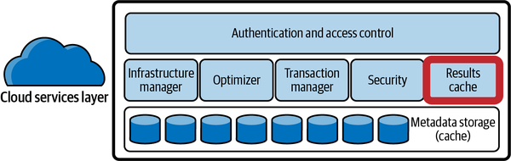

Slide 20
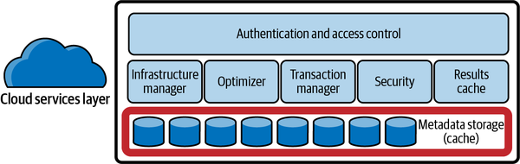

Slide 21
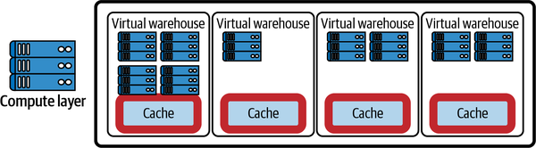

Slide 22

Technical features
Zero-copy cloning
Time Travel
Beyond structured data

Slide 23
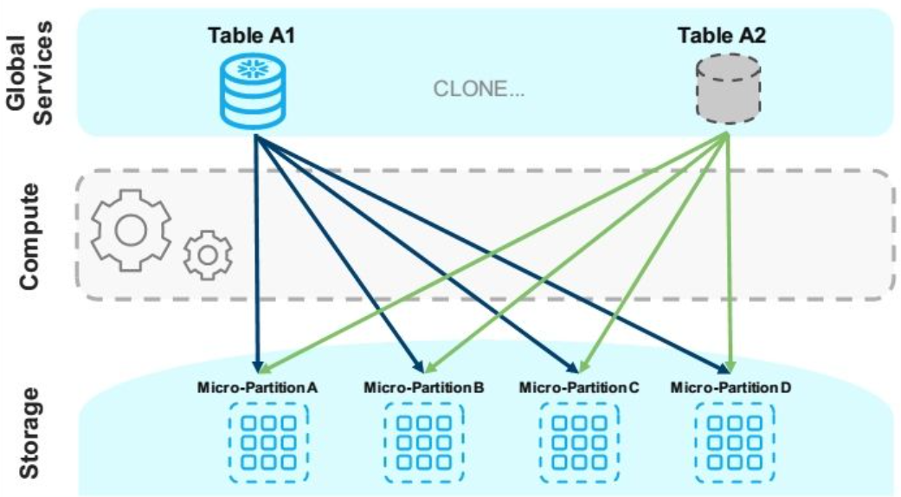
Zero-copy cloning
instantly creates independent copies (clones) of databases, schemas, or tables without duplicating data, making it fast and storage-efficient by initially sharing the same physical data.
It works using metadata pointers and a "copy-on-write" mechanism: data is only physically copied and stored separately (using new micropartitions) when changes are made to the clone, not the original, enabling safe development, testing, and branching.
Metadata-Driven
Copy-on-Write
Data Isolation
-- Clone an entire database
CREATE DATABASE my_dev_db CLONE prod_db;
-- Clone a specific table
CREATE TABLE sales_test_table CLONE sales_data;

Slide 24
Time Travel
Hybrid Unistore tables
Beyond structured data

Slide 25
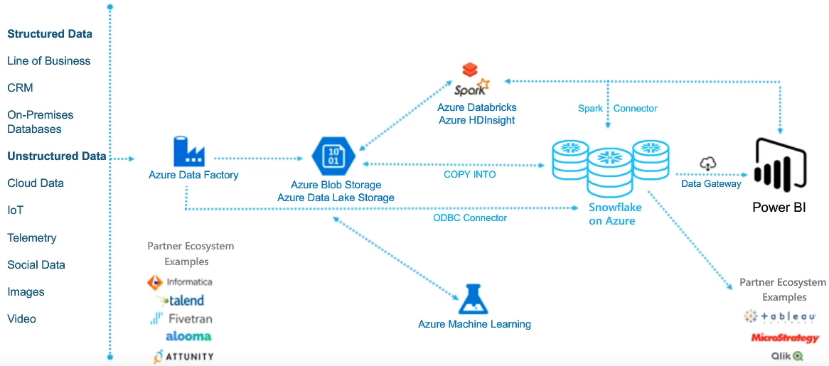
Reference Architecture

Slide 26
Reference Links

Slide 27

Your success is our success
Contact
Mail: info@funnygorilla.com.au
Linkedin: https://mt.linkedin.com/in/songqing-gu-2ba9034b/de
Web Chat: FunnyGorilla
Phone: 0420891343

