Slide 1

Data Objects of Snowflake
Your success is our success
Funny Gorilla 诙猩猩
Notes:
Notes for title slide

Slide 2
Learning Objectives
Data Ingestion
Factors to consider when designing data ingestion
Why build pipeline
How the build pipeline built

Slide 3
Access control

Slide 4
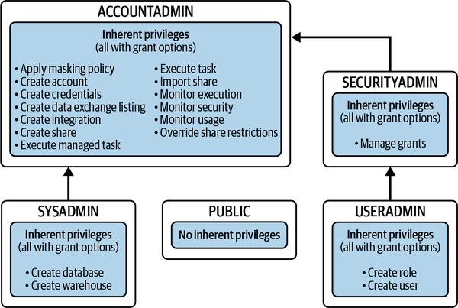

Slide 5
Data Objects

Slide 6
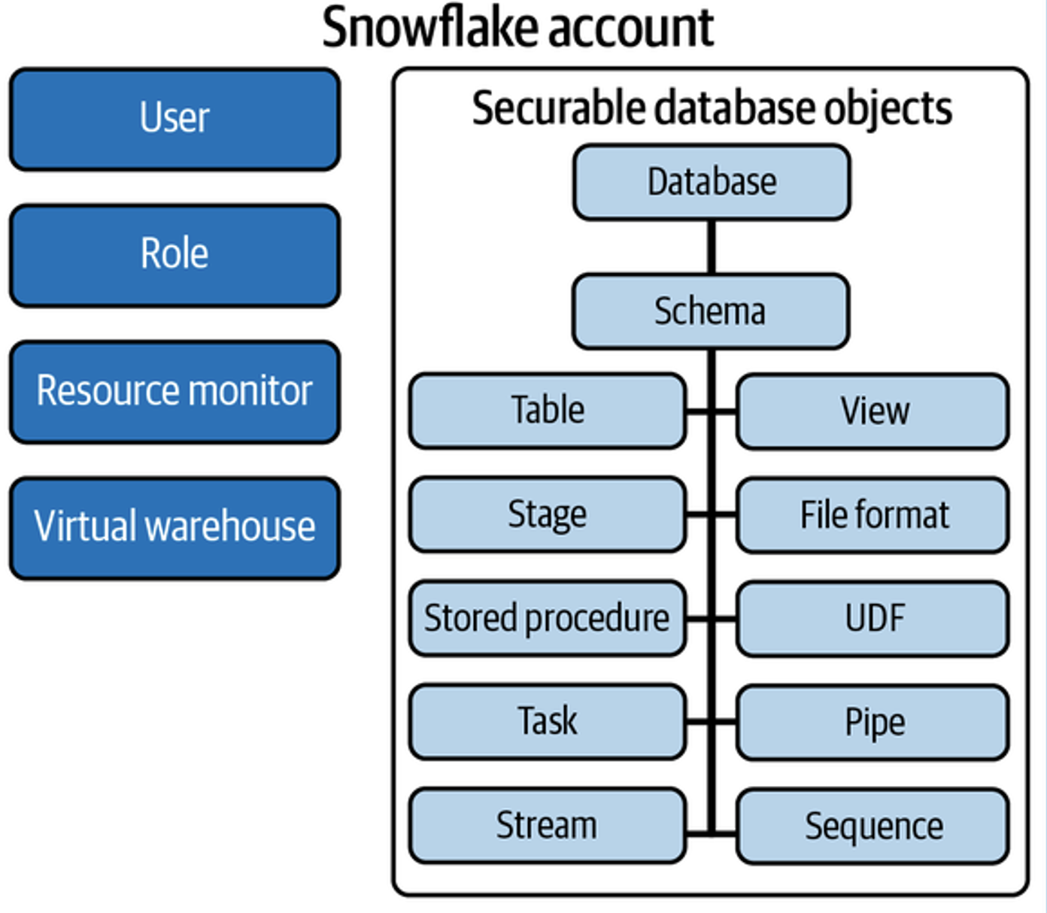
Dynamic Table

Slide 7
Stage

Slide 8
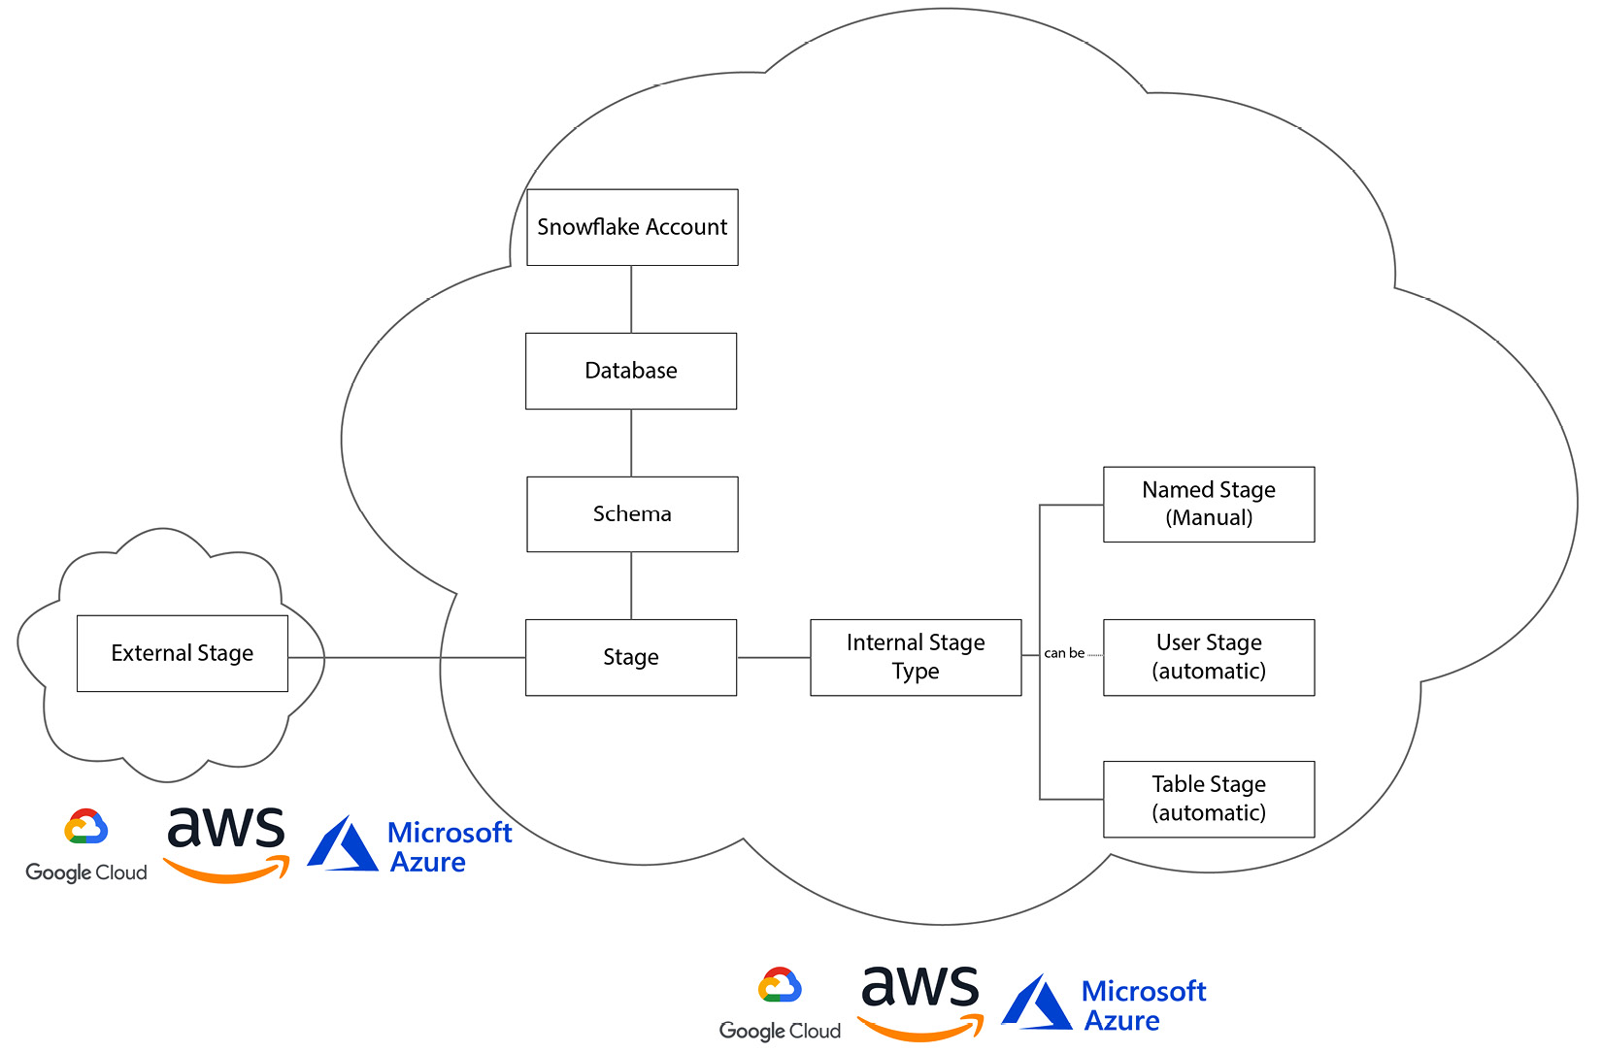
Before data can make its way into tables, it must be loaded into Snowflake using a stage.
Stages are logical objects that abstract cloud filesystems so they can be used in a standard manner to load data into Snowflake.

Slide 9
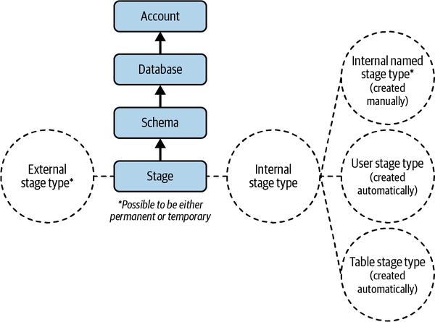
Stage
Stages point to a storage location, either internal to Snowflake or on external cloud storage.

Slide 10
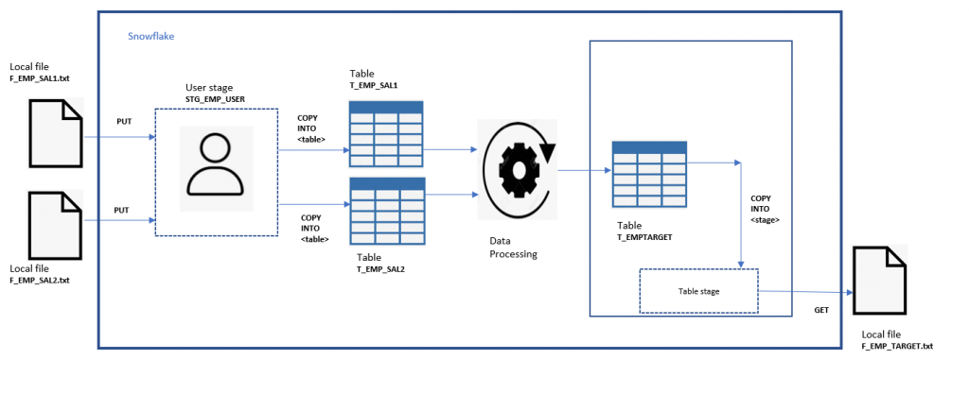
User, table Stage

Slide 11
Internal Stage

Slide 12
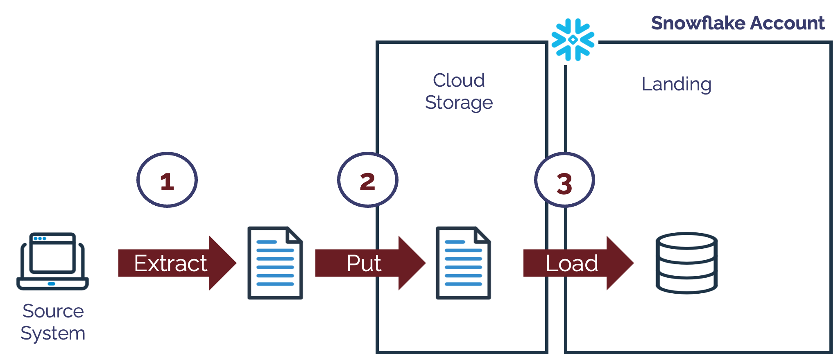
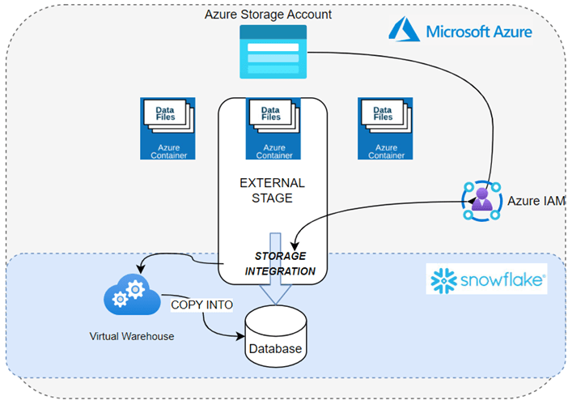
External Stage
Azure Entra ID
Internal stage

Slide 13
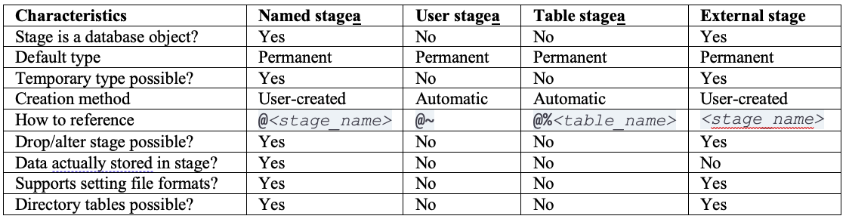
Stage comparison

Slide 14
Schama

Slide 15
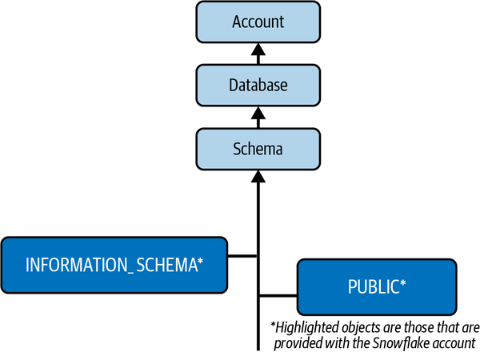
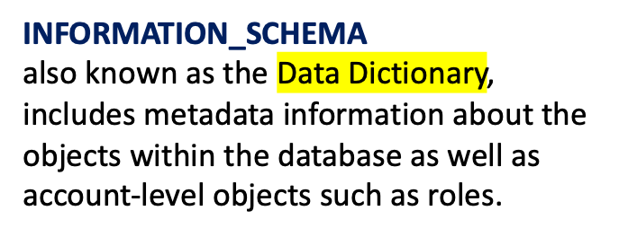
Data Schema
PUBLIC schema
the default schema and can be used to create any other objects,

Slide 16
Table
Permanent
Transient
Temporary
Hybrid Unistore tables

Slide 17
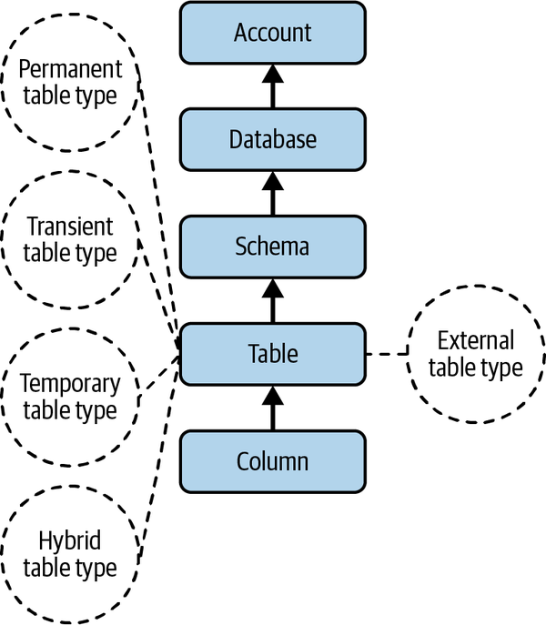
Table

Slide 18
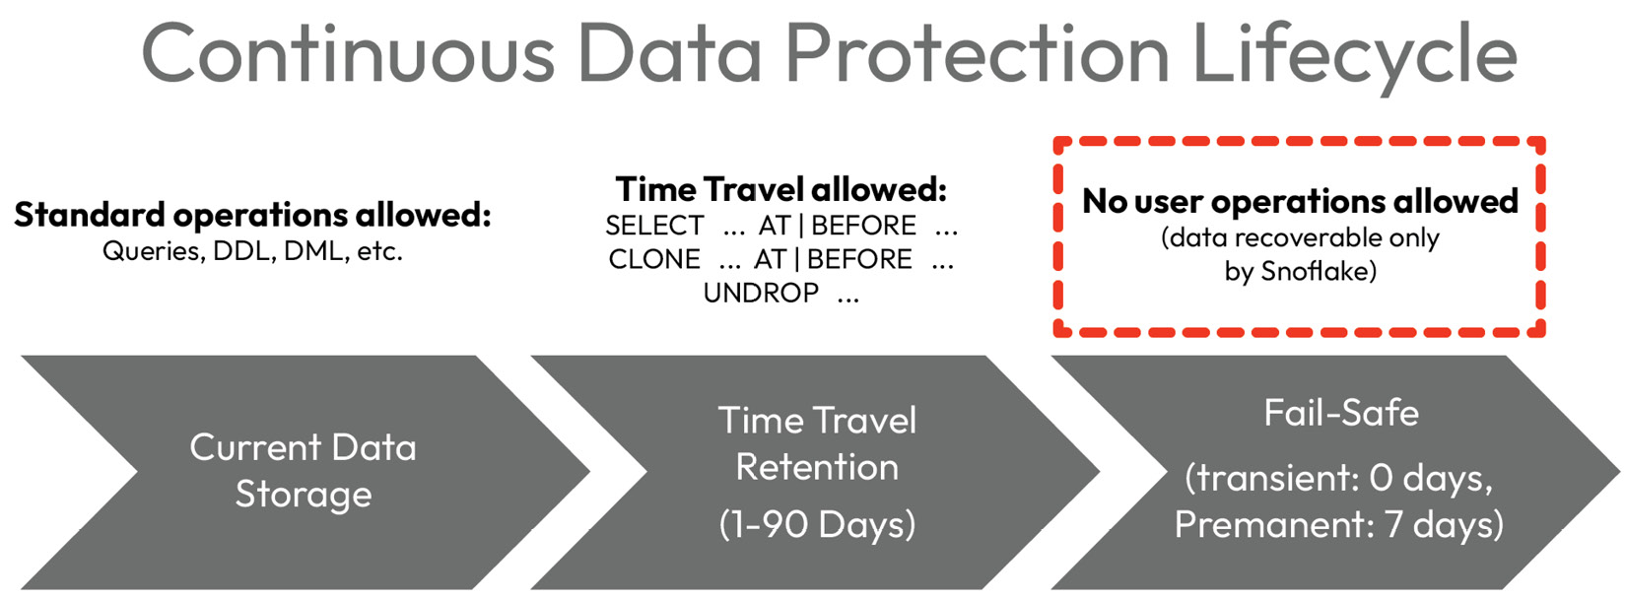

Slide 19
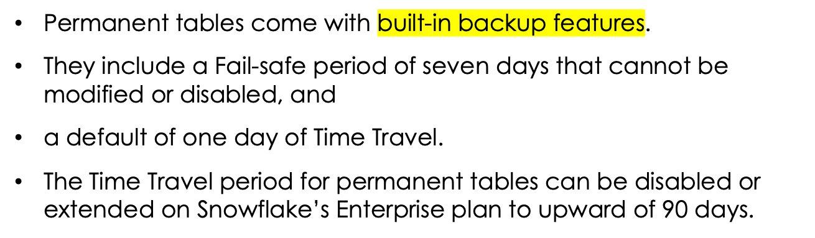
Permanent Table

Slide 20
Transient Table
transient tables have no Fail-safe period but do come with one day of Time Travel by default.
Users can turn off Time Travel by setting it to 0 but can not extend it beyond 1, even on Enterprise plans.
Use case
ideal for staging data and development environments,
Snowflake also offers a temporary table type that persists only for the duration of a user session.
a good choice when backup and recovery are not a high priority—as in the case of staging tables.

Slide 21
Temporary Table
temporary tables are dropped at the end of the user session. A session can be thought of as an active login.
Use case
temporary tables are meant to hold intermediate results for processes during the same session.
Temporary tables can also be used for throw-away tests in development environments, saving the user the labor of dropping them explicitly.

Slide 22
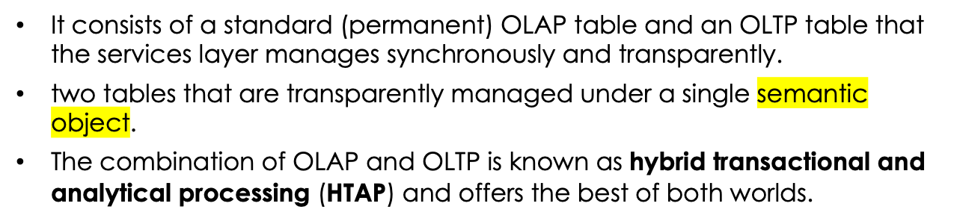
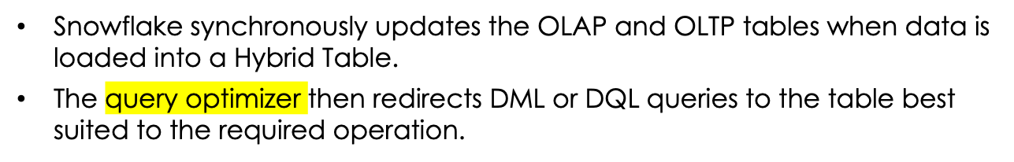
Hybrid Unistore Table
Use case

Slide 23
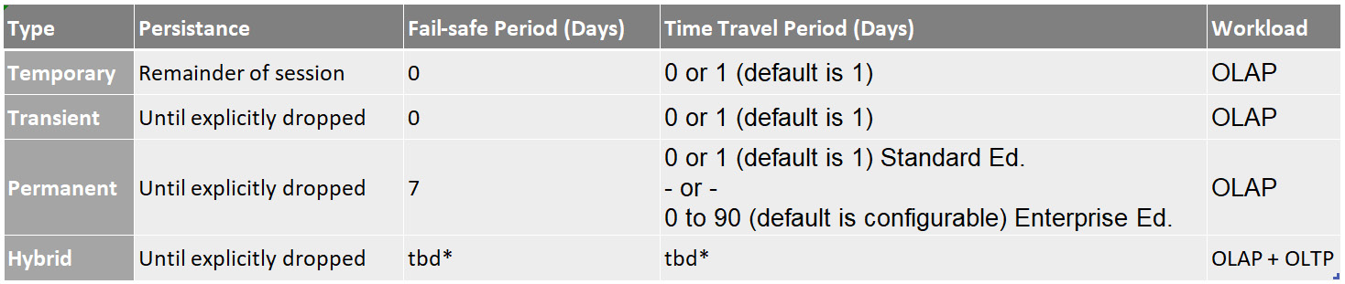
Table

Slide 24
Metadata Table
metadata objects created on top of stages that allow users to query the data in externally staged files as if it were inside the database.
The columns are included for all external tables:
- VALUE : A VARIANT-type column representing a single row in the external file
- METADATA$FILENAME: Identifies the name of each staged data file in the external table
- METADATA$FILE_ROW_NUMBER: Shows the row number for each record in a staged data file.

Slide 25
View

Slide 26
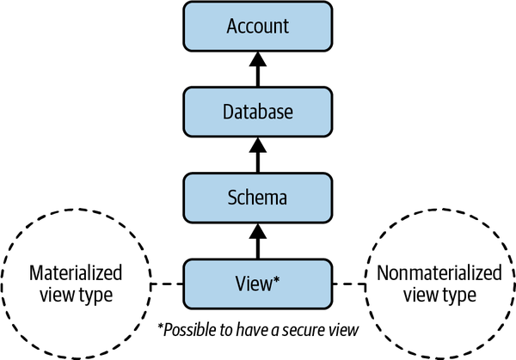
View
Data processing logic is complex
Data processing logic is simple
Data change less frequently
Data change frequently

Slide 27
Stored procedure & UDF

Slide 28
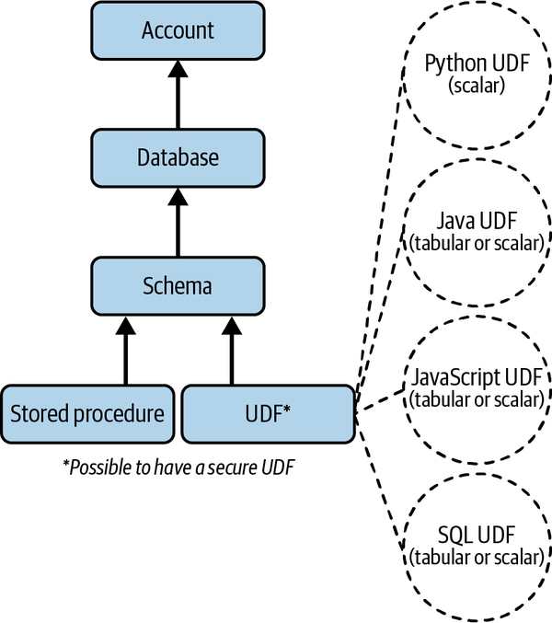
Stored procedure & UDF

Slide 29
Stored procedure
Stored Procedures are not atomic, you need to specifically wrap the code in the procedure in a transaction.
A stored procedure runs with either the caller’s or owner’s rights
generally operates with the privileges of the procedure's owner.
accessing information related to the caller

Slide 30
Stream

Slide 31
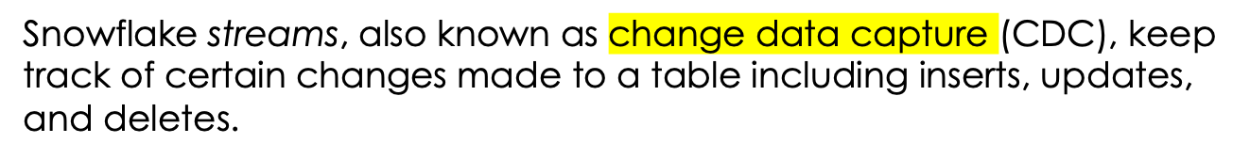
enables near real-time data ingestion and analysis, crucial for timely insights and immediate operational responses.

Slide 32
Pipes

Slide 33
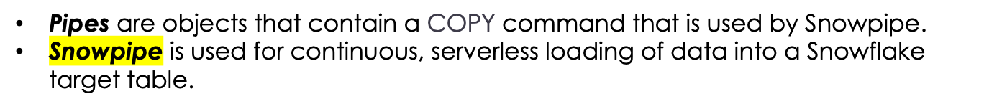

Slide 34
Reference Links

Slide 35

Your success is our success
Contact
Mail: info@funnygorilla.com.au
Linkedin: https://mt.linkedin.com/in/songqing-gu-2ba9034b/de
Web Chat: FunnyGorilla
Phone: 0420891343

