Slide 1

Access Control
Snowflake
Your success is our success
Funny Gorilla 诙猩猩
Notes:
Notes for title slide

Slide 2
Learning Objectives
Data Ingestion
Factors to consider when designing data ingestion
Why build pipeline
How the build pipeline built

Slide 3
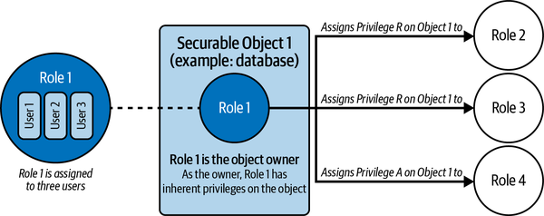
Role, object, privilege
role
object
privilege

Slide 4
Role
System defined roles
User defined roles

Slide 5
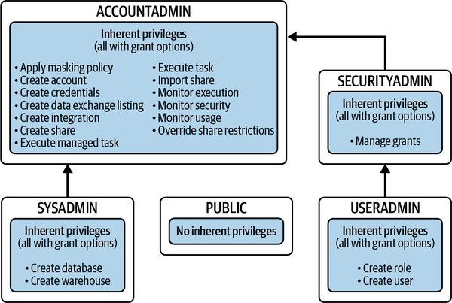
System defined roles

Slide 6
User defined roles

Slide 7
Reference Links

Slide 8
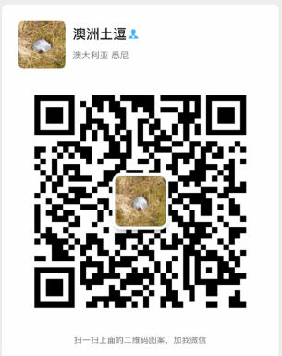
Your success is our success
Contact
Mail: info@funnygorilla.com.au
Linkedin: https://mt.linkedin.com/in/songqing-gu-2ba9034b/de
Web Chat: FunnyGorilla
Phone: 0420891343

