Slide 1
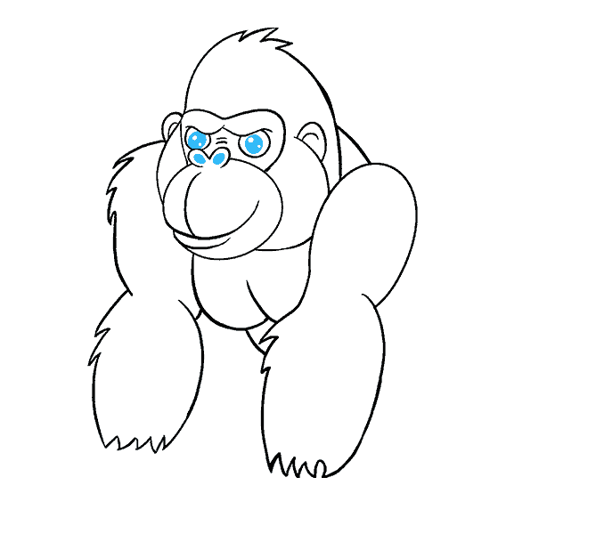
Data Cloud Deployment Framework
Your success is our success
Funny Gorilla 诙猩猩
Notes:
Notes for title slide

Slide 2
Learning Objectives
DCDF framework/design pattern
Data ingestion approaches
Preserve history with SCD
Detect changes with Stream
Maintain data with dynamic table

Slide 3
Data Cloud Deployment Framework
DCDF

Slide 4
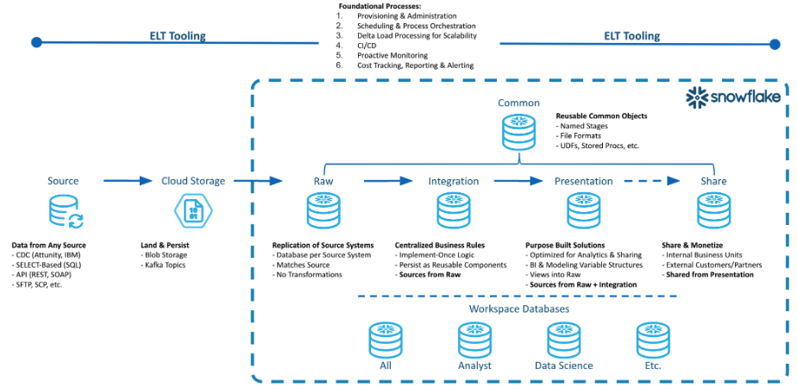

Slide 5
Raw layer

Slide 6
The Raw Layer represents the first processing layer within Snowflake. It facilitates data ingestion into Snowflake and will manage the data as it exists in the source system, with no applied transformations.
The following attributes:
One database per data source.
Hash generation for surrogate keys.
Replication of source data along with the creation of a surrogate key or control column for downstream transformations.

Slide 7
Integration layer

Slide 8
The Integration Layer is used to centralize all business rules applied to the data. This layer performs the transformation, application of business rules, and materialization of data from the Raw Layer into one central location.
The following are attributes of the Integration Layer:
Centralized business rules.
Intermediate results persisted as tables.
Units of work in one place with reusable components.

Slide 9
Presentation layer

Slide 10
The Presentation Layer performs the organization of data from the raw and integration layers into various purpose-built solutions for reporting and analytics.
The following are attributes of the Presentation Layer:
Conforming Dimensions
Atomic Aggregate Fact Tables
Flat data sets for data science model building
Views for governing exposure of data for consumption, analytics and sharing.
Note Business rules should not be implemented within the Presentation Layer. Using permanent tables for incrementally updated tables is recommended.

Slide 11
Common database

Slide 12
The Common Database is a single database with one or more schemas to manage objects that span the breadth of the data architecture layers.
The following are attributes of the Common Database:
User Defined Functions
File Formats
External and Internal Stages
Audit Tables
Common dimensions such as Date, Zip Code, State, Country, etc.
Common table data that is utilized across the DCDF layers.

Slide 13
Workspace database

Slide 14
A Workspace is a sandbox environment where individual teams can persist data for their own development and testing.
These workspaces can be a database and related virtual warehouse for each department or team within a business entity.
One example can be a Data Science team that clones data from the Presentation Layer into their workspace and run models on that data to determine actionable insights.
The following are attributes of a Workspace Database:
Persist intermediate results
Non-production datasets for testing purposes
Compute isolation to mitigate contention and facilitate cost governance.

Slide 15
Reference Links

Slide 16
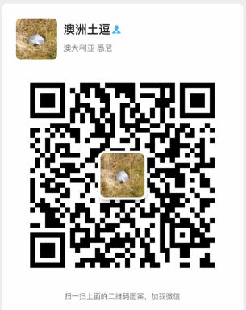
Your success is our success
Contact
Mail: info@funnygorilla.com.au
Linkedin: https://mt.linkedin.com/in/songqing-gu-2ba9034b/de
Web Chat: FunnyGorilla
Phone: 0420891343

