Slide 1

Data Ingestion Pipeline
Your success is our success
Funny Gorilla 诙猩猩
Notes:
Notes for title slide

Slide 2
Learning Objectives

Slide 3
Design Considerations

Slide 4
Source system and data structure
Where is the data coming from? A relational database? Logs? Is it structured, semistructured, or unstructured data?
What are the requirements around how often data needs to be ingested? How soon does data need to be available to downstream processing?
Timeliness of data ingestion and accessibility
Partitioning and splitting of data
How should data be partitioned after ingest? Does the data need to be ingested into multiple target systems (e.g., HDFS and HBase)?
Incremental updates
How will new data be added? Does it need to be appended to existing data? Or overwrite existing data?
Data access and processing
Will the data be used in processing? If so, will it be used in batch processing jobs? Or is random access to the data required?
Storage format
What format will the data be stored in?
Data transformation
Does the data need to be transformed in flight?

Slide 5
Design overview

Slide 6
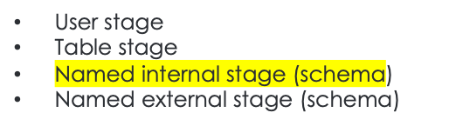


internal stages: cloud storage contained in your Snowflake account
Amazon S3
Google Cloud Storage
Microsoft Azure storage
external stages: cloud storage accounts managed by your business entity
using the tools provided by the cloud storage service
Supported data locations
Bulk vs continuous loading
File Upload & Copy from the Python Connector

Slide 7

Technical performance
Cost optimal
Understand how to be billed

Slide 8


Data ingestion approach
- Bulk loading

Slide 9
SQL Inserts from the Python Connector
Ingest is billed based on warehouse credits consumed while online.
The connectors support multi-inserts but data containing a variant field cannot be formatted into a multi-insert.

Slide 10
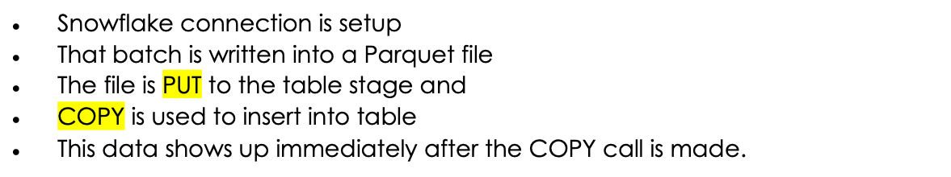
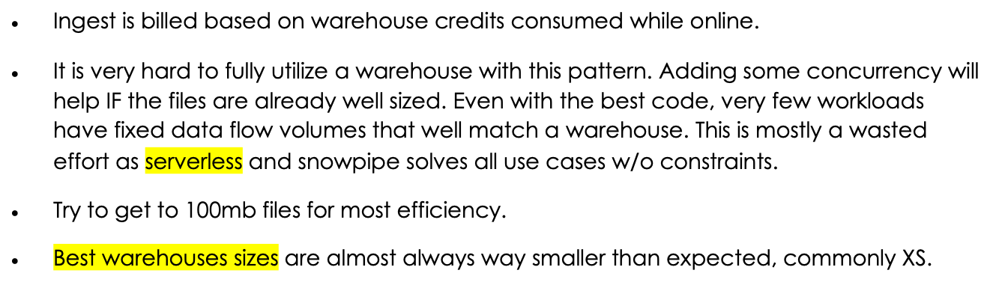
File Upload & Copy (Warehouse) from the Python Connector

Slide 11
File Upload & Copy (Snowpipe) using Python
user-provided virtual warehouses
Simple transformations

Slide 13
Data ingestion approach
- Continuous loading
Continuous loading using Snowpipe
Loading data from Apache Kafka topics

Slide 14
Continuous loading using Snowpipe
user-provided virtual warehouses
Simple transformations

Slide 15
Continuous loading using Snowpipe Streaming
writes rows of data directly to Snowflake tables
lower load latencies
corresponding lower costs

Slide 16
Loading data from Apache Kafka topics
an Apache Kafka server
The Snowflake Connector for Kafka

Slide 17
Snowpipe

Slide 18
Snowpipe introduction
Snowpipe is a continuous, event-driven data ingestion service in Snowflake that detects new data files as they arrive in external storage and loads them automatically into Snowflake tables.
Advantages
Automated Data Ingestion: Eliminates the need for manual data uploads by automating the ingestion process.
Cost Efficiency: Uses compute resources only when data is ingested, reducing costs.
Event-Driven Processing: Works with notification services such as Azure Event Grid and Azure Queue to trigger near real-time ingestion.
Scalability: Handles large-scale data loads without impacting performance.
Seamless Integration: Works smoothly with Azure Blob Storage and other cloud storage services.

Slide 19
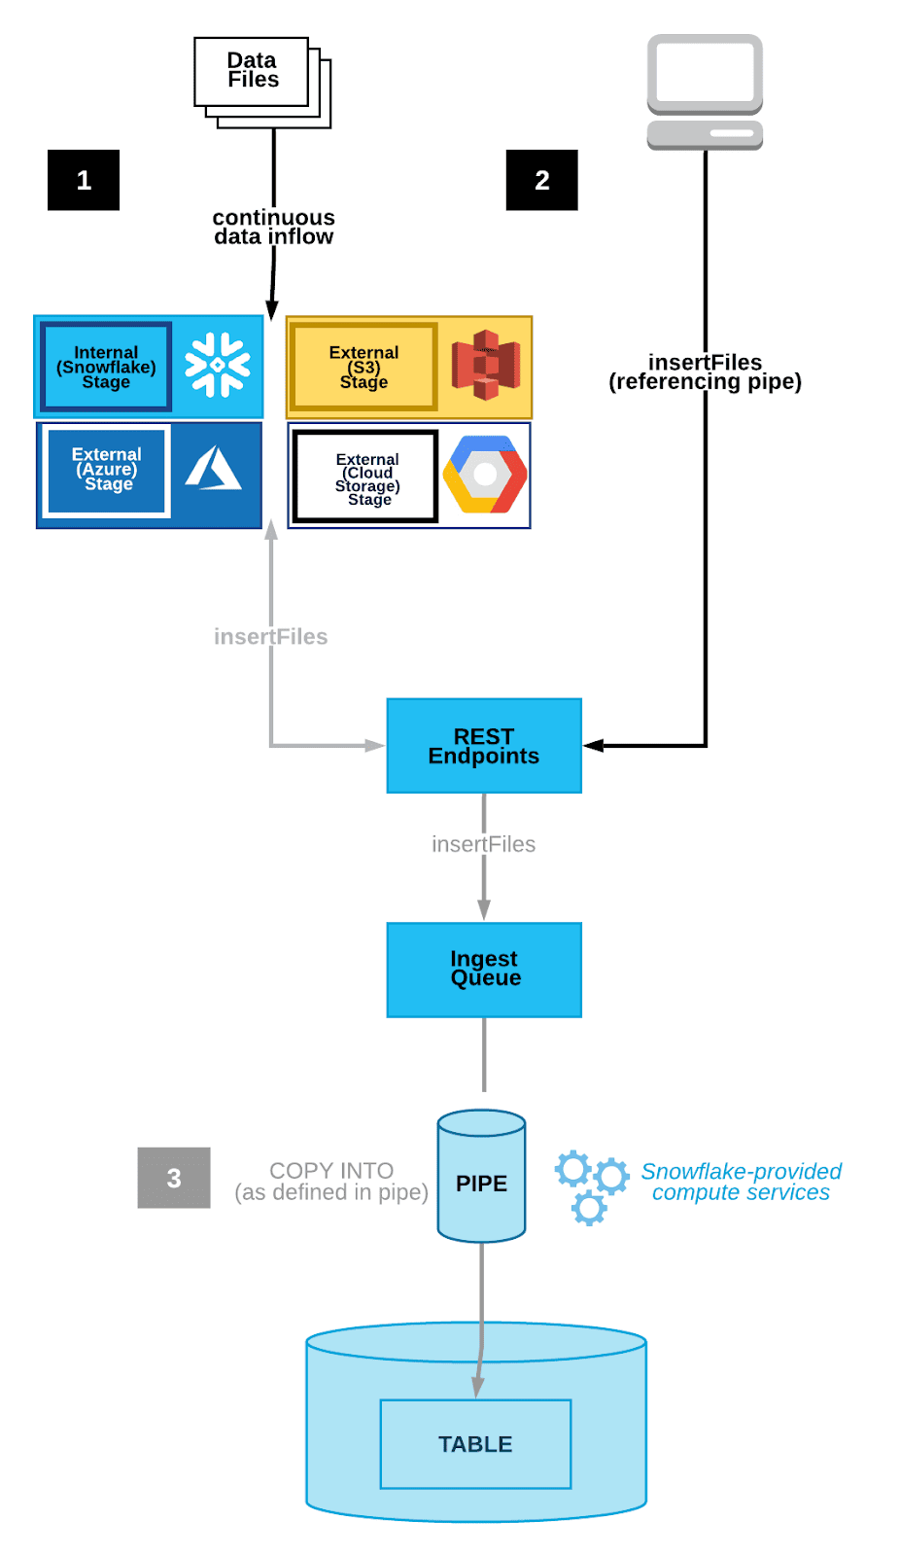


the cloud storage notification service triggers a notification to the Snowflake Snowpipe object
Snowpipe it extracts the data file from the AWS S3 bucket and loads it into the table
Snowpipe uses file-loading metadata associated with each pipe object to prevent loading the same files again.

Slide 20
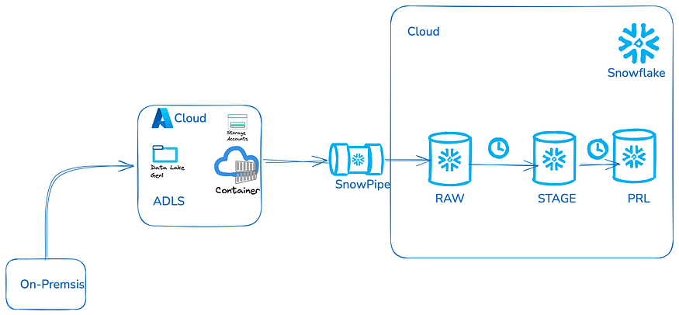
Use case
Azure Blob Storage: Users or systems upload raw data files to Azure Blob Storage.
Storage Integration: Snowflake connects to Azure Blob Storage, allowing seamless access to data.
Notification Integration: Azure Event Grid continuously monitors Azure Blob Storage for new file uploads. When a file is detected, it triggers an event and sends a message to Azure Queue, ensuring real-time notification to Snowpipe.

Slide 21
Best Practices and Optimization Tips:
To ensure optimal performance and cost efficiency, follow these best practices:
Optimize File Sizes: Keep file sizes between 10-100MB for efficient ingestion.
Use Compression: Compress files (e.g., GZIP) to reduce storage costs and improve processing speed.
Monitor Performance: Regularly check Snowpipe logs and notifications for troubleshooting.
Implement Data Validation: Automate validation checks before ingestion to maintain data integrity.
Leverage Partitioning: Use logical partitions to enhance query performance.

Slide 22
Reference Links

Slide 23

Your success is our success
Contact
Mail: info@funnygorilla.com.au
Linkedin: https://mt.linkedin.com/in/songqing-gu-2ba9034b/de
Web Chat: FunnyGorilla
Phone: 0420891343

