Slide 1

Introduction to
Data Storage
Your success is our success
Funny Gorilla 诙猩猩
Notes:
Notes for title slide

Slide 2
Learning Objectives
Data Infrastructure
Data Type
Why build pipeline
How the build pipeline built

Slide 3
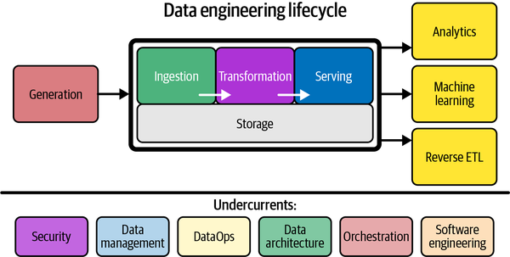
What is the Data Engineering?

Slide 4
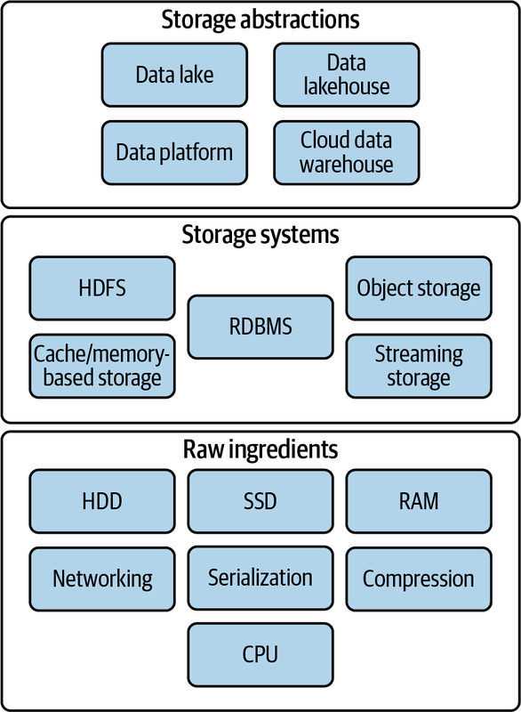

Slide 5
Raw Ingredients

Slide 6
Storage Systems

Slide 7
Storage Abstractions

Slide 8
Data Warehouse
Delta Lake
Apache Hudi
Apache Iceberg

Slide 9



Data Warehouse
database where data from different systems is stored and modeled to support analysis and other activities related to answering questions with it.
Data structured and optimized is for reporting and analysis queries.

Slide 10
Data Lake

Slide 11
Data Lakehouse
Delta Lake
Apache Hudi
Apache Iceberg

Slide 12
Trends in Storage
Data Catalog
Data Sharing
Separate Compute from Storage

Slide 13
Reference Links

Slide 14

Your success is our success
Contact
Mail: info@funnygorilla.com.au
Linkedin: https://mt.linkedin.com/in/songqing-gu-2ba9034b/de
Web Chat: FunnyGorilla
Phone: 0420891343

