Slide 1

Introduction to
Database
Your success is our success
Funny Gorilla 诙猩猩
Notes:
Notes for title slide

Slide 2
Learning Objectives
Data Infrastructure
Data Type
Why build pipeline
How the build pipeline built

Slide 3
Big picture of Data Modeling

Slide 4
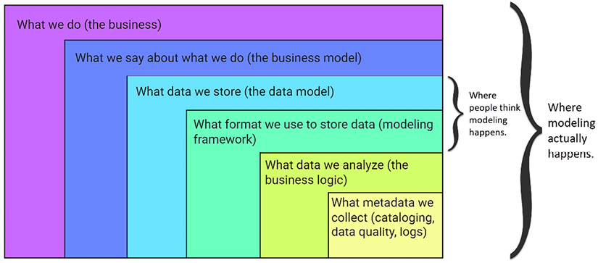
Business layers where modeling actually happens

Slide 5
Normalization

Slide 6
Database normalization
The process of organizing a database in a way that reduces redundancy and dependency within its tables.
This is achieved by breaking a large table into smaller ones and linking them through foreign key relationships.
Doing so leads to fewer data inconsistencies and improved data integrity.

Slide 7
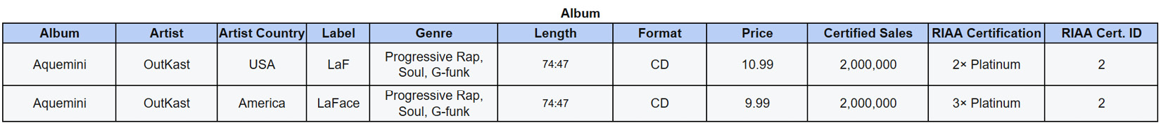
first normal form (1NF)
1NF is satisfied when the following are in place:
Every record is unique
Every cell contains a single value

Slide 8
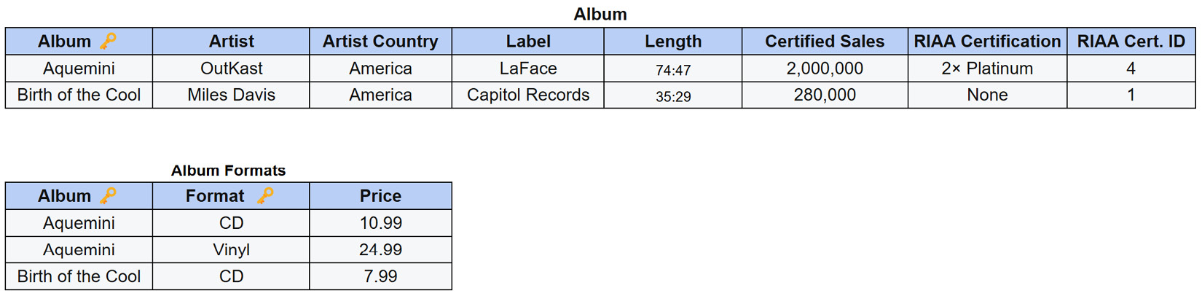
The second normal form (2NF)
2NF is satisfied when the following are in place:
1NF rules are satisfied
Every non-candidate-key attribute must depend on the whole candidate key (no partial dependencies)

Slide 9
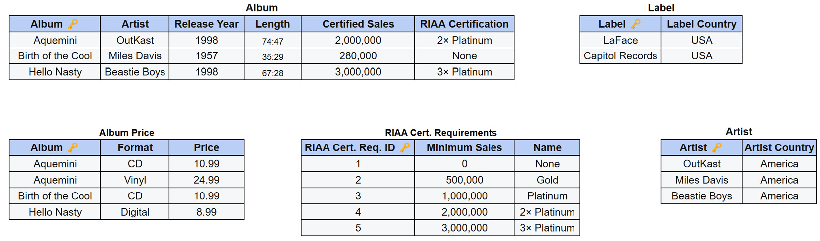
The third normal form (3NF)
3NF is satisfied when the following are in place:
2NF rules are satisfied
There are no transitive functional dependencies

Slide 10
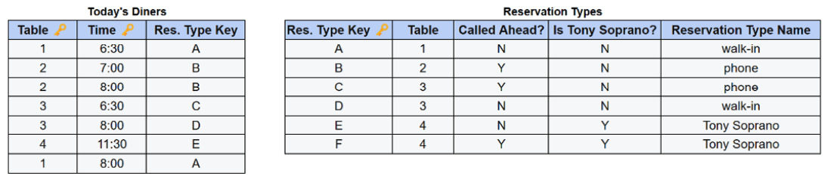
BCNF
BCNF (also referred to as 3.5NF) is satisfied when the following are in place:
3NF rules are satisfied
Every non-trivial functional dependency is itself a key

Slide 11
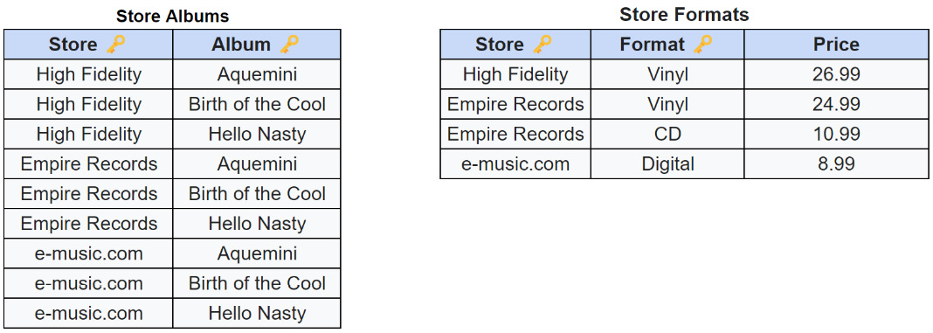
The fourth normal form (4NF)
The fourth normal form (4NF) is satisfied when the following are in place:
BCNF rules are satisfied
Every non-trivial functional and multivalued functional dependency begins with a superkey

Slide 12
The Five normal form (5NF)
The fifth normal form (5NF) is satisfied when the following is in place:
4NF rules are satisfied
Tables can not be decomposed further without loss of data

Slide 13
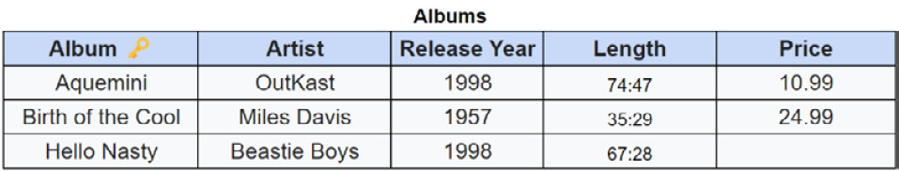
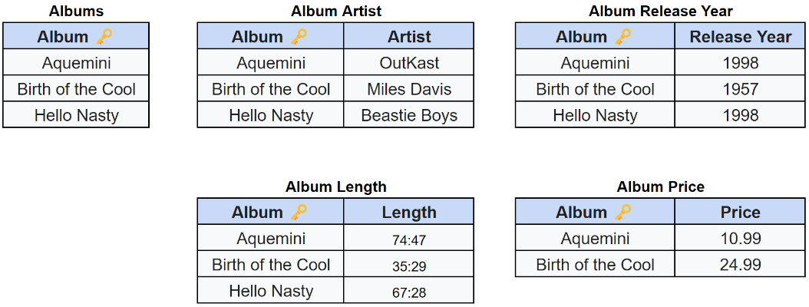
The Sixth normal form (6NF)
6NF is satisfied when the following are in place:
5NF rules are satisfied
Every table contains a primary key and, at most, one attribute
A design that satisfies 5NF but not 6NF

Slide 14
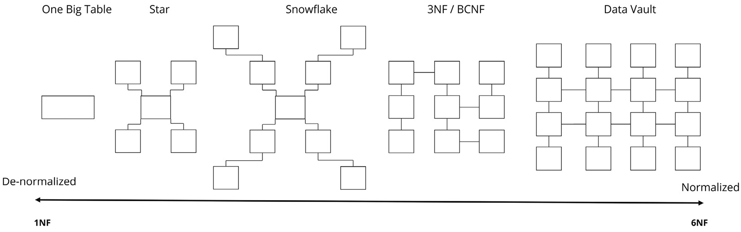
Common data models arranged on the normalization spectrum

Slide 15
Relational Database

Slide 16


Read/write
current access
2
1
Data file
Redo/transaction log file

Slide 17
Transaction - ACID
A database transaction is a sequence of operations on a database that satisfies four properties: atomicity, consistency, isolation, and durability, commonly referred to by acronym ACID.
Atomicity
ensures that all changes made to the database are executed as a single operation.
consistency
property guarantees that the database transitions from one consistent state at the beginning of the transaction to another consistent state at the end of the transaction.
Durability
refers to the persistence of committed transactions. It guarantees that once a transaction is completed successfully, it will result in a permanent state even in the event of a system failure.

Slide 18
Isolation level

Slide 19
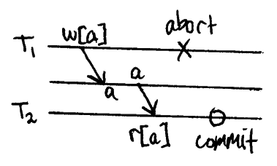
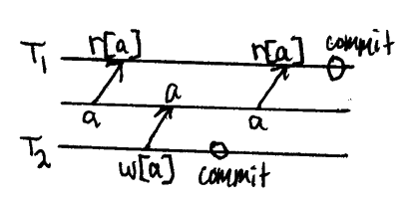
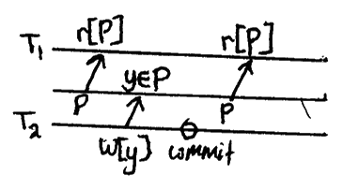
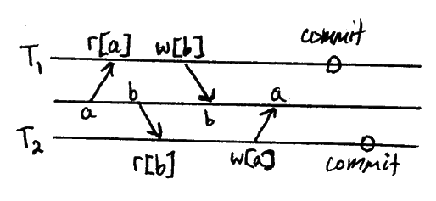
4 problems
Dirty Reads
Non-Repeatable Reads
Phantom Reads
Write Skew

Slide 20
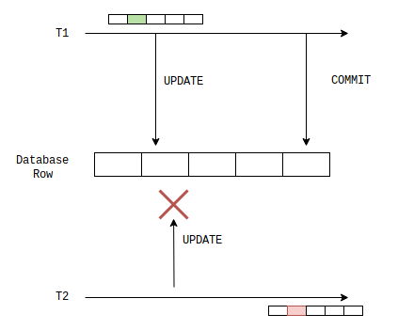
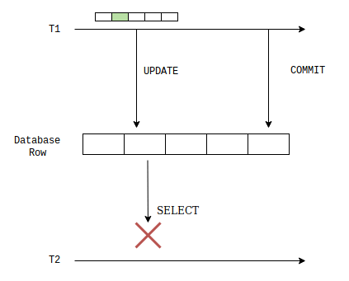
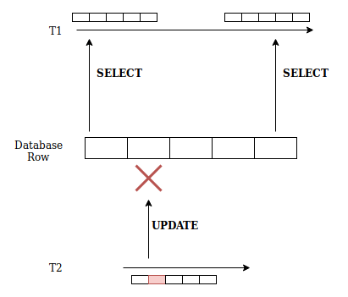
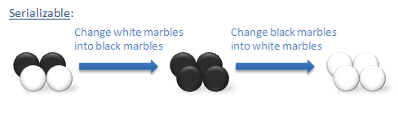
4 Isolation level
1-Read Uncommitted
2-Read committed
4-Serializable
3-Repeatable Read

Slide 21
How does it work?
Pessimistic locking
We do that by locking specific parts of the database. When a given part is locked by one transaction, then another transaction cannot read or write data according to the transaction isolation level to avoid issues.
Optimistic locking
When a transaction starts, it records the version number so it knows what is the state of the rows. When it reads from a table, it only extracts rows that were modified before the transaction was started. Next, when the transaction modifies the data and tries to commit them to the database, the database verifies row versions. If rows were modified in the meantime by some other transaction, the update is now rejected and the transaction has to start from scratch.
Default isolation level is not standardized
Typical libraries use SERIALIZABLE or READ COMMITED level.

Slide 22
Local transaction

Slide 23
Query execution
Execution logic
Performance tunning
https://www.sqlshack.com/query-optimization-techniques-in-sql-server-database-design-and-architecture/

Slide 24
Performance Considerations
Index
Partition vs Sharding
Connection, cursor
Separate read from write

Slide 25
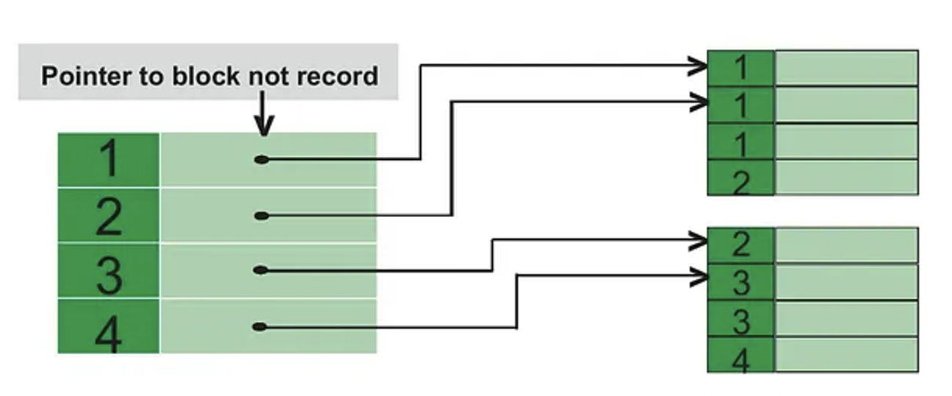
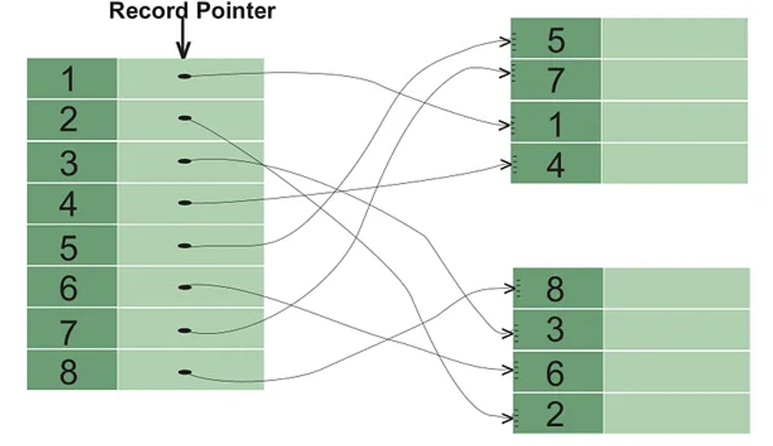
Index
clustered index
Un-clustered index

Slide 26
Partition
Large tables that are slow to query.
Partitioning is the process of splitting a large table into smaller parts, called partitions, within a single database instance.
The application usually sees these as one logical table
Horizontal Partitioning: Splits a table by rows. For example, a "Sales" table might be partitioned by year, with 2023 data in one partition and 2024 in another.
Vertical Partitioning: Splits a table by columns. Less frequently used columns (like user bios) are moved to a separate table to keep the main table slim and fast.
Key Benefit: Partition Pruning
The database engine can skip irrelevant partitions during a search, drastically reducing disk I/O.

Slide 27
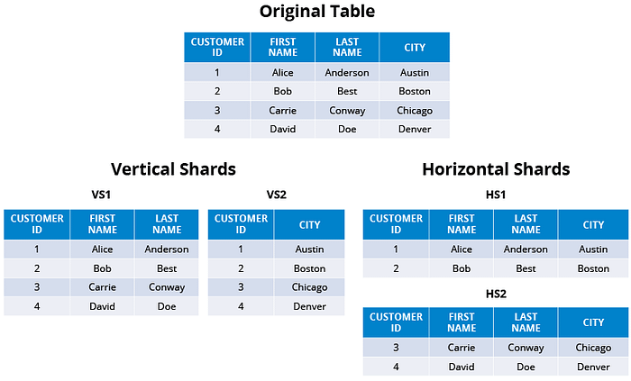
Sharding
Massive data that exceeds one server's capacity.
Sharding is a specific type of horizontal partitioning where the data is distributed across multiple physically separate servers (shards), Which enables distributed data storage and parallel processing, which improves performance

Slide 28
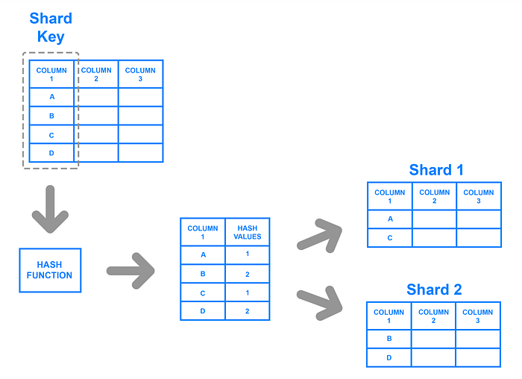
Sharding - Key Based

Slide 29
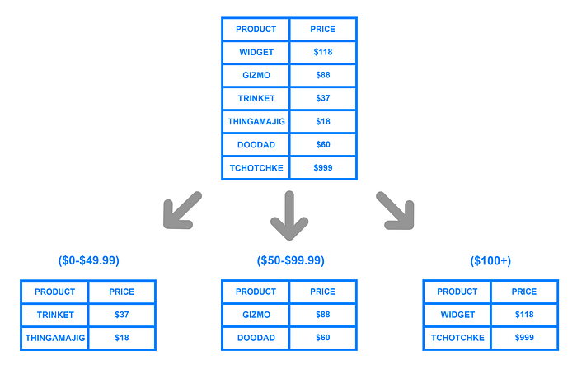
Sharding - Range Based

Slide 30
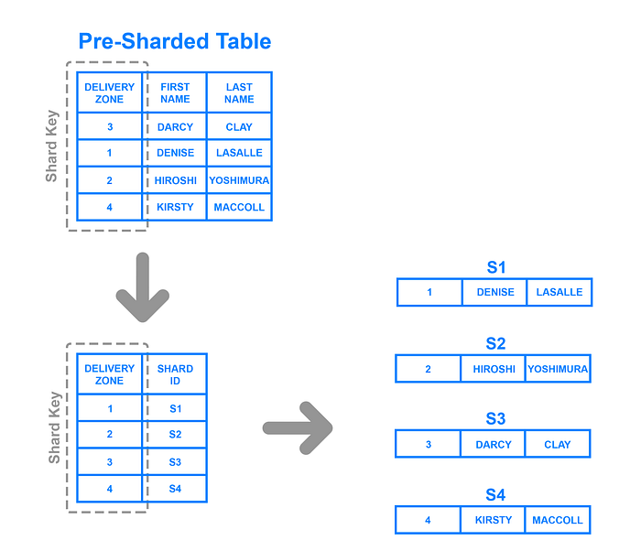
Directory Based Sharding

Slide 31
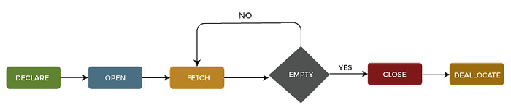
Cursor
It acts as a pointer to a specific row, allowing for granular control over complex data processing, updates, or transformations. Cursors are often used for procedural logic but are generally slower than set-based queries.

Slide 32
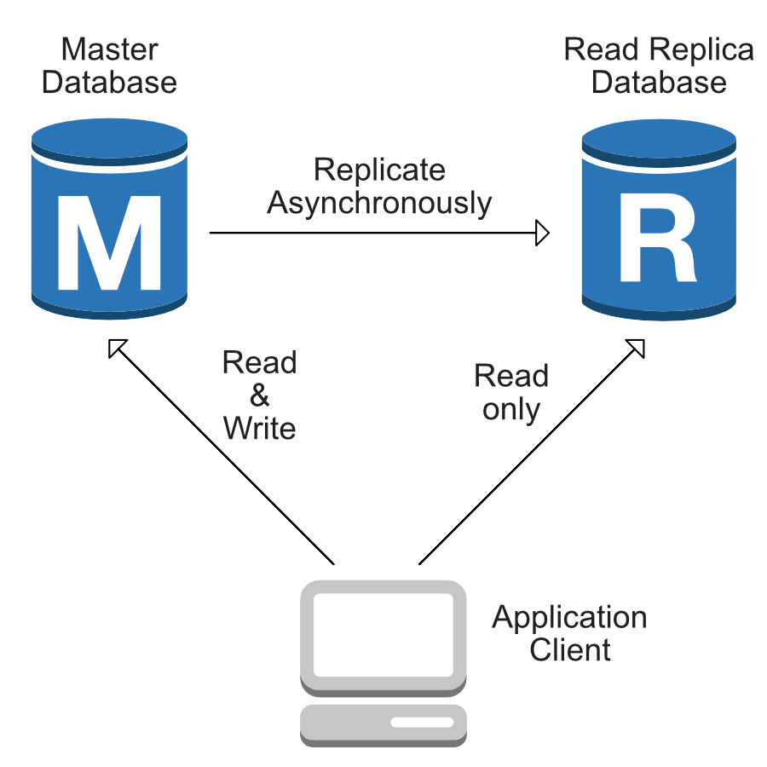
Separate read from write

Slide 33
Reference Links

Slide 34

Your success is our success
Contact
Mail: info@funnygorilla.com.au
Linkedin: https://mt.linkedin.com/in/songqing-gu-2ba9034b/de
Web Chat: FunnyGorilla
Phone: 0420891343

