Slide 1

Introduction to
Data Warehouse
Your success is our success
Funny Gorilla 诙猩猩
Notes:
Notes for title slide

Slide 2
Learning Objectives
Data Infrastructure
Data Type
Why build pipeline
How the build pipeline built

Slide 3
Data Warehouse

Slide 4
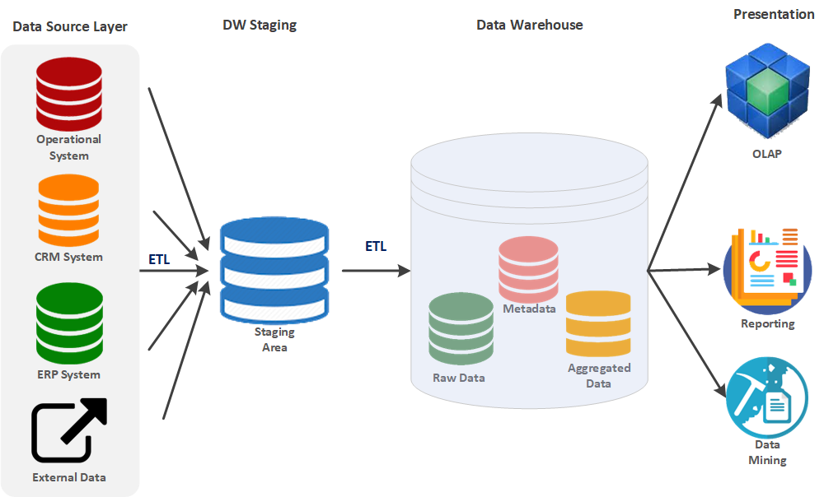

Data landscape
Volume (Scale)
Different transformation requirement
Velocity (Speed)
Variety (Diversity)
Veracity (Reliability)

Slide 5
Some history
Hive was created by Facebook to convert SQL statements into MapReduce jobs.
Data Lakehouse
MapReduce
HDFS
Hive
Hive table format
Iceberg table format
Apache Spark
Apache Flink
Warehouse
On premise Warehouse
On Cloud Warehouse

Slide 6



Data Warehouse
database where data from different systems is stored and modeled to support analysis and other activities related to answering questions with it.
Data structured and optimized is for reporting and analysis queries.

Slide 7

Data requirements
Business domain data
Master data
Reference data
Analytic data
Summary data

Slide 8
Common Challenges
Notes:
a cupcake just didn’t magically appear in the display case! Raw ingredients went through a rigorous process of preparation, mixing, melting, and baking before they got there.
Just as eating raw flour isn’t that appetizing, neither is deriving insights from raw data since it rarely has a nice structure that makes it poised for analytics. There’s some considerable work that’s needed to organize data and make it usable for business users.

Slide 9
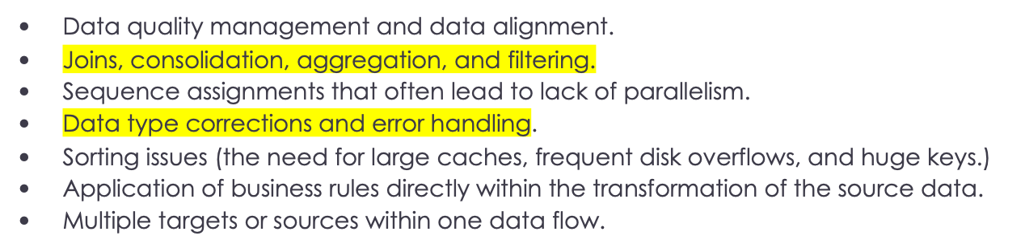
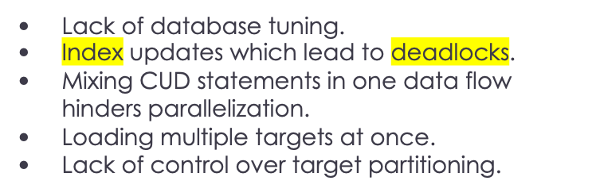
Sourcing
issues
transformation
issues
Challenges
at targets
Limited availability
Cross-system joins, filters or aggregates.
Indexing issues in the source data.
Missing source keys / whole data sets.
Bad or out-of-range source data.
Complexities of data structures.
CPU, RAM, and disk load
Transactional record locks.
Notes:
a cupcake just didn’t magically appear in the display case! Raw ingredients went through a rigorous process of preparation, mixing, melting, and baking before they got there.
Just as eating raw flour isn’t that appetizing, neither is deriving insights from raw data since it rarely has a nice structure that makes it poised for analytics. There’s some considerable work that’s needed to organize data and make it usable for business users.

Slide 10
Architecture
Technical stack
Technical stack selection – certain tool servers certain purpose
Trouble shooting
Performance tunning
Notes:
Snowflake has skyrocketed in popularity over the past 5 years and firmly planted itself at the center of many companies' data stacks.
Snowflake came into existence in 2012 with a unique architecture, described in their seminal white paper as "the elastic data warehouse".
Rather than have compute and storage coupled on the same machine like their competitors did ¹, they proposed a new design that took advantage of the near-infinite resources available in cloud computing platforms like Amazon Web Services (AWS).

Slide 11
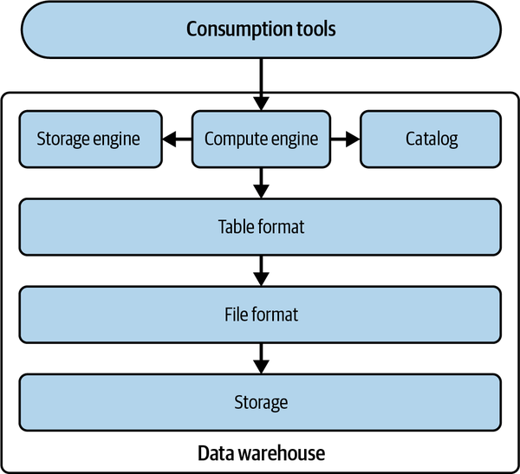
Logical architecture

Slide 12
Storage

Slide 13

store large to significant amounts of data – compression
High performant query
Security-Encryption and decryption
a local filesystem
options for storage
distributed filesystem
object storage

Slide 14
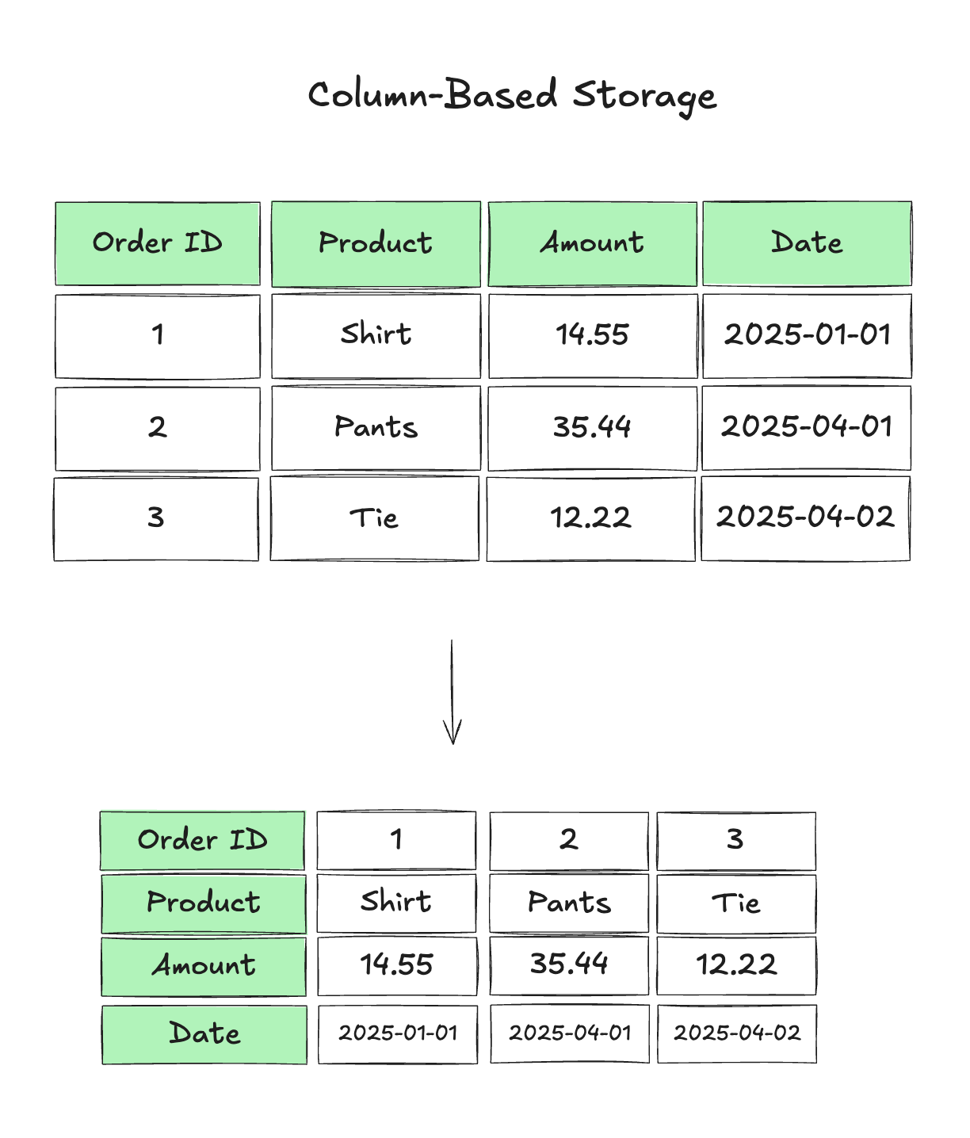

Slide 15
File format

Slide 16

File format
impacts things such as
the compression of the files,
the data structure,
the performance
semistructured (CSV),
semistructured (JSON), and
unstructured (text files).
Ingestion
categories:
Storage
Depending on the use case, certain file formats can be more advantageous than others

Slide 17
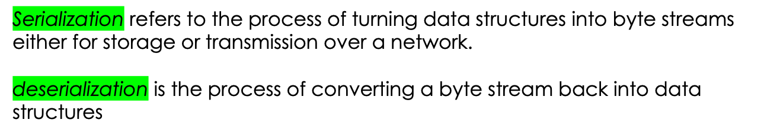
Serialization Formats
Writables
Avro
main serialization format
Thrift
Protocol Buffers

Slide 18
Table structure
Logic structure
Physical structure

Slide 19
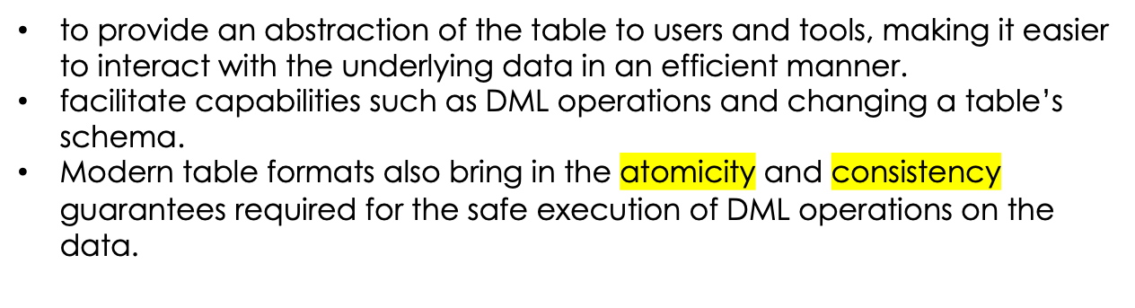
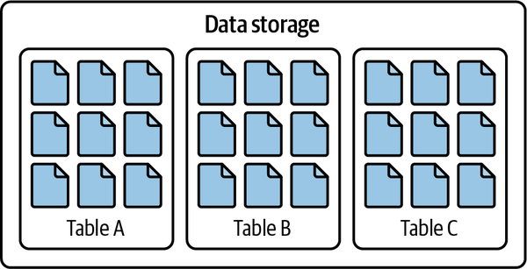
Logical Structure
The ultimate goal:

Slide 20
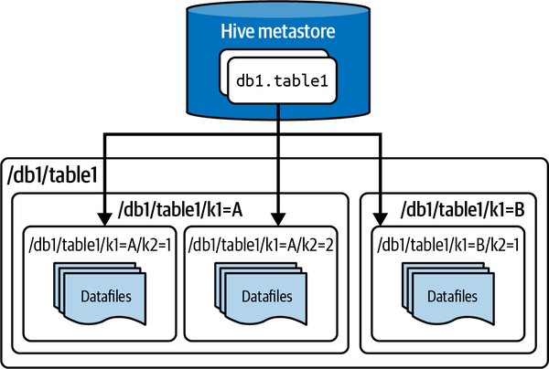
Physical Structure
Facebook developed in 2019
Defining a table as any and all files within a specified directory
The partitions of those tables would be the subdirectories.

Slide 21
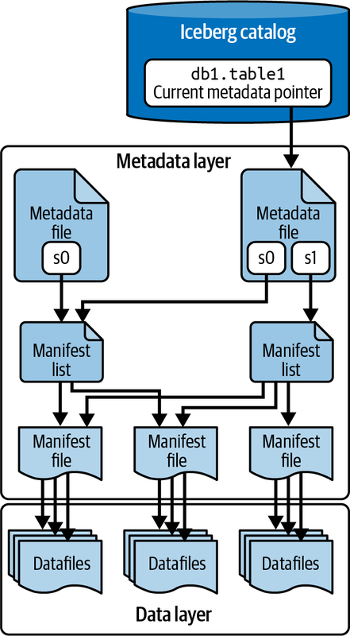
Netflix developed in 2017
Files that define a table’s structure, including its schema, partitioning scheme, and a listing of snapshots.
A list of datafiles, containing each datafile’s location/path and key metadata about those datafiles, which allows for creating more efficient execution plans.

Slide 22
Storage engine

Slide 23
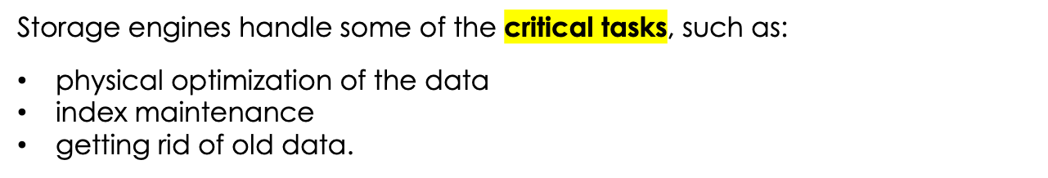
Responsible for actually:
doing the work of laying out the data in the form specified by the table format and
keeping all the files and data structures up-to-date with the new data.

Slide 24
Catalog

Slide 25
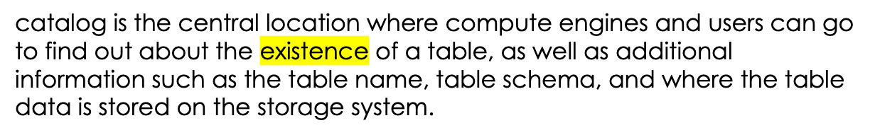
Catalog
When dealing with data from various sources and on a larger scale, it is important to quickly identify the data you might need for your analysis
Internal catalog: snowflake catalog
external catalog: Collibra

Slide 26
Computer Engine

Slide 27
Computer Engine
Depending on the volume of data, computation load, and type of workload, utilize one or more compute engines for this task
massively parallel processing (MPP)
Apache Spark,
Snowflake,
Dremio

Slide 28
Difference from ODS
Notes:
a cupcake just didn’t magically appear in the display case! Raw ingredients went through a rigorous process of preparation, mixing, melting, and baking before they got there.
Just as eating raw flour isn’t that appetizing, neither is deriving insights from raw data since it rarely has a nice structure that makes it poised for analytics. There’s some considerable work that’s needed to organize data and make it usable for business users.

Slide 29
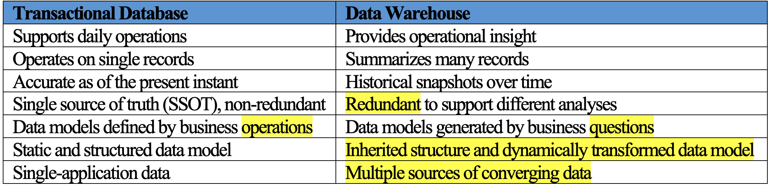
Notes:
a cupcake just didn’t magically appear in the display case! Raw ingredients went through a rigorous process of preparation, mixing, melting, and baking before they got there.
Just as eating raw flour isn’t that appetizing, neither is deriving insights from raw data since it rarely has a nice structure that makes it poised for analytics. There’s some considerable work that’s needed to organize data and make it usable for business users.

Slide 30
Reference Links
https://select.dev/posts/snowflake-architecture

Slide 31

Your success is our success
Contact
Mail: info@funnygorilla.com.au
Linkedin: https://mt.linkedin.com/in/songqing-gu-2ba9034b/de
Web Chat: FunnyGorilla
Phone: 0420891343

