Slide 1

Introduction to Delta Lake
Your success is our success
Funny Gorilla 诙猩猩
Notes:
Notes for title slide

Slide 2
Learning Objectives
File format - Parque
Transaction log
Check point
Schema handling
Time traveling
Change Data Feed

Slide 3
Transaction support
Support for diverse data types
Schema enforcement and governance
Lakehouse
capabilities
Openness
Storage is decoupled from compute
Support for diverse workloads
BI support
End-to-end streaming

Slide 4
Delta Lake
Delta Lake is an open-source table format for data storage.
Delta Lake improves data storage by supporting
ACID transactions,
schema enforcement and evolution,
data versioning
high-performance query optimizations,
many other features

Slide 5
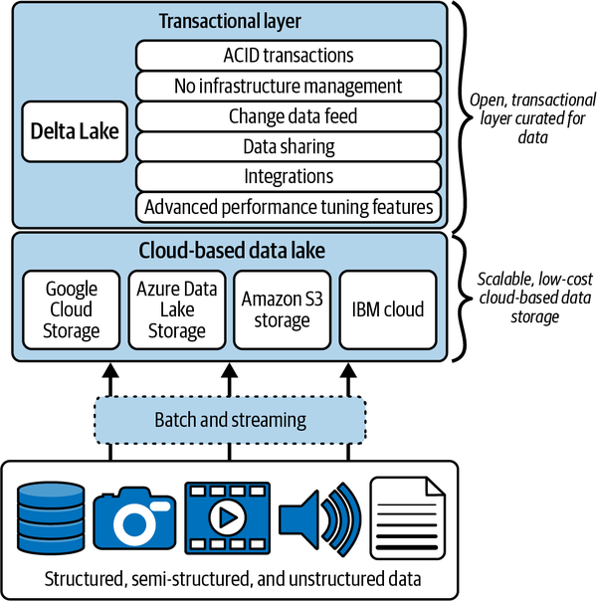
adds transactional guarantees,
DML support,
auditing,
a unified streaming and batch model,
schema enforcement
a scalable metadata model
Data Lake + Data warehouse

Slide 6
adds transactional guarantees,
DML support,
auditing,
a unified streaming and batch model,
schema enforcement
a scalable metadata model
ACID transactions
Schema enforcement and evolution
Data versioning
Query optimizations
storing file paths and metadata in the transaction log
executing partial reads via Partition, Data-skipping
co-locating similar data to allow for better data-skipping - Z-Ordering or Liquid Clustering.

Slide 7
Data Format - Parquet

Slide 8
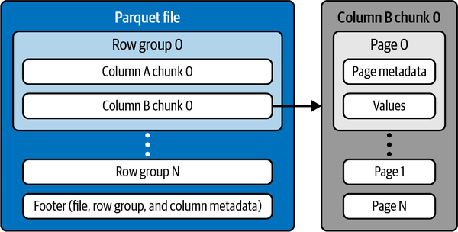
Logical model
The metadata in a Parquet file contains information about
these row groups,
about columns (e.g., min/max values, number of values)
the data schema, which makes Parquet a self-describing file with additional metadata to enable better data skipping.
contain data from the same column, and thus each column is stored together in a row group.

Slide 9
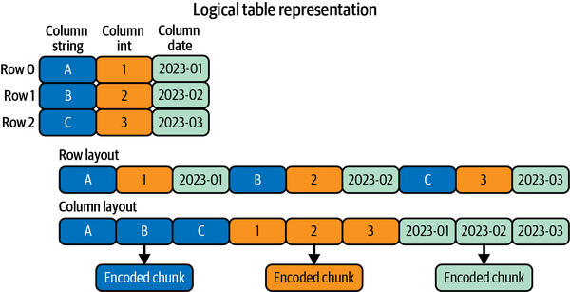
Row oriented vs Column oriented

Slide 10
Advantages of Parquet files
better compression and encoding since these algorithms can take advantage of the similar values and data types stored in each column.
High performance
Cost-effective
Interoperability
leverage better compression and encoding, this inherently makes the data more cost-effective to store.
they are very widely supported across different tools and engines, and offer great interoperability.

Slide 11
Parque file Demo

Slide 12
Schema enforcement
Schema definition
Schema validation
Schema evolution

Slide 13
For ELT scenarios where the schema of the data is constantly evolving, you may be seeking a method for accommodating these schema changes through schema evolution features.
Since every data frame in Apache Spark contains a schema, when it is written to a Delta Lake in delta format, the schema is saved in JSON format in the transaction logs.
This allows for a few neat capabilities and features such as:
schema validation, to ensure quality data by rejecting writes to a table that do not match the table’s schema and
schema evolution, which allows users to easily change a table’s current schema to accommodate data that may be changing over time.
It is commonly used when performing an append or overwrite operation to automatically adapt the schema to include one or more new columns.

Slide 14
Transaction Log – Delta Log
atomicity guarantee
metadata
time travel
significantly faster metadata operations for large tabular datasets.

Slide 15
What is transaction log
transaction log
an ordered record of every transaction made against a Delta table since it was created.
It acts as a single source of truth and tracks all changes made to the table.
The transaction log allows users to reason about their data and trust its completeness and quality.
if an operation is not recorded in the transaction log, it never happened.

Slide 16
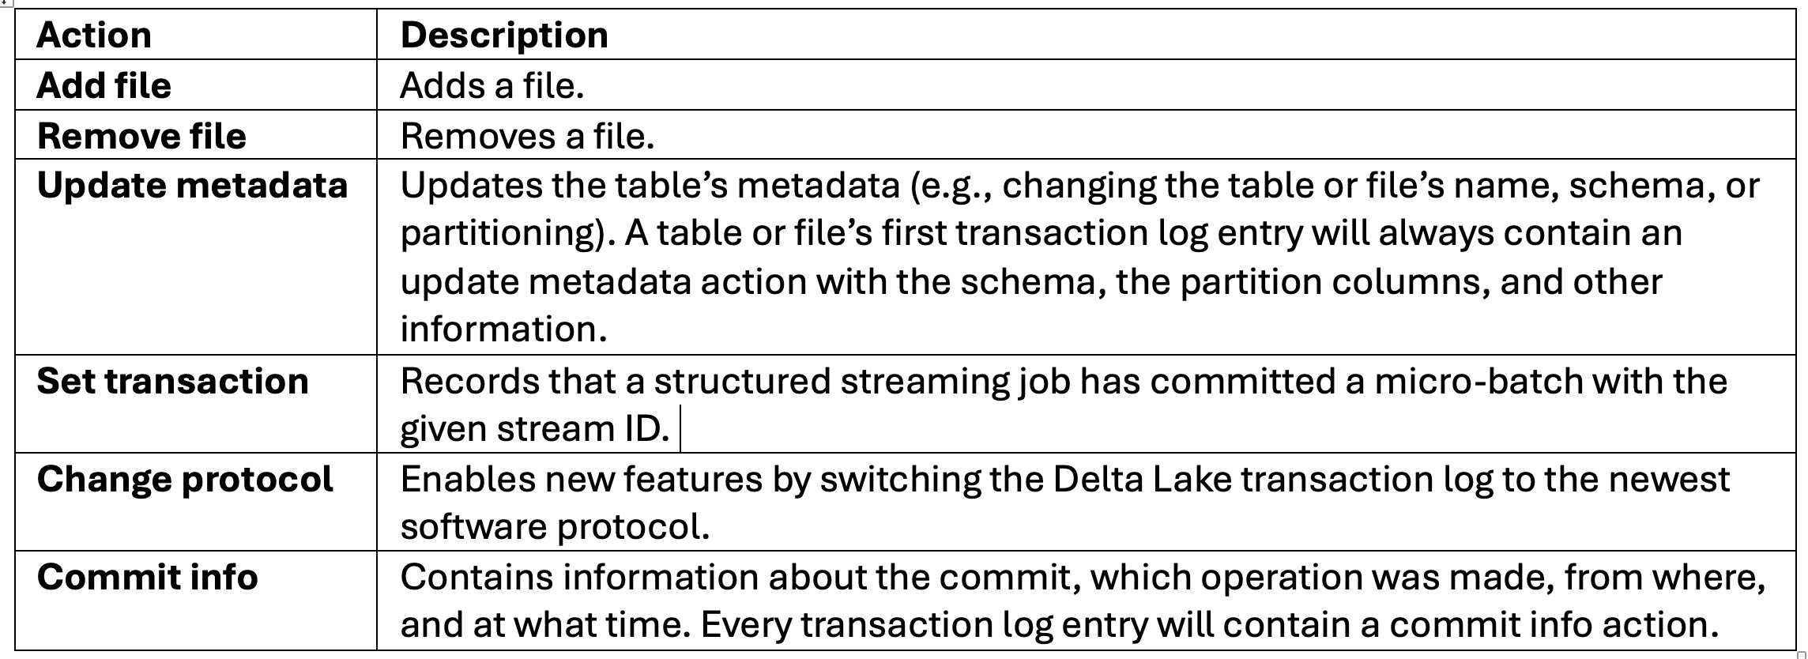
Implements Atomicity
all operations (e.g., INSERT, UPDATE, DELETE, or MERGE) performed on your file will either succeed as a whole or not succeed at all.
Without atomicity, any hardware failure or software bug can cause a data file to be written partially, resulting in corrupted or, at a minimum, invalid data.
List of possible actions in a transaction log entry
These actions are recorded in the transaction log entries (*.json) as ordered, atomic units known as commits.

Slide 17
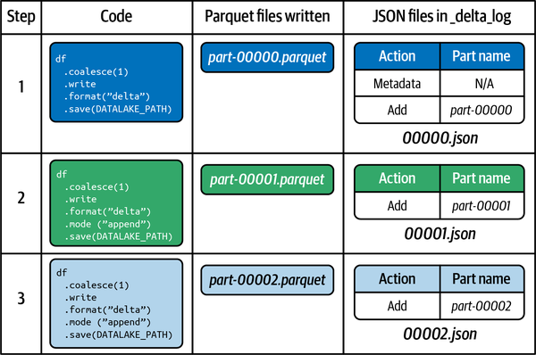
Sample

Slide 18
Multiple write Demo

Slide 19
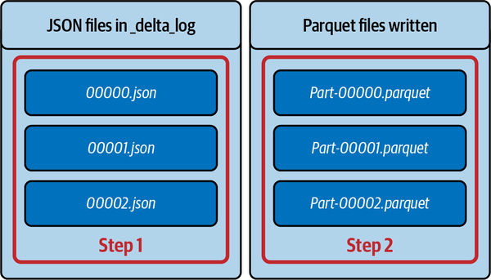
Read Delta table data
Read the transaction log files
read data file based on the log files.

Slide 20
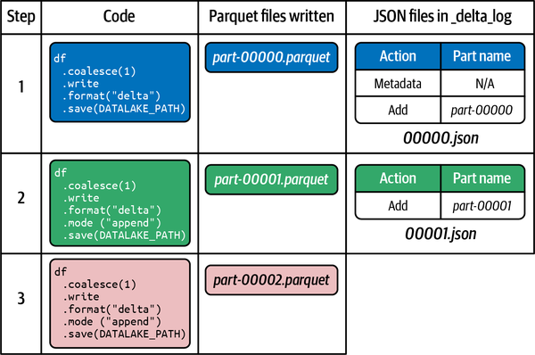
Failure scenario with write operation

Slide 21
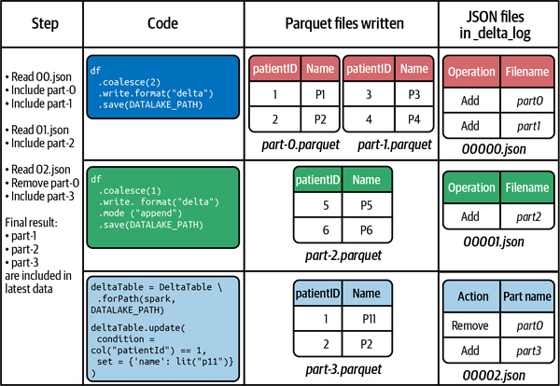
Update scenario

Slide 22
update Demo

Slide 23
Scale metadata – check point

Slide 24
Scale metadata handling challenge
we can have many very large files with thousands of transaction log entries for a single Parquet file.
How does Delta Lake scale its metadata handling without needing to read thousands of small files?
Check point
The Delta Lake writer will continue to generate a new checkpoint every 10 commits.
A checkpoint file saves the entire state of the table at a given point in time. “state” refers to the different actions, not the file’s actual content.
So, it will contain the add file, remove file, update metadata, commit info, etc., actions, with all the context information. It will save this list in native Parquet format.
This will allow Spark to read the checkpoint quickly. This gives the Spark reader a “shortcut” to fully reproduce a table’s state and avoid reprocessing thousands of small JSON files, which could be inefficient.

Slide 25
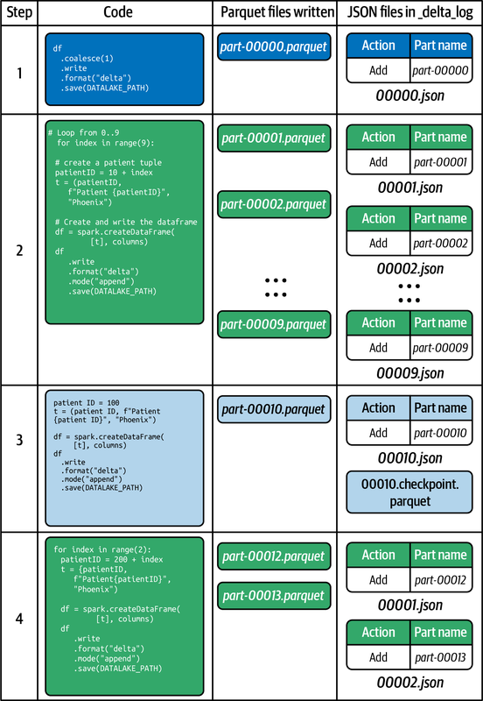

Slide 26
Check point Demo

Slide 27
Schema evaluation Demo

Slide 28
Change Data Feed

Slide 29

Solution
Challenges
regular parquet file formats are immutable
there is no graceful method of performing CRUD operations on parquet file formats
this Change Data Capture process also comes with significant overhead of having to scan and read the entire files even if only a few records within have changed.
Silver
Gold
Change Data Feed within Databricks supplements this Change Data Capture (CDC) process by storing metadata about CDC records for optimized management of these changed records.

Slide 30
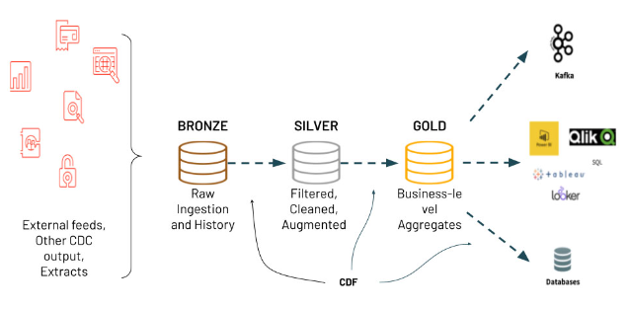
Medallion Architecture

Slide 31
Change Data Feed Demo

Slide 32
Design considerations
This is an optimal process since it is not required to read all data within lake to identify changed records;
with streaming data, it supports the opportunity to design and implement highly scalable lambda architectural patterns using Delta Change Data Feed.

Slide 33
Implementation considerations
The table_changes from the Change Data Feed can be used to explore details related to the inserts, updates, and deletes.
you could create views and explore versions, timestamps, and granular details related to the table changes.

Slide 34
CDF use cases

Slide 35
Use cases
Silver and Gold Tables - Improve the Delta Performance by processing the only Row-Level Changes following initial MERGE, UPDATE, or DELETE operations to accelerate and simplify the ETL and ELT operations.
B. Materialized Views - Create the up-to-date aggregated views of information for use in BI and analytics without having to re-process the full underlying tables, instead updating only where Changes have come through.
C. Transmit Changes - Send a Change Data Feed to Downstream Systems, such as Kafka or RDBMS that can use it to incrementally process in the later stages of data pipelines.
D. Audit Trail Table - Capture the Change Data Feed as a delta table provides perpetual storage and efficient query capability to see all the changes over time, including when deletes occur and what updates were made.

Slide 36
Delta Lake Time travel

Slide 37
Scenario – why Time Travel?
Regulatory
Auditing and regulatory compliance can require that data be stored and retrieved for many years or can require that you track certain changes to your data (e.g., GDPR).
Reproduce experiments and reports
There are often requirements for data scientists or analysts to re-create reports or machine learning experiments and model outputs given a specific set of data at a specific point in time.
Rollbacks
Accidental or bad DML operations on your data, such as INSERT, UPDATE, DELETE, and MERGE, can require fixes and rollbacks to a previous state.
Time-series analysis
Reporting needs can require you to look back or analyze data over time, for example, how many new customers were added over the course of a month.
Debugging
Troubleshooting ETL pipelines, data quality issues, or broken processes where the specific cause may only be observable in a historical state.
The ab

Slide 38
Solution
Because all of the transactions are stored in the transaction log,
Delta Lake can always travel back to earlier states of your table.

Slide 39
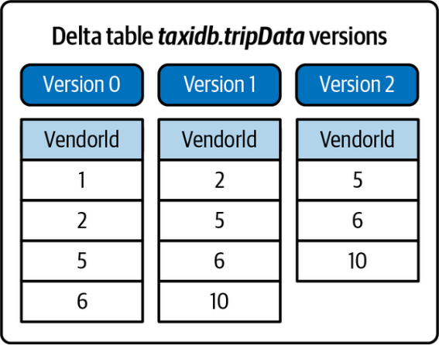
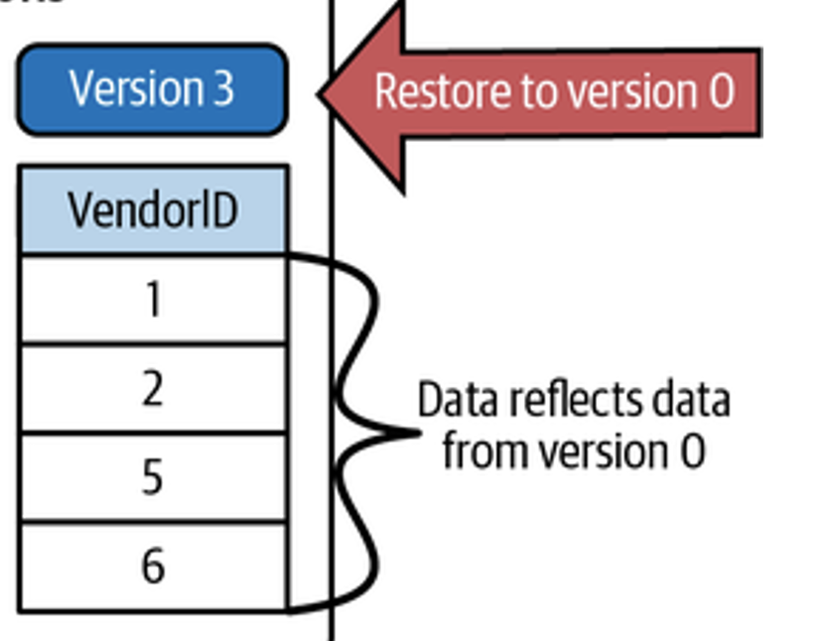

Slide 40
Time travel Demo

Slide 41
Reference Links
https://docs.delta.io/latest/delta-intro.html

Slide 42

Your success is our success
Contact
Mail: info@funnygorilla.com.au
Linkedin: https://mt.linkedin.com/in/songqing-gu-2ba9034b/de
Web Chat: FunnyGorilla
Phone: 0420891343

