Slide 1

Delta Lake Performance Tunning
Your success is our success
Funny Gorilla 诙猩猩
Notes:
Notes for title slide

Slide 2
Learning Objectives
Partition
Data Clustering
Data skipping
Optimized write
Auto compaction
Vacuum

Slide 3
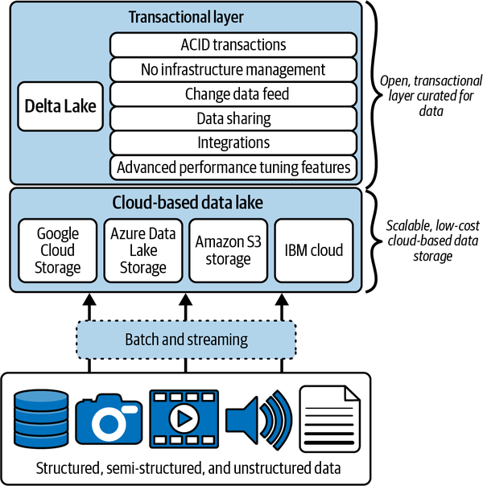
adds transactional guarantees,
DML support,
auditing,
a unified streaming and batch model,
schema enforcement, and
a scalable metadata model

Slide 4
Query optimizations
storing file paths and metadata in the transaction log
executing partial reads via Partition -> Data-skipping
co-locating similar data to allow for better data-skipping - Z-Ordering or Liquid Clustering.
Optimized write - shuffle before write
Auto compaction
Vacuum - shuffle before write

Slide 5
storing file paths and metadata in the transaction log
partial reads
Liquid Clustering
Partition
Data-skipping
Z-Ordering
Optimized write
Auto compaction
Vacuum

Slide 6
Partition

Slide 7
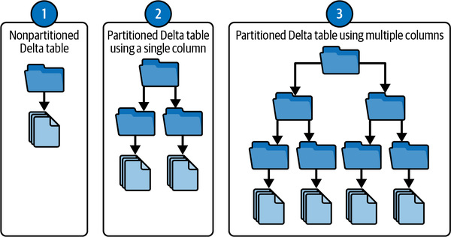
referring to on-disk, or Hive-style, partitioning where data is organized with paths that contain key value pairs such as Year=2023.
create partitions based on the values in one or more columns of the table (the most common being date) which can speed up:
queries against the table, as well as with
data manipulation commands such as INSERT, UPDATE, MERGE, and DELETE.
the underlying dataset is organized into different directories and subdirectories for each partition:

Slide 8
Advantages
Performance Boost: Partitioning minimizes the amount of data scanned during queries. Instead of reading the entire dataset, only the relevant partitions are accessed.
Improved Scalability: Managing massive datasets becomes much more efficient with partitioning, especially when your data grows over time. It breaks down large datasets into more manageable parts.
Reduced Cost: in a cloud environment, the cost of scanning and processing data directly impacts your budget. Partitioning ensures you’re using only the necessary resources.

Slide 9
Downside
partitions run the risk of decreasing performance in many cases, as opposed to not partitioning a Delta table:
partitions can create the small file problem

Slide 10
Partition Demo

Slide 11
Data Clustering
Liquid Clustering
Z-ordering
Hive-style partitioning

Slide 12
Covered in Databricks
Your ETL workload will likely benefit from clustering if:
You often need to filter by high cardinality columns.
Your data has significant skew in data distribution.
Your tables grow quickly and require maintenance and tuning effort.
Your data access patterns change over time.

Slide 13
Data Skipping
Skipping nonrelevant data is ultimately the foundation for most performance tuning features, as it aims to reduce the amount of data that needs to be read.

Slide 14
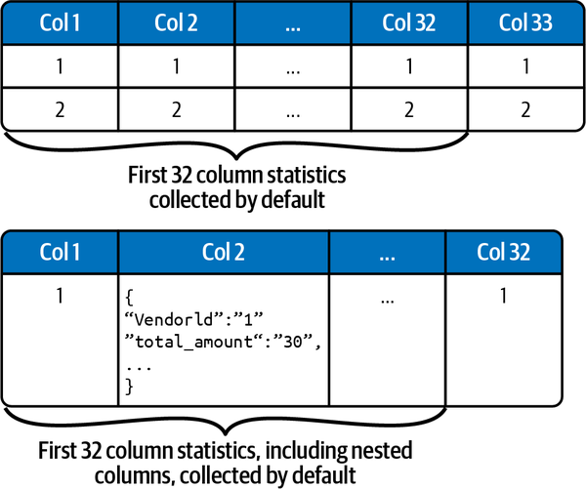
Data skipping statistics
Delta Lake automatically collects the following data skipping statistics for each data file as part of metadata
Number of records
Minimum values for each of the first 32 columns
Maximum values for each of the first 32 columns
Number of null values for each of the first 32 columns
to skip the files that are out of the range of the querying field values.

Slide 15
Config statistics collection
reordering columns in the schema
increase the number of columns to collect statistics on by using delta.dataSkippingNumIndexedCols, but adding additional columns also adds additional overhead that can adversely affect write performance.
Typically, you want to collect data skipping statistics on columns that are commonly used in filters, WHERE clauses, joins, and columns that you tend to perform aggregations on.
avoid collecting data skipping statistics on long strings as they are far less efficient for data skipping purposes.

Slide 16
Optimized writes

Slide 17
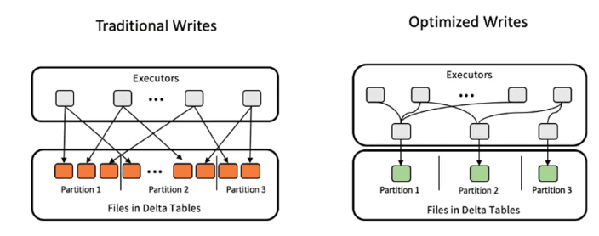
Optimized Writes - concept
combines all the small writes to the same partition into a single write command before executing. This is great when multiple processes are writing to the same partitioned Delta table, i.e. a distributed write operation
Optimized Write rebalances the data using a data shuffle before writing the files to the table. This way you will reduce the number of small files.

Slide 18
Optimized Writes - Implementation
enable Optimized Write by setting the optimizeWrite option in your Delta Lake writer:
for your whole Delta table by setting the delta.autoOptimize.optimizeWrite table property.
for your whole Spark SQL session by setting the spark.databricks.delta.optimizeWrite.enabled SQL configuration
Optimized Writes take a bit longer to execute because of the data shuffle that is performed before the data gets written.
That’s why the feature is not enabled by default.

Slide 19
Auto Compaction

Slide 20
Problem to solve
for example when you are writing frequent small updates to a table.
In this case, the files will still be small, even after an Optimized Write.
Solution
automatically running a small optimize command after every write operation.
Data from files under a certain threshold size is automatically combined into a larger file.
This way, your downstream queries can benefit from a more optimal file size.

Slide 21
Vacuum

Slide 22
Problem to solve
Some data file problem.
the older, smaller files are still on disk. This doesn’t affect your read performance because Delta Lake knows that you only need to access the latest file.
But you might still want to remove these files, for example to save on storage costs.
Solution
Delta Lake has iteratively combined all the small writes into a larger file.
It has also recorded in the transaction log the path to the latest file.
Downstream data reads will look at the transaction log and access only the last, largest file.

Slide 23
Implementation
remove these older files with a VACUUM command
The VACUUM command removes old files that are no longer actively referenced in the transaction log.
By default, VACUUM only affects files older than the default retention duration which is 7 days.

Slide 24
Reference Links

Slide 25

Your success is our success
Contact
Mail: info@funnygorilla.com.au
Linkedin: https://mt.linkedin.com/in/songqing-gu-2ba9034b/de
Web Chat: FunnyGorilla
Phone: 0420891343

