Slide 1
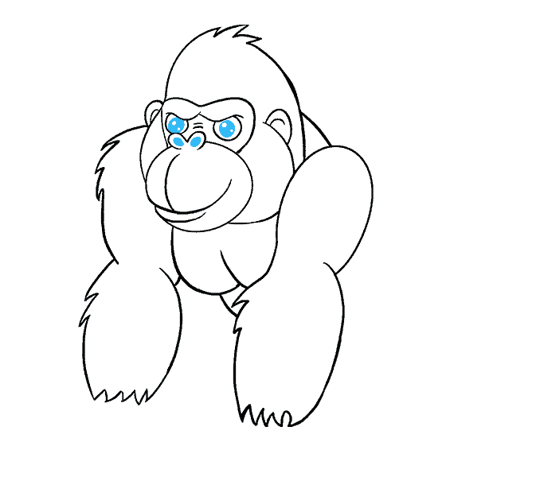

Your success is our success
Kafka Introduction
Funny Gorilla诙猩猩-IT培训

Slide 2
Learning Objectives
Pub / Sub
Event & Stream
Architecture
Broker
Topic
Zookeeper
Change Data Capture

Slide 3
Messaging system

Slide 4
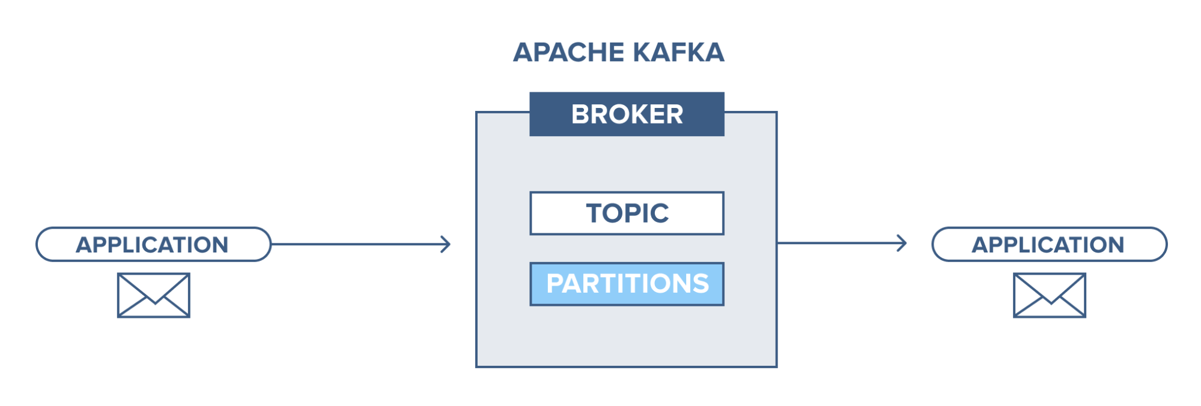
Publish-subscribe
Event

Slide 5
Event
An event is a record of something that happened that also provides information about what happened.
Event Structure:
Header
Key
Value
timestamp

Slide 6
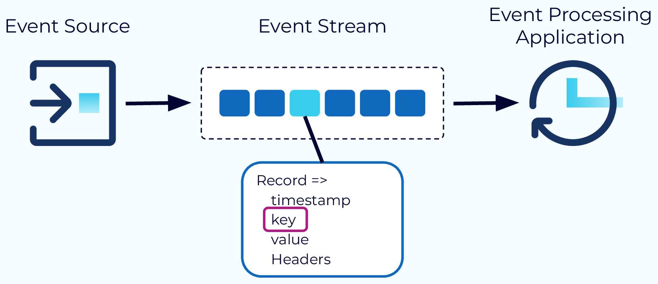
Event and Stream

Slide 7
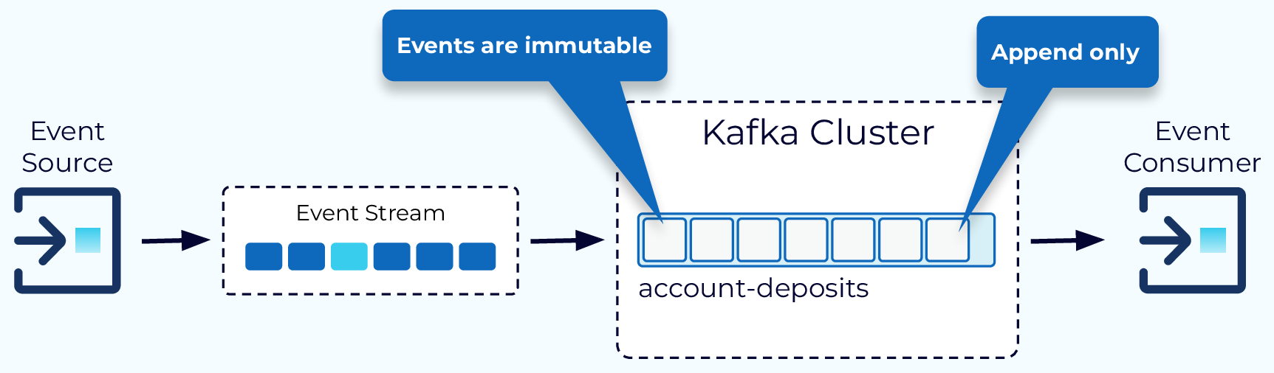

Slide 8
Architecture

Slide 9
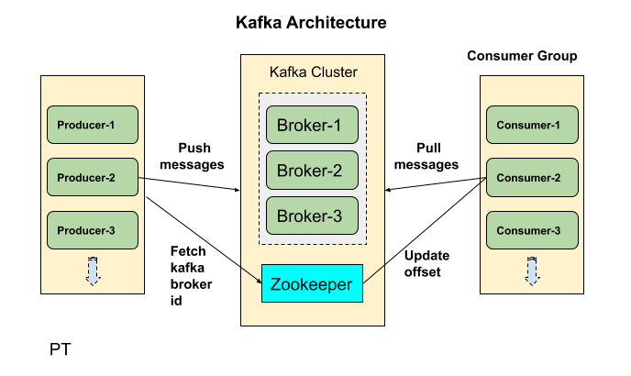
Architecture
Scalable
High performant
Fault tolerant

Slide 10
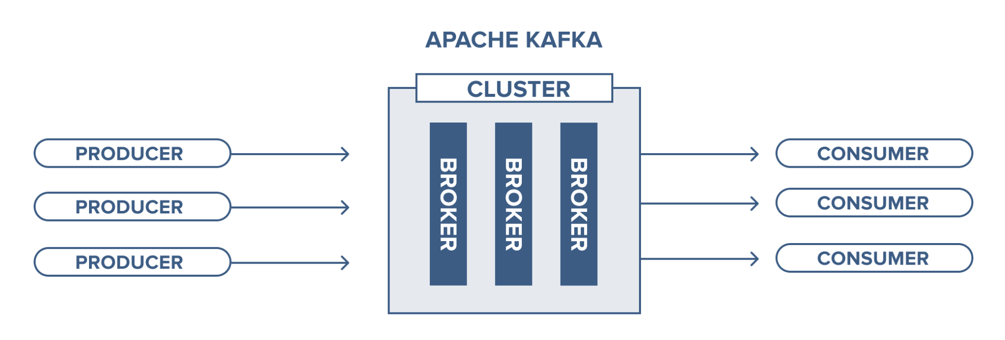
Broker

Slide 11
Topic
Roughly analogous to a database table or folder.
Partition
A single topic can be scaled horizontally across various servers to deliver performance well beyond the capabilities of a single server
Replicate
there is no assurance of message time-ordering throughout the whole topic – only within a single partition

Slide 12
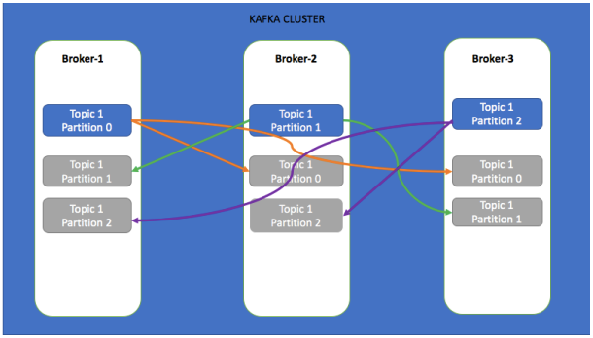
Replicate & Partition
Lead
Slave

Slide 13
Zookeeper
ZooKeeper is used for managing and coordinating Kafka broker.
ZooKeeper service is mainly used to notify producer and consumer about the presence of any new broker in the Kafka cluster system or failure of the broker in the Kafka cluster system.
As per the notification received by the Zookeeper regarding presence or failure of the broker then producer and consumer takes decision and starts coordinating their task with some other broker.

Slide 14
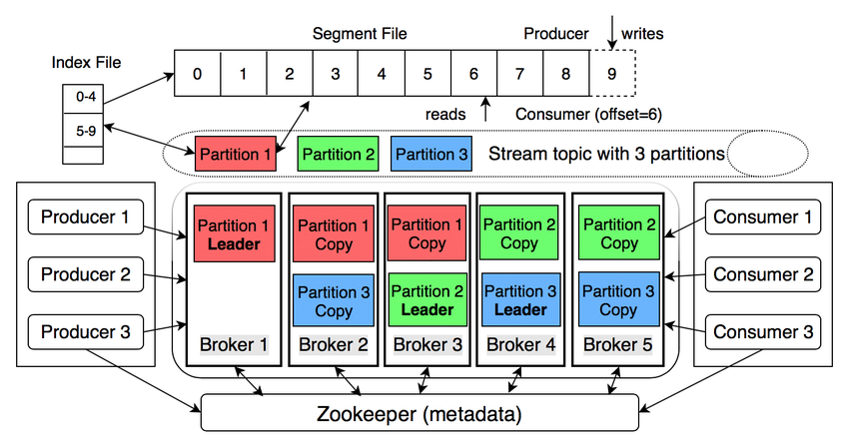

Slide 15
Producer

Slide 16
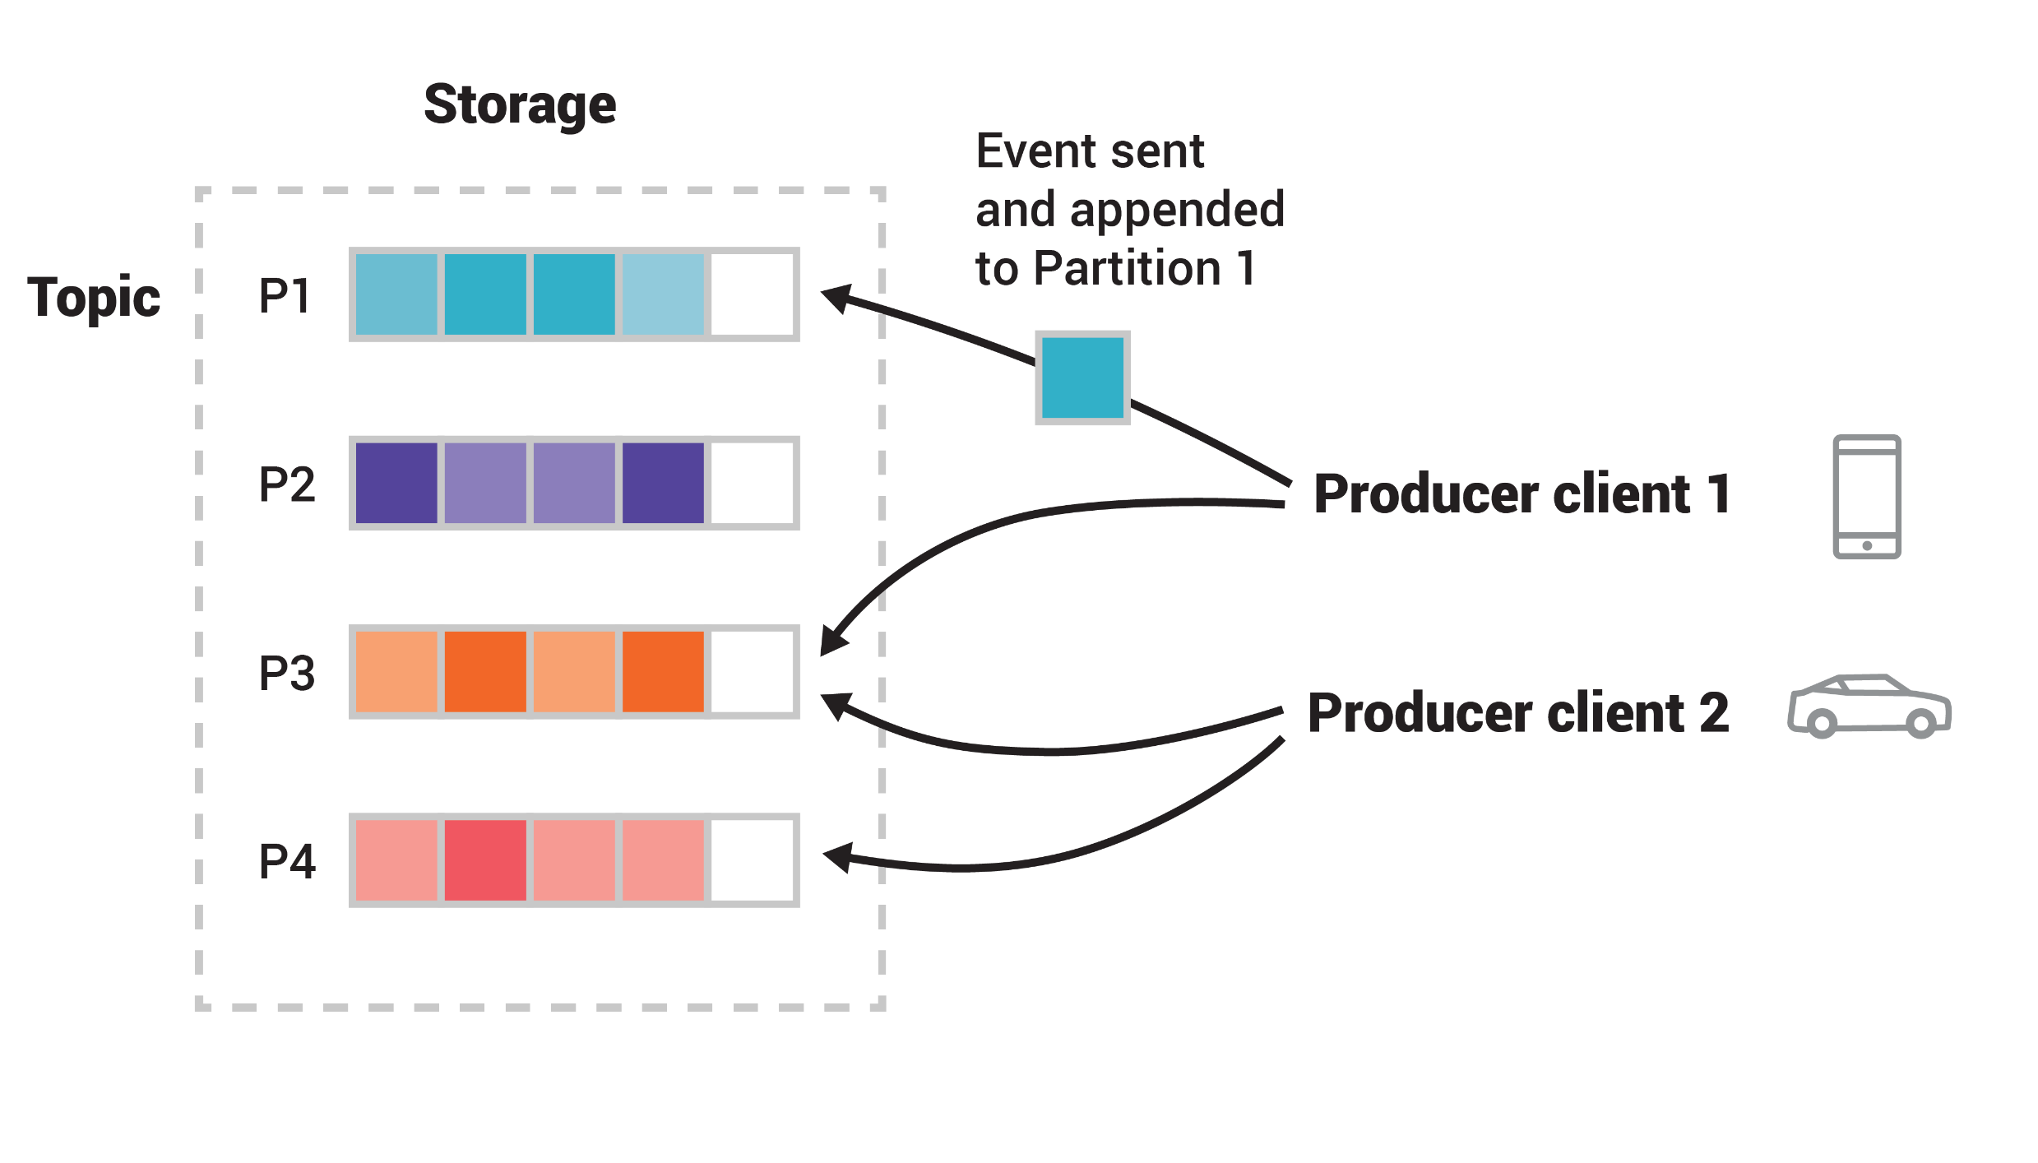

Slide 17
Consumer

Slide 18
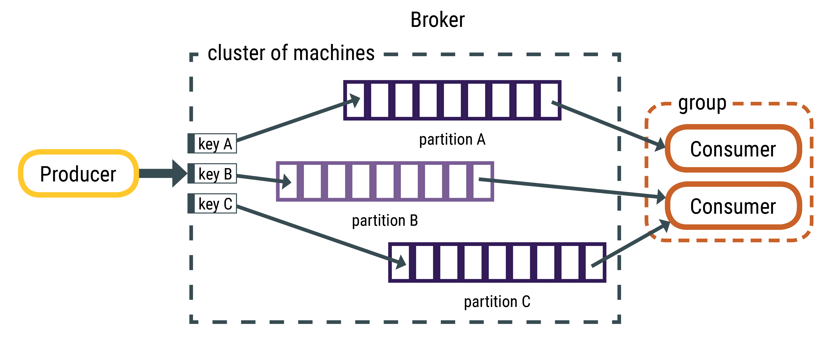

Slide 19
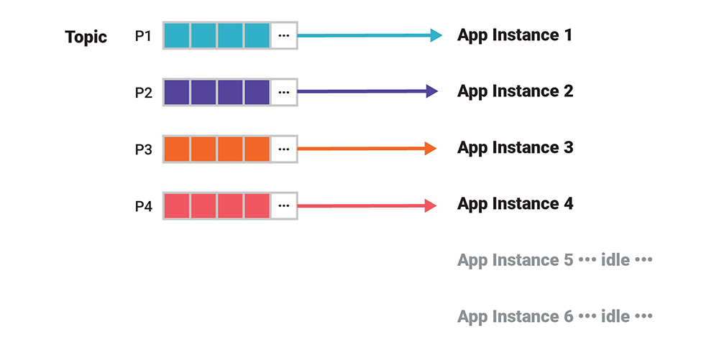
Partition and Consumers

Slide 20
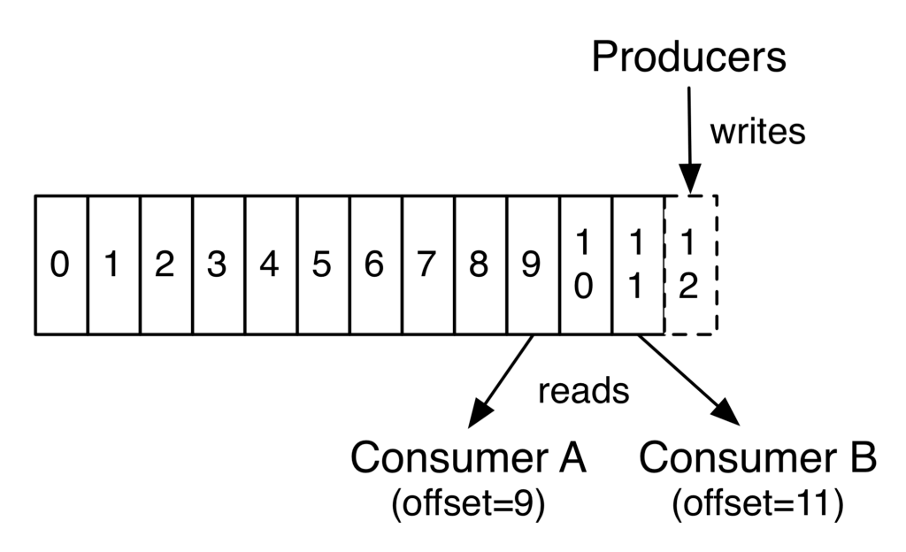

Slide 21
Data Flow in Kafka

Slide 22
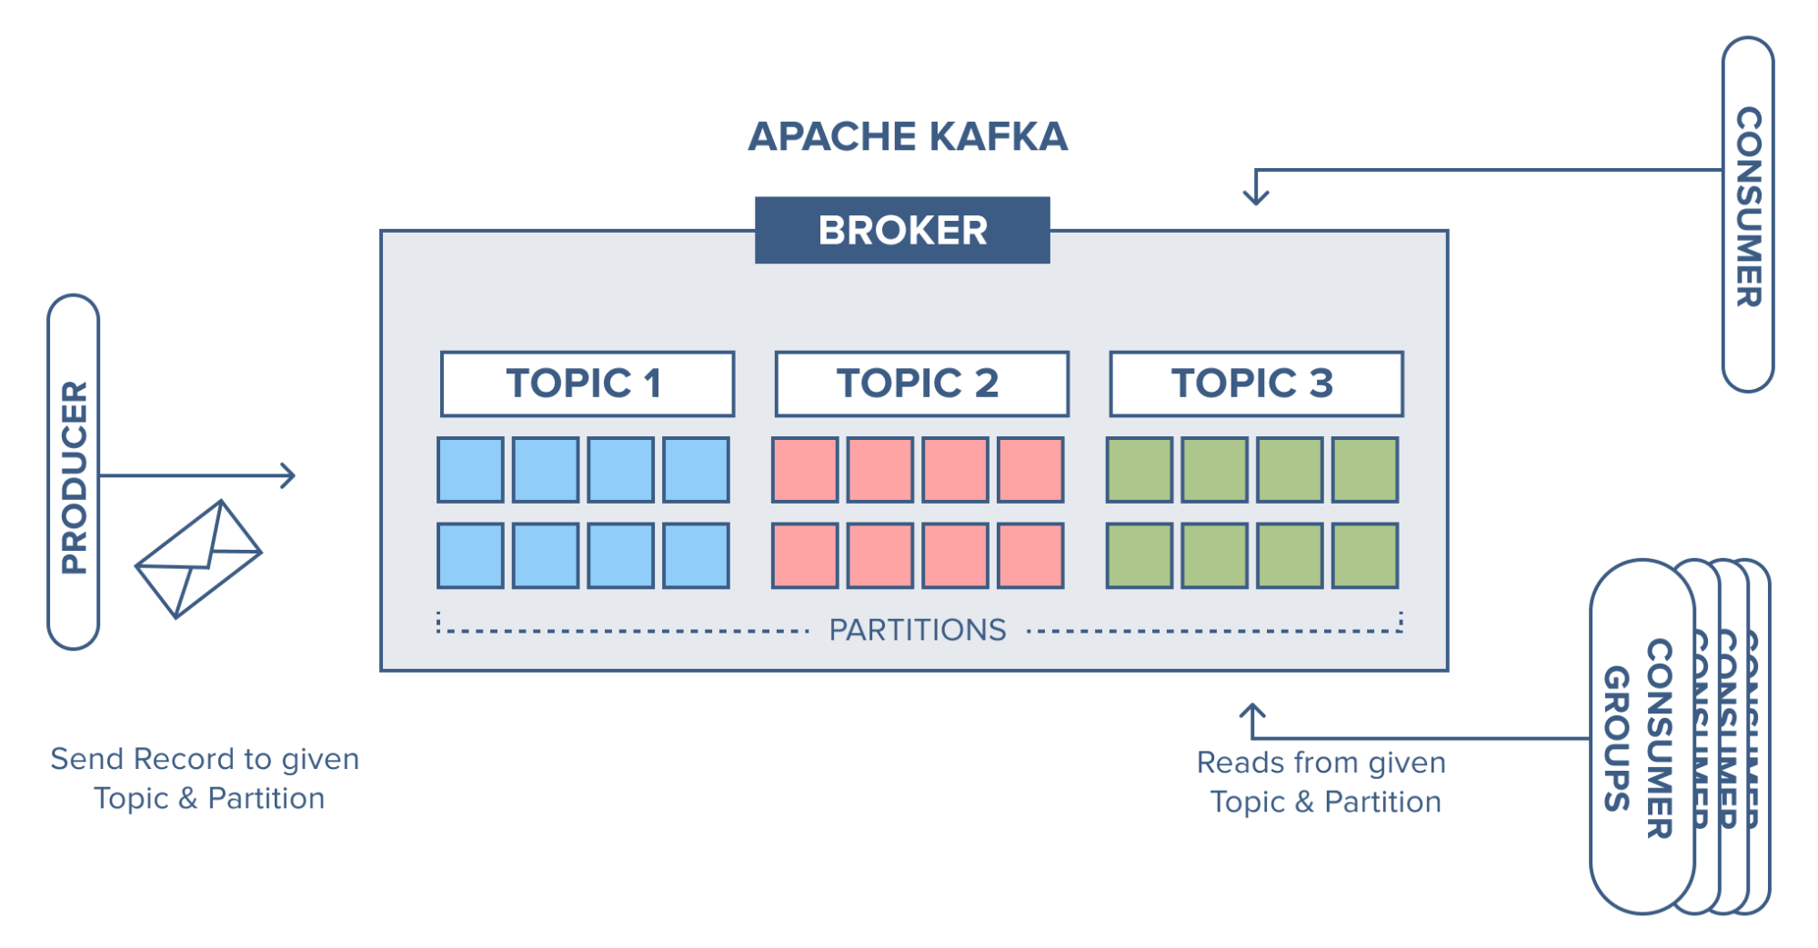

Slide 23
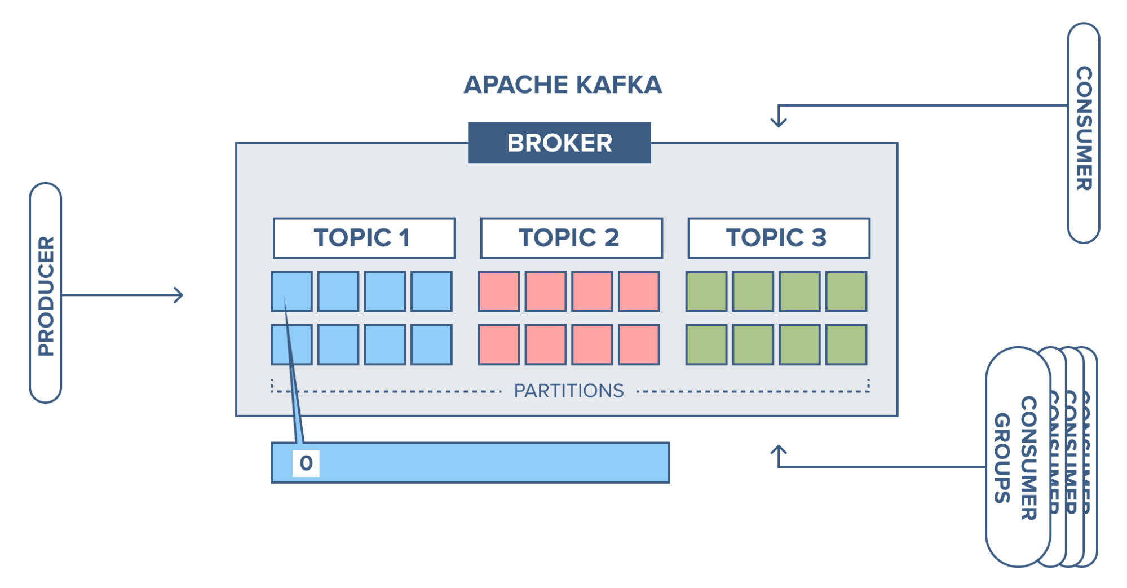

Slide 24
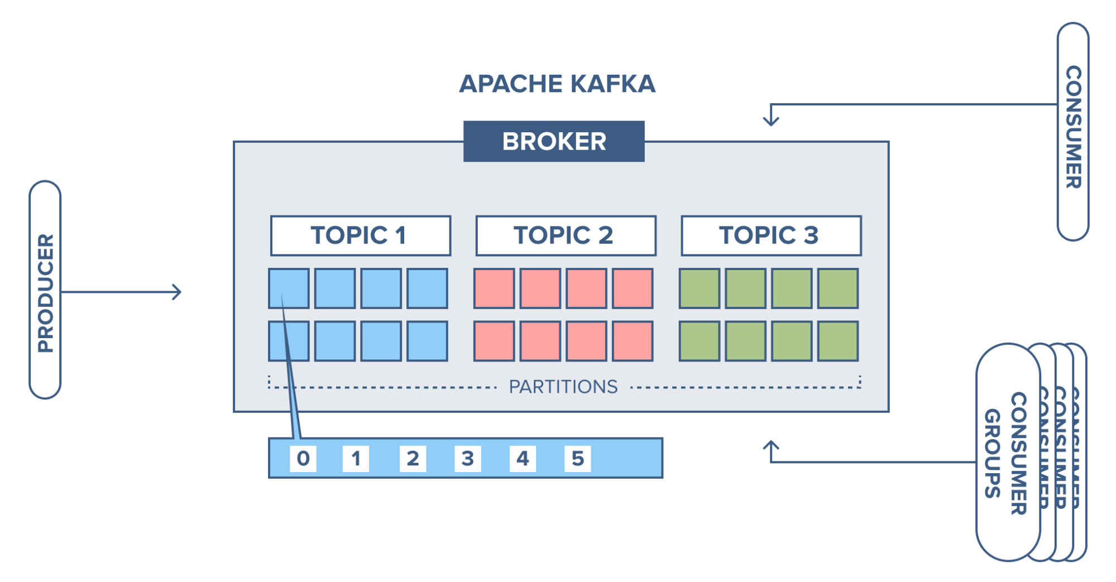

Slide 25
Ecosystem

Slide 26
Kafka Connector

Slide 27
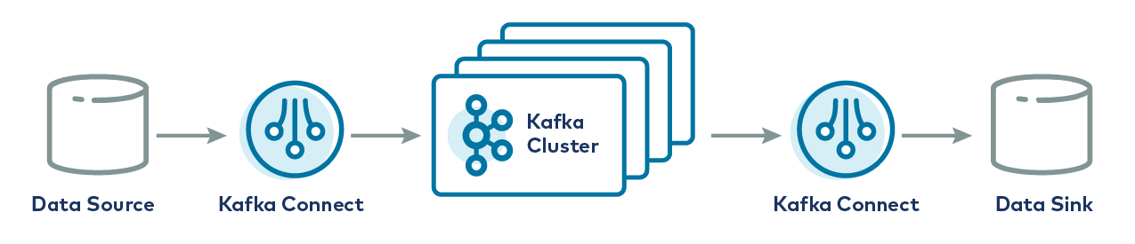
Kafka Connector

Slide 28
Change Data Capture

Slide 29
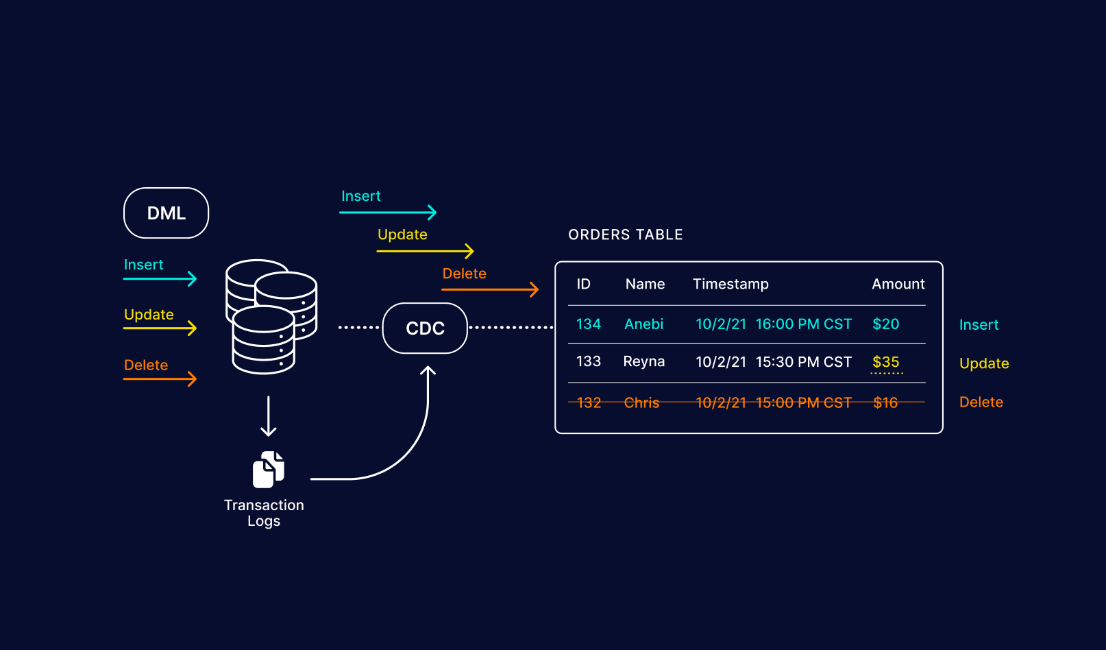

Slide 30
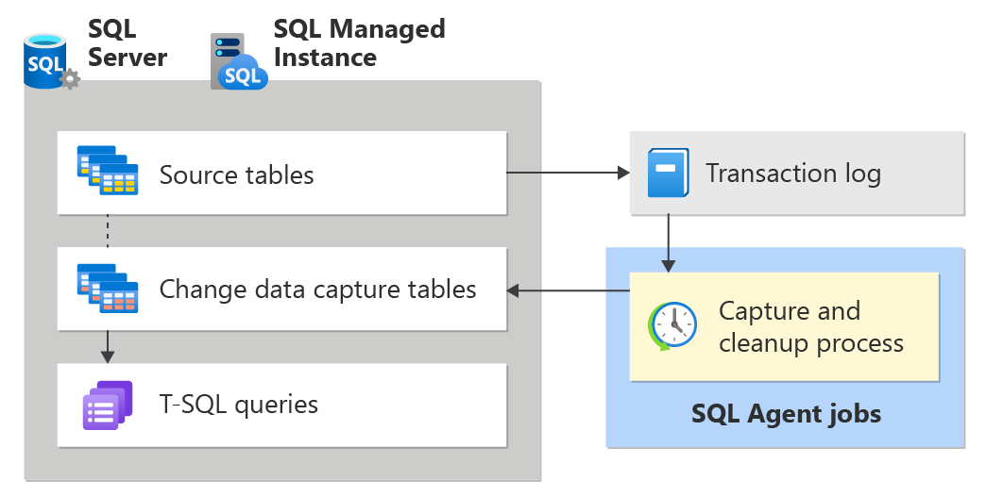

Slide 31
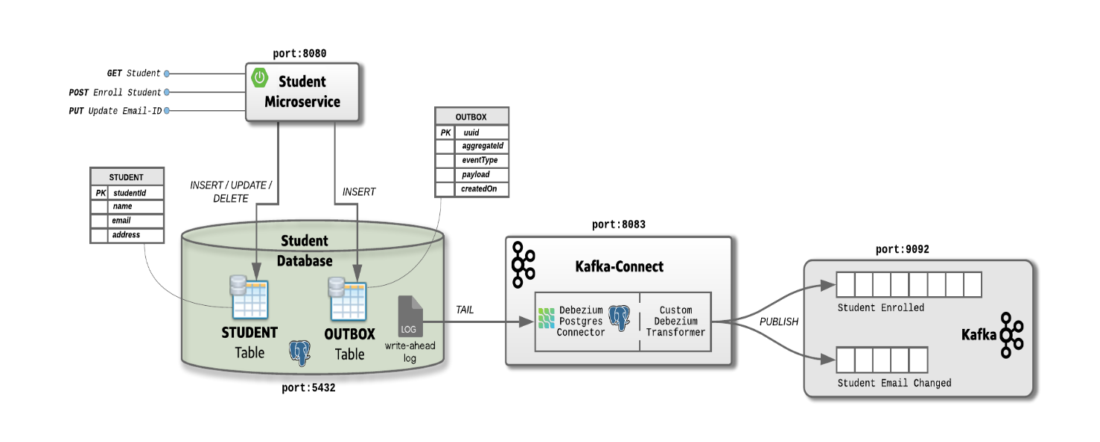
Case Study

Slide 32
References
https://docs.confluent.io/kafka/get-started.html
https://developer.confluent.io/courses/#fundamentals
https://www.confluent.io/blog/kafka-streams-tables-part-1-event-streaming/
https://developer.confluent.io/courses/architecture/get-started/

Slide 33
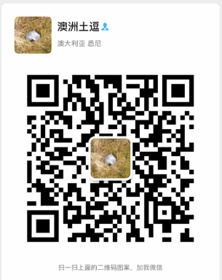
Your success is our success
Contact
Mail: info@funnygorilla.com.au
Linkedin: https://mt.linkedin.com/in/songqing-gu-2ba9034b/de
Web Chat: FunnyGorilla
Phone: 0420891343

