Slide 1

Introduction to
Apache Airflow
Your success is our success
Funny Gorilla 诙猩猩
Notes:
Notes for title slide

Slide 2
Learning Objectives
A sample scenario
Execute pipeline
How Airflow works
Architecture

Slide 3

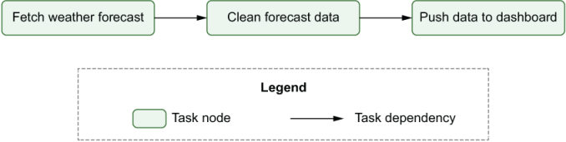
A Sample Scenario

Slide 5
Execution a Pipeline

Slide 6
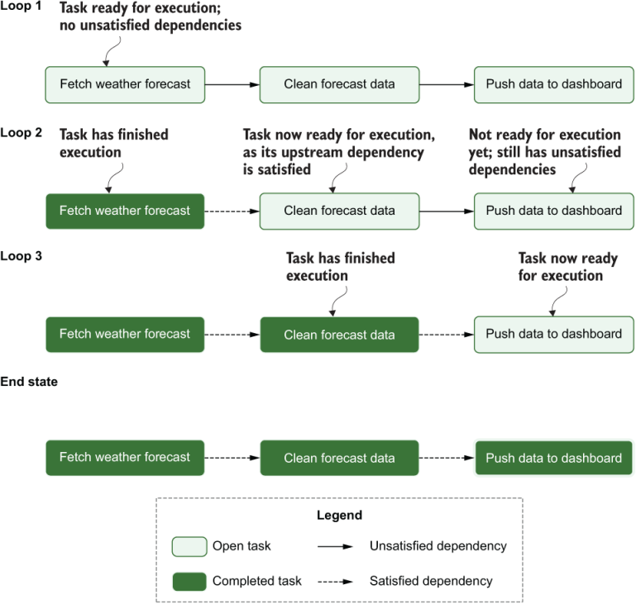
Spark

Slide 7
How Airflow Works

Slide 8
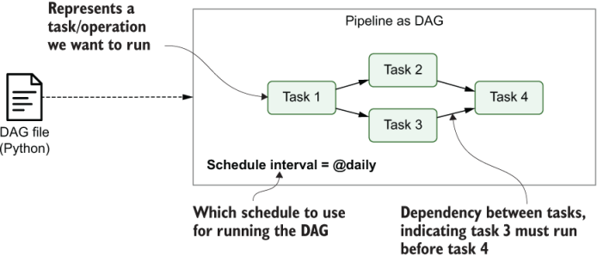

Slide 9
Airflow Architecture

Slide 10
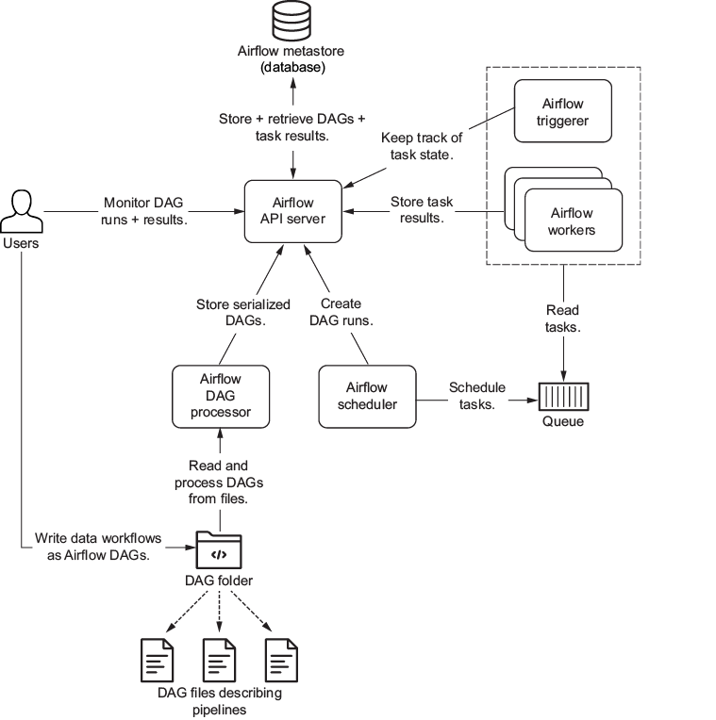
Architecture overview
Executor

Slide 11
API server’s
to visually display information about the status of the pipelines and allow the user to perform certain actions, such as triggering a DAG. In addition,
the API server functions as the main communication portal for other Airflow components.
The DAG processor parses DAG files (i.e., reads DAG files, extracts bits and pieces, and stores these bits in the metastore) and makes them available to Airflow in general.
The scheduler’s responsibility is to determine which tasks to run and place these tasks in a queue.
The triggerer is responsible for executing deferred tasks asynchronously. The triggerer is used only to work with deferrable operators.
The workers pick up tasks to be executed and perform the required work. The workers are part of the execution framework defined by the executor.
If you’re using the CeleryExecutor, for example, the workers are Celery worker processes that do the actual work.
The metastore stores all metadata related to Airflow-native entities (DAG runs, triggers, data set, and so on) as well as serialized versions of your DAGs. These serialized versions are accessible to all Airflow components so they don’t need to parse the DAG files themselves.

Slide 12
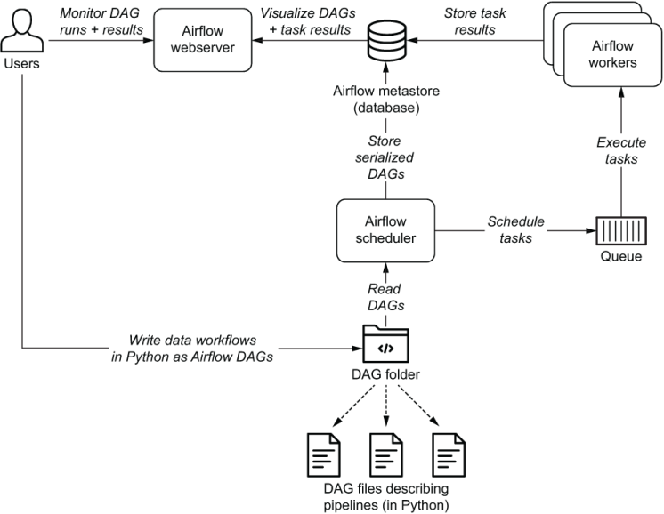
API Server
Executor

Slide 13
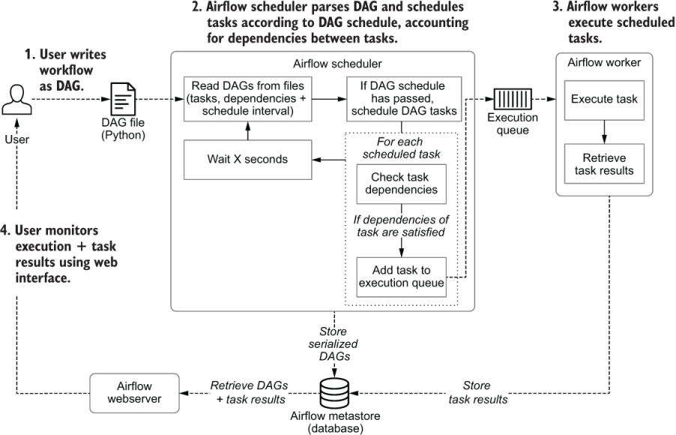
How scheduler works

Slide 14
Anatomy of Airflow
DAG
Task
Operator

Slide 15
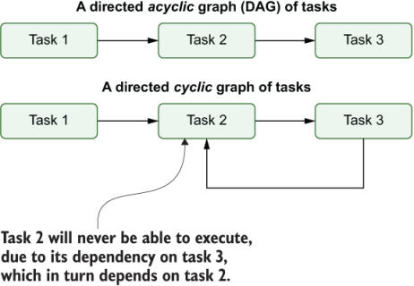
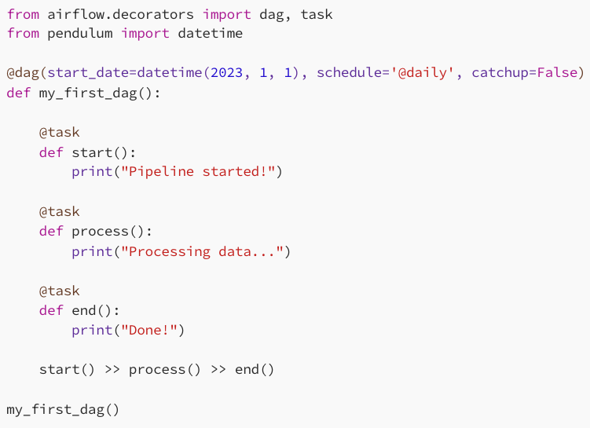
DAG – Directed Acyclic graph
a collection of tasks where all the tasks (if connected) are connected via directed lines.
defined using Python code in Airflow

Slide 16
DAG Logic model
Operator
Sensors
SubDags
Task-01
DAG
Task-N

Slide 17
Task
scheduler created empty task instance
scheduler sent the task to the queue – to be run
task completed
No status
Schedules
Queued
Running
Success
scheduler determined task instance needs to run
(worker picked up a task and is now executing it)

Slide 18
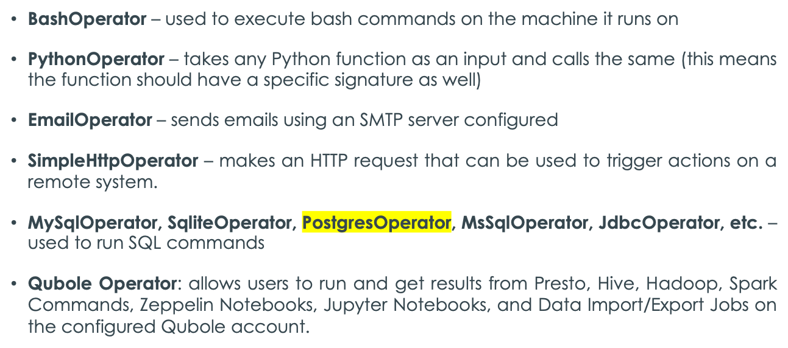
Operator
usually provides integration to some other service which provides a way to access these services from Airflow.
Some common operators:

Slide 19
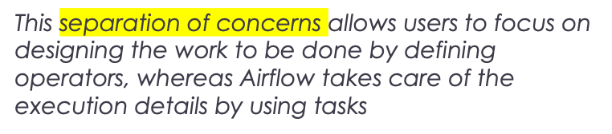
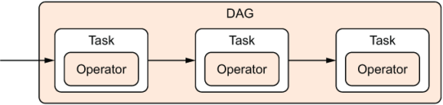
Task vs Operator
DAG is to orchestrate the execution of a collection of operators
Operators have a single responsibility: they exist to perform one single piece of work.
Tasks in Airflow manage the execution of an operator; they can be thought of as small wrappers around an operator or managers that ensure that the operator executes correctly.
The wrapper role of a task involves:
handling errors,
managing dependencies, and
scheduling the execution of the operator.

Slide 20
Demo

Slide 21
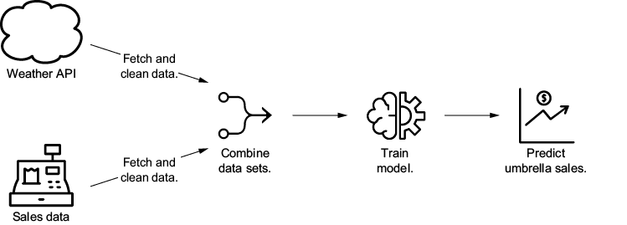
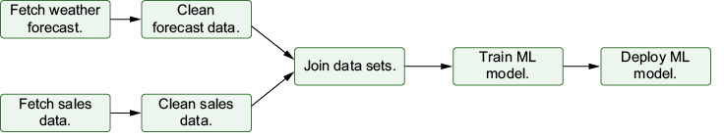

Slide 22
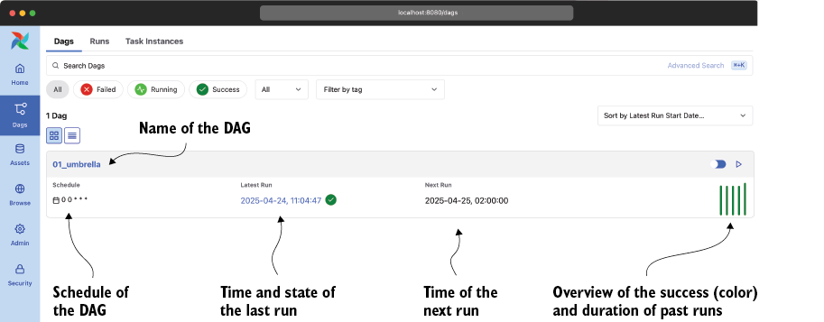

Slide 23
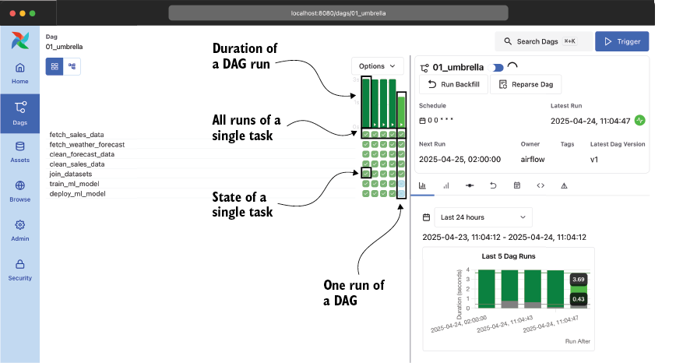

Slide 24
Reference Links
https://airflow.apache.org/docs/apache-airflow/stable/index.html

Slide 25

Your success is our success
Contact
Mail: info@funnygorilla.com.au
Linkedin: https://mt.linkedin.com/in/songqing-gu-2ba9034b/de
Web Chat: FunnyGorilla
Phone: 0420891343

