Slide 1



Funny Gorilla诙猩猩-IT培训
Your success is our success
GIT Introduction

Slide 2

Version Control System
Version Control System (VCS) is a software that helps software developers to work together and maintain a complete history of their work. Listed below are the functions of a VCS:
Allows developers to work simultaneously.
Does not allow overwriting each other’s changes.
Maintains a history of every version.

Slide 3
GIT Introduction

Slide 4
Local vs Remote

Slide 5
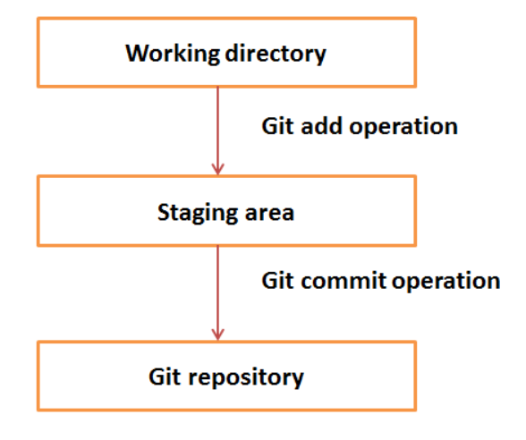
Local Git

Slide 6
GIT – local setup
//Create local git repository
git init
//add new file to staging
git add fileName
//commit new file into repository
git commit -m "from Arthur first"

Slide 7
Commit
Appendix A: Introduction to Git

Slide 8
Branch
A branch represents a separate line of development, allowing you to isolate changes without affecting the main project.
Appendix A: Introduction to Git

Slide 9
Why Use Branches?
Branching is a core concept in Git that promotes safer and more efficient development.
Isolation: Work on new features or bug fixes in an isolated environment without disturbing the stable main codebase.
Collaboration: Multiple developers can work on different tasks simultaneously within the same project
Testing: Allows for thorough testing of changes on a feature branch before merging them back into the main line of development.

Slide 10
//-- list branch
git branch -- local branch
//-- create a branch
git branch [name-of-your-new-branch]
//-- checkout a bran – work with a branch
git checkout [name-of-your-new-branch]

Slide 11
Demo – Local repository
Appendix A: Introduction to Git

Slide 12

Your success is our success
Contact
Mail: info@funnygorilla.com.au
Linkedin: https://mt.linkedin.com/in/songqing-gu-2ba9034b/de
Web Chat: FunnyGorilla
Phone: 0420891343

