Slide 1
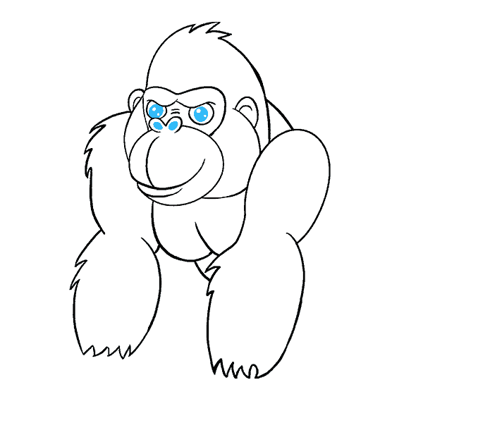
Micro-partition & data clustering
Your success is our success
Understanding Table Structure
Funny Gorilla 诙猩猩
Notes:
Notes for title slide

Slide 2

Learning Objectives
Understand table structure
Micro-partition
Data clustering
https://docs.snowflake.com/en/user-guide/tables-micro-partitions

Slide 3
Understand table structure
Understand logic table structure
Understand physical table structure

Slide 4
logic table structure
All data in Snowflake is stored in database tables, logically structured as collections of columns and rows.
understanding of the physical structure behind the logical structure.

Slide 5
Physical table structure

Slide 6
Partitions

Slide 7
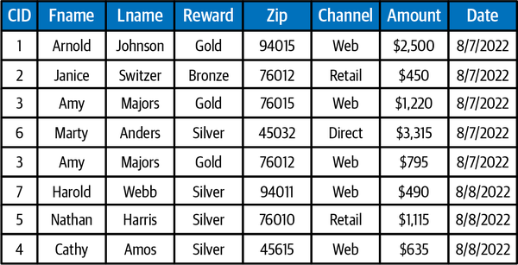

Slide 8
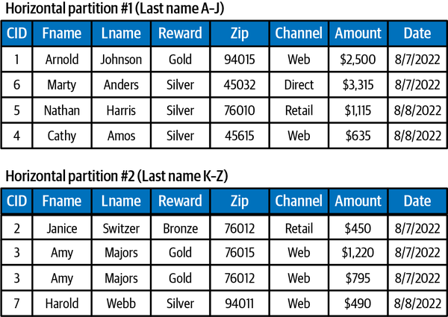
Horizontal partitioning (Sharding)

Slide 9
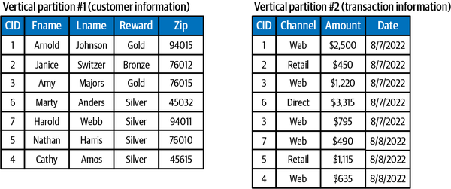
Vertical partitioning (column-based)
Vertical partitions that include a foreign key, linking them to another partition, are taking advantage of normalization.
store the static or slowly changing information in one table and
the dynamic or frequently changing information in a different table

Slide 10
Micro-partitions

Slide 11
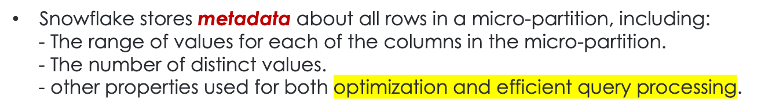
Micro-partitions
All data in tables is automatically divided into micro-partitions, contiguous units of storage.
Small in size (50 to 500 MB, before compression)

Slide 12
Benefits Micro-partitions
Enables extremely efficient DML and fine-grained query pruning for faster queries.
Columns are stored independently within micro-partitions, enables efficient scanning

Slide 13
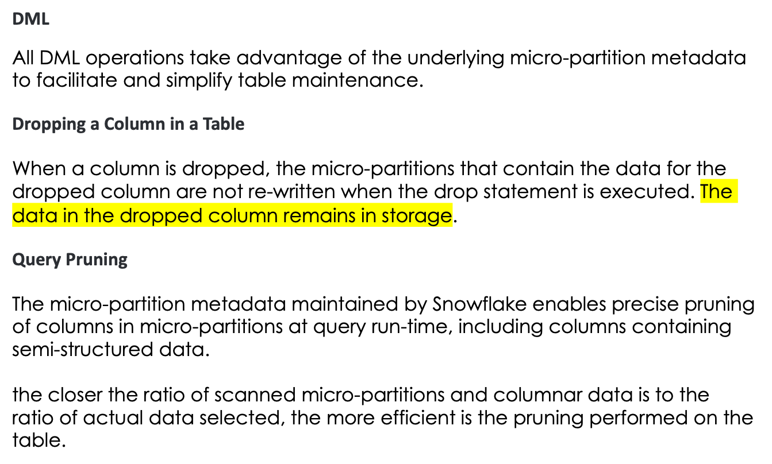
Impact of Micro-partitions

Slide 15
Data Clustering

Slide 16
Data Clustering
Data clustering describes the distribution of data across micro-partitions for a particular table.
Snowflake then leverages this clustering information to avoid unnecessary scanning of micro-partitions during querying, significantly accelerating the performance of queries that reference these columns.

Slide 17
Clustering meta maintained for micro-partition
- The total number of micro-partitions that comprise the table.
- The number of micro-partitions containing values that overlap with each other
- The depth of the overlapping micro-partitions.
avoid unnecessary scanning of micro-partitions during querying,
significantly accelerating the performance of queries:
prune micro-partitions that are not needed for the query.
prune by column within the remaining micro-partitions.

Slide 18
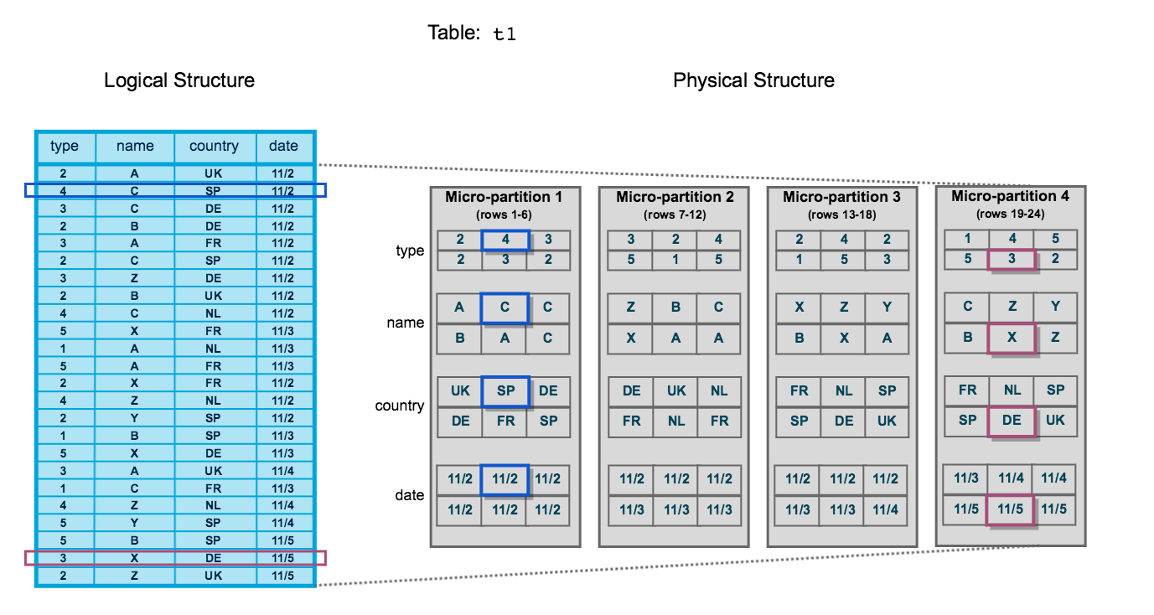
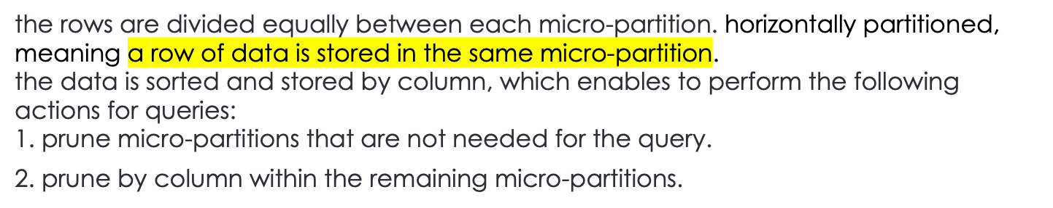

Slide 19
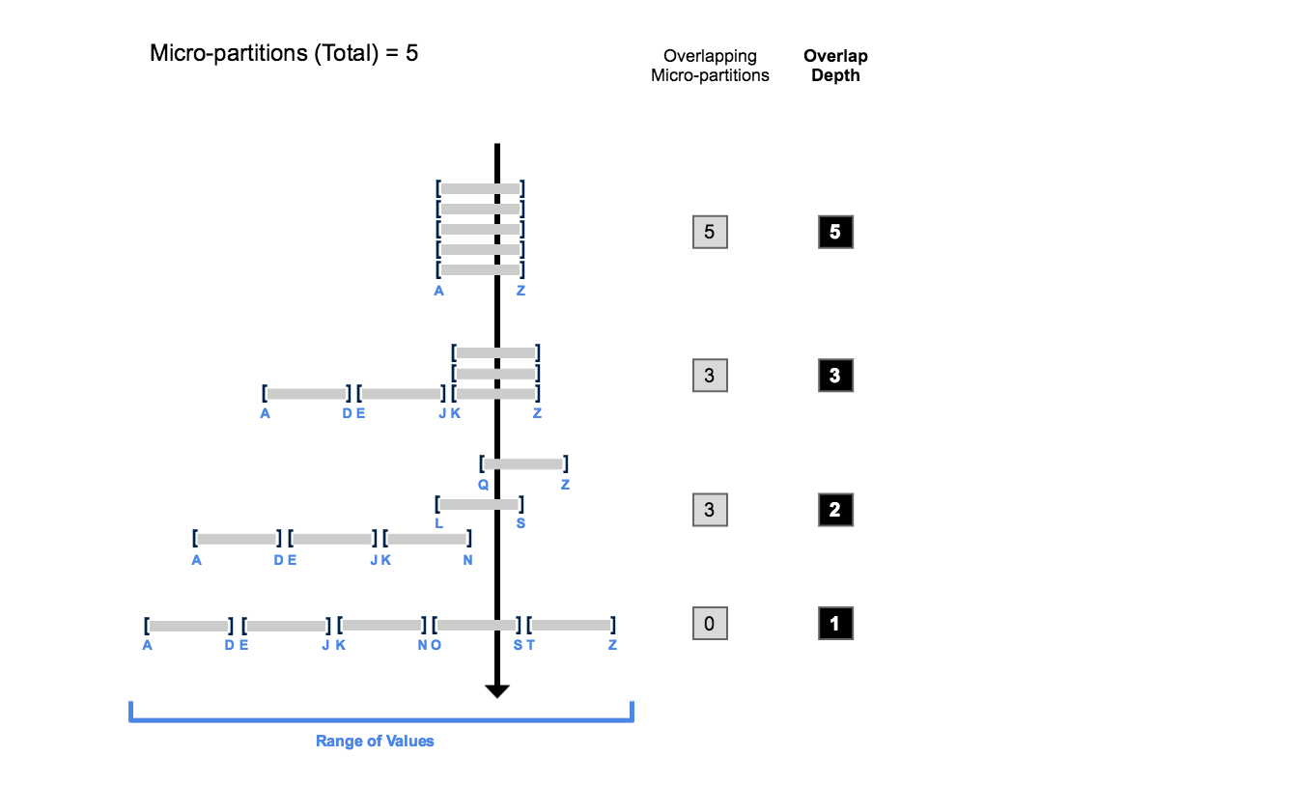
Clustering Depth
how overlap affects clustering depth

Slide 20
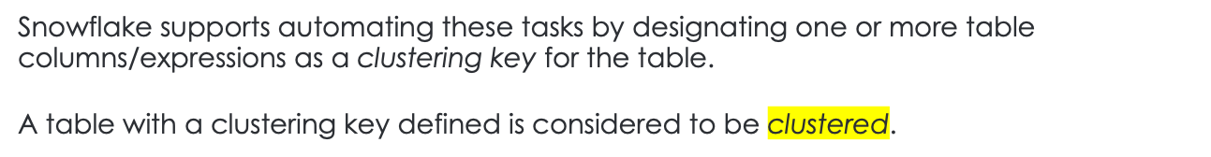
Clustered table/materialized views
Clustering key
A clustering key is a subset of columns in a table (or expressions on a table) that are explicitly designated to co-locate the data in the table in the same micro-partitions.
This is useful for very large tables where the ordering was not ideal (at the time the data was inserted/loaded) or extensive DML has caused the table’s natural clustering to degrade.
Prioritizing keys in the order:
Cluster columns that are most actively used in selective filters.
If there is room for additional cluster keys, consider columns frequently used in join predicates

Slide 21
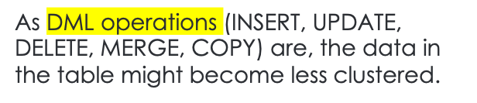
Automatic Clustering
Re-clustering
Periodic/regular reclustering of the table is required to maintain optimal clustering.
Snowflake uses the clustering key for a clustered table to reorganize the column data, so that related records are relocated to the same micro-partition.
This DML operation deletes the affected records and re-inserts them, grouped according to the clustering key.
Cost

Slide 22
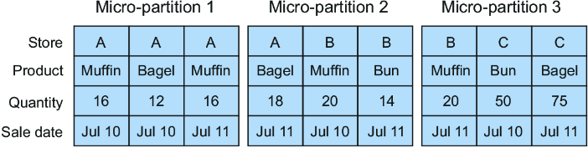
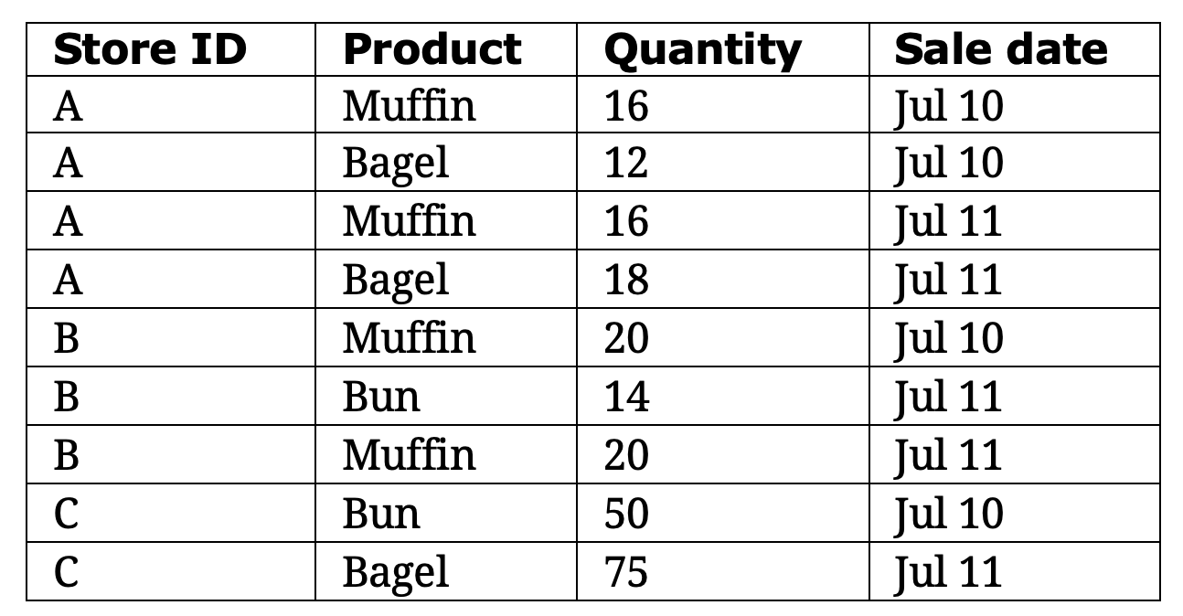


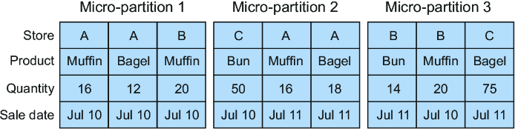
11

Slide 23
Reference Links

Slide 24

Your success is our success
Contact
Mail: info@funnygorilla.com.au
Linkedin: https://mt.linkedin.com/in/songqing-gu-2ba9034b/de
Web Chat: FunnyGorilla
Phone: 0420891343

