Slide 1

Data Ingestion Pipeline
Your success is our success
Funny Gorilla 诙猩猩
Notes:
Notes for title slide

Slide 2
Learning Objectives

Slide 3
Storage integration

Slide 5
Snowpipe

Slide 6
Snowpipe introduction
Snowpipe is a continuous, event-driven data ingestion service in Snowflake that detects new data files as they arrive in external storage and loads them automatically into Snowflake tables.
Advantages
Automated Data Ingestion: Eliminates the need for manual data uploads by automating the ingestion process.
Cost Efficiency: Uses compute resources only when data is ingested, reducing costs.
Event-Driven Processing: Works with notification services such as Azure Event Grid and Azure Queue to trigger near real-time ingestion.
Scalability: Handles large-scale data loads without impacting performance.
Seamless Integration: Works smoothly with Azure Blob Storage and other cloud storage services.

Slide 7
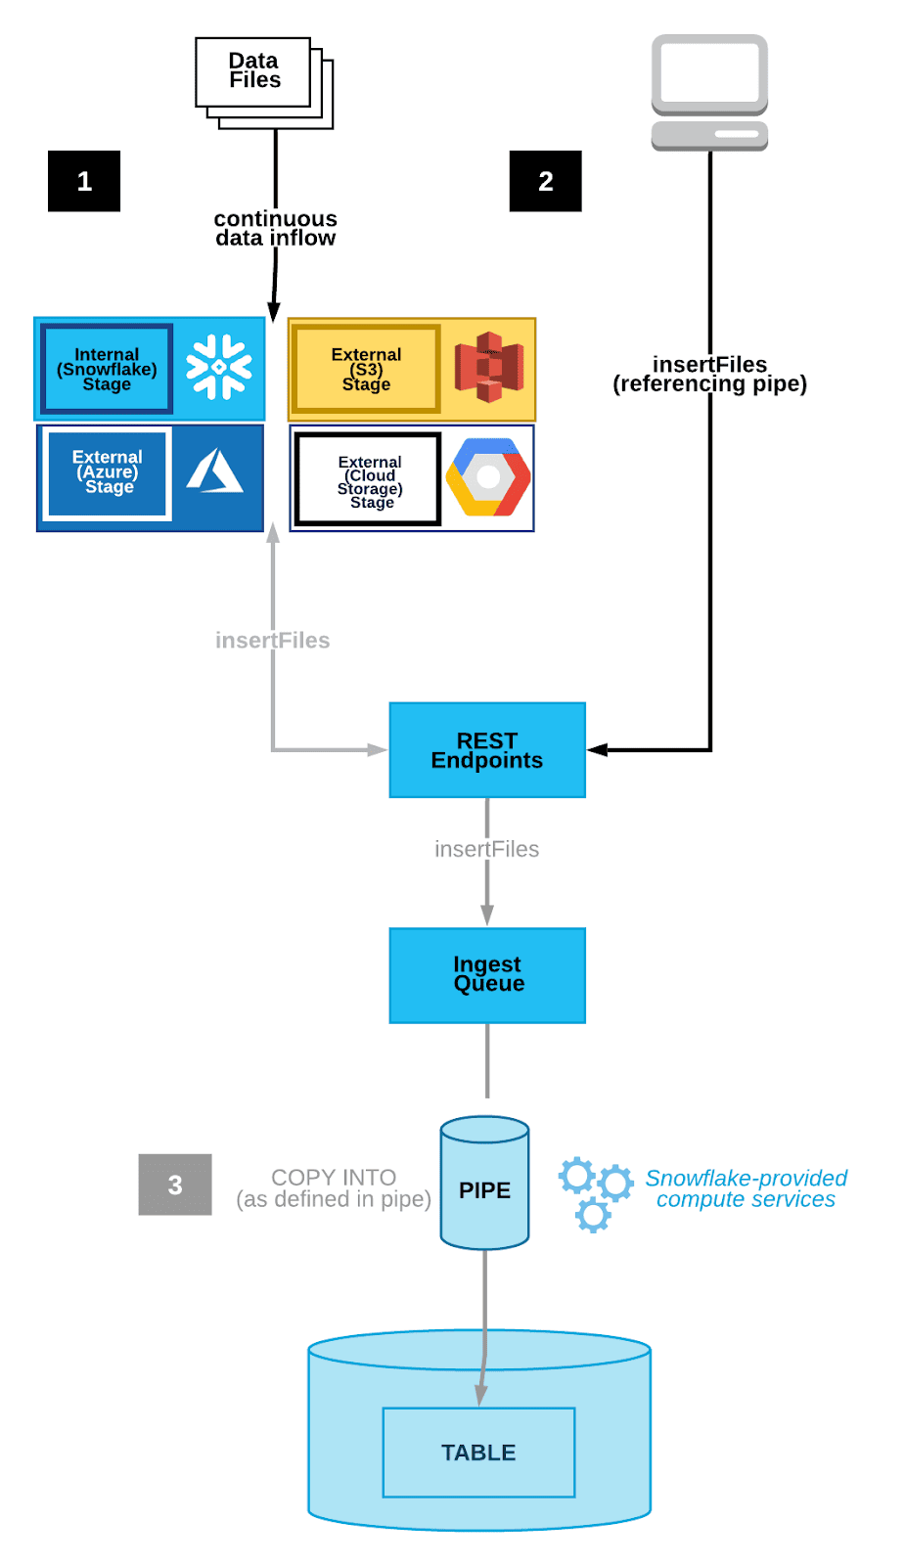


the cloud storage notification service triggers a notification to the Snowflake Snowpipe object
Snowpipe it extracts the data file from the AWS S3 bucket and loads it into the table
Snowpipe uses file-loading metadata associated with each pipe object to prevent loading the same files again.

Slide 8
Cloud Messaging Service
GTM
Write
read
old
New
Changed Data Capture

Slide 9
Notification integration
a secure, named, first-class account object that acts as a wrapper bridging Snowflake and third-party messaging services.

Slide 10
Storage integration
a secure, named, first-class account object that acts as a wrapper bridging Snowflake and third-party storage services.

Slide 11
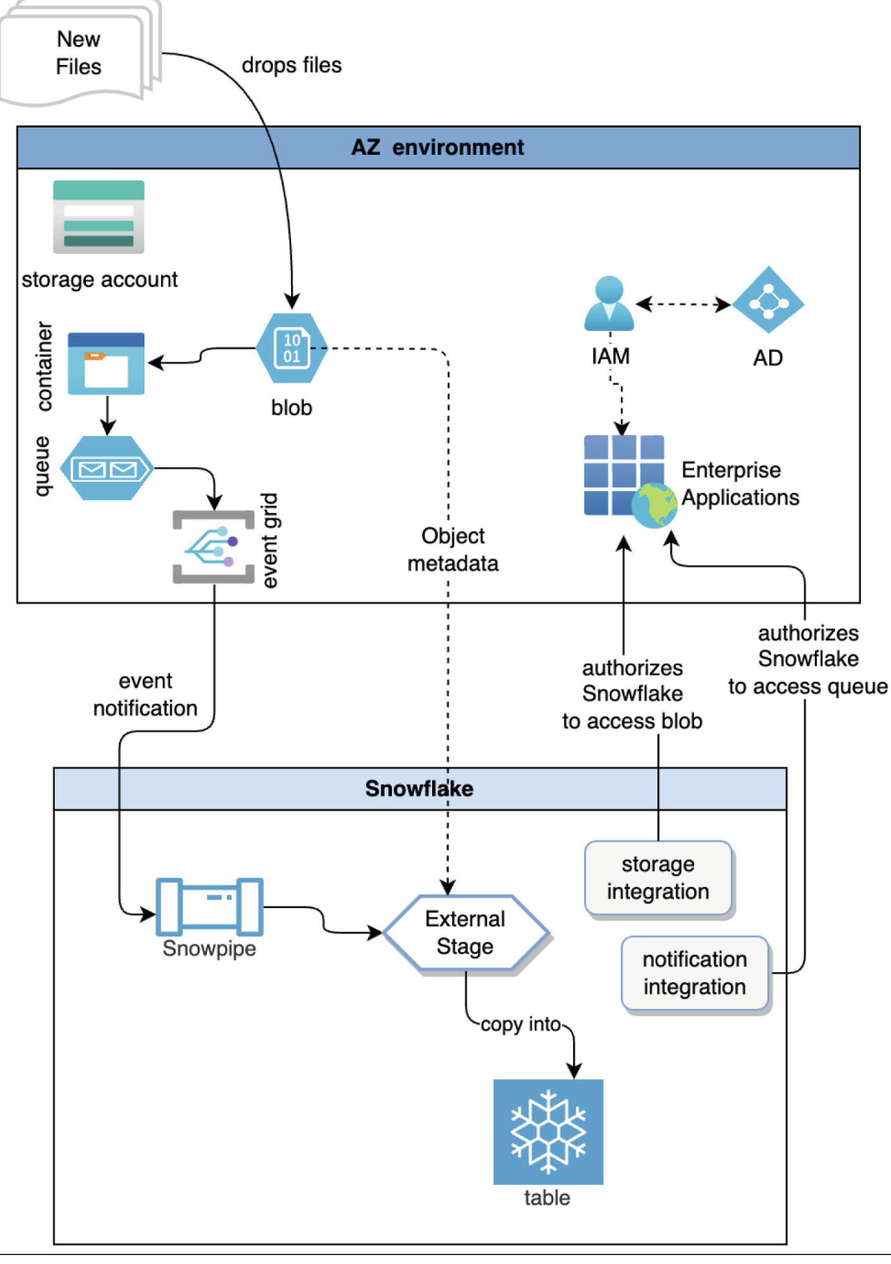
Use case
1
2
3
4
5

Slide 12
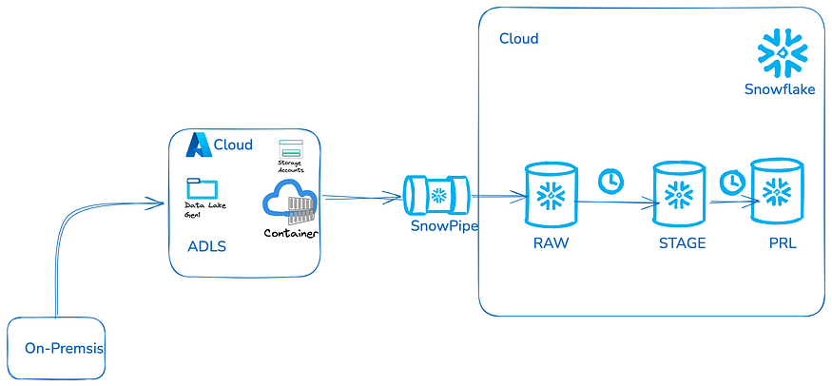
4
2
3
stage
1
queue
Azure Blob Storage: Users or systems upload raw data files to Azure Blob Storage.
Storage Integration: Snowflake connects to Azure Blob Storage, allowing seamless access to data.
Notification Integration: Azure Event Grid continuously monitors Azure Blob Storage for new file uploads. When a file is detected, it triggers an event and sends a message to Azure Queue, ensuring real-time notification to Snowpipe.

Slide 13
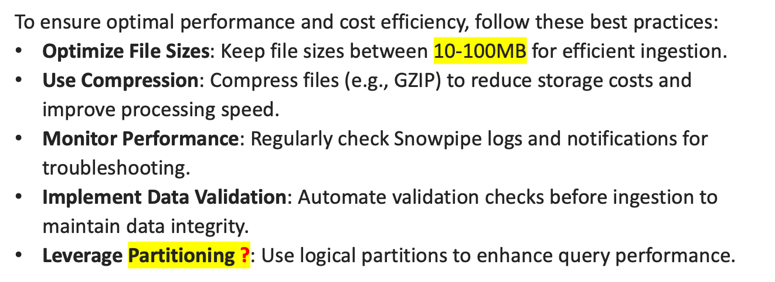
Best Practices and Optimization Tips:

Slide 14
Reference Links

Slide 15
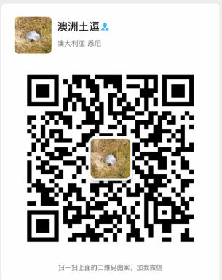
Your success is our success
Contact
Mail: info@funnygorilla.com.au
Linkedin: https://mt.linkedin.com/in/songqing-gu-2ba9034b/de
Web Chat: FunnyGorilla
Phone: 0420891343

