Slide 1

DBT pipeline Design
Your success is our success
Funny Gorilla 诙猩猩
Notes:
Notes for title slide

Slide 2
Learning Objectives
Data Ingestion
Factors to consider when designing data ingestion
Why build pipeline
How the build pipeline built

Slide 3

High level process - Diagram
Common design
What we want
Understand overall process
No code in your mind
How it can help
Know each technical components
Common solutions for common steps
Verbal description
1
2
3
4
retrieve
Make it working
load
Implement with design ideas
transform
Other alternatives?
performance
Technical stack
security
Pull / push
cost
Functional requirements
Non- Functional requirements

Slide 4
Common architecture

Slide 5
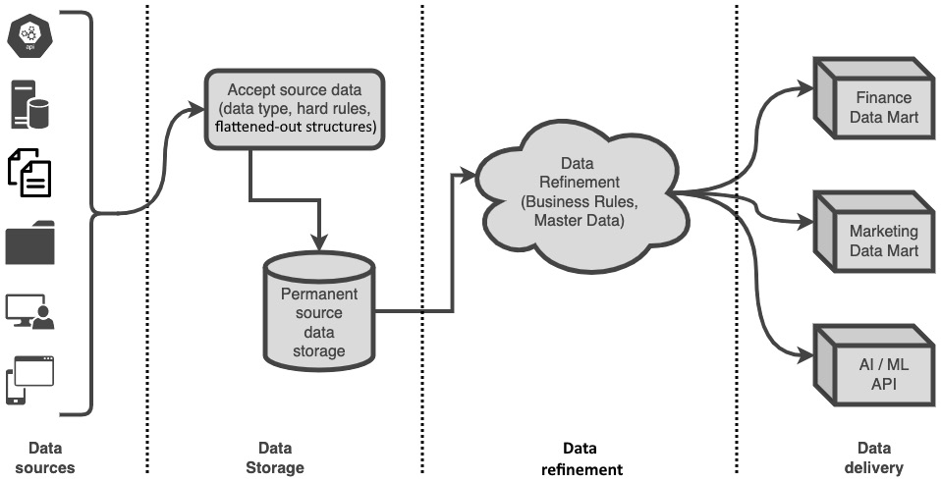

Slide 6
Use Case
Files
Query

Slide 7
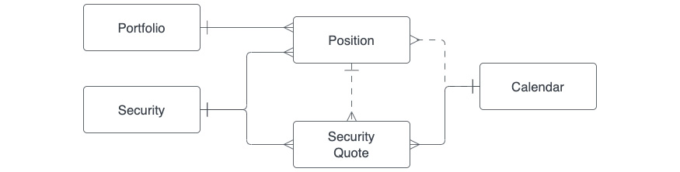

Slide 8
Pipeline Design
Basic idea about warehousing
Why Star schema?

Slide 9
Master/reference data
Source
Staging
Data
Warehouse
Delivery
Source
Landing
Landing & Staging
Warehouse
Data Mart

Slide 10





Master/reference data
Staging
warehouse
Source
Mart
Source
Landing

Slide 11
Source systems

Slide 12
sources:
- name: <source system name>
database: <db name>
schema: <schema name>
description: <some description of the system>
freshness: # system level freshness SLA
warn_after: {count: 12, period: hour}
error_after: {count: 24, period: hour}
loaded_at_field: <default timestamp field>
tables:
- name: <name we want to use for the source table/view>
identifier: <name in the target database>
description: source table description

Slide 13
Staging models
the incremental-only ingestion
using staging views ?

Slide 14
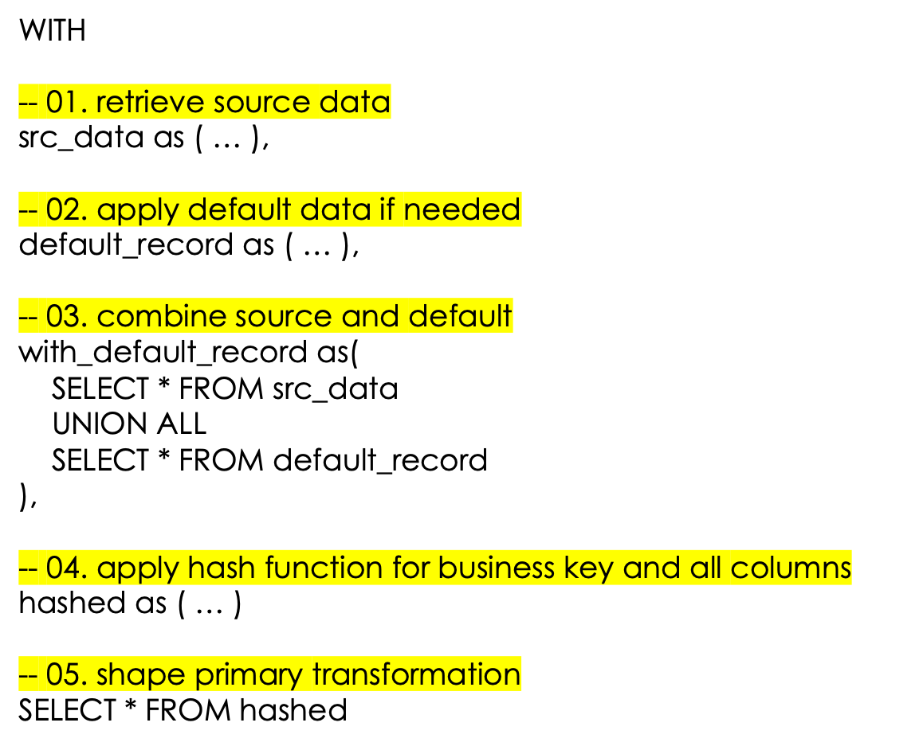

Slide 15
Warehouse models

Slide 16
Mart models
usually materialized at tables

Slide 17
Test models
General tests
Singular tests

Slide 18
CI/CD

Slide 19
Reference Links

Slide 20

Your success is our success
Contact
Mail: info@funnygorilla.com.au
Linkedin: https://mt.linkedin.com/in/songqing-gu-2ba9034b/de
Web Chat: FunnyGorilla
Phone: 0420891343

