Slide 1

Data Mesh Project
Your success is our success
Funny Gorilla 诙猩猩
Notes:
Notes for title slide

Slide 2
Project landscape

Slide 3
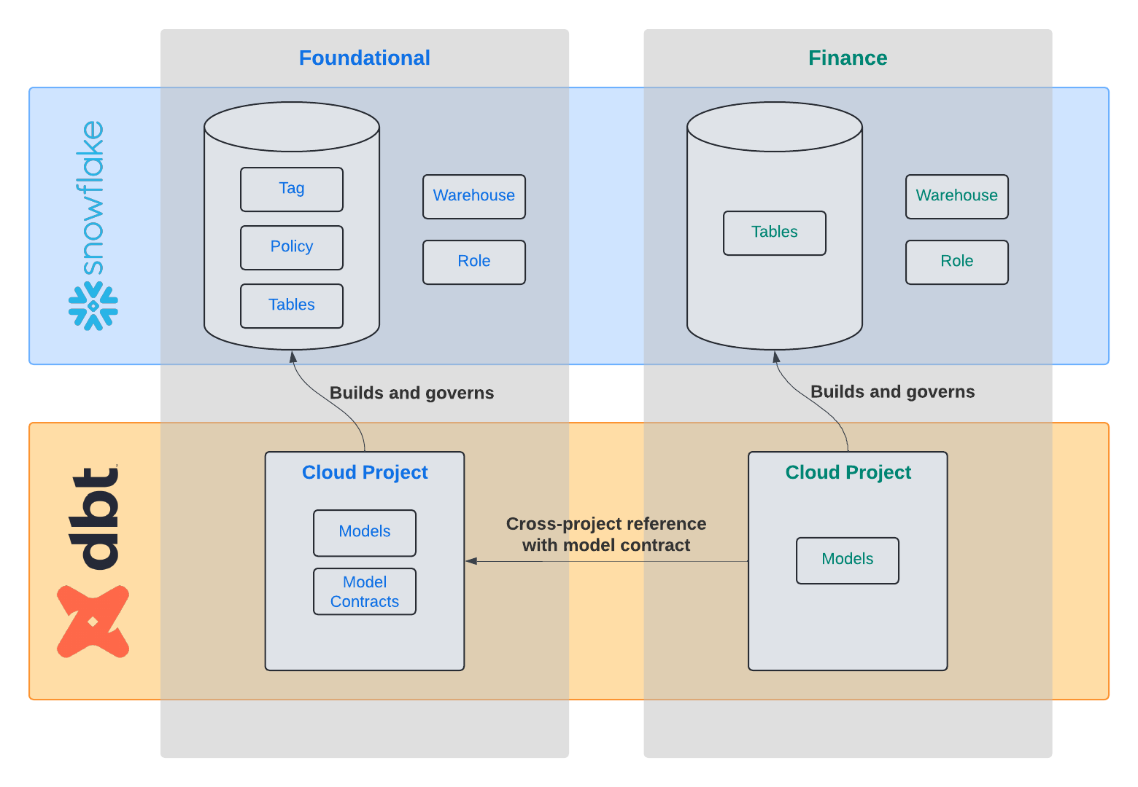

Slide 4
Foundational project
Foundational project
Masking PII data
Add model contract
Publish it as data product

Slide 5
Master/reference data
Order
Staging
Data
Warehouse
Stg_Order
Fact_Orderes
Line-Item
Landing
Stg_Line_Item
Customer
Stg_Customer
Landing & Staging
Warehouse
Data Mart

Slide 6
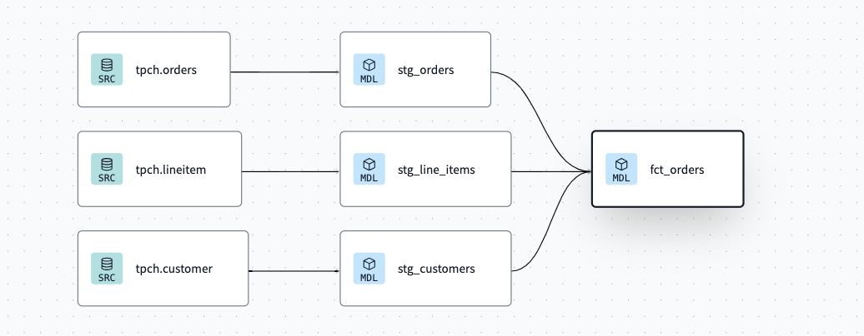
Data Lineage

Slide 7
Apply Data Masking

Slide 8

Mask PII data – Order:: name
Create a masking policy
otherwise, show “*******”
Assign policy to tag
Create a tag for PII data
Apply tag
fact_order :: name
Model post-hook

Slide 9
Add model contract

Slide 10
Schema: core.yml
Access level: public
Contract enforced: true
Permission grant: role name list

Slide 11
Financial project

Slide 12
Setup project reference
Foundational project
Create data model

Slide 13
Explore data product

Slide 14
dbt Cloud
With dbt Explorer, data products built with dbt are automatically published and searchable, allowing for easy discovery and re-usability.
By using dbt Cloud, you gained additional governance, automation, and interoperability mechanisms than from Snowflake alone.
Overall, these two self-service platforms combined increase the likelihood of success of a data mesh project.

Slide 15
Reference Links

Slide 16

Your success is our success
Contact
Mail: info@funnygorilla.com.au
Linkedin: https://mt.linkedin.com/in/songqing-gu-2ba9034b/de
Web Chat: FunnyGorilla
Phone: 0420891343

